Slide 1
Chapter 5: Mediating Access
Computer Networks: A Systems Approach

Slide 2
Overview
Switched networks resolve contention at the switches. Shared access networks (e.g., wireless) must mediate access to the common medium. This chapter looks at three approaches to mediating shared access.

Slide 3
Media Access Control
Resource allocation problem
  Who gets to transmit next
  Typically implemented in the network adaptor (NIC)
  Sometimes referred to as the MAC layer
Centralize mediator
  A designated node schedules who speaks next
  Distributes a “schedule” to all the other nodes
Token passing
  Physical order determines turn (Token Ring, FDDI)
Opportunistic
  Transmit when idle; back off and retry on collision (Ethernet)

Slide 4
Design Considerations
Optimistic vs. conservative allocation
  Optimistic: transmit freely, back off on contention (Ethernet, Wi-Fi)
  Conservative: centrally allocate a share to each node (5G, PON)
Broadcast medium
  Every node can hear every packet
  Enables broadcast, but also eavesdropping
Mobility (wireless only)
  Which base station serves a given node, and when that changes
Variable capacity (primarily wireless)
  Available bandwidth changes with conditions

Slide 5
Managing Spectrum

Slide 6
Overview
Radio frequency bands are controlled by governments
  Agencies like the FCC (US) allocate spectrum
  Much of it is licensed to MNO (Mobile Network Operators)
  License-exempt (or lightly licensed) bands are set aside
    e.g., 5.150 GHz to 5.850 GHz is allocated to Wi-Fi
    e.g., CBRS (Citizens Broadband Radio Service) used by “Private 5G”
  Limits on transmission power bound range
    e.g., 5GHz Wi-Fi typically has reach of 50-75ft indoors (100-300ft outdoors)
Allocated bands then subdivided into channels
  e.g., Wi-Fi’s 5GHz band is managed as 25 x 20-MHz channels
Multiplexing technique (next) mediates access to channels
  Wi-Fi and 5G now adopt the same underlying multiplexing algorithm

Slide 7
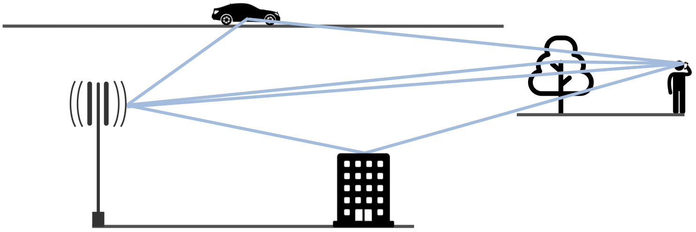
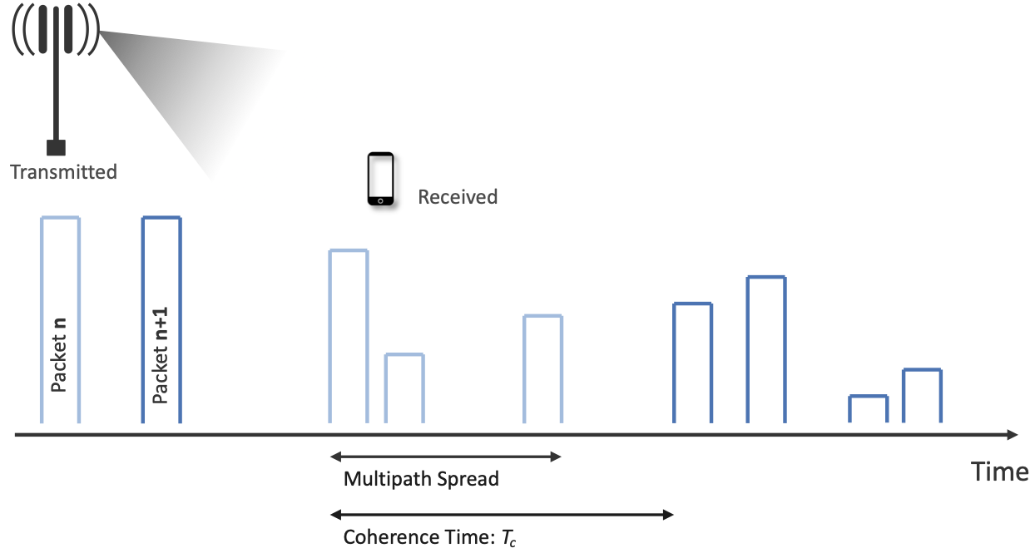
Transmission Challenges
Deal with noise and attenuation
Signal arrives via multiple paths
  Reflected signal
  MIMO adds multiple paths by design
Coherence time
  How long the channel stays stable
  Shorter at higher frequency or higher mobility
Solution must adapt
  Real-time conditions
  Environment (e.g., urban, suburban)

Slide 8
Multiplexing: OFDM to OFDMA
Earlier approaches
  Frequency hopping, TDMA, CDMA
OFDM
  Many orthogonal subcarriers
  Each modulated independently
OFDMA
  OFDM extended to multiple simultaneous users
  Each user gets a different subcarrier and time slot
QAM sets bits per symbol
  More capacity when channel quality is high
  e.g., 16-QAM yields 4 bits per symbol and 64-QAM yields 6 bits per symbol

Slide 9
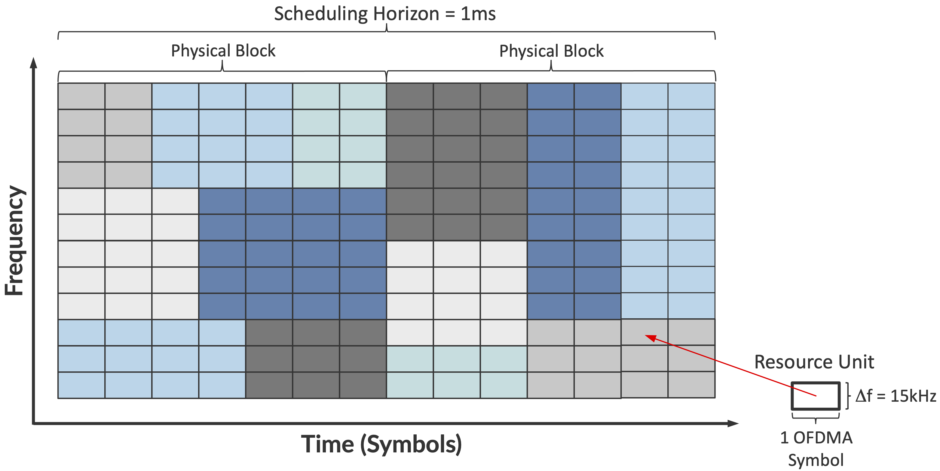
Resource Units
Spectrum as a 2-D grid
  Subcarrier x Time
Resource Unit (RU)
  One subcarrier
  One symbol time
Physical Block
  Set of RUs scheduled as a unit
Scheduler decides
  Modulation and MIMO parameters for next interval
  Which users get which RUs
“Numerology” is a particular config
  Subcarrier spacing, symbol width, QAM

Slide 10
Wi-Fi

Slide 11
Overview
IEEE 802.11 standard
  “Wi-Fi" is a certification trademark
Backward compatible across generations
  802.11a/g/n/ac all use OFDM
  802.11ax (Wi-Fi 6) adds the OFDMA framework
Collision Avoidance (CA)
  Can't detect collisions while transmitting
  Use CSMA/CA instead of CSMA/CD

Slide 12
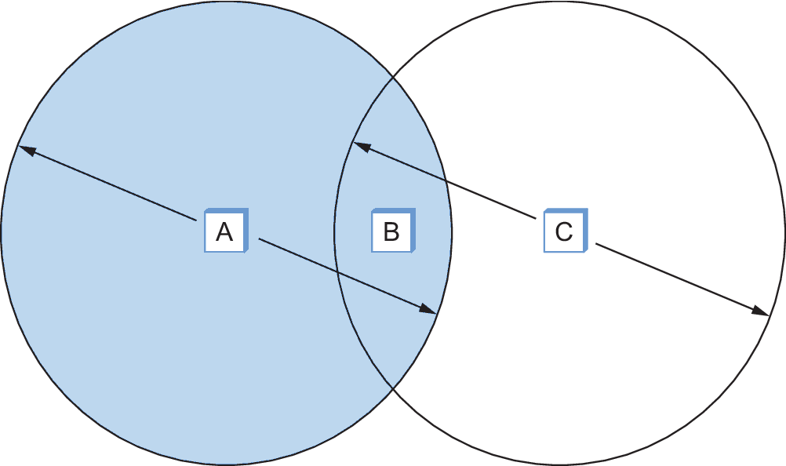
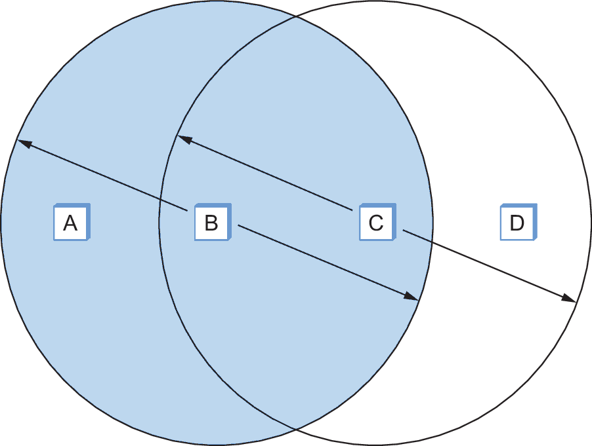
Challenges
Hidden Nodes
  Out of range of each other, collide at a shared neighbor
Exposed Nodes
  Can hear each other, but transmissions wouldn't actually interfere at destinations

Slide 13
RTS-CTS
Sender sends a short RTS; receiver replies with a CTS
CTS reaches hidden nodes even if the RTS didn't
Nearby nodes stay quiet for the announced transmission time
Colliding RTS frames handled by exponential backoff
  After 1st collision, delay either 0 or 51.2 μs (selected at random)
  After 2nd collision, delay either 0, 51.2, 102.4, or 153.6 μs
  …
  After N^{th} collision, delay k × 51.2 μs for randomly selected k = [0..2^{N}-1]

Slide 14
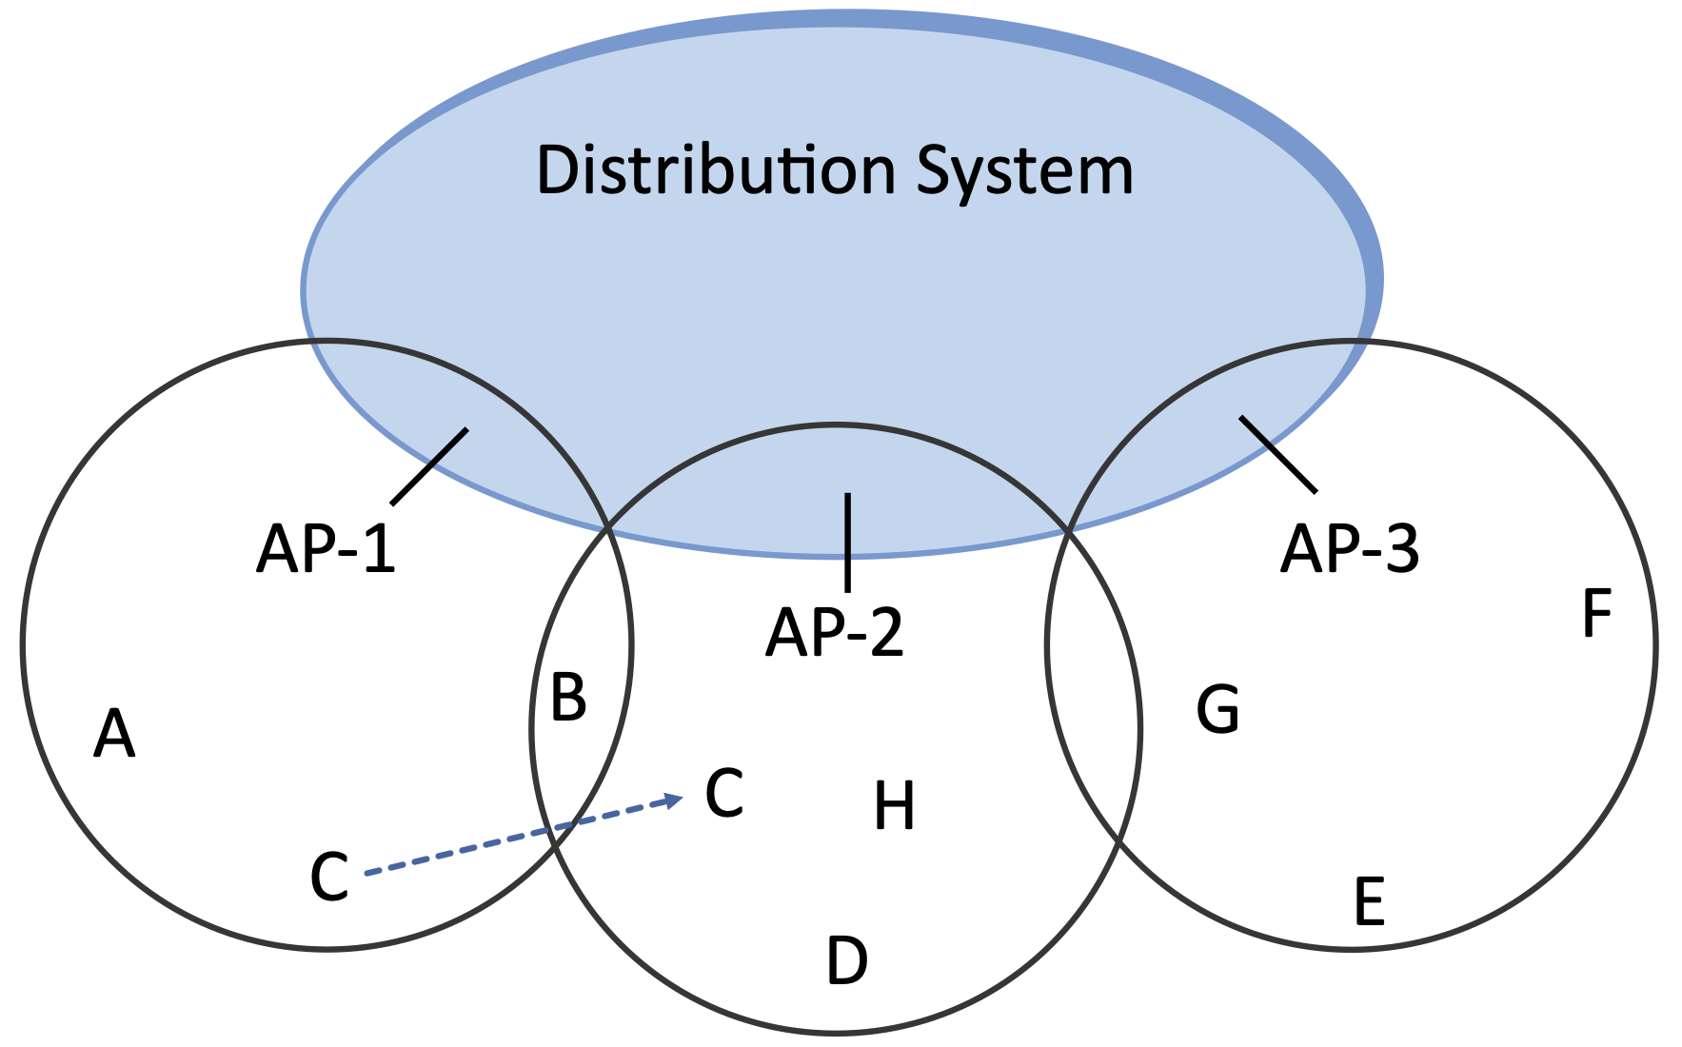
Distribution System
Access Points connected by a wired backbone
  Assumes L2 forwarding
Node associates with one AP
Scanning: how a node selects an AP
  Probe / Probe Response
  Association Request / Association Response
Handling mobility
  Active scanning: node sends Probes while moving
  Passive scanning: node listens for Beacon frames
  New AP notifies the old AP of the change

Slide 15
Frame Format
Four addresses (not two)
ToDS / FromDS bits in Control field determine how they're interpreted
  Both 0: direct node-to-node frame
  Both 1: frame crossed the distribution system
  Rest of Control field is used to distinguish RTS, CTS, and so on

Slide 16
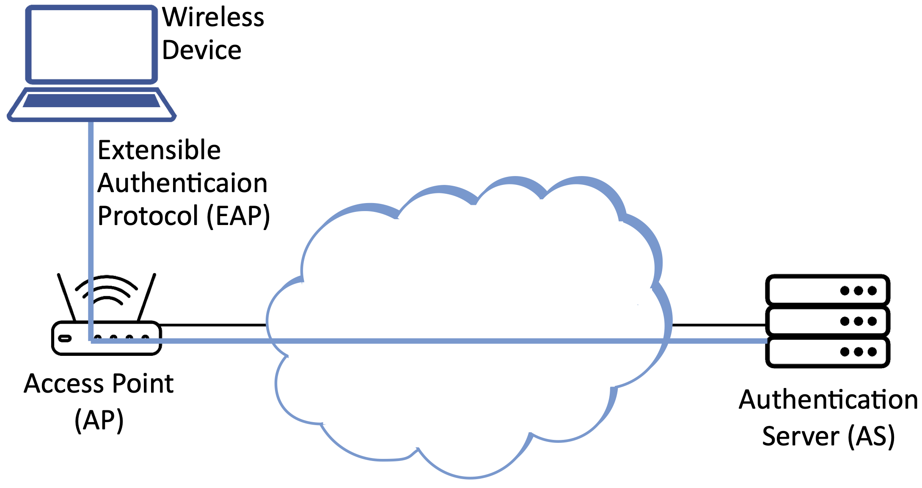
Wireless Security
802.11i (WPA3)
  Authentication
  Integrity
  Confidentiality
4-way handshake establishes session keys
CCMP provides confidentiality and integrity

Slide 17
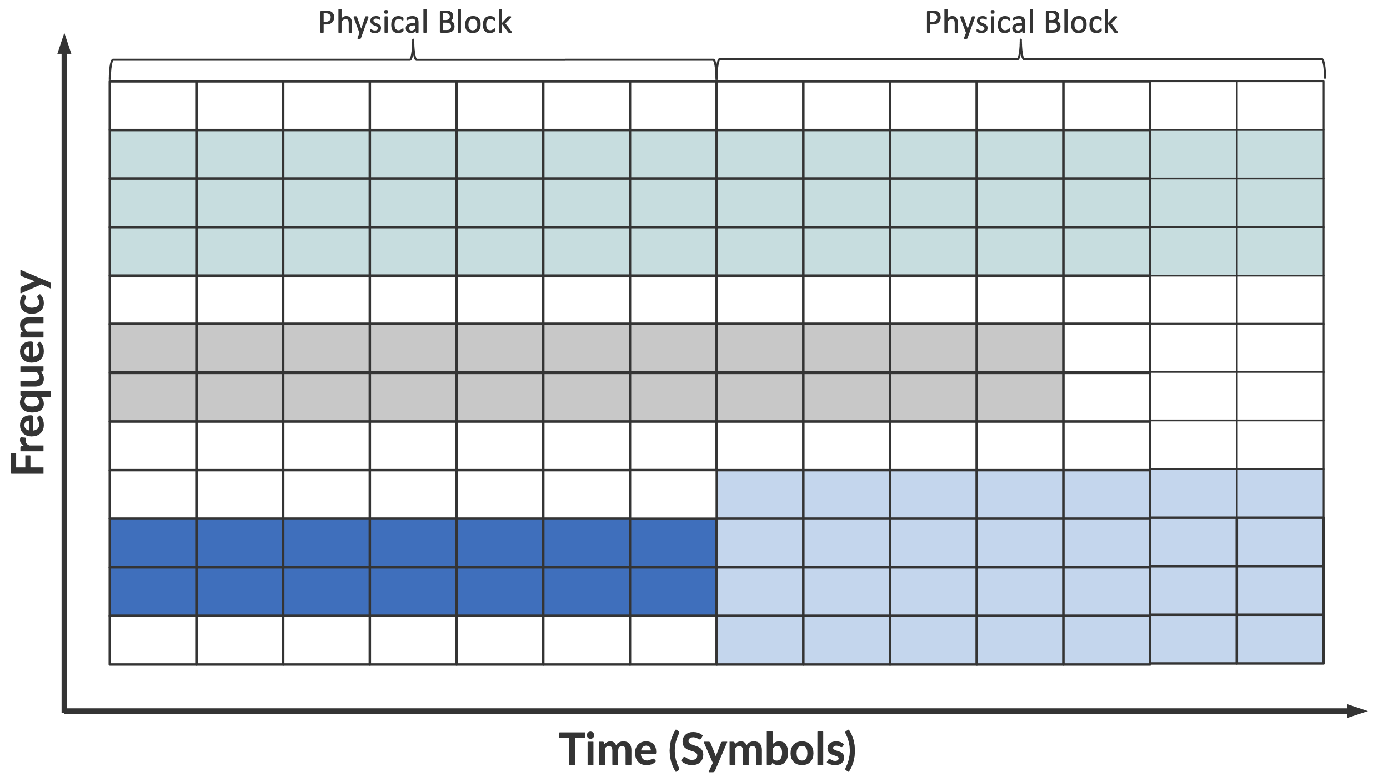
Scheduling Transmission
Best-effort; no QoS guarantees
FIFO queue at the MAC layer
Wi-Fi 6 piggybacks RU assignment on RTS/CTS messages
Device holds its subcarriers until its packet is sent

Slide 18
Mobile Cellular Network

Slide 19
Overview
3GPP: standards body for cellular networks
5G goals*
  Massive IoT
    Energy: 10+ years battery lifetime
    Simplicity: 10s of bits per second
    Density: 1M devices per square kilometer
  Mission-critical Control
    Availability 99.999% (five nines)
    Low Latency: under 1ms
    Mobility: up to 100 km/hr
  Enhanced Broadband
    Per-User Peak: multi-Gbps
    Per-User Sustained: 100+ Mbps
    Aggregate: 10 Tbps per square kilometer
*Aspirational

Slide 20
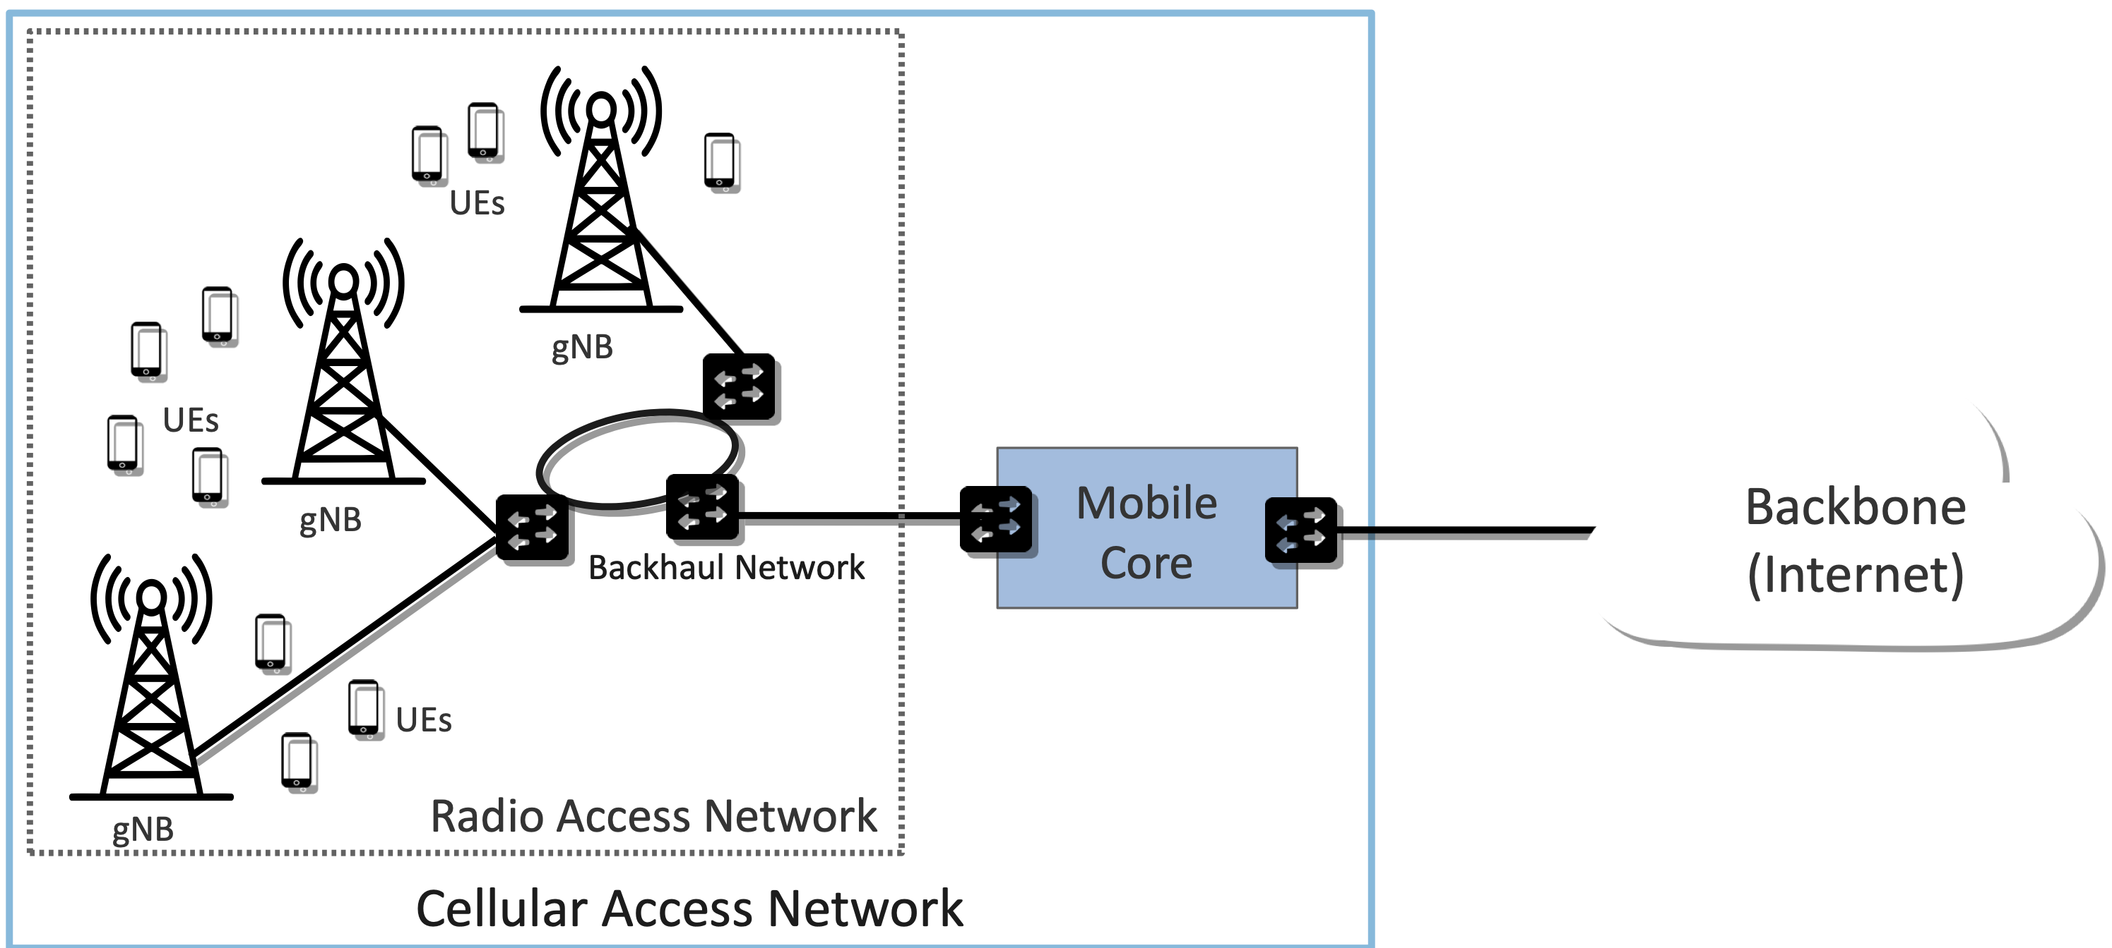
RAN and Mobile Core
Radio Access Network (RAN): network of base stations (gNB)
Mobile Core: authentication, IP connectivity, QoS, mobility, billing

Slide 21
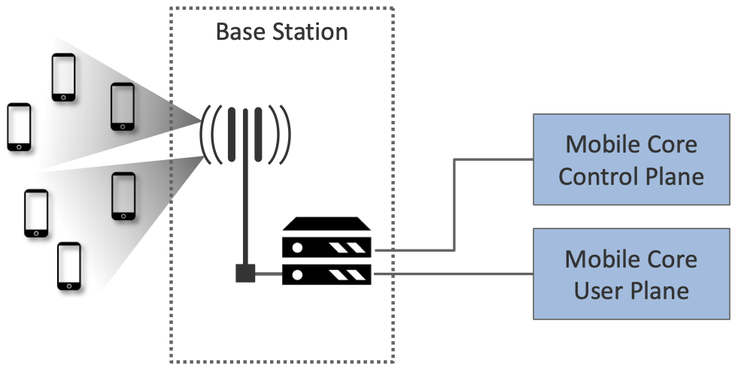
Control and User Plane Separation
Each base station independently…
  Schedules RUs for transmission
  Handles D-to-A conversion
Mobile Core split into Control Plane and User Plane
  Same idea as Data/Control Planes split

Slide 22
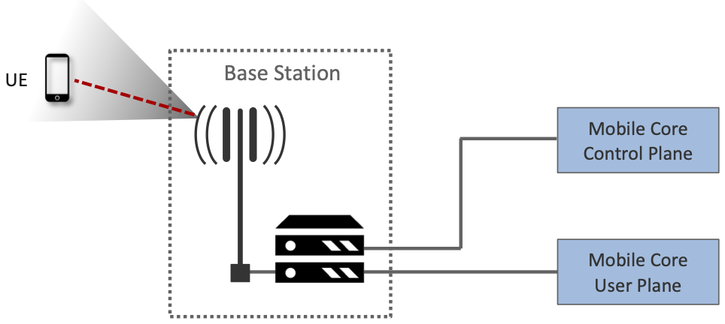
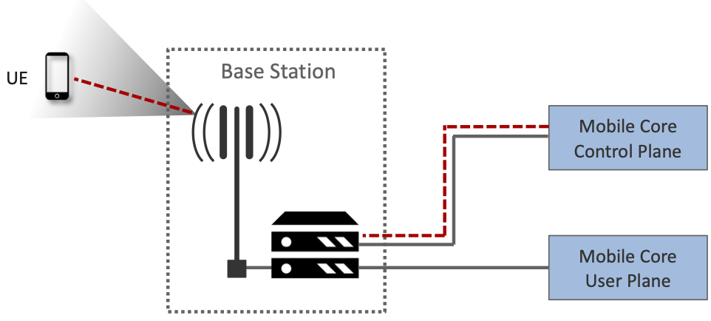
Establishing Connectivity
Base station detects a UE, establishes a wireless channel
Channel released after a period of inactivity
Base station links each UE to the Core's Control Plane
Control plane authenticate the UE

Slide 23
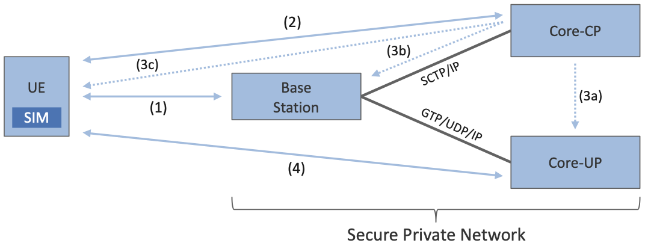
Mobile Core Security
SIM holds a unique IMSI and a secret key
IMSI encodes MCC / MNC / Subscriber ID
Connection sequence
Mobility
  Inter-basestation mobility is transparent
  Re-run these steps if UE moves to new Core

Slide 24
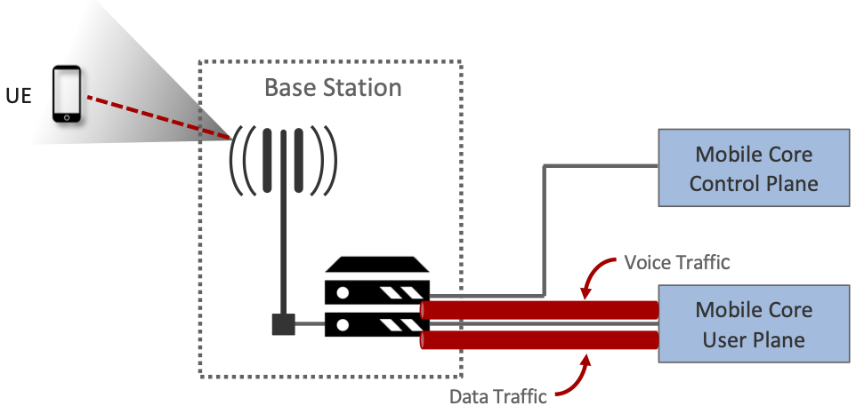
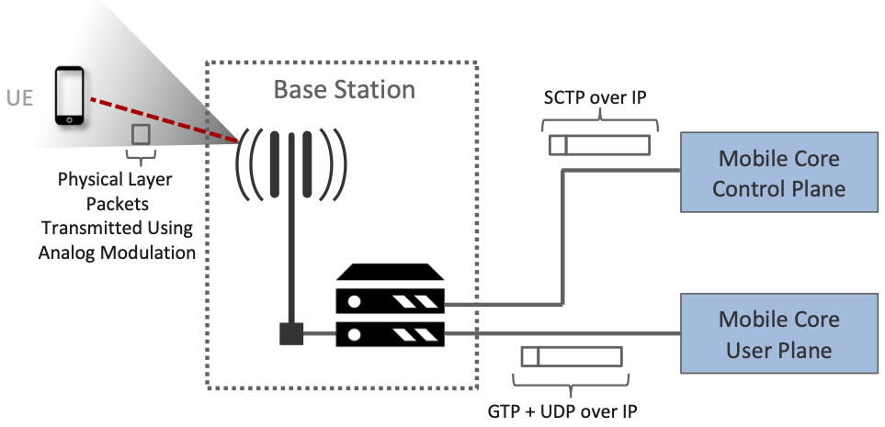
Tunneling
One or more tunnels per active UE
Network slicing is a possibility
Control plane: SCTP over IP
User plane: GTP over UDP over IP
Also for base-station-to-base-station coordination

Slide 25
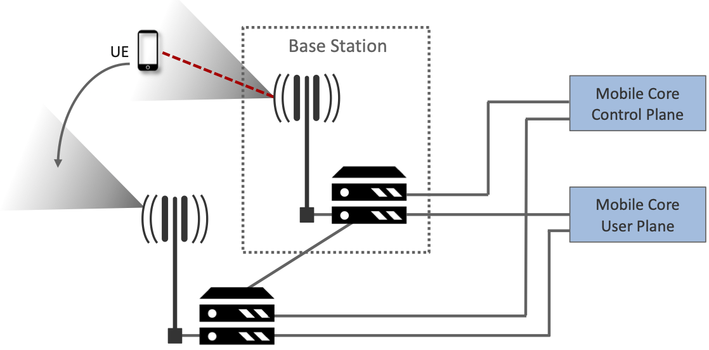
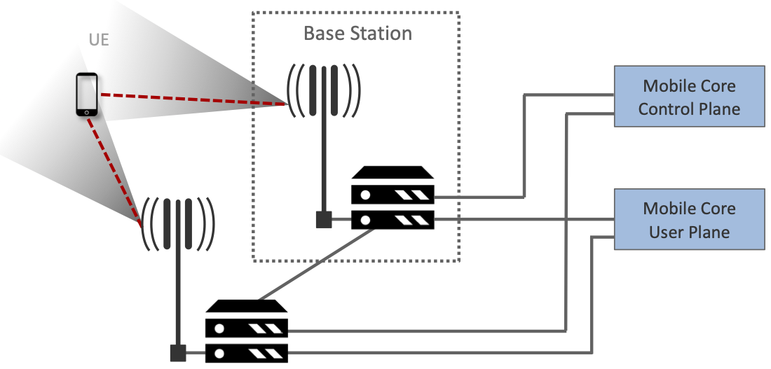
Base Station Coordination
Coordinate directly to hand off a UE
Decision based on measured channel quality
Also cooperate for link aggregation
Used to balance (spread out) load

Slide 26
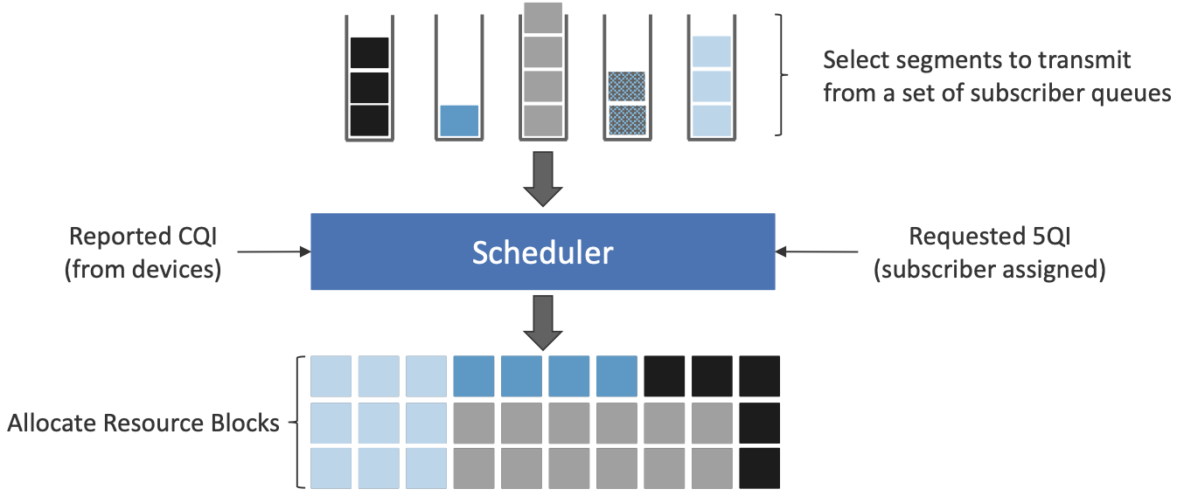
Scheduling Transmission
CQI: receiver-reported channel quality
QCI (5QI): per-traffic-class parameters
  Guaranteed vs. non-guaranteed
  Delay budget
  Max burst size
Numerology tailored to frequency band
  Below 1 GHz
    Subcarrier spacings of 15, 30 and 60 kHz
    Scheduling intervals of 0.5, 0.25, and 0.125 ms
  mmWave
    Subcarrier spacings of 60 kHz and 120 kHz
    Scheduling interval of 0.125 ms

Slide 27
Passive Optical Network

Slide 28
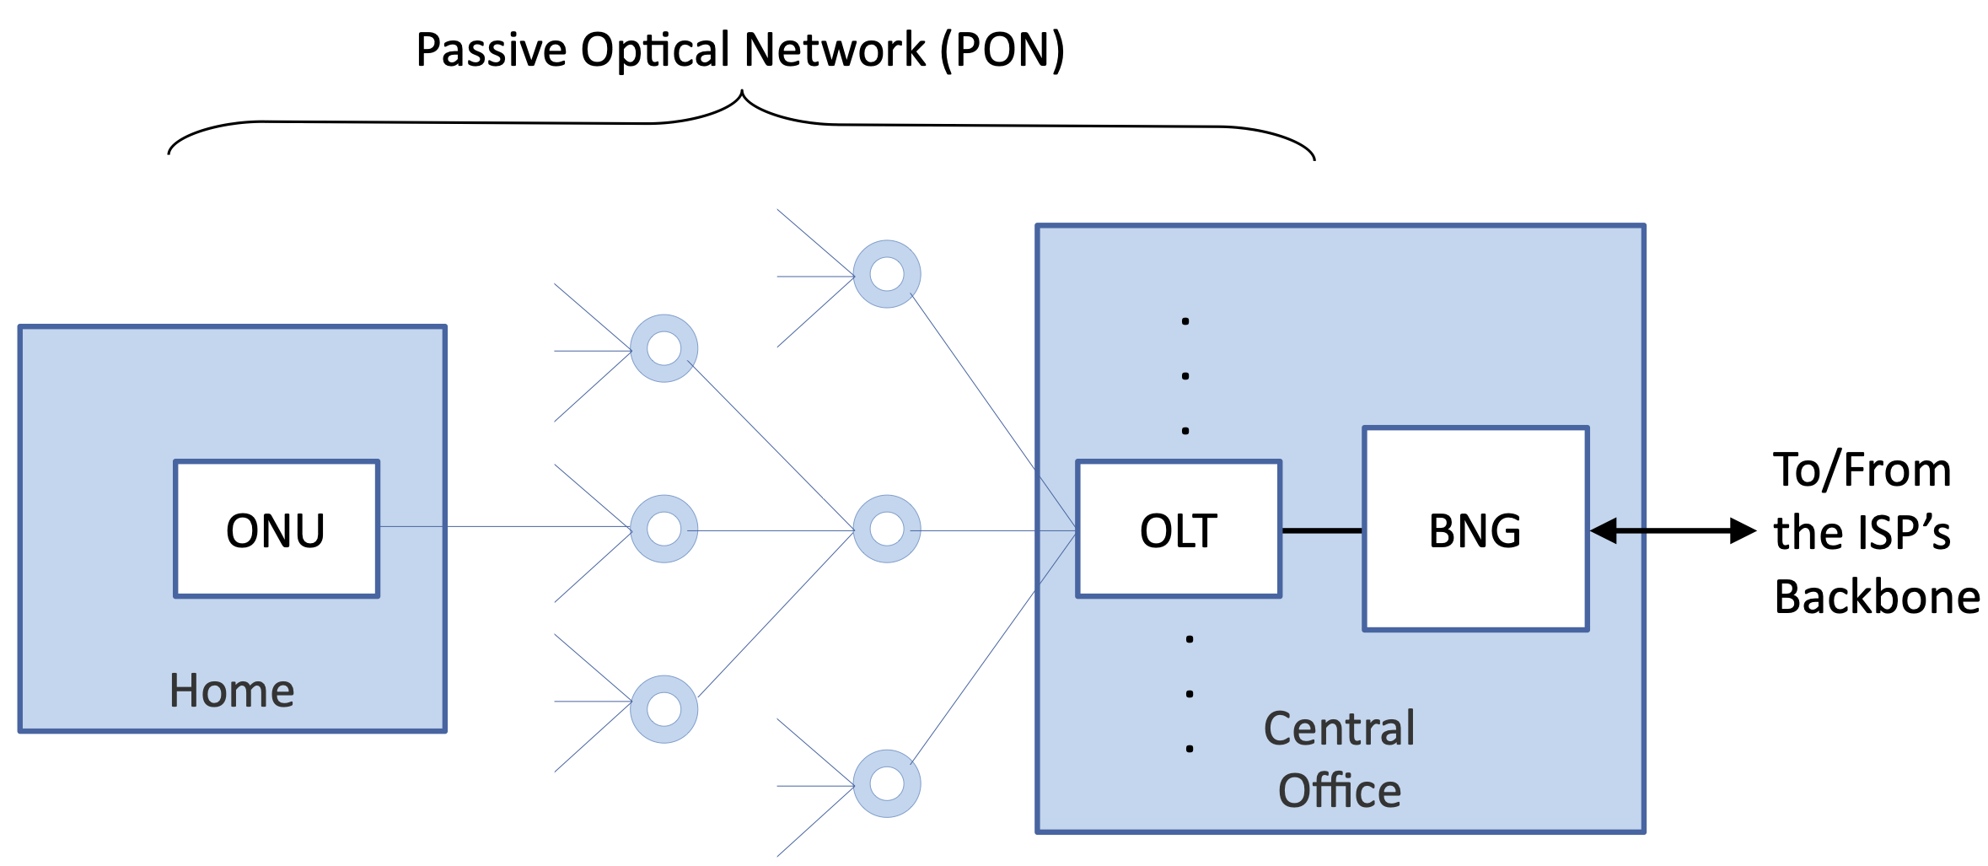
Overview
Point-to-multipoint tree with passive splitters
OLT (ISP side) and ONU (home side) do the framing
BNG: gateway between the access network and the Internet

Slide 29
Sharing the Fiber
Downstream: broadcast to every ONU
  Each ONU keeps only the frames addressed to it
  Encryption protects against eavesdropping
Upstream: time-division multiplexed
  OLT grants each ONU a transmission interval
Bandwidth has grown over generations
  G-PON, XGS-PON, 50G-PON

