Slide 1
Chapter 2: Network Applications
Computer Networks: A Systems Approach

Slide 2
Overview
The genius of the Internet is that it is designed to support any application. Those applications are implemented in software and run on general-purpose computers. This chapter introduces this software ecosystem, setting the stage for understanding everything it takes to create apps.

Slide 3
Client-Server Computing
Dominant application programming paradigm
  Client initiates / Server responds
Each application defines its own protocol
  e.g., HTTP, SMTP
Typically runs on top of TCP/IP
  Provided as part of the OS
Socket API provides the programming interface
  Originally defined in BSD Unix
  Now universal across all operating systems
  Often wrapped in a language-specific library (e.g., java.net)

Slide 4
Socket API
Server performs a passive open; blocks waiting for requests
Client performs an active open
Both sides exchange messages
bind(sock, &addr, len);
listen(sock, backlog);
new_sock = accept(sock, &peer, &len);
connect(sock, &addr, len);
send(sock, msg, len, 0);
recv(sock, buf, len, 0);
/* Server */
bind(sock, &addr, len);
listen(sock, backlog);
new_sock = accept(sock, &peer, &len);
/* Client */
connect(sock, &addr, len);
/* Both */
send(sock, msg, len, 0);
recv(sock, buf, len, 0);

Slide 5
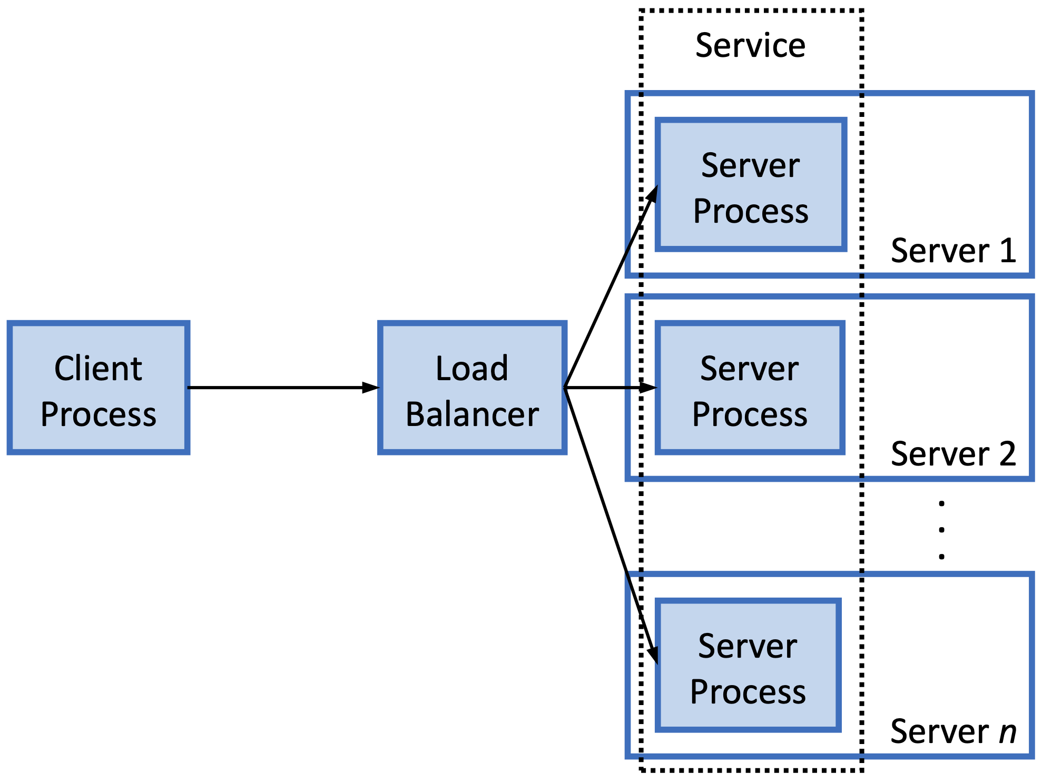
Scalable Services
Cloud scales server side
  Load balancer distributes requests across a pool of backend instances
  Instances ~ Containers
Client see a single IP address
  Makes request to a service

Slide 6
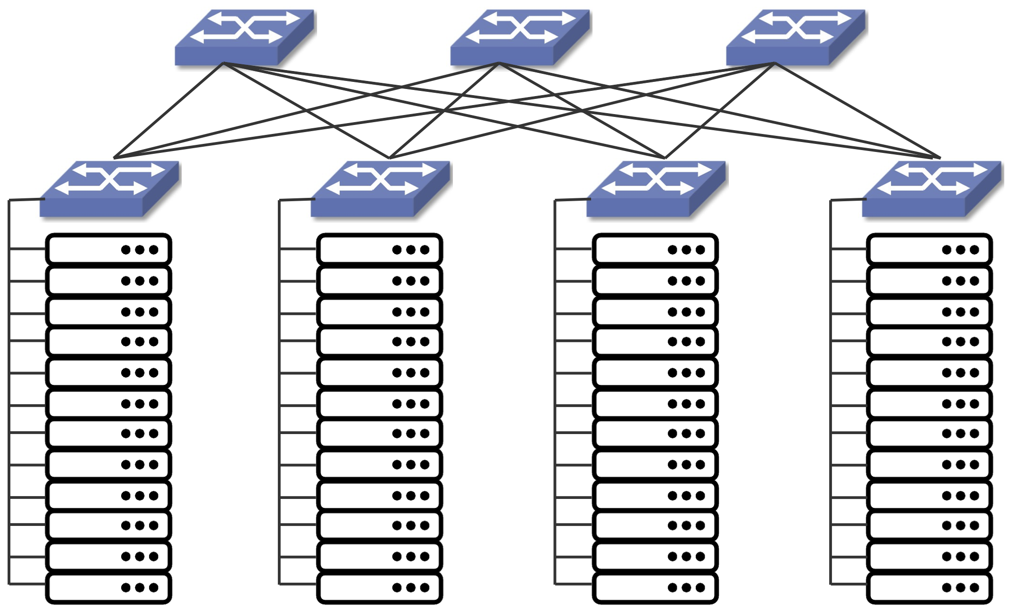
Scalable Services: Datacenter
Leaf-spine Datacenter Fabric
  Commodity Switches
  Example shows two-level fabric
Leaf (Top-of-Rack) Switches
  Connect servers within a rack
Spine Switches
  Connect leaf switches across racks
  Supports multiple paths

Slide 7
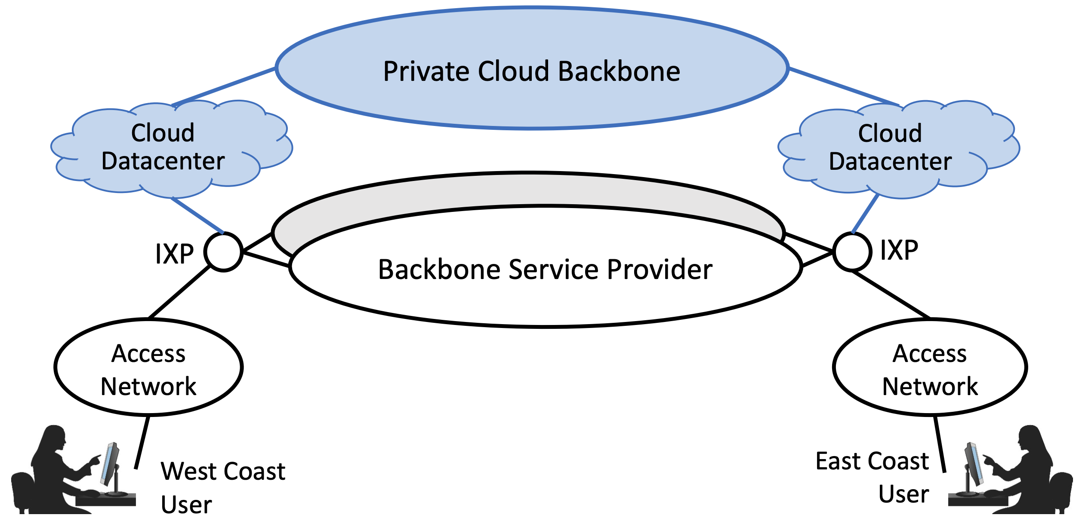
Distributed Services
Replicate service over multiple sites
  Lower Latency: serve from nearby site
  Higher Capacity: aggregate resources
  Higher Availability: survive site failure
5000+ cloud sites worldwide
  Hyperscale datacenters
  Edge locations (e.g., IXP)
Internet and Cloud are Symbiotic
  Cloud runs over Internet protocols
  Internet functions run on cloud servers

Slide 8
Distributed Computation
Parallel programs are another kind of application that use the network
  Historically known as High-Performance Computing (HPC)
    e.g., weather forecasting, financial modeling, aerodynamic design, physics simulations
  Originally ran on purpose-built supercomputers
  Today they typically run in datacenters (commodity servers, datacenter fabric)
Modern workloads now include…
  Building search indices
  AI model training
Key properties (with respect to networking)
  Involve a group of processes (a collective) rather than just a client-server pair
  Programs are structured to iterate through a sequence of steps
    Scatter “chunks of data” to peers (one-to-many communication)
    Shuffle “intermediate results” between peers (many-to-many communication)
    Gather “results” back in a central location (many-to-one communication)

Slide 9
Synchronization and Work Queues
Goal is to maximize parallelism and minimize blocking
Synchronization barrier between steps and iterations
  Next iteration can't start until previous one fully completes
  Overall speed = slowest transfer, not the fastest
Avoid blocking on the network
  Communication “channel” includes a work queue and a completion queue
  Threads asynchronously insert messages into a work queue
  Threads poll the completion queue for a notice about success/failure
Sockets do not provide the right abstraction
  And neither does TCP
  We’ll see alternatives to both in Chapter 15

Slide 10
HTTP: From App to Framework

Slide 11
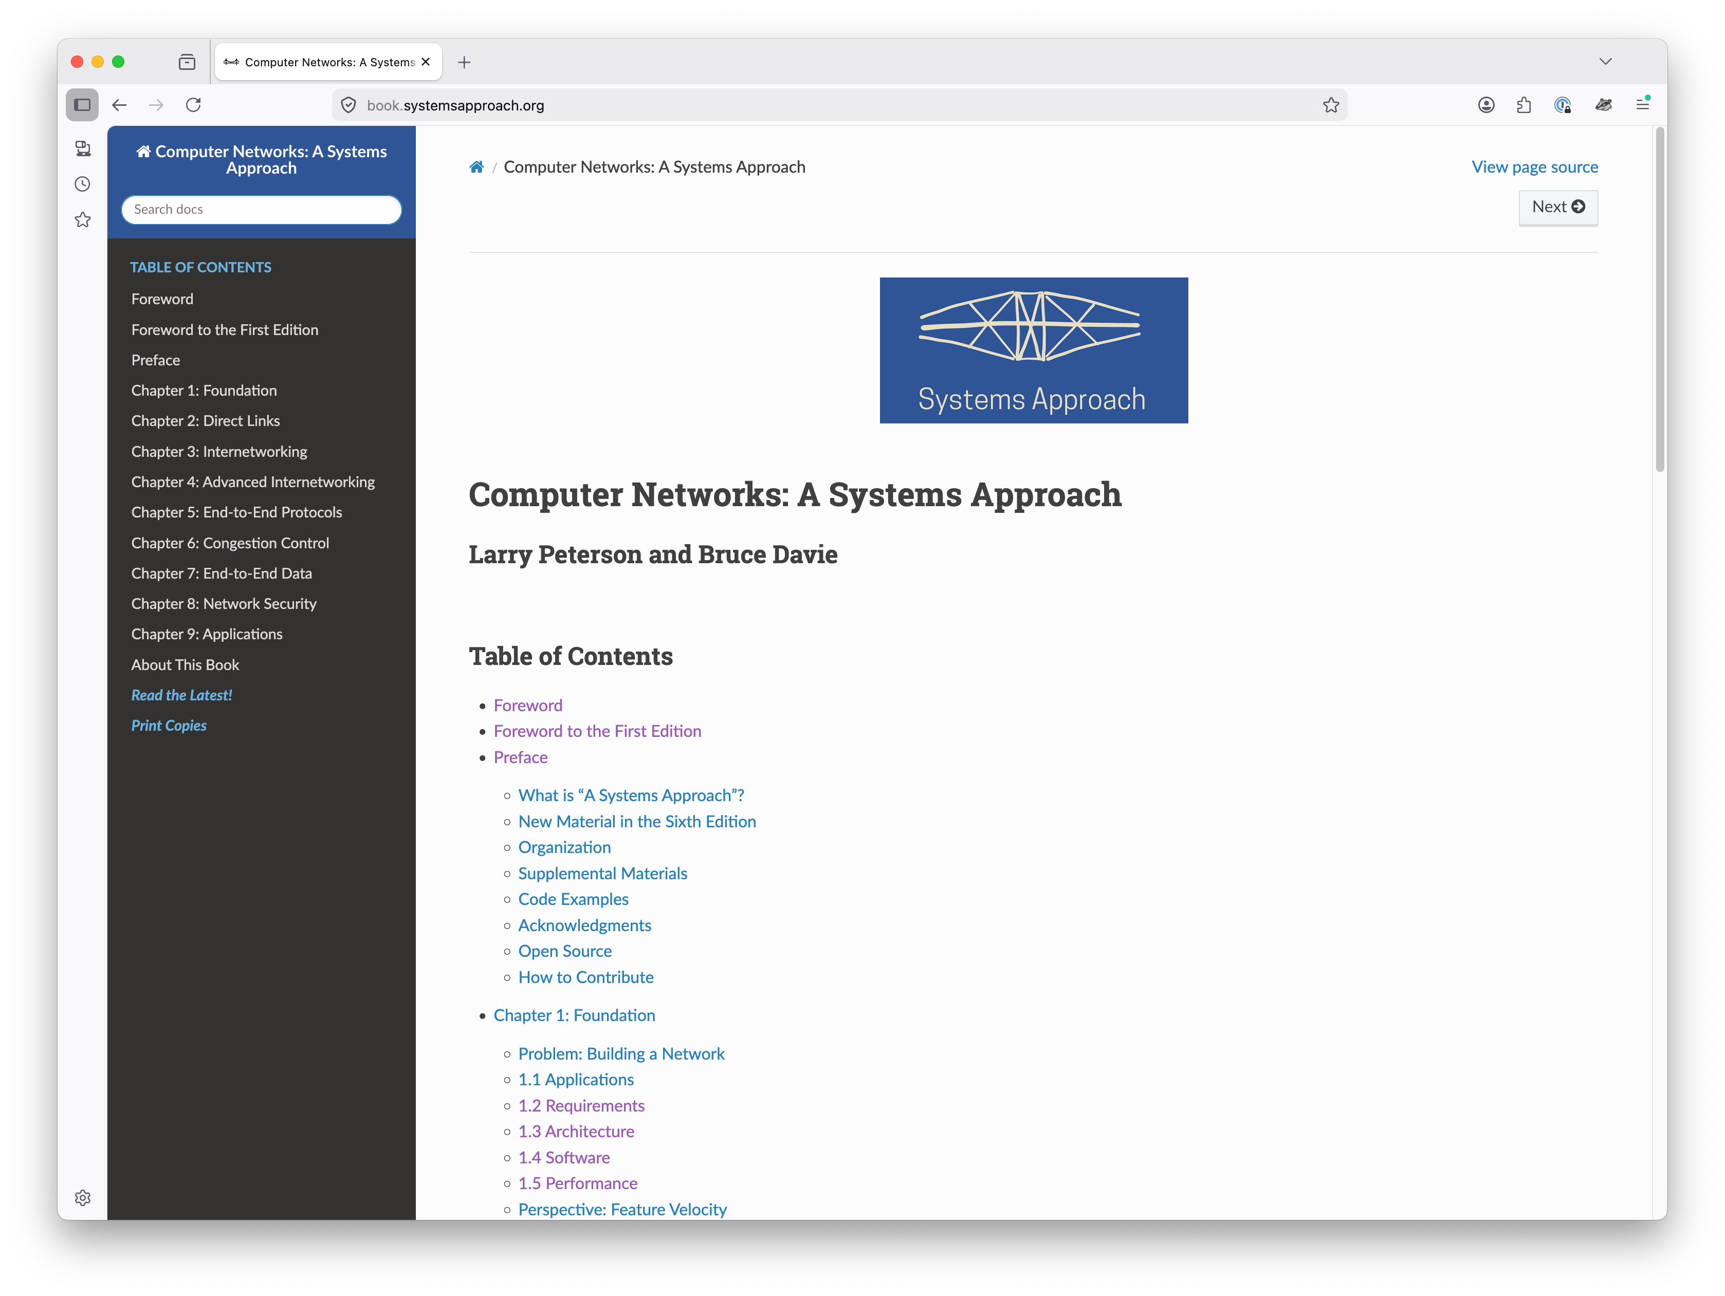
Overview
HTTP began as the protocol of the World Wide Web
Has evolved into a framework for Internet applications
  Mobile apps, video streaming…
Request/Response Protocol
  and more…

Slide 12
Request/Response Protocol
Request: Method + Resource (named by URL)
  GET (retrieve), POST (submit), PUT (update), DELETE (remove)
Response: 3-digit status code + reason phrase
  2xx success, 3xx redirect, 4xx client error, 5xx server error
HTML and HTTP are companion standards
  Data format separate from transfer protocol
  Easy to substitute other formats (e.g., XML)

Slide 13
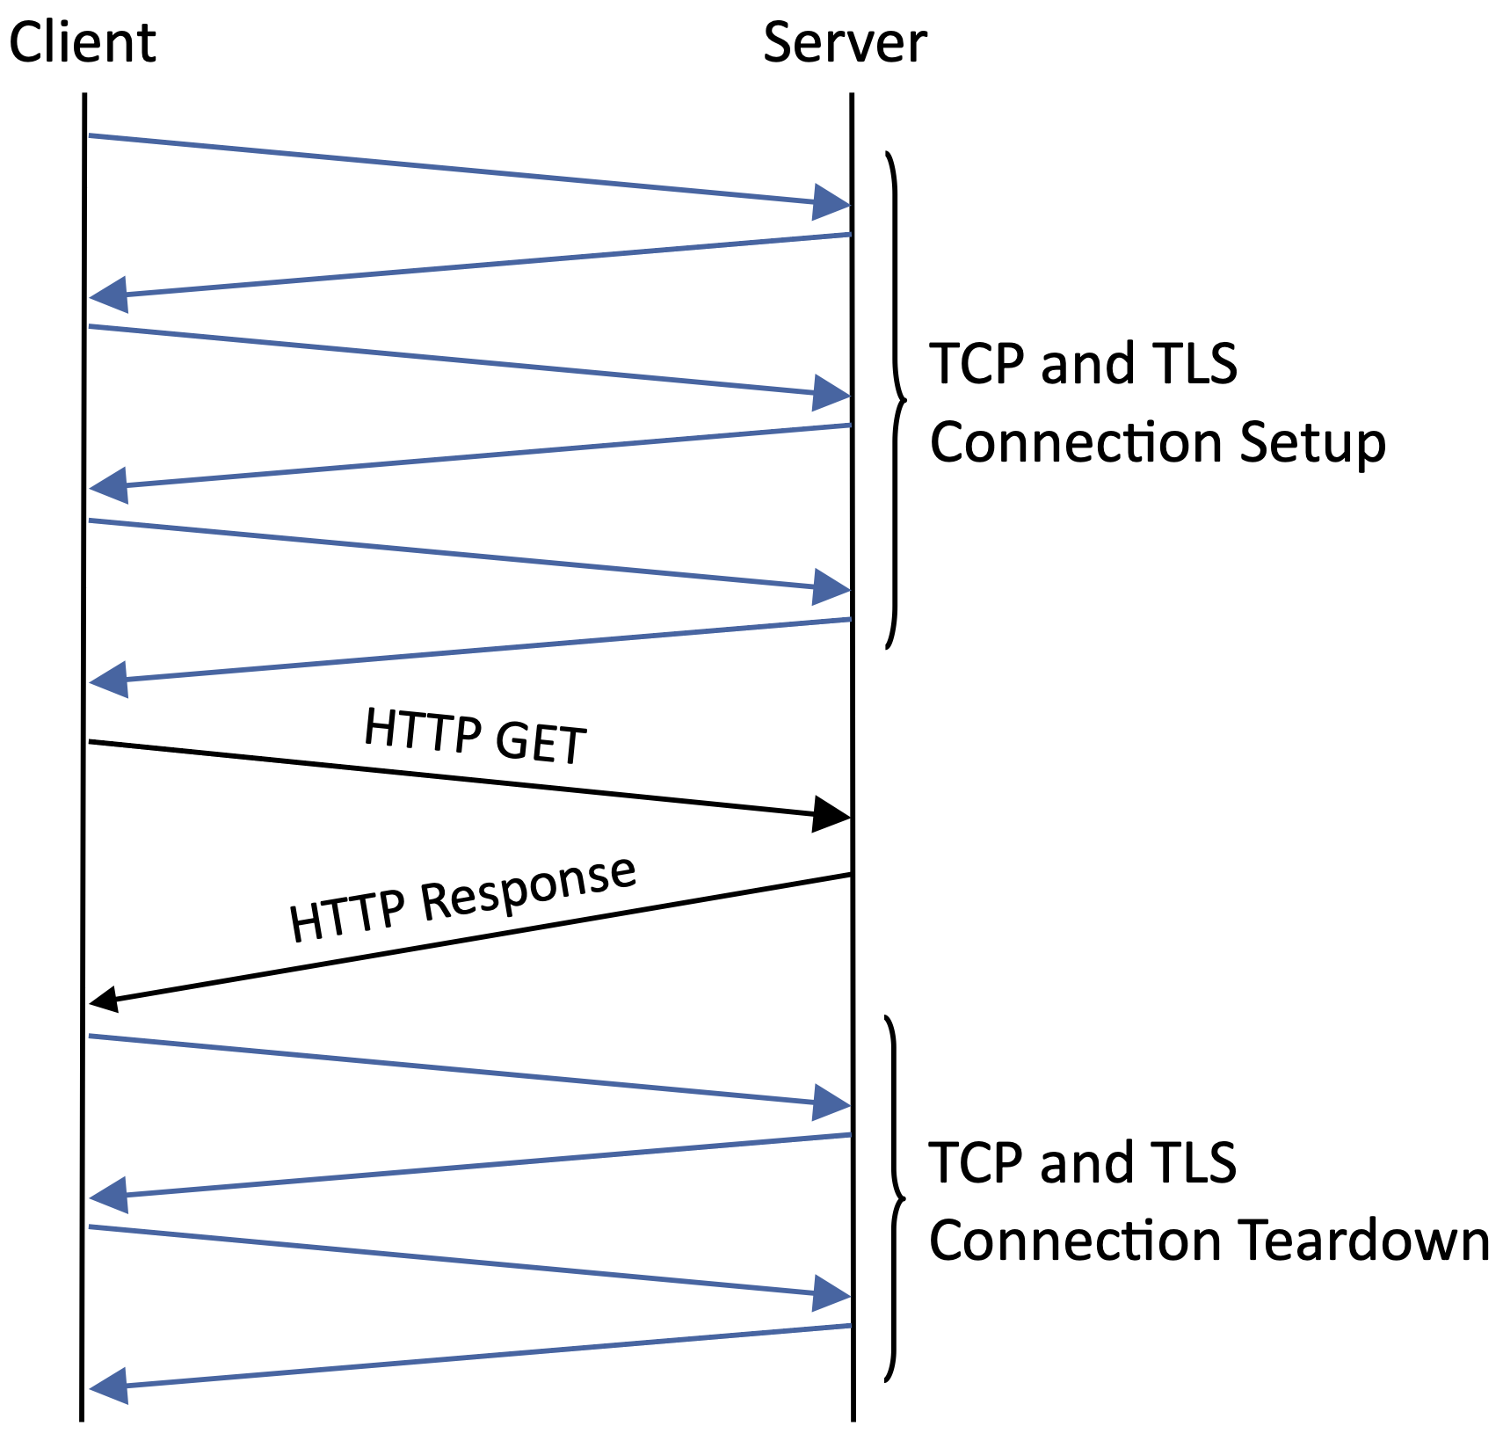
Connection Overhead
HTTP 1.0
  One TCP connection per object
  Page with 12 images → 13 TCP connections
  TLS adds additional round trips
HTTP 1.1
  Persistent connections
  Reuse one TCP for multiple requests
HTTP/2
  Multiplexed streams
  Concurrent request/response pairs on one TCP
HTTP/3 & QUIC
  Replaces TCP entirely
  See Chapter 15

Slide 14
Naming Scheme
URI: Uniform Resource Identifier
  Names any resource on the Internet
  Format: scheme + scheme-specific part
URL: Uniform Resource Locator
  URI that also locates the resource
  https://book.systemsapproach.org/index.html (the familiar form)
URN: Uniform Resource Name
  URI that gives a persistent name without implying a location
  doi:10.17487/RFC0791 (identifies RFC 791 regardless of where it's hosted)

Slide 15
Caching Infrastructure
Two Benefits
  Reduces response time
  Reduces server load
Where do caches live?
  Browser
  Site Proxy
  CDNs: Overlay network with caches distributed globally
HTTP explicitly supports caching
  Expires Header: cache valid until this time
  Conditional GET: server returns page only if modified since last fetch
302 Redirect
  Routes clients to nearest cache — intrinsic part of a CDN (Chapter 16)

Slide 16
RESTful API
ReST: Architectural style underlying the Web
  Representable State Transfer (Fielding, 2000)
Everything is a resource, identified by a URI
HTTP methods parallel Object Oriented Programming
  CRUD: Create, Read, Update, Delete
  HTTP: POST, GET, PUT, DELETE
Payload carries state representation
  e.g., JSON, XML
Reuses web infrastructure
  Proxies, CDNs, and Caches work automatically

Slide 17
Electronic Mail

Slide 18
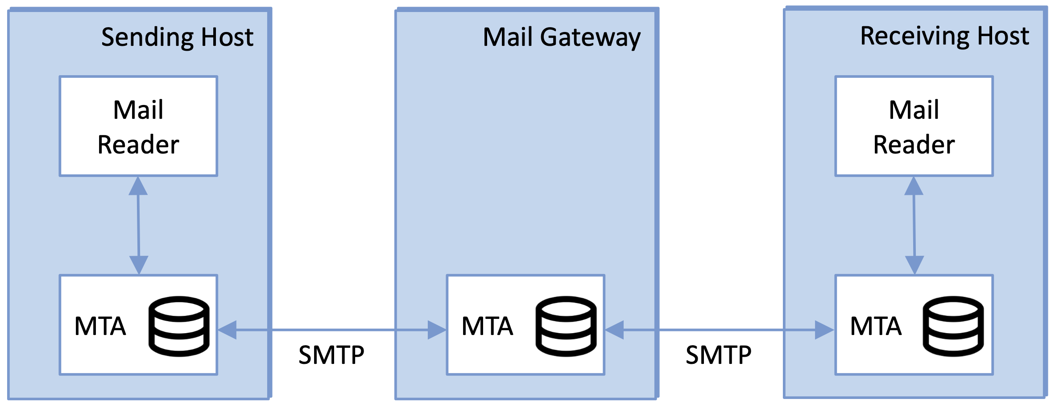
Overview
Email
  Internet's original killer app
  Example of pre-web design
Mailbox Abstraction
  Rendezvous point for messages
SMTP
  Send mail to a mailbox
  Store-and-forward via MTAs
IMAP / POP
  Retrieve mail from a mailbox
Modern Web Mail (e.g., Gmail)
  HTTPS/ReST replaces IMAP

Slide 19
Message Format
RFC 822 / 5322
  Header + Body (both as ASCII text)
  Headers: To, From, Subject, Date, Received
MIME (1992)
  Extends email to carry binary content
  Content-Type declares the data type
    e.g., image/jpeg, audio/mp3, multipart/mixed
  Base64 maps binary to ASCII

Slide 20
Message Transfer
MTA (Message Transfer Agent)
  Both client and server sides
Store-and-forward
  Each MTA buffers to disk
  Retries for days if needed
  Hides organization internals
SMTP defines the Protocol
  ASCII command/response dialog
  Influenced HTTP’s design
HELO cs.princeton.edu
250 Hello daemon@mail.princeton.edu
MAIL FROM:<bob@princeton.edu>
250 OK
RCPT TO:<alice@systemsapproach.org>
250 OK
DATA
354 Start mail input; end with <CRLF>.<CRLF>
...message body...
.
250 OK
QUIT
221 Closing connection

Slide 21
Adaptive Streaming

Slide 22
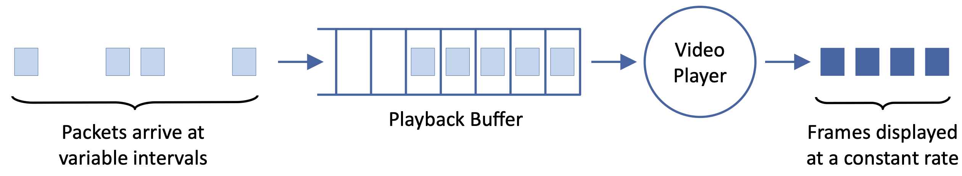
Overview
Video must adapt to variable network capacity
DASH (Dynamic Adaptable Streaming over HTTP)
  Store video as N quality levels × M time segments
  Client downloads MPD manifest
  Issue HTTP GET requests for one segment one at a time
Each segment is an opportunity to request a different quality level
  Buffer draining → request lower quality
  Buffer filling → try higher quality

Slide 23
Rate Adaptation
Goal: match video bitrate to available bandwidth
Two mechanisms working in tandem
  TCP's congestion control adjusts sending rate
  DASH adapting volume of traffic being sent
Key Tradeoffs
  Stability: frequent quality switches more annoying than a steady lower quality
  Responsiveness: slow reaction wastes bandwidth or causes stalls
Real-time video conferencing cannot use buffered streaming
  Needs < 300ms end-to-end latency
  Requires a different approach (Chapter 17)

