Slide 1
Service
Server 1
Server
Process
Server 2
Client
Process
Load
Balancer
Server
Process
.
.
.
Server n
Server
Process

Slide 2

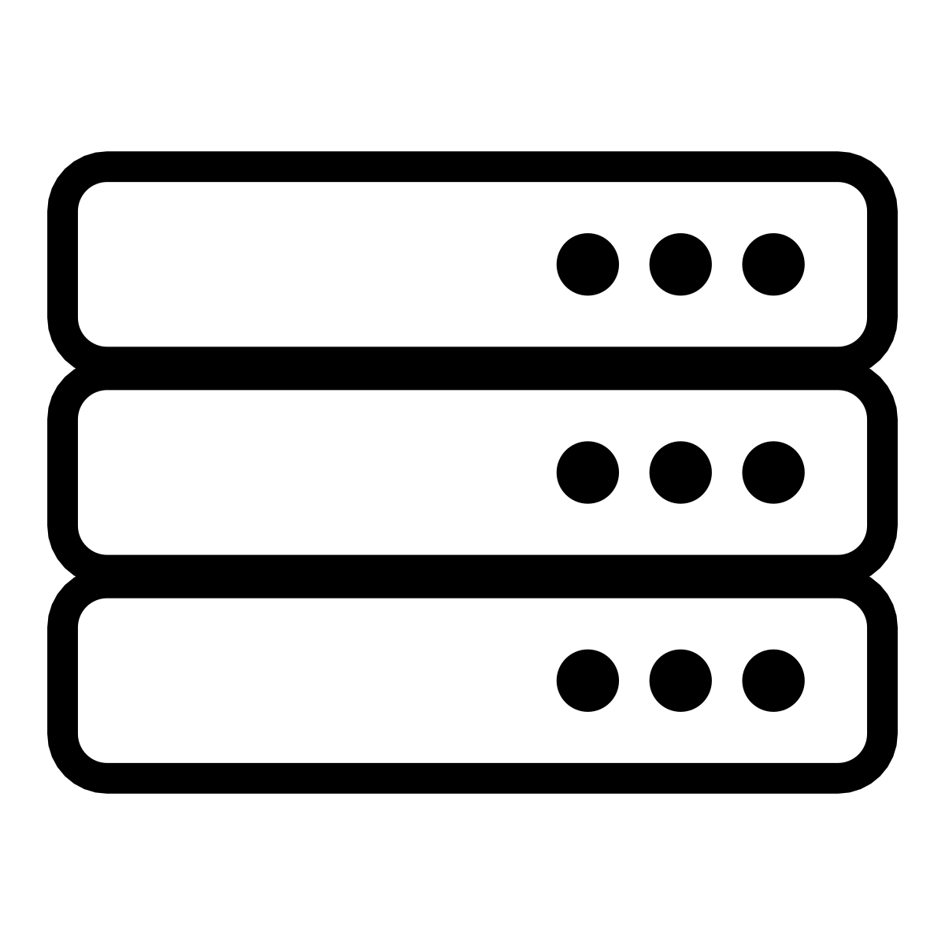

Slide 3

Private Cloud Backbone
Cloud
Datacenter
Cloud
Datacenter
Backbone Service Provider
IXP
IXP
Access
Network
Access
Network
West Coast
User
East Coast
User

