Slide 1









Calibri (16pt by default)
Calibri (16pt by default)
Darker Color 0070c0
Default Color 6a99d0
Lighter Color bdd7ee
WiFi
Access Point
Server(s)
Stackable = Rack
Generic
Switch
Generic
Switch
User
UE
Phone
UE
Phone
UE
Phone
Generic Office
or Enterprise
5G
Basestation

Slide 2
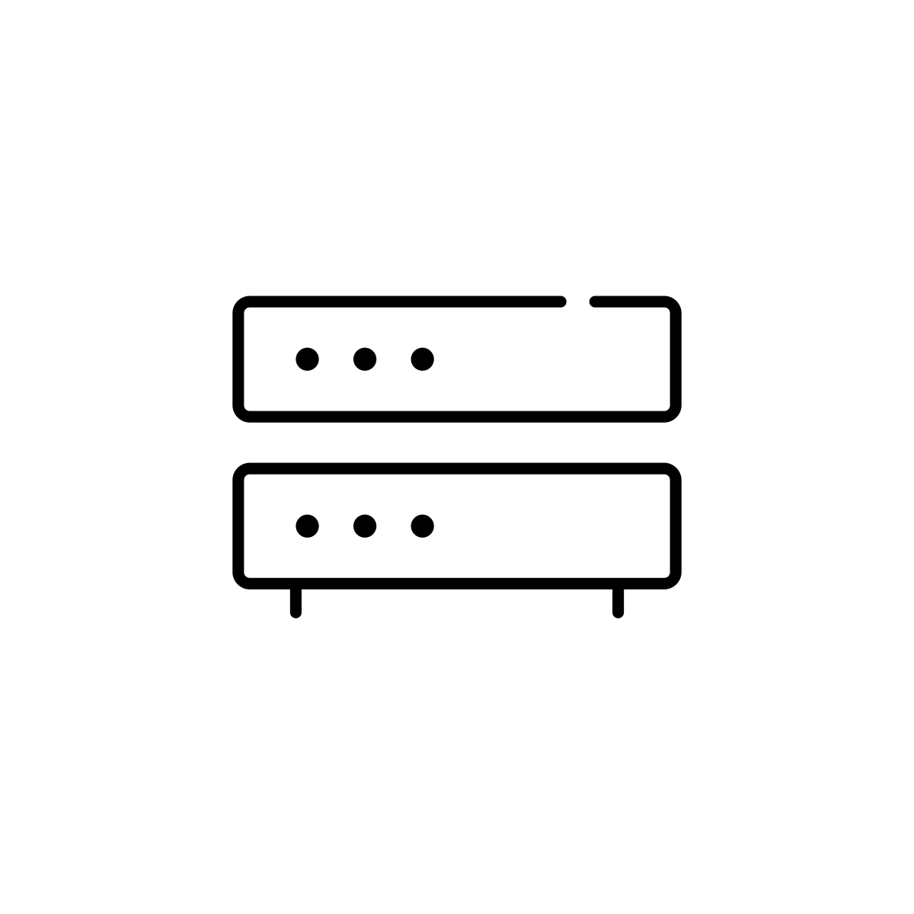


Query
Client
Server
Response
Router
Cloud

