Slide 1
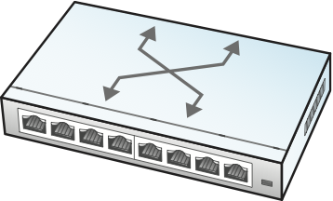
Control
App
Control
App
Control
App
Control
App
. . .
Network OS
Global
Network
Map
Control Plane
Abstract
Forwarding Model
(e.g., OpenFlow, P4)
Data Plane

Slide 2

Private Cloud Backbone
Cloud
Site
Cloud
Site
Backbone Service Provider
IXP
IXP
Consumer
ISP
Consumer
ISP
West Coast
User
East Coast
User

