Slide 1

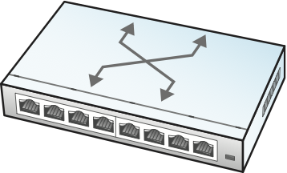
Network Operator
(Alerts, Intent)
Configuration & Management Tool
gNMI
(YANG-based
models)

