Slide 1
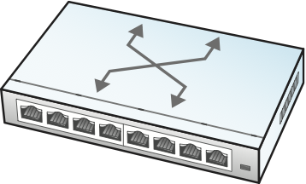
Control
App
Control
App
Control
App
Control
App
. . .
Network OS
Global
Network
Map
Control Plane
Abstract
Forwarding Model
(e.g., OpenFlow, P4)
Data Plane

Slide 2

Private Cloud Backbone
Cloud
Site
Cloud
Site
Backbone Service Provider
IXP
IXP
Consumer
ISP
Consumer
ISP
West Coast
User
East Coast
User

Slide 3
HTTP
SMTP
DNS
IMAP
Applications
TCP
UDP
HTTP
Evolution
of the
TLS
IP
Narrow
Waist
TCP
IP
802.11
PPP
ATM
SONET
Networks

Slide 4
(2) Query Route URL for Id Data
and verify with Public Key.
Identity
Data
Private
Blockstack DB
Query DB with Name
and get Public Key and
Route in return.
Name
Public
Route
Blockchain
Blockstack Log Entry

Slide 5
64
48
48
16
16
Preamble
DestAddr
SrcAddr
Type
… Body …
CRC
802.1
802.1Q
Hdr
Preamble
DestAddr
SrcAddr
Type
… Body …
CRC
802.1Q
16:
4:
12:
Type
Control
Tag
32 =

Slide 6




Users
&
Devices
Edge Clouds
IXP Clouds
Public Clouds
Access
Networks

