Slide 1

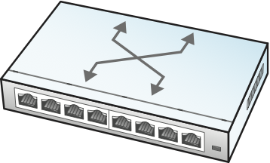
Network Operator
(Alerts, Intent)
Configuration & Management Tool
gNMI / YANG

