Slide 1


Edge Platforms/Apps
Network OS
SD-Fabric
SwitchOS
SwitchOS
SwitchOS
SwitchOS
Helm
Kubernetes
SwitchOS
SwitchOS

Slide 2

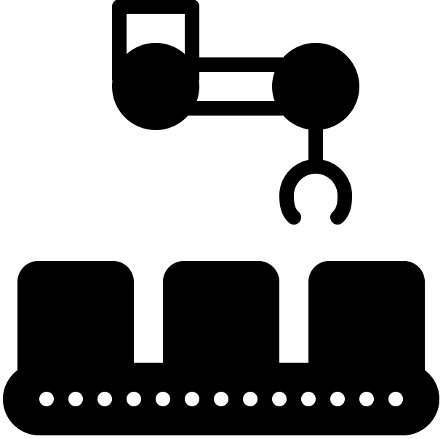

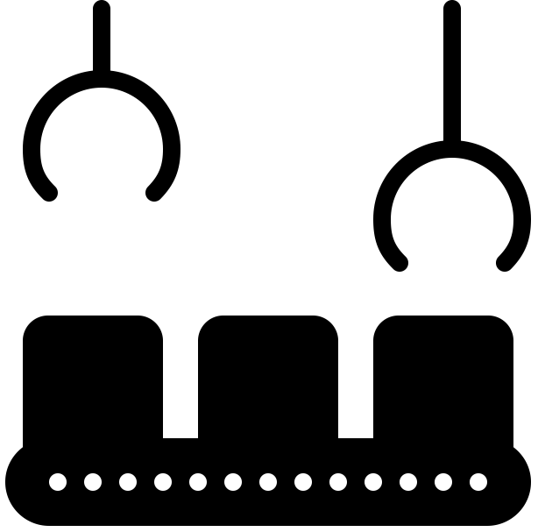



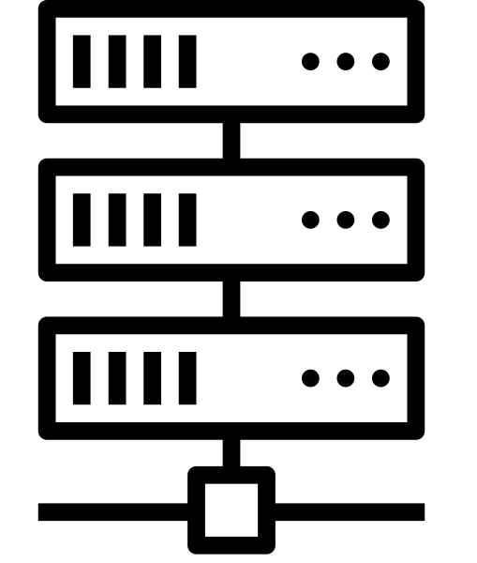




On-Prem
Off-Prem
IoT
Sensors
Small Cell
SD-RAN
SD-Core
(User Plane)
Surveillance
Central Apps
Edge Apps
Control and
Management
Platform
Multimedia
Small Cell
Edge Cloud
SD-Core
(Control Plane)
Employees
Central Cloud
Visitors
Small Cell

Slide 3
Edge Platforms/Apps
SD-RAN
Network OS
SD-Core
(UP)
SD-Fabric
SwitchOS
SwitchOS
SwitchOS
SwitchOS
SwitchOS
SwitchOS

Slide 4
Edge Platforms/Apps
AMP
SD-Core
(CP)
SD-Core
(CP)
SD-Core
(CP)
Multiple ACE Sites
Central Cloud

Slide 5
Edge Platforms/Apps
User Portal
Operations Portal
Aether Management Platform (AMP)
Resource
Provisioning
Lifecycle Management
Runtime Control
Monitoring
& Telemetry
AMP
(CP)
(CP)
Central Cloud
Multiple ACE Sites

Slide 6
Install & Inventory
(Ops Team)
Inventory
Repo
Zero-Touch
Provision (System)
Config
Repo
Operational Cloud
Used by Lifecycle Management

Slide 7
Populated by Resource Provisioning
Config
Repo
Continuous Innovation
(Dev Team)
Code
Repo
Continuous Integration (System)
Image
Repo
Continuous Deployment (System)
Operational Cloud

Slide 8
Manage end-to-end connectivity on a per-device/application basis.
Runtime Control
Control API
SD-RAN
Network OS
SD-Core
(UP)
SD-Core
(CP)
SD-Fabric
Edge Services
Central Service

Slide 9
Continual Development → Continual Integration → Continual Deployment
Usage & Experience

Slide 10
QA Cluster
Testing
Staging Cluster
Image
Repo
Integration
Gate
Testing
Code
Repo
Production Clusters
Testing
Build
Construct Plan
Deployment Gate
Execute
Plan
Checks
Config
Repo
Review
...
Populated by Resource Provisioning
Continuous Integration
Continuous Deployment

Slide 11

User
Portal
Selenium
Robot
Runtime Control
NG40
SD-Core
SD-RAN
Robot
SD-Fabric
TestON
TestVectors
Stratum (fabric.p4)
Stratum (fabric.p4)
Leaf1
Leaf2
Testing Frameworks

Slide 12
Feedback
Build
Code Review
Unit Tests
Developers
Static Checks
Push
Trigger
Smoke
Tests
(Pull Request)
Code
Repos
Integration
Tests
Performance Tests
GitHub/Gerrit
Jenkins

Slide 13
Build
Code Review
Unit Tests
Developers
Static Checks
Image
Repo
Merge
Trigger
Smoke
Tests
Publish
(Tag:GitHash)
Code
Repos
Integration
Tests
Performance Tests
GitHub/Gerrit
Jenkins

Slide 14
Feedback
Build
Unit Tests
Developers
Image
Repo
Trigger
Smoke
Tests
Pull
(Tag:GitHash)
Integration
Tests
Performance Tests
Jenkins

Slide 15
User
Portal
Ops
Portal
Closed-Loop Control App
Runtime Control API with RBAC
gNMI
Runtime
Control
Workflow
Engine
x-config
(YANG Models)
Atomix
K/V Store
gNMI
Adaptor
Adaptor
Adaptor
Adaptor
Backend
Subsystems
SD-RAN
SD-Core
(UP)
SD-Fabric
SD-Core
(CP)
…

Slide 16
User
Portal
Ops
Portal
Closed-Loop Control App
Runtime Control
Runtime Control API with RBAC
Lifecycle
Management
Monitoring
& Telemetry
Resource Provisioning

Slide 17
User
Portal
Ops
Portal
Closed-Loop Control App
Runtime
Control
Monitoring
& Telemetry
Runtime Control API with RBAC
SD-RAN
SD-Core
(UP)
SD-Fabric
SD-Core
(CP)
Lifecycle
Mgmt

Slide 18
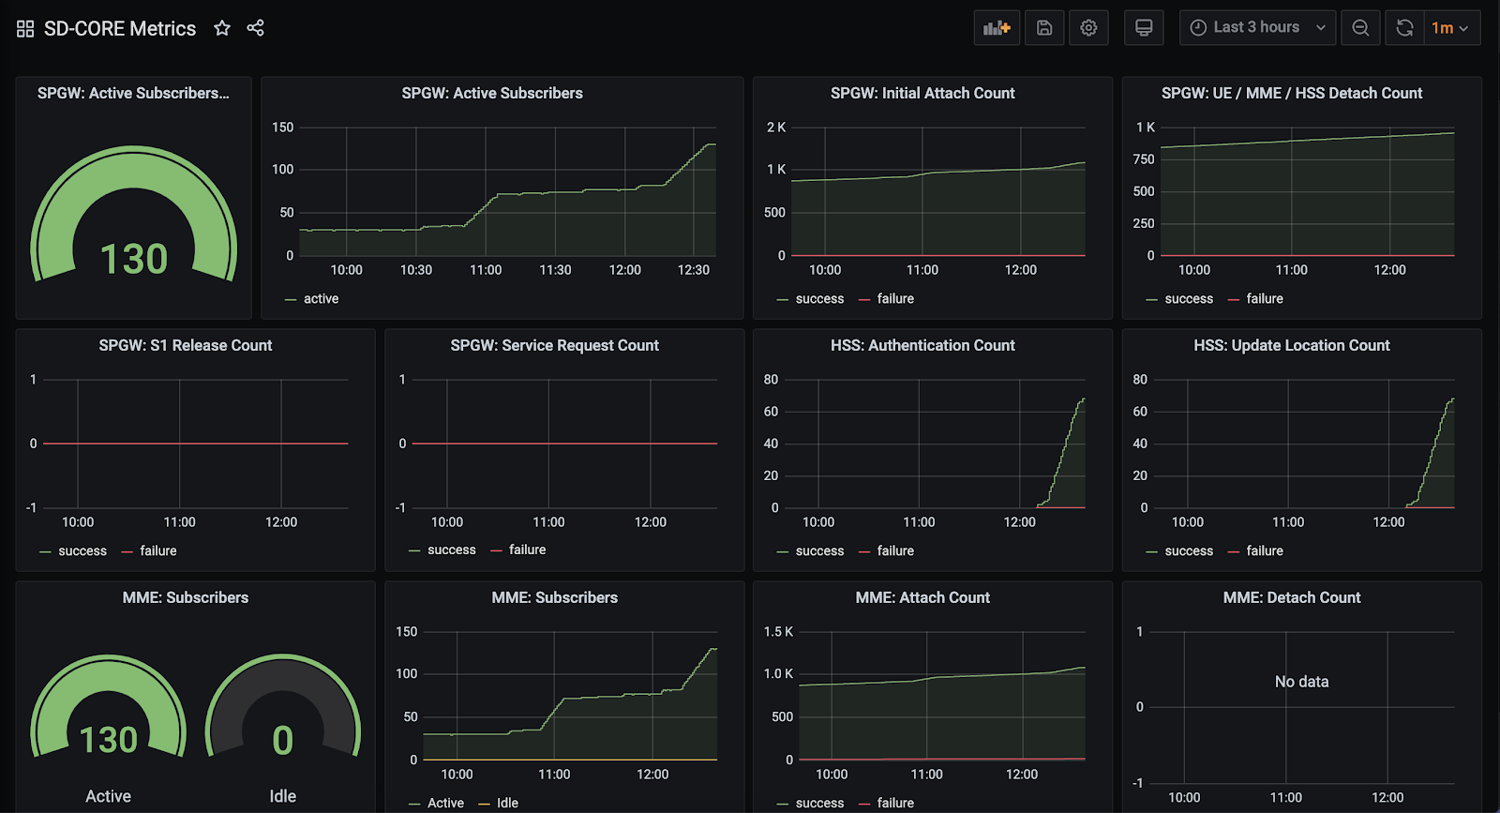

Slide 19
Infrastructure-as-Code
(Terraform)
Commercial Cloud
Provisioning API
Logical Structure
(NetBox)
Provisioning API
Physical Hardware

Slide 20
Inventory
Repo
(NetBox)
edgeconfig.py
YAML
Ansible Roles & Playbooks
(e.g. Netplan)
YAML
YAML
YAML
Mgmt
Server
Compute
Servers
Fabric
Switches

Slide 21
Infrastructure-as-Code
(Terraform)
Commercial Cloud
Provisioning API (Rancher)
Provisioning API (GCP)
Physical Cluster
Physical Cluster
…

Slide 22
Infrastructure-as-Code
(Terraform)
Configuration-as-Code
(Fleet)
Commercial Cloud
Provisioning API (Rancher)
Provisioning API (GCP)
Physical Cluster
Physical Cluster
…

Slide 23




SD-Fabric
SD-RAN
SD-Core

Slide 24
Individual Features
In Development
Set of Features
Integrated & Evaluated
Set of Features
Run in Production
Merge
Deploy
Code Review
Soak (Canary) Tests
Smoke Tests
Performance Tests
End-to-End Tests
Unit Tests
Integration Tests
Monitoring & Logging
Feature Lifetime

Slide 25
Users
Ops
REST API
Runtime Control
[Monitoring & Telemetry]
Ops
Lifecycle Mgmt
[Provisioning]
Code (Commit to Repo)
Dev

Slide 26
Service A
Network Call
Service B
Parent Span
Span Context
Child Span
Child
Log
Log
Log
Log
Child
Log
Log

Slide 27
Service Mesh Controller
Security
Policy
Telemetry
Collector
Sidecar
Sidecar
Service A
Service B

