Slide 1



…
Backbone
(Internet)
…
Notes:
View from 30,000 feet
Central Office → Edge
Smart-phones → Cyber-physical world

Slide 2
Cellular Access Network
Radio Access Network
UEs
eNB
UEs
Mobile
Core
Backbone
(Internet)
eNB
Backhaul Network
UEs
eNB

Slide 3

Base Station
Mobile Core
Control Plane
Mobile Core
User Plane

Slide 4





Base Station
Mobile Core
Control Plane
IoT
IoT App
Multimedia
Mobile Core
User Plane
Video App

Slide 5
Base Station
5QI
RAN Stack
Radio
TX/RX
CQI

Slide 6
Base Station
UE
Mobile Core Control Plane
Mobile Core User Plane

Slide 7
Base Station
UE
Mobile Core Control Plane
Mobile Core User Plane

Slide 8
Base Station
UE
Mobile Core Control Plane
Voice Traffic
Mobile Core
User Plane
Data Traffic
Notes:
Can be multiple “User Plane Tunnels” each with a different QCI and for a different application.

Slide 9
SCTP over IP
Base Station
UE
Mobile Core Control Plane
Physical Layer
Packets
Transmitted Using
Analog Modulation
Mobile Core User Plane
GTP + UDP over IP
Notes:
SCTP = Stream Control Transport Protocol → alternative to TCP
GTP = (General Packet Radio Service) Tunneling Protocol → alternative to GRE (Generic Routing Encapsulation)

Slide 10
Base Station
UE
Mobile Core Control Plane
Mobile Core User Plane

Slide 11
Base Station
UE
Mobile Core Control Plane
Mobile Core User Plane

Slide 12
(2)
Core-CP
(3b)
UE
(3c)
SCTP/IP
Base
Station
(3a)
(1)
SIM
GTP/UDP/IP
Core-UP
(4)
Secure Private Network

Slide 13
UE1
Base
Station
Core UP
UE2
Base Station to
Core-UP Tunnel(s)

Slide 14
Coding
Digital
Modulation
Pulse
Shaping
RF
Modulation

Slide 15




Notes:
MIMO – Multiple Input / Multiple Output
Wireline comparison

Slide 16
Transmitted
Received
Packet n
Packet n+1
Multipath Spread
Time
Coherence Time: T_{c}
Notes:
𝑐 = velocity of the signal
𝑣 = velocity of the receiver
𝑓 = frequency of the carrier signal.
Inversely proportional to both v and f…
Higher frequency = narrower wave = shorter coherence time
Faster receiver moving = longer coherence time.

Slide 17
Transmission Time Interval (TTI) = 1ms
PRB
PRB
12 subcarriers
= 180 kHz
Frequency
Resource Element
Δf = 15kHz
Time (Symbols)
1 OFDMA
Symbol

Slide 18
Select segments to transmit
from a set of subscriber queues
Reported CQI
(from devices)
Scheduler
Requested 5QI
(subscriber assigned)
Allocate Resource Blocks
Notes:
Scheduler is the Abstract Interface:
Two parameters: CQI, QCI

Slide 19
SCHEDULER
WIRELESS HYPERVISOR
Virtual RB to Physical RB
Mapping
Virtual RBs
Physical RBs

Slide 20
SCHEDULER
SCHEDULER
WIRELESS HYPERVISOR
Virtual RB to Physical RB
Mapping
Virtual RBs
Physical RBs

Slide 21
Base Station
Mobile Core
NSSF
PCF
NRF
NEF
UDM
UDR
UDSF
AMF
SMF
AUSF
N2
UPF
Internet
N3
User Plane
Control Plane

Slide 22
UDR
NAF
UDM
AUSF
NSSF
PCF
Nudm
Nudr
Nausf
Nnssf
Npcf
Naf
Nnrf
Namf
Nsmf
NRF
AMF
SMF
N11
N1
N4
5G Core Control Plane
5G UE
NR Uu
N2
N3
N6
UPF
Internet
gNB
S1-U
LTE Uu
4G Core Control Plane
eNB
S1-MME
S1-MME
4G UE
HSS
MME
SPGW_C
PCRF
S6a
S11
Gx

Slide 23



5G Mobile Core Control Plane
SMF
Translator
P4Runtime Client
Model
UPF
Writes
Model
UPF
Reads
Model UPF.p4
P4 Tooling
P4Runtime Server
5G Mobile Core UPF
Translator
Physical UPF.p4
Buffer Service

Slide 24
Aether Server
192.168.252.1
192.168.250.1
UPF
GTP
Tunnel
ens18
access
core
ens18
172.250.0.0/16
10.76.28.187
192.168.252.3
192.168.250.3
10.76.28.113

Slide 25
AMF
SMF
…
NRF
gNBsim container
gNBsim container
172.20.0.0/16
gnbaccess
ens18
ens18
gNBsim container
10.76.28.0/24
access
UPF
core

Slide 26
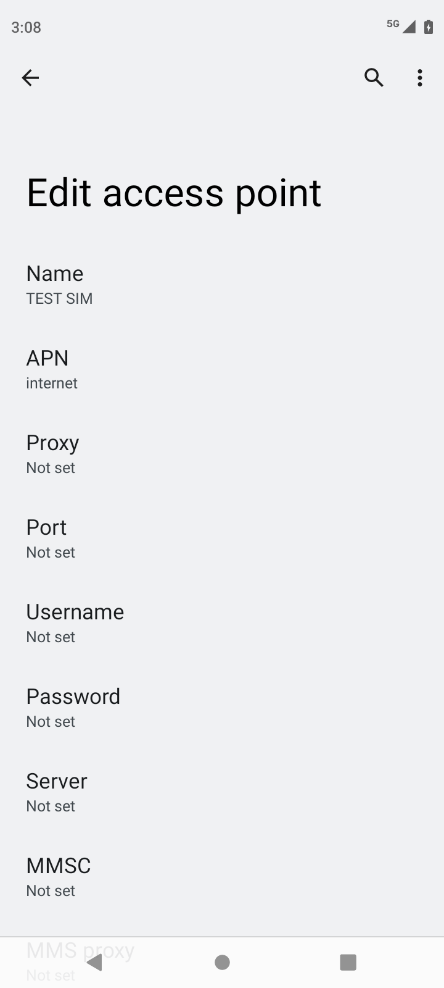
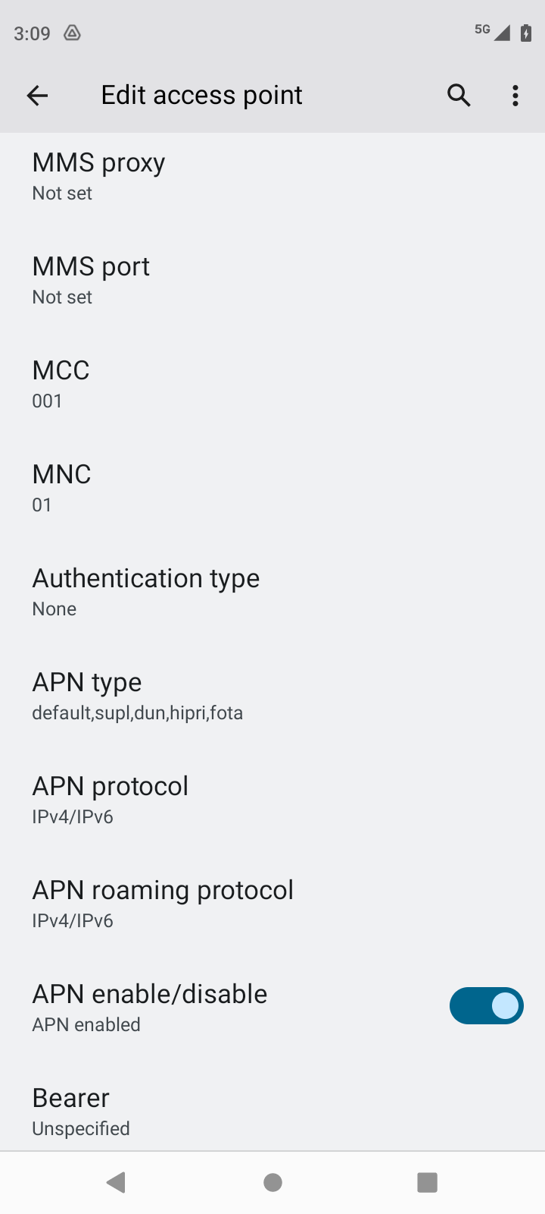

Slide 27
AMF
SMF
…
NRF
ens18
access
UPF
core
gnbaccess
gNBsim container

