Slide 1

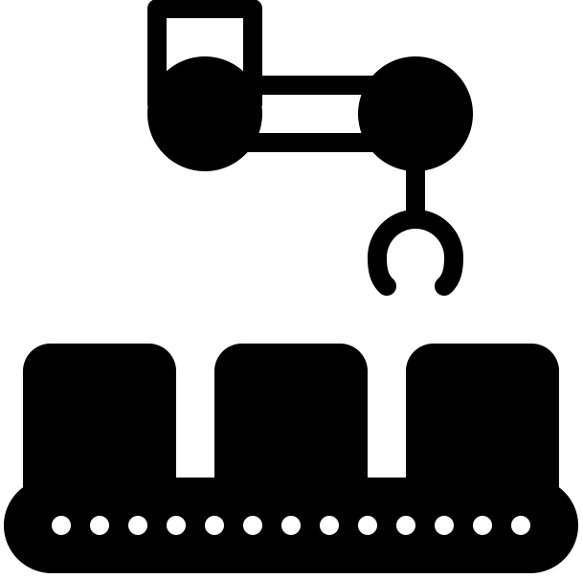

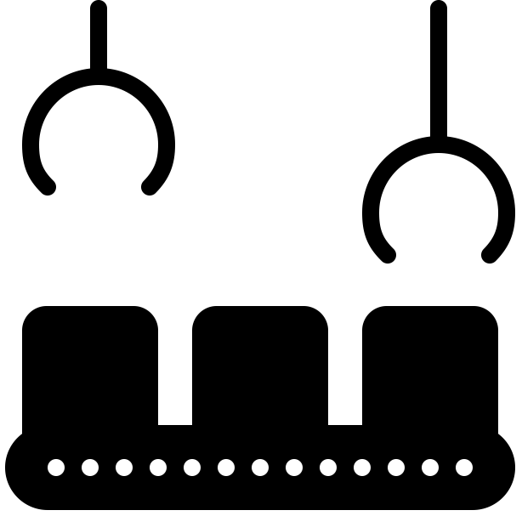



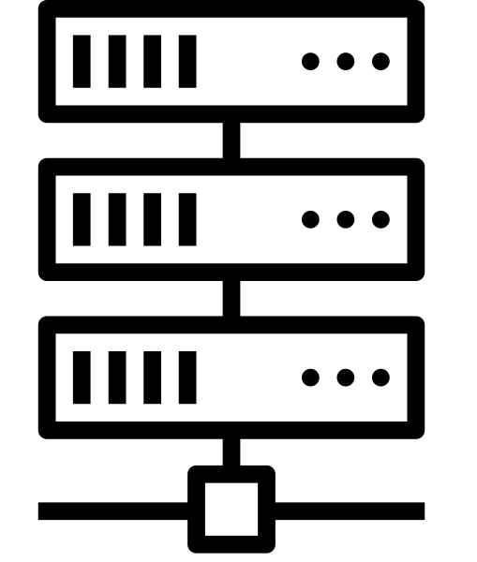




On-Prem
Off-Prem
IoT
Sensors
Small Cell
5G Data Plane
Surveillance
Central Apps
Edge Apps
Cloud Service
Console
Multimedia
Small Cell
Edge Cloud
5G Control
Plane
Employees
Central Cloud
Visitors
Small Cell

Slide 2
Human Operators
Intents
Management Layer
Actions
Deployed Network Elements
(Hardware & Software)

Slide 3
On-Prem
Off-Prem
IoT
Sensors
Small Cell
SD-RAN
SD-Core
(User Plane)
Surveillance
Central Apps
Edge Apps
Small Cell
Cloud
Management
Platform
Multimedia
Edge Cloud
SD-Core
(Control Plane)
Employees
Central Cloud
Visitors
Small Cell

Slide 4
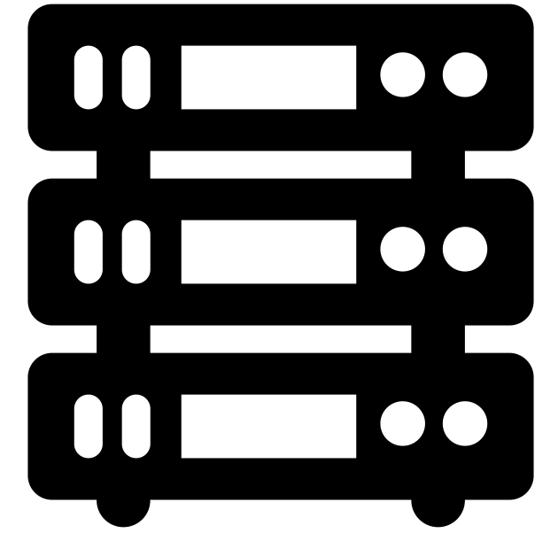

Edge Platforms/Apps
Helm
Fleet
Kubernetes
(e.g., AKS, EKS, GKE, RKE)
Terraform

Slide 5
Edge Platforms/Apps
SD-RAN
SD-Fabric
SD-Core
(UP)

Slide 6
Edge Platforms/Apps
AMP
SD-Core
(CP)
SD-Core
(CP)
SD-Core
(CP)
Multiple ACE Sites
Central Cloud

Slide 7
Edge Platforms/Apps
User Portal
Operations Portal
Aether Management Platform (AMP)
Resource
Provisioning
Lifecycle Management
Service Orchestration
Monitoring
& Telemetry
AMP
(CP)
(CP)
Central Cloud
Multiple ACE Sites

Slide 8
QA Cluster
Testing
Staging Cluster
Image
Repo
Integration
Gate
Testing
Code
Repo
Production Clusters
Testing
Build
Construct Plan
Deployment Gate
Execute
Plan
Checks
Config
Repo
Review
...
Infrastructure-as-Code
Continuous Integration
Continuous Deployment

Slide 9
Manage end-to-end connectivity on a per-device/application basis.
Service Orchestration
Control API
Data Model
K/V
gNMI
SD-RAN
SD-Fabric
SD-Core
(UP)
SD-Core
(CP)
Edge Services
Central Service

Slide 10
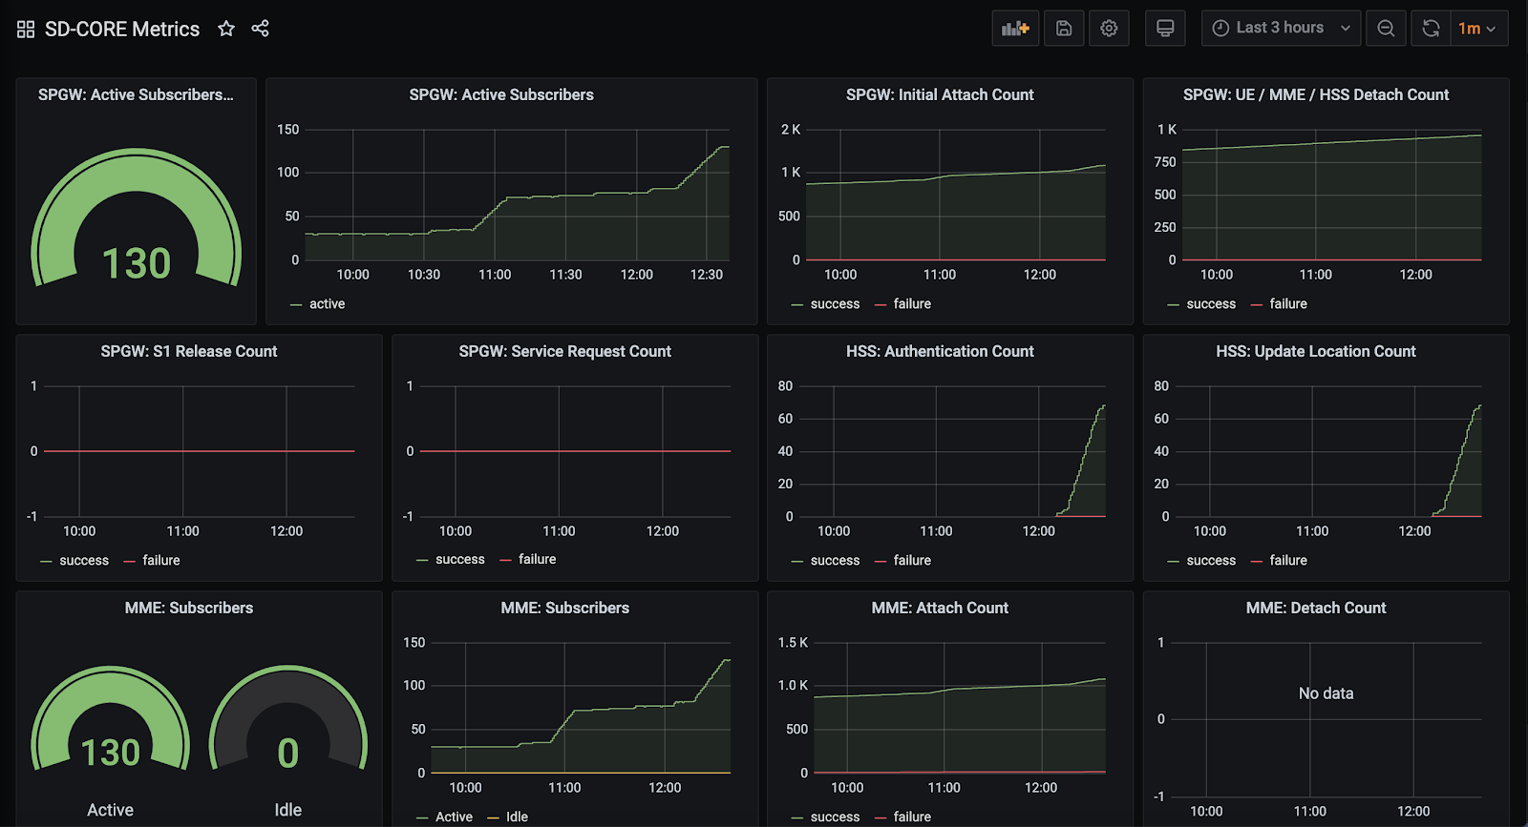

Slide 11
Users
Control
Apps
Ops
REST API
Service Orchestration
[Monitoring & Telemetry]
Ops
Lifecycle Mgmt
[Provisioning]
Code (Commit to Repo)
Dev

Slide 12
Infrastructure-as-Code
(Terraform)
Provisioning API
Bootstrap tooling to prep a cluster for Kubernetes workloads.
Commercial Cloud
Provisioning API
Physical Hardware

