Slide 1

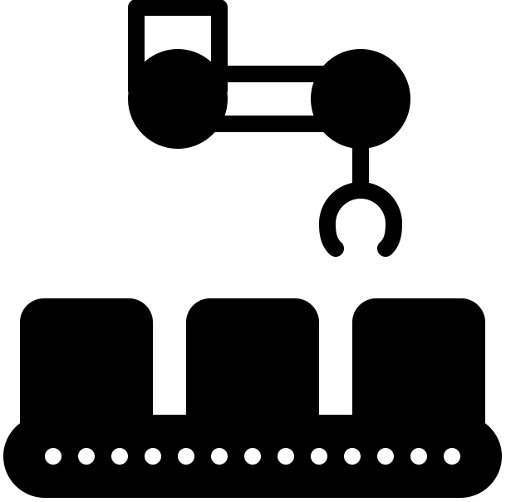

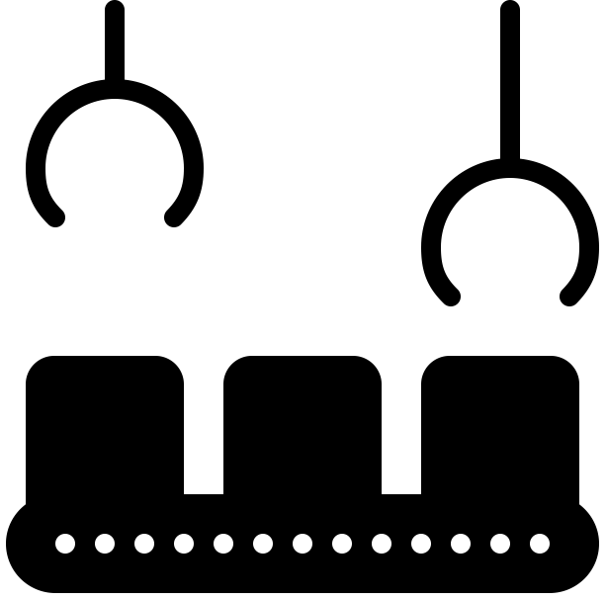



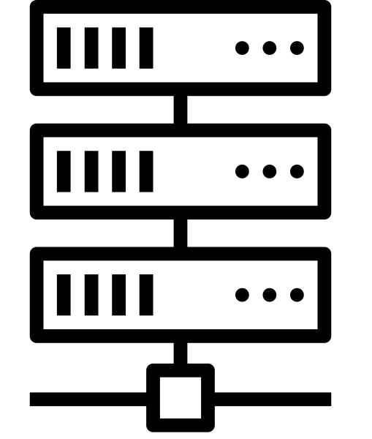




On-Prem
Off-Prem
IoT
Sensors
Small Cell
5G Data Plane
Surveillance
Central Apps
Edge Apps
Cloud Service
Console
Multimedia
Small Cell
Edge Cloud
5G Control
Plane
Employees
Central Cloud
Visitors
Small Cell

Slide 2
On-Prem
Off-Prem
IoT
Sensors
Small Cell
SD-RAN
SD-Core
(User Plane)
Surveillance
Central Apps
Edge Apps
Control and
Management
Platform
Multimedia
Small Cell
Edge Cloud
SD-Core
(Control Plane)
Employees
Central Cloud
Visitors
Small Cell

Slide 3


Edge Platforms/Apps
SD-RAN
Network OS
SD-Core
(UP)
SD-Fabric
SwitchOS
SwitchOS
SwitchOS
SwitchOS
SwitchOS
SwitchOS

Slide 4
Edge Platforms/Apps
AMP
SD-Core
(CP)
SD-Core
(CP)
SD-Core
(CP)
Multiple ACE Sites
Central Cloud

Slide 5
Edge Platforms/Apps
User Portal
Operations Portal
Aether Management Platform (AMP)
Resource
Provisioning
Lifecycle Management
Runtime Control
Monitoring
& Logging
AMP
(CP)
(CP)
Central Cloud
Multiple ACE Sites

Slide 6
Install & Inventory
(Ops Team)
Inventory
Repo
Zero-Touch
Provision (System)
Config
Repo
Operational Cloud
Used by Lifecycle Management

Slide 7
Populated by Resource Provisioning
Config
Repo
Continuous Innovation
(Dev Team)
Code
Repo
Continuous Integration (System)
Image
Repo
Continuous Deployment (System)
Operational Cloud

Slide 8
Manage end-to-end connectivity on a per-device/application basis.
Runtime Control
Control API
SD-RAN
Network OS
SD-Core
(UP)
SD-Core
(CP)
SD-Fabric
Edge Services
Central Service

Slide 9
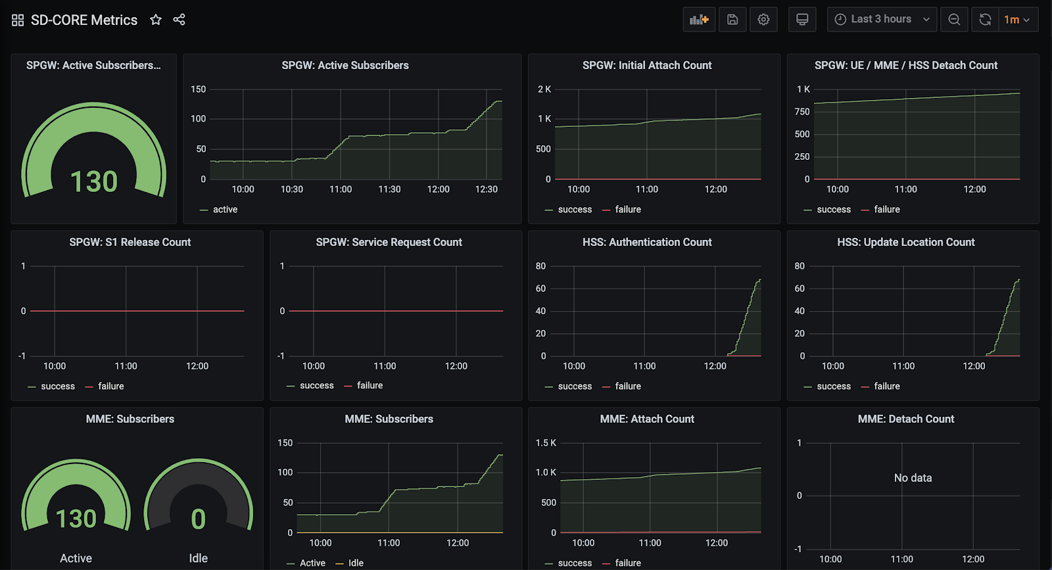

Slide 10
Human Operators
Intents
Management Layer
Actions
Deployed Network Elements
(Hardware & Software)

