Slide 1
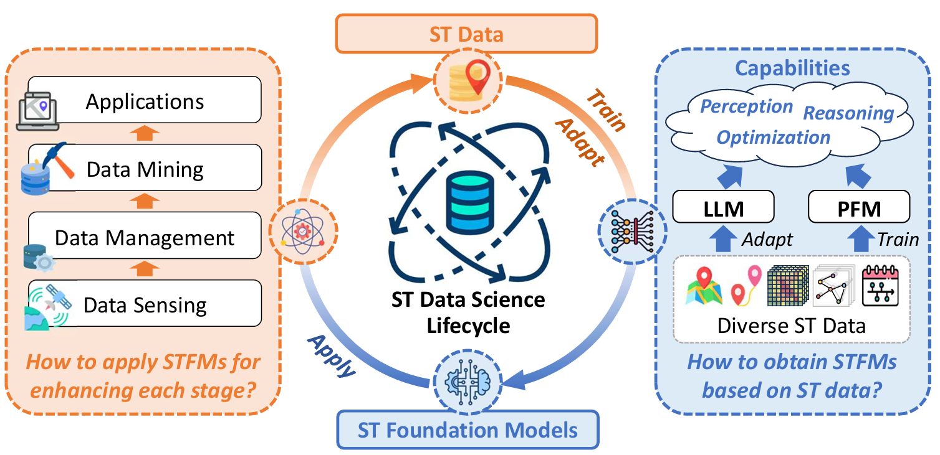




Foundation Models for Spatio-Temporal Data Science: A Tutorial and Survey

