Slide 1
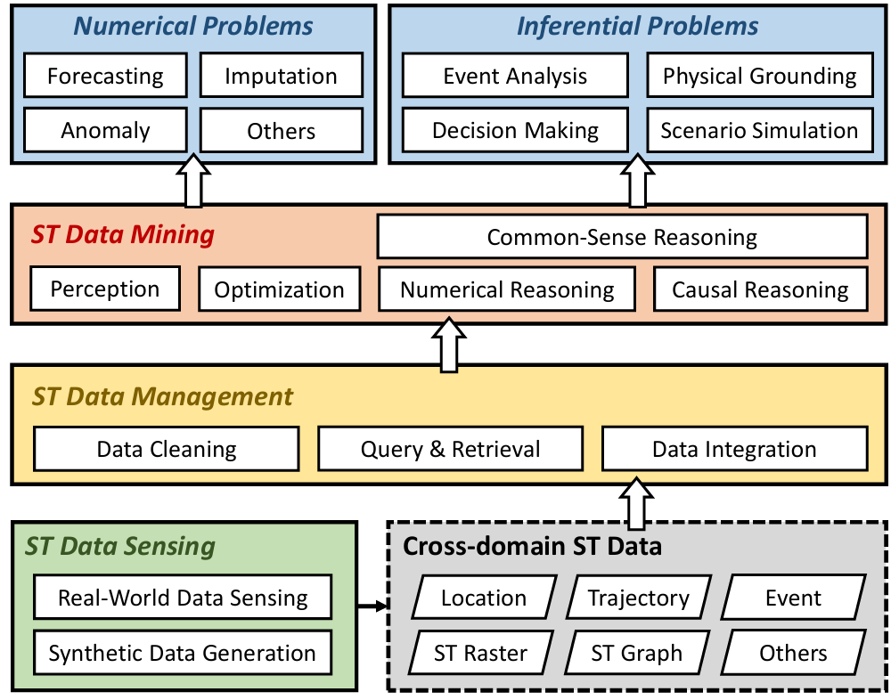
Foundation Models for Spatio-Temporal Data Science: A Tutorial and Survey

