Slide 1
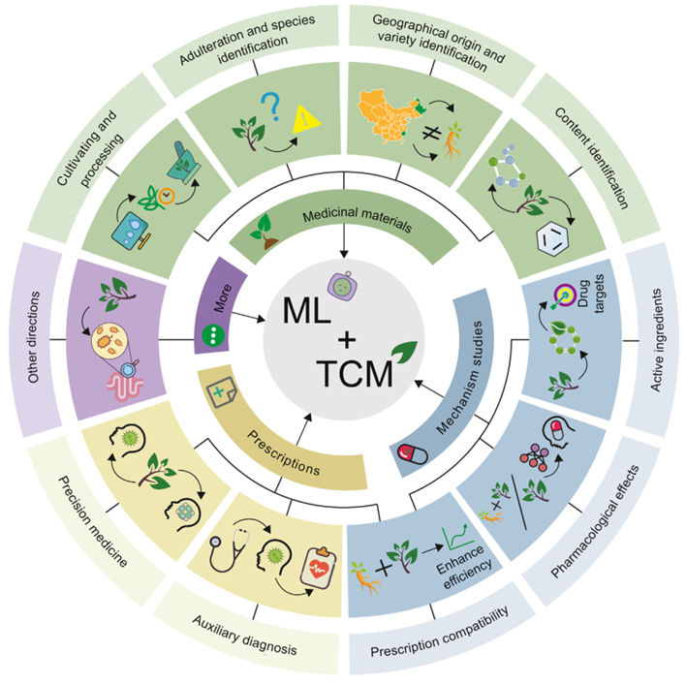
The integration of machine learning into traditional Chinese medicine

