Slide 1
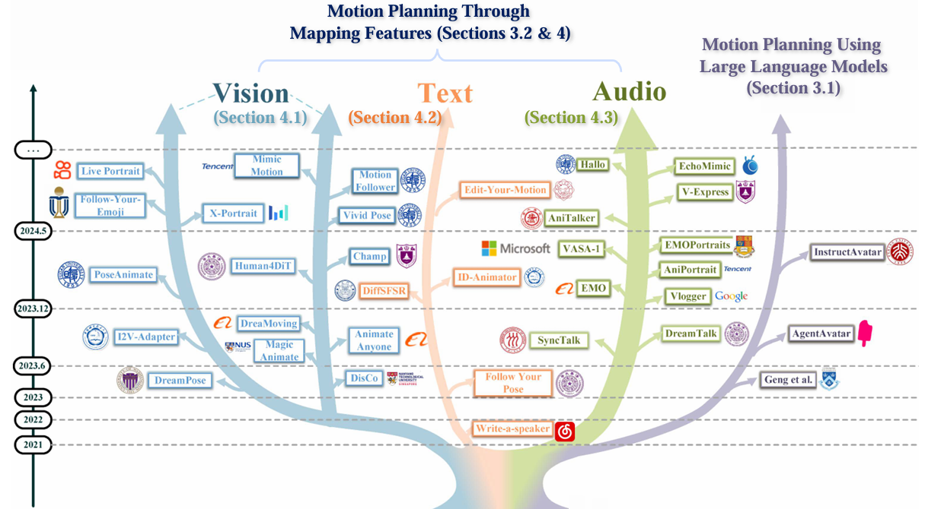
Human Motion Video Generation: A Survey

