Slide 1
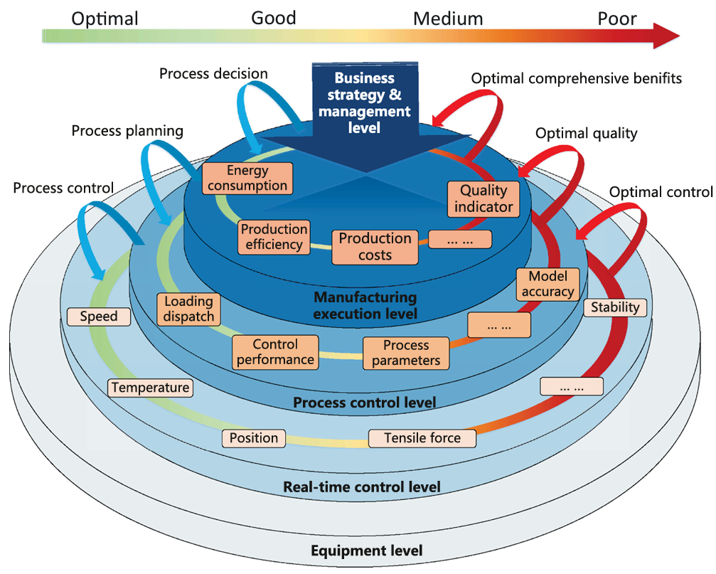
Performance-driven closed-loop optimization and control for smart manufacturing processes in the cloud-edge-device collaborative architecture: A review and new perspectives

