Slide 1
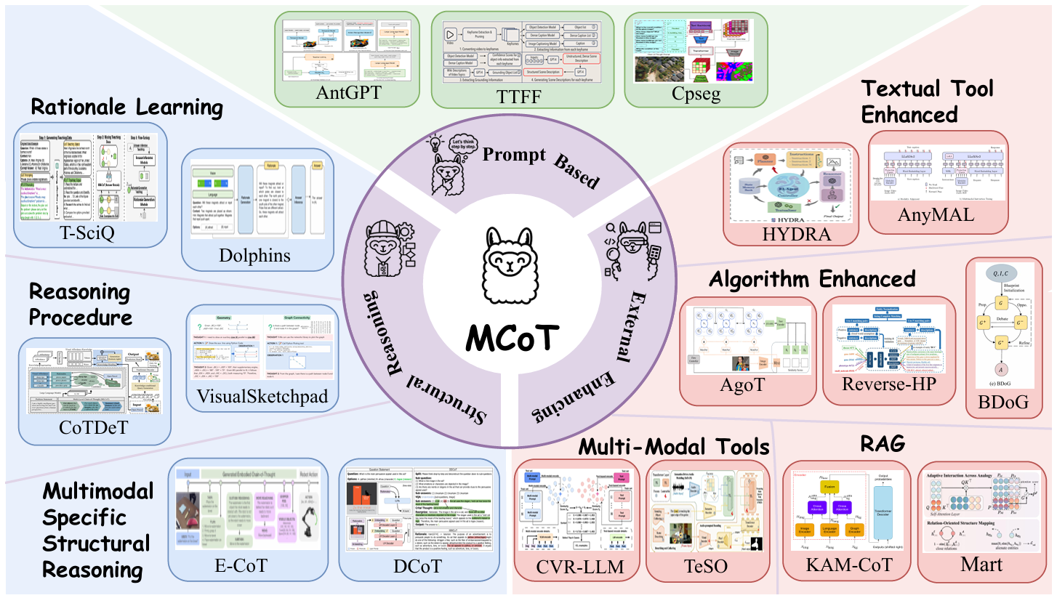
Perception, Reason, Think, and Plan: ASurvey on Large Multimodal Reasoning Models

