Slide 1
Blockchain-based self-sovereign identity in healthcare
Sytse Oegema
Fatih Turkmen & Mohammed Alghazwi

Slide 2
Self-sovereign identity
Existence
Control
Access
Transparency
Persistence
Portability
Interoperability
Consent
Minimalization
Protection
Source: Allen C. (2016) “The Path to Self-Sovereign Identity”.

Slide 3

Blockchain-based Self-sovereign identity
Existence
Control
Access
Transparency
Persistence
Portability
Interoperability
Consent
Minimalization
Protection
Source: Quinten Stokkink and Johan Pouwelse. (2018). "Deployment of a Blockchain-Based Self-Sovereign Identity".

Slide 4

Problem definition
Electronic Health Records

Slide 5
Existing solutions
Covered | Not (explicitly) Covered
Basics | Partial data sharing
- user-control | Personal Annotations
data sharing | Emergency Access
- storage | …

Slide 6
Emergency Access
Situations where the patient is in desperate need of medical attention
but is unable to consent to the use of its private medical data

Slide 7
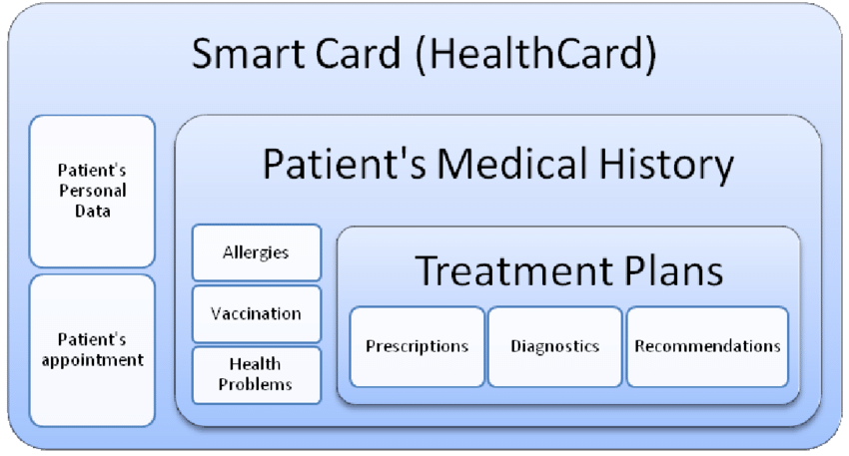
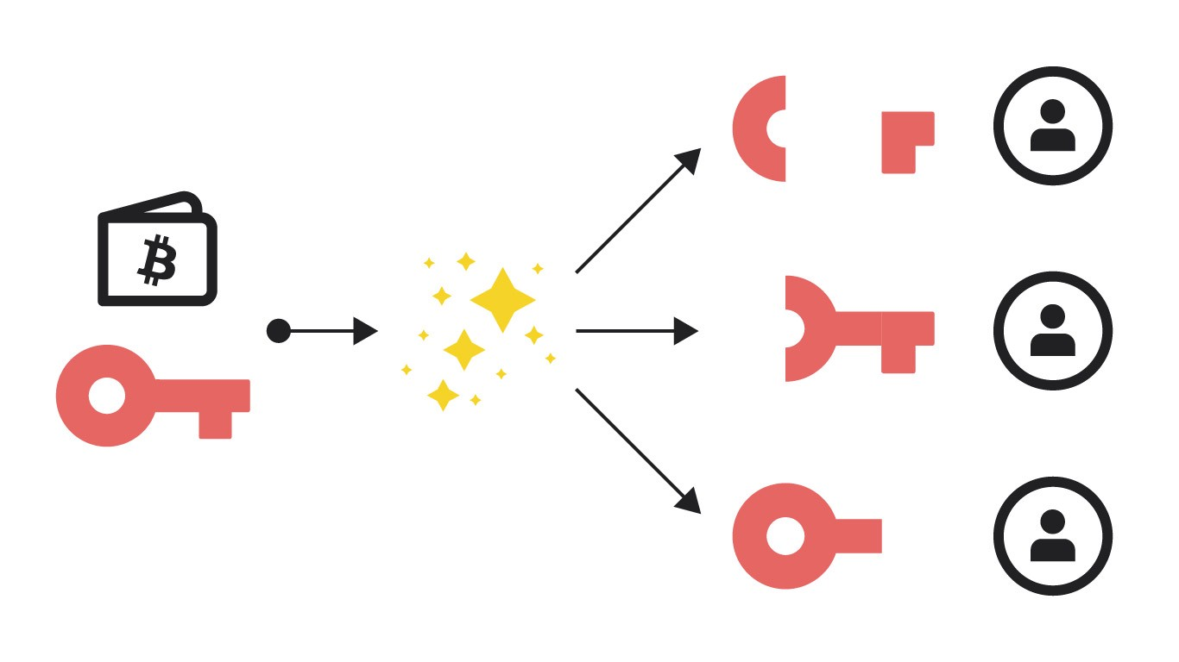
Emergency access
Offline
Online
Source: Adi Shamir. (1979) "How to Share a Secret".

Slide 8

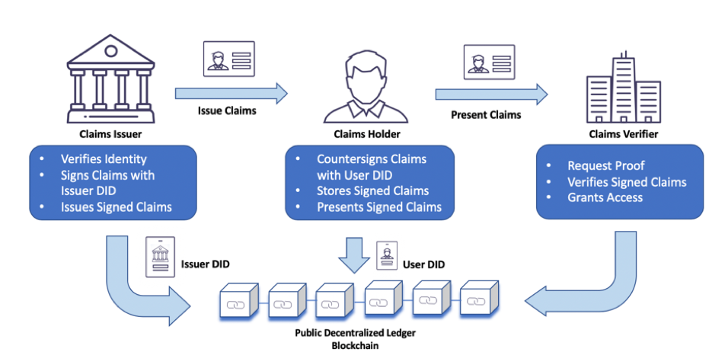
implementation

Slide 9

Stakeholders
Government Instance
Patient
Doctor
Trusted Party

Slide 10
schemas
Name | Attributes
Electronic Health Records | importance_ level | issuer | data_value | data_type
Shared Secrets | secret_owner | secret_issuer | secret
Emergency Trusted Parties | secret_owner | secret_issuer | secret_min | secret_total
Doctor Certificate | is_emergency_doctor | name | school
Created by the Government Instance

Slide 11
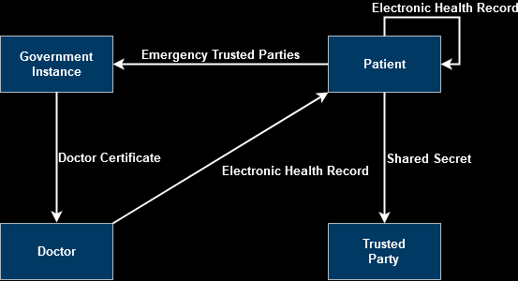
Credential flow

Slide 12
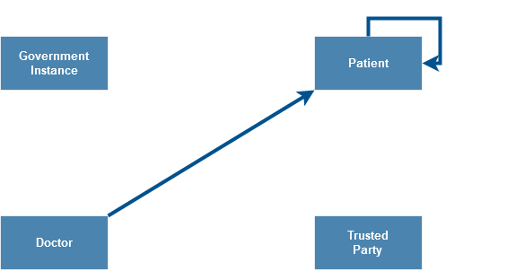
Creation of Personal annotations

Slide 13
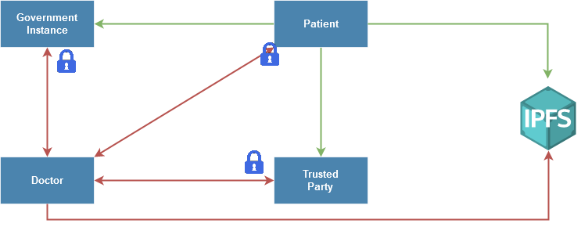
Emergency access protocols

Slide 14
Emergency Doctor proof
"predicate1_referent": {
"name":"is_emergency_doctor", "p_type":">=", "p_value":1, "restrictions": [
{
"cred_def_id":"NcZ4tw9KDDGnCWpGShk9n5:3:CL:NcZ4tw9KDDGnCWpGShk9n5:2:Doctor-Certificate:1.0.0:TAG1“
}
]
}

Slide 15
Results
Existence
Control
Access
Transparency
Persistence
Portability
Interoperability
Consent
Minimalization
Protection

Slide 16

Live demo
C# cli application
Hyperledger Indy, IPFS

Slide 17
sources
Allen C. (2016). The Path to Self-Sovereign Identity". In: Life With Alacrity.
Quinten Stokkink and Johan Pouwelse. (2018). "Deployment of a Blockchain-Based Self-Sovereign Identity". In: 2018 IEEE International Conference on Internet of Things(iThings) and IEEE Green Computing and Communications (GreenCom) and IEEE Cyber, Physical and Social Computing (CPSCom) and IEEE Smart Data (SmartData).
Cataño, Néstor. (2020). "A JML-Based Strategy for Incorporating Formal Specifications into the Software Development Process Advisor".
Asaph Azaria et al. (2016). MedRec: Using Blockchain for Medical Data Access and Permission Management". In: 2016 2nd International Conference on Open and Big Data (OBD).
Qi Xia et al. (2017). BBDS: Blockchain-Based Data Sharing for Electronic Medical Records in Cloud Environments". In: Information v8 n2 (20170417): 44.
Tingting Chen and Sheng Zhong. (2012). Emergency Access Authorization for Personally Controlled Online Health Care Data". In: Journal of Medical Systems 36, 291-300 (2012).
Adi Shamir. (1979) "How to Share a Secret". In: Communications of the ACM Volume 22 Number 11 (1979). url: https : / / cs . jhu . edu / ~sdoshi / crypto / papers /shamirturing.pdf (visited on 06/26/2020).
Suveen Angraal, Harlan M. Krumholz, and Wade L. Schulz. (2017). "Blockchain Technology Applications in Health Care". In: Circ. Cardiovasc. Qual. Outcomes 2017, 10, e003800.

Slide 18
Image sources
https://news.bitcoin.com/gem-health-blockchain-medical-mgmt/
https://www.stratech.nl/phpthumbsup/sx/0/sy/0/sw/1280/sh/935/w/633/src/uploads/Logistiek-en-industrie/Nieuws/Blockchain.jpg
https://www.innovationnewsnetwork.com/wp-content/uploads/2020/04/%C2%A9-iStock-elenabs-1-696x392.jpg
https://www.researchgate.net/figure/Proposed-information-held-on-a-smart-card-for-medical-appointment-management_fig4_265080623
https://miro.medium.com/max/2732/1*aF_ME8NUbOmPLTL04zqQNA.jpeg
https://www.idaptive.com/sites/default/files/inline-images/Rajesh%20Self%20Sovereign%20image1.png
https://upload.wikimedia.org/wikipedia/commons/1/18/Ipfs-logo-1024-ice-text.png

