Slide 1

Machine Learning Reading Group (MLRG)
Read Deeply. Think Critically. Share Clearly.

Slide 2

Why ML Reading Group?
The pace of ML research is rapid; papers are the primary knowledge medium
Reading groups provide structure, accountability, and collaborative learning
Our aim: help you sharpen your technical reading and communication skills

Slide 3
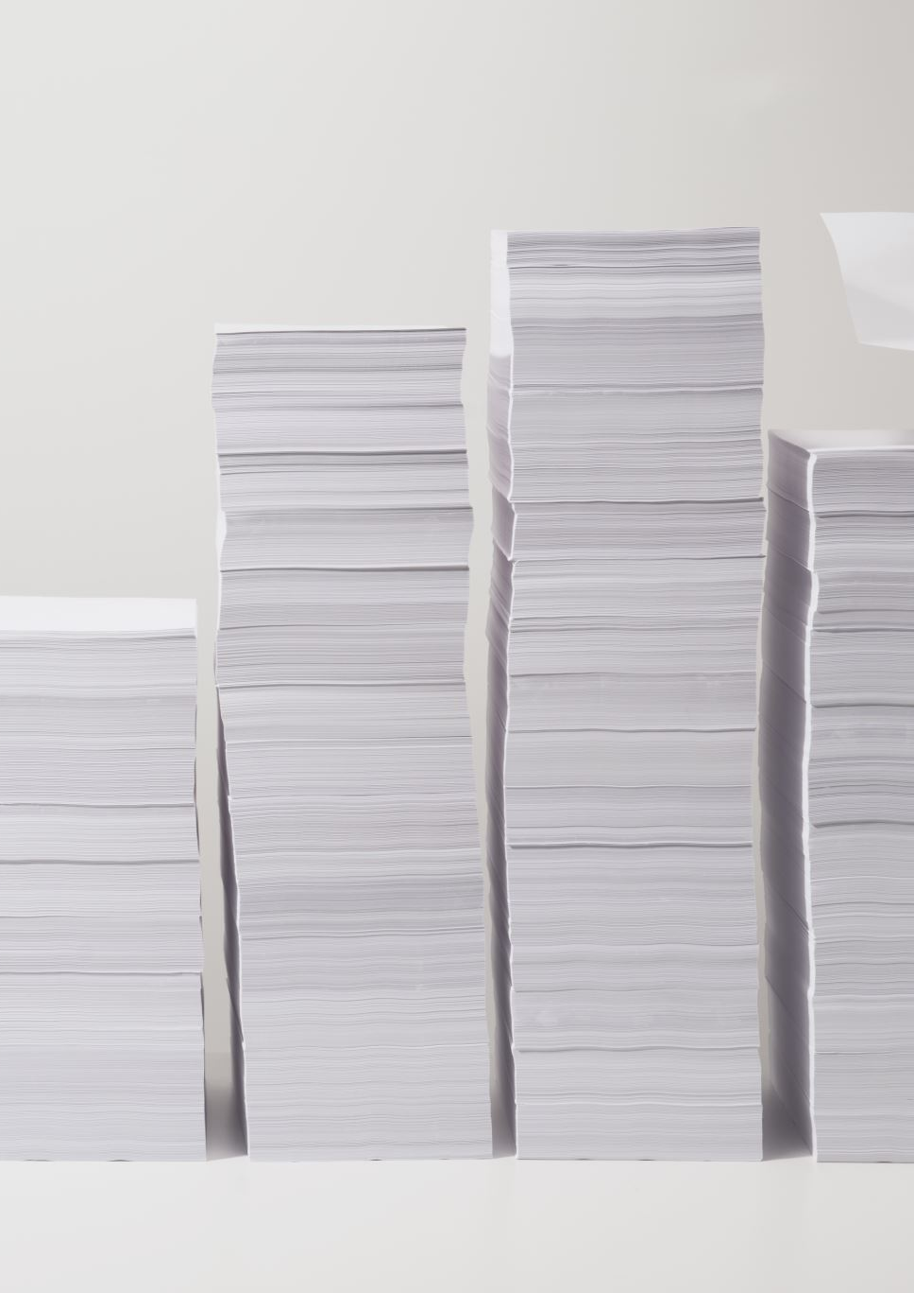
The Challenge of Reading ML Papers
ML papers are dense, mathematical, and full of implicit assumptions
Skimming
Exposes you to a breadth of research topics, narrative, methods, and ideas, BUT
Can lead to misunderstanding and pseudo-expertise
Deep and deliberate reading
Improves genuine understand and facilitates critical thinking and critiquing, BUT
It takes a lot of time and may require tangential reading to fully understand
This group encourages both strategic deep reading and skimming

Slide 4
Why This Matters for You
Academic and Research Advantages
Enhanced comprehension of advanced research papers. Better preparation for peer review and research design.
Professional and Communication Benefits
Sharpened presentation and teaching abilities. Increased confidence in articulating complex technical ideas.
Community and Intellectual Growth
Cultivates a scholarly atmosphere of support, curiosity, and mastery-oriented growth.

Slide 5
Core Pillars of MLRG
Depth and Breadth
Unpack the full logic, methods, and assumptions of a few papers
Become familiar with a range of other papers
Critical Thinking
Big picture thinking: strengths and weaknesses, rigor, reproducibility, relevance
Communication and Citizenship
Constructive participation from all members
Consistency and Co-Learning
Regular engagement and discourse about the literature builds momentum
We are all learners and teachers. Learn and share with each other
Valuing diverse perspectives and applications of ML research
Active discussion and critiquing

Slide 6
Pillar 1: Depth and Breadth
Unpack the full logic, methods, and assumptions of a few papers
Become familiar with a range of other papers

Slide 7

Pillar 2: Critical Thinking
Intellectual merits and broader impacts
strengths and weaknesses, rigor, reproducibility, relevance
Active discussion and critiquing

Slide 8

Pillar 3: Communication and Citizenship
Constructive participation from all members
Valuing diverse perspectives and applications of ML research

Slide 9
Pillar 4: Consistency and Co-Learning
Regular engagement and discourse about the literature builds momentum
We are all learners and teachers. Learn and share with each other

Slide 10
MLRG Format
Deep reading, presentation, and discussion for a few papers
Skimming many papers

Slide 11
MLRG Format
Each week, one paper is selected for deep reading
One student presents the paper live during meetings (30-40min. presentation, 15-20min. discussion)
One student prepares critiques and questions about the paper to ask the presenter
Outside members are welcome to participate in either or both ways
Each week, all MLRG participants survey papers
Select five papers to skim (or three papers for students with course work or TA duties)
For each paper, log a brief summary, strengths, weaknesses

Slide 12
Expectations
Presentations
Students past quals may sign up for two presentations.
Early PhD students with courses and/or TA assignments sign up for one presentation
Critiques
Everyone signs up for at least one critique role
Students past quals sign up for more as needed
Presenters pick the paper and share one week in advance!

Slide 13
Presentation and Discussion Format (Deep Reading)
The presenter should cover:
High-level motivation and context
A selection of relevant prior work (no need to cover all of them)
Detailed explanation of the methods and mathematical mechanisms
Walkthrough and full explanation of all major figures
Results, Discussion, and Implications
Your personal reflection: strengths, weaknesses, clarity, novelty
Future work, critiques, and open questions
The critique should:
Analyze the paper carefully
Prepare probing and constructive questions or critiques
Ask the questions after the presentation and engage in a mini-debate with the presenter (the presenter must defend the paper or acknowledge weaknesses)

Slide 14
Surveying the Literature (Skimming)
Skimming
Read the title, abstract, and discussion/conclusion sections
Examine each figure, read captions
Spot-read as needed to get a gist of the paper
Documenting
Write a brief overview of the paper and its goals, then write your opinion about strengths and weaknesses
Include a reference to the paper (Google Scholar makes this easy)

Slide 15
Understanding Research is a Marathon, not a Race
Building deep knowledge of ML takes consistent and concerted effort
We move faster and better together
We succeed when everyone contributes
Everyone is welcome!
Read deeply. Think critically. Share Clearly.

Slide 16
Logistics and Next Steps
Microsoft Teams Onboarding
Sign-ups

Slide 17
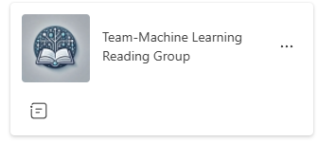
Microsoft Teams
We use Microsoft Teams for communication
ALL presentation, critiques, and personal reading (skimming) is stored there
Presentations occur in person, but remote is allowed as a contingency

Slide 18

Spring 2026 Scheduling
Does Tuesday 4:30-5:30 work?

