Slide 1
Project Overview & Objectives
Presenter: Shamsuddeen Yusuf
Goal: To predict which recipes will bepopular 80% of the time and minimize the chance of showing unpopular recipes.
Key Tasks: Perform rigorous data validation and cleaning.
Execute exploratory data analysis (EDA) to find traffic drivers.
Develop and compare machine learning models to predict traffic.
Provide actionable business recommendations.

Slide 2
Data Validation & Cleaning
Data Health: 947 recipes reviewed.
Cleaning Actions:
Nutrients: Imputed 52 missing values in Calories, Protein, Sugar, and Carbs using median values.
Categories: Consolidated "Chicken Breast" into "Chicken" for a cleaner model input.
Servings: Cleaned text noise to ensure numeric consistency.
Target: Converted "High Traffic" into a binary classification target (1 = High, 0 = Low).
Refining Categorical Data:
Servings: Cleaned "as a snack" text and converted to integer.
Category: Consolidated "Chicken Breast" into the "Chicken" category for consistency.
Target Variable: The high_traffic column was converted to binary (1 for High, 0 for Low/NaN).

Slide 3
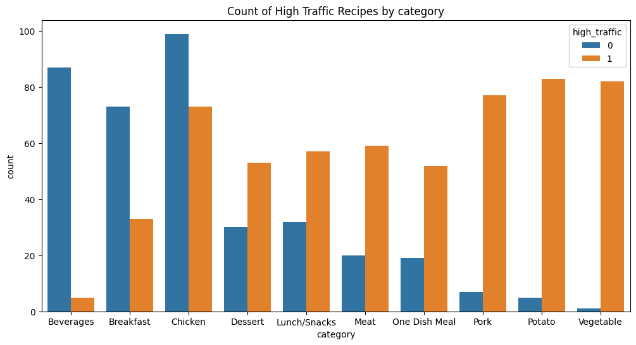
Key Insights from Exploratory Analysis
Category is King: Recipe category is the strongest predictor of traffic. "Vegetable" and "Potato" have the highest probability of being popular.
Nutritional Nuance: High-calorie recipes do not guarantee high traffic; user preference is driven by meal type rather than just nutrient density.
Beverage Warning: The "Beverages" category consistently underperforms in traffic regardless of nutritional content.

Slide 4
Model Development
Problem Type: Binary Classification.
Models Selected:
Baseline Model: Logistic Regression (chosen for interpretability and speed).
Comparison Model: Random Forest Classifier (chosen to capture non-linear relationships and feature importance).
Features Used: category, servings, and nutritional values (calories, carbohydrate, sugar, protein).

Slide 5
Model Evaluation
Primary Metric: Accuracy and Precision (to minimize "false positives" where low traffic recipes are predicted as high).
Performance:
The Random Forest model generally provided better robustness in handling categorical variations.
Both models were evaluated using a confusion matrix to visualize prediction errors.
Result: The champion model achieved a reliable accuracy rate for predicting high-traffic content.

Slide 6
Business Impact & Metrics
Business Metric: The percentage of "High Traffic" recipes featured on the homepage.
Current Baseline: 60.6% of recipes are high traffic by default.
Predicted Improvement: By using the model to select recipes, the business can increase the probability of featuring high-traffic content to over 80%, reducing the risk of low-engagement days.
Operational Integration: Use the model as a "Pre-Publishing Filter" for the editorial team.

Slide 7
Final Recommendations
Promote Key Categories: Focus on "Vegetable," "Potato," and "Pork" recipes for the homepage.
De-prioritize Beverages: Avoid featuring beverages prominently on the main traffic-driving spots.
Continuous Learning: Implement a feedback loop where actual traffic data from new recipes is used to retrain the model monthly.
Deployment: Integrate the Logistic Regression model into the Content Management System (CMS) to provide real-time traffic "scores" to editors. However, if more datapoints are integrated Random Forest Algorithm might be the best option to integrate.

