Slide 1
Strategic Analysis of Subscriber Churn
Identifying Drivers and Retention Opportunities for Q3
Shamsuddeen Yusuf
Data Analyst
Company: Fit.ly Tech

Slide 2
Project Overview & Business Goals
The Problem: Churn has increased over the last two quarters.
The Cost: Customer acquisition costs (CAC) are rising; losing existing users increases financial pressure.
Goal: Identify why users leave and provide evidence-based actions to stabilize the subscriber base.

Slide 3
Data Quality & Validation
The Process: Consolidated data from Account, Support, and Activity systems.
Validation Steps:
  Unified 400 unique customer records.
  Standardized churn status (Missing = Active; "Y" = Churned).
  Cleaned Customer Support "Unknown" channels and verified Pacific Time timestamps.
  Handled system downtimes in Activity logs as noted by Engineering.

Slide 4
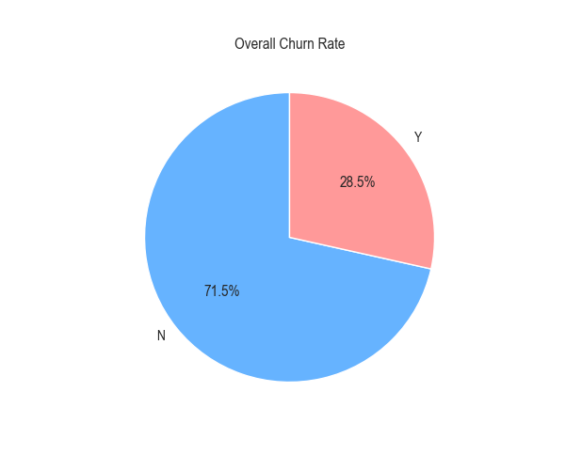
Current State of Churn
Key Insight: Nearly 1 in 3 users are leaving the platform, representing a significant revenue leak.

Slide 5
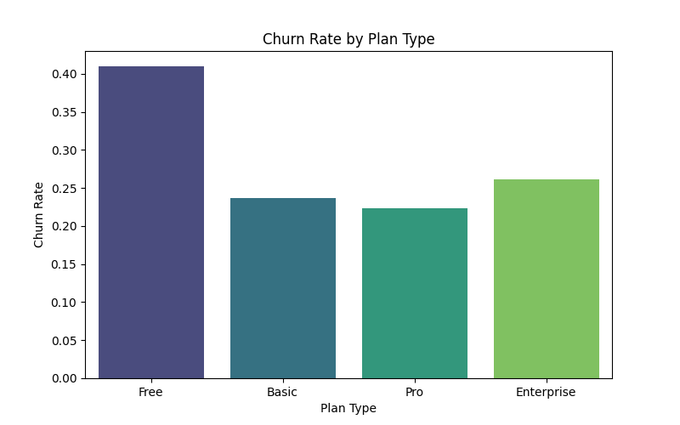
Subscription Tier Impact
Key Insight: The Free Tier (41% churn) is the most volatile. The Pro Tier (22% churn) is our most stable segment.

Slide 6
Support & Technical Drivers
Findings:
  Support volume is roughly equal for both groups (~2.3 tickets).
  Churn is not primarily driven by "bad" support; it is driven by a lack of perceived value in the app.
  GDPR "Right to be Forgotten" requests are present in support logs and require manual compliance tracking.

Slide 7
Proposed Metric: Active Engagement Rate (AER)
The KPI: Average number of app activities per user, per month.
Why AER? It is a leading indicator. We can see a user "stopping" their workouts weeks before they actually hit the cancel button.
Current Baseline:
  Health Target: > 1.4 activities/month.
  At-Risk Threshold: < 0.5 activities/month

Slide 8
Strategic Recommendations
1. Automated Re-engagement: Trigger "We Miss You" notifications for users whose AER drops below 0.5.
2. Pro-Tier Incentives: Offer Free/Basic users a trial of Pro features once they complete 3 workouts to increase "stickiness."
3. Engineering Alignment: Improve activity logging reliability to ensure churn data isn't skewed by server downtime.
4. Compliance: Automate the "Right to be Forgotten" support workflow.

