Slide 1
Rank the whole class and calculate the corresponding grade

Slide 2
Program introduction
Rank the scores of 30 students in the class and count their grades.
Count the number of people at all levels
Grade A accounts for 25% of the class, and the score is above 90.
Grade B accounts for 50% of the class, and the score is above 80.
The rest of the students are Grade C.

Slide 3
Program Design and Implementation
Algorithm flow:
(1) Copy the scores of all 30 students to the memory address pointed by RESULT;
(2) Output students' scores in descending order by bubble sorting. The sorting results are stored in x4000 to x401E;
(3) Calculate the number of people at A and B levels and save them to the corresponding addresses of x4100 and x4101.

Slide 4
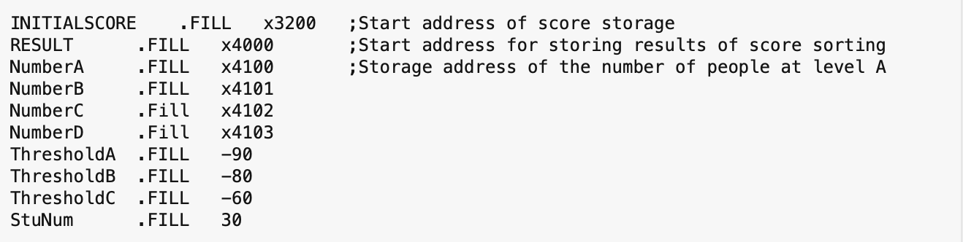
Program Design and Implementation
Important addresses and constants are denoted as follows:

Slide 5
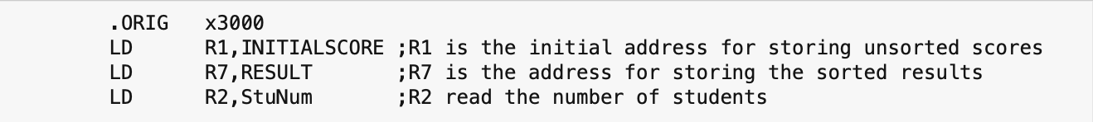
Program Design and Implementation
Program implementation:

Slide 6
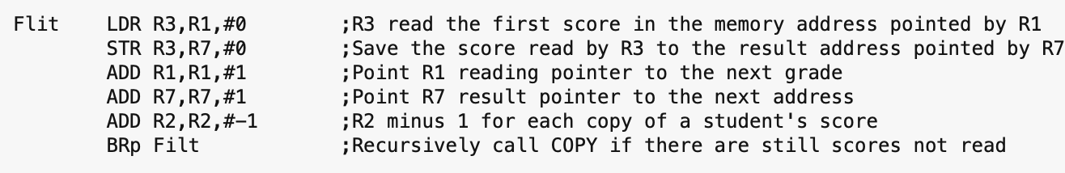
Program Design and Implementation
Storage of achievements:
Store the first address x3200 of the score with the label SCORE, and record 30 scores with files at the starting position: ORIG x3200. The continuous recursion of Filt is used to copy the scores.

Slide 7
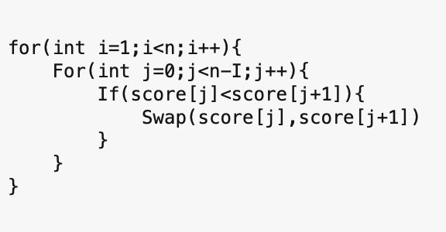
Program Design and Implementation
Bubble sort:
Bubble sorting is to start from the first element in the sequence and compare two adjacent elements in turn. If the previous element is larger than the next element, exchange their positions.
If the previous element is less than or equal to the next element, they will not be exchanged; This comparison and exchange continues until the last element that has not been ordered.

Slide 8
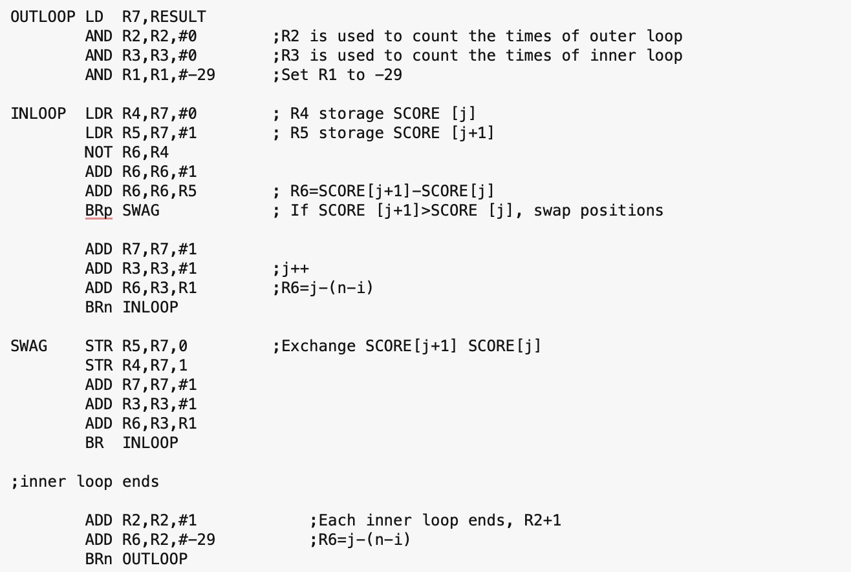
Program Design and Implementation
Bubble sort:

Slide 9
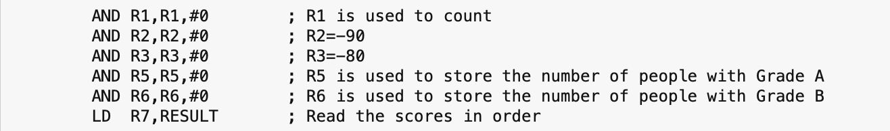
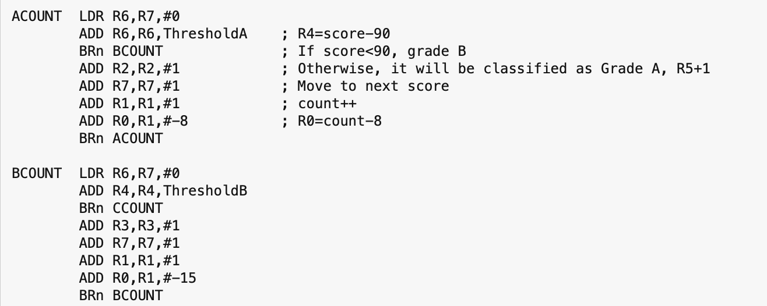
Program Design and Implementation
Gradation:

Slide 10
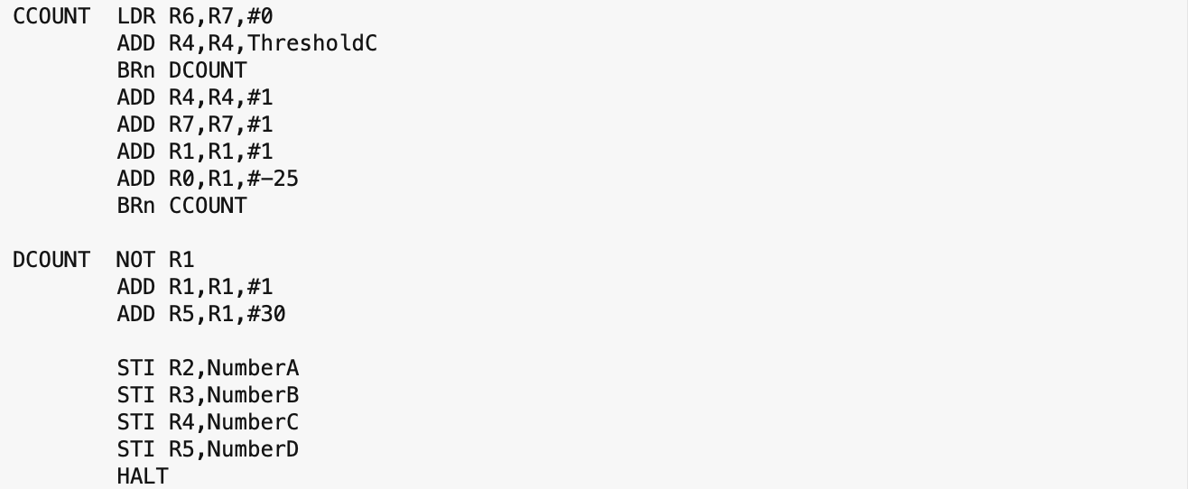
Program Design and Implementation
Gradation:

Slide 11
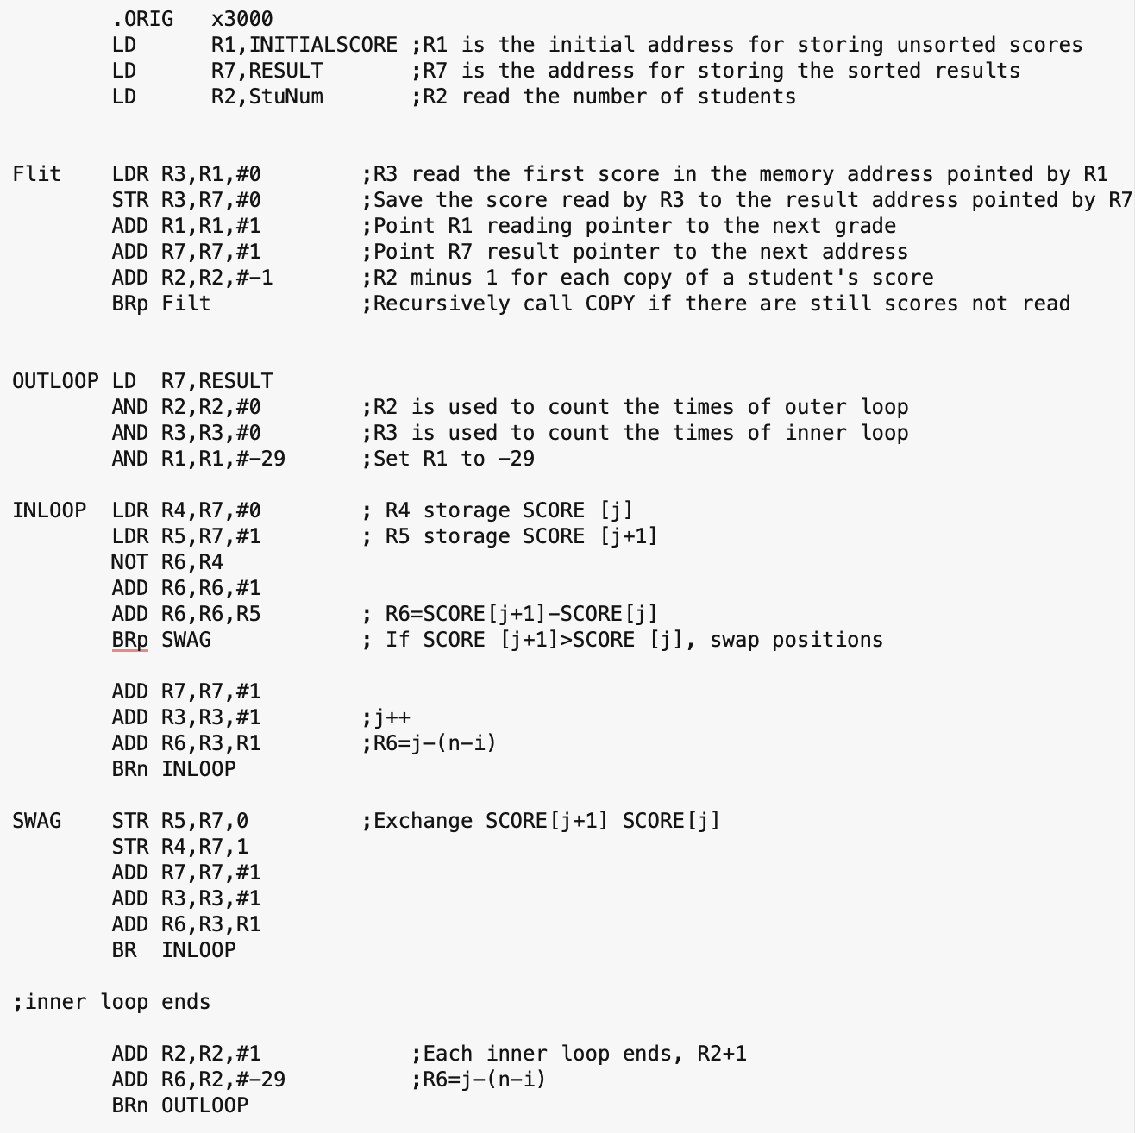
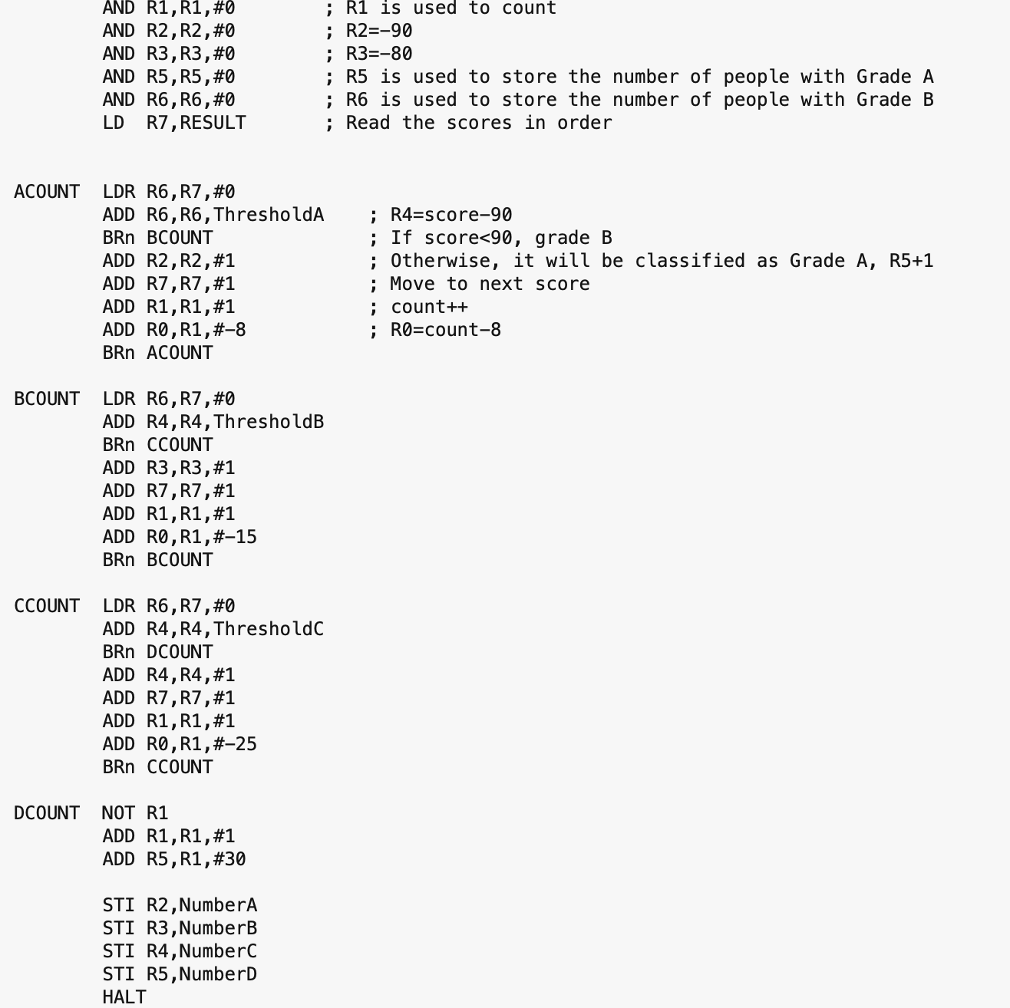
Appendix:

