Slide 1
Distributed System (BESE-VII) POKHARA UNIVERSITY
Compiled by
Er. Madan Kadariya
Assistant Professor
HOD, Department of Information Technology Engineering
Nepal College of Information Technology
Balkumari, Lalitpur

Slide 2
Chapter 6: Transaction and Concurrency Control
References:
G. Coulouris, J. Dollimore and T. Kindberg; Distributed Systems Concepts and Design,4th Edition.
Andrew S. Tanenbaum and Maarten van Steen; Distributed Systems: Principles and Paradigms, 2nd Edition.

Slide 3
Outline
6.1. Distributed transactions
6.1.1. Flat and nested transactions
6.1.2. Concurrency control mechanisms
6.1.2.1. Locks
6.1.2.2. Optimistic concurrency control
6.1.2.3. Timestamp ordering
6.1.3. Distributed deadlocks
6.1.4. Atomic commit protocols

Slide 4
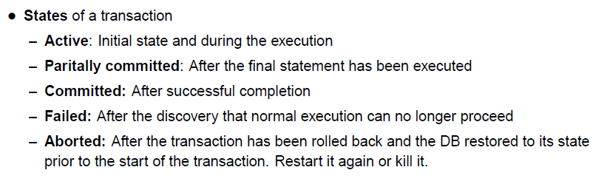
TRANSACTION & NESTED TRANSACTION
Transaction: specified by a client as a set of operations on objects to be performed as an indivisible unit by the servers managed those objects.
Goal of transaction: ensure all the objects managed by a server remain in a consistent state when accessed by multiple transactions and in the presence of server crashes.

Slide 5
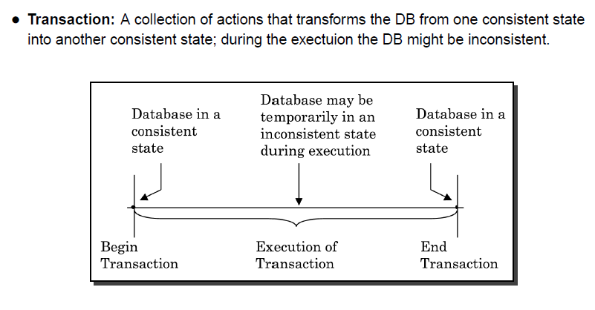
TRANSACTION & NESTED TRANSACTION

Slide 6
TRANSACTION & NESTED TRANSACTION
Transaction: specified by a client as a set of operations on objects to be performed as an indivisible unit by the servers managed those objects.
Goal of transaction: ensure all the objects managed by a server remain in a consistent state when accessed by multiple transactions and in the presence of server crashes.
Transaction applies to recoverable objects and intended to be atomic (atomic transaction):
Recoverable objects: objects can be recovered after their server crashes.
Atomic operations: operations that are free from interference from concurrent operations being performed in the other threads.
Transaction properties (ACID):
Atomicity- Transaction must be all or none
Consistency- Transaction of the system takes one consistent to another consistent state.
Isolation -one process could not hamper other
Durability – storing the transaction’s log report in non- volatile storage

Slide 7
TRANSACTION & NESTED TRANSACTION
Maximize concurrency: transactions are allowed to execute concurrently if they would have the same effect as a serial execution → serially equivalent.
Cases of transaction failing:
Service actions related to process crashes.
Client actions related to server process crashes.
Concurrency control:
Lost update problem
Inconsistent retrievals problem.
Serial equivalence
Conflicting operations

Slide 8
Lost update problem
Occur when two transactions reads the old value of variable and then use it to calculate the new value.
TRANSACTION T | TRANSACTION U
balance = b.getBalance( ); b.setBalance(balance*1.1); a.withdraw(balance/10); | balance = b.getBalance( ); b.setBalance(balance*1.1); c.withdraw(balance/10);
balance = b.getBalance( ); $200 b.setBalance(balance*1.1); $220 a.withdraw(balance/10); $80 | balance = b.getBalance( ); $200 b.setBalance(balance*1.1); $220 c.withdraw(balance/10) ; $280
Initially A,B,C has $100,$200,$300 respectively. Transaction T transfer the amount from A to B and Transaction U transfer an amount from account C to an account B. In both cases, the amount transfer is calculated to increase the balance by 10%. The net effects on account B of executing the transactions T and U should be to increase the balance of account B by 10% twice, so its final value is $242.

Slide 9
Inconsistent retrievals problem
This problem occur when retrieval transaction run concurrently with an update transaction. can not occur if retrieval transaction is performed before or after the update transaction.
TRANSACTION V | TRANSACTION W
a.withdraw(100); b.deposit(100); | aBranch.branchTotal( );
a.withdraw(100); $100 b.deposit(100); $300 | total = a.getBalance( ); $100 total = total + b.getBalance( ); $300 total = total + c.getBalance( ); . .
A and b both initially $200. The result of branchTotal includes the sum of A and B as $300, which is wrong(It should be $400).

Slide 10
A serially equivalent interleaving of T and U
Removes the lost and updates and inconsistent retrieval problem
An interleaving of the transaction had been performed one at a time in some order is a serially equivalent interleaving.
TRANSACTION T | TRANSACTION U
balance = b.getBalance( ); b.setBalance(balance*1.1); a.withdraw(balance/10); | balance = b.getBalance( ); b.setBalance(balance*1.1); c.withdraw(balance/10);
balance = b.getBalance( ); $200 b.setBalance(balance*1.1); $220 a.withdraw(balance/10); $80 | balance = b.getBalance( ); $220 b.setBalance(balance*1.1); $242 c.withdraw(balance/10) ; $278

Slide 11
A serially equivalent interleaving of V and W
TRANSACTION V | TRANSACTION W
a.withdraw(100); b.deposit(100); | aBranch.branchTotal( );
a.withdraw(100); $100 b.deposit(100); $300 | total = a.getBalance( ); $100 total = total + b.getBalance( ); $400 total = total + c.getBalance( ); . .

Slide 12
Read and write operation conflict rules
Operations of different transactions | Conflict
Read Read Read Write Write Write | NO YES YES
For two transaction to be serially equivalent, it is necessary and sufficient that all pairs of conflicting operations of the two transactions be executed in the same order at all of the objects they both access.

Slide 13
TRANSACTION & NESTED TRANSACTION
Recoverability from aborts
Problems with aborting:
Dirty read
Premature writes
Solutions:
Recoverability of transactions
Avoid cascading aborts
Strict execution of transactions
Tentative versions

Slide 14
A dirty read when transaction T aborts
TRANSACTION T | TRANSACTION U
a.getBalance( ); a.setBalance(balance+10); | a.getBalance( ); a.setBalance(balance+20);
balance = a.getBalance( ); $100 a.setBalance(balance+10); $110 abort transaction; | balance = a.getBalance( ); $110 a.setBalance(balance+20); $130 commit transaction;
Recoverability of transactions: delay commits until after the commitment of any other transaction whose uncommitted state has been observed.
Cascading aborts: the aborting of any transactions may cause further transactions to be aborted → transactions are only allowed to read objects that were written by committed transactions.

Slide 15
Overwriting uncommitted values
TRANSACTION T | TRANSACTION U
a.setBalance(105); | a.setBalance(110);
$100 a.setBalance(105); $105 | a.setBalance(110); $110
- Strict execution of transaction: service delay both read and write operations on an object until all transactions that previously wrote that object have either committed or aborted.
- Tentative versions: update operations performed during a transaction are done in tentative versions of objects in volatile memory.

Slide 16
Nested transaction
T: top-level transaction
T1 = openSubTransaction T2 = openSubTransaction
commit
T1
T2
openSubTransaction openSubTransaction
openSubTransaction
prov.commit
abort
T11
T12
T21
openSubTransaction
prov.commit
prov.commit
prov.commit
T211

Slide 17
TRANSACTION & NESTED TRANSACTION
Advantages of nested transaction:
Additional concurrency in a transaction
Subtransactions can commit or abort independently
Rules for commitment of nested transactions:
Transactions commit/abort only after its child have completed.
After completing, subtransaction makes independent decision either to commit provisionally or to abort.
When a parent aborts, all of its subtransactions are aborted.
When a subtransaction aborts, parent can decide whether to abort or not.
Top-level transaction commits→all of the provisionally committed subtransactions can commit too (provided none of their ancestor has aborted).

Slide 18
METHOD FOR CONCURRENT CONTROL
Lock:
Server attempts to lock any object that is about to use by client’s transaction.
Requests to lock object’s are suspended and wait until the objects are unlocked.
Serial equivalence: Serial equivalence requires that all of the transaction’s accesses to a particular object be serialized with respect to accesses by other transactions. To achieve serial equivalence transaction is not allowed any new locks after it has release a lock.
Two-phase lock: growing phase (new locks are acquired), shrinking phase (locks are released).
Strict execution: locks are held until transaction commits/aborts (Strict two-phase locking).
Recoverability: locks must be held until all the objects it updated have been written to permanent storage.

Slide 19
METHOD FOR CONCURRENT CONTROL
Lock:
Simple exclusive lock reduces concurrency→ locking schema for multiple transaction reading, single transaction writing: read locks (shared lock) & write locks(exclusive lock).
Operation conflict rules:
Request for a write lock is delayed by the presence of a read lock belonging to another transaction.
Request for either a read/write lock is delayed by the presence of a write lock belonging to another transaction.

Slide 20
Lock compatibility
For one object | Lock requested Read Write
Lock already set none read write | OK OK OK wait Wait wait

Slide 21
Transaction T and U with exclusive(write) locks.
Both Read and write operations are blocked under exclusive locks.
TRANSACTION T | TRANSACTION U
balance = b.getBalance( ); b.setBalance(balance*1.1); a.withdraw(balance/10); | balance = b.getBalance( ); b.setBalance(balance*1.1); c.withdraw(balance/10);
openTransaction balance = b.getBalance( ); lock B b.setBalance(balance*1.1); a.withdraw(balance/10); lock A closeTransaction unlock A,B | openTransaction balance = b.getBalance( ); wait for T’lock on B … b.setBalance(balance*1.1); lock B c.withdraw(balance/10) ; lock C closeTransaction unlock B,C

Slide 22
Use of lock in two-phase locking:
When an operation accesses an objects within a transaction:
if the object is not already lock, it is locked and the operation proceeds.
if the object has a conflicting lock set by another transaction, the transaction must wait until it is unlocked.
if the object has a non-conflicting lock set by another transaction, the lock is shared and the operation proceeds.
if the object has already been locked in the same transaction, the lock will be promoted if necessary and the operation proceeds. (Where promotion is prevented by a conflicting lock, rule (b) is used).
When a transaction is committed or aborted, the server unlocks all objects it locked for the transaction.

Slide 23
METHOD FOR CONCURRENT CONTROL
Locking rule for nested transactions:
Locks that are acquired by a successful subtransaction is inherited by its parent & ancestors when it completes. Locks held until top-level transaction commits/aborts.
Parent transactions are not allowed to run concurrently with their child transactions.
Subtransactions at the same level are allowed to run concurrently.

Slide 24
Deadlock with write lock.
Transaction T | Transaction U
Operations Lock | Operations Lock
a.deposit(100) write lock A b.Withdraw(100) wait for U’s lock on B … … … | b.deposit(200) write lock B a.Withdraw(200) wait for T’s lock on A … …

Slide 25
METHOD FOR CONCURRENT CONTROL
Deadlock:
Definition: A state in which each member of a group of transactions is waiting for some other member to release a lock.
Prevention:
Lock all the objects used by a transaction when it starts → not a good way.
Request locks on objects in a predefined order → premature locking & reduction in concurrency.
Detection: Finding cycle in a wait-for graph→ select a transaction for aborting to break the cycle.
Choice of transaction to be aborted is not simple.
Timeouts: each lock is given a limited period in which it is invulnerable.
Transaction is sometimes aborted but actually there is no deadlock.
Appropriate length of a timeout.

Slide 26
METHOD FOR CONCURRENT CONTROL
Increasing concurrency in locking schema: 2 approaches
Two-version locking: the setting of exclusive locks is delayed until a transaction commits.
Hierarchic locks: mix-granularity locks are used.

Slide 27
Lock compatibility for two-version locking
For one object | Lock to be set Read write commit
Lock already set none read write commit | OK OK OK OK OK wait OK wait ---- Wait wait ----
Two-version locking: allows one transaction to write tentative versions of objects when other transactions read from the committed version of the same objects.
read operations are delayed only while the transactions are being committed rather than during entire execution.
read operations can cause delay in committing other transactions.

Slide 28
METHOD FOR CONCURRENT CONTROL
Drawbacks of locking:
Lock maintenance represents an overhead that is not present in systems that do not support concurrent access to shared data.
Deadlock prevention by locks reduces the concurrency (lock transaction can not use by other until it unlock the transaction). Deadlock detection or timeout not wholly satisfactory for use in interactive programs.
To avoid cascading abort, locks can not be release until the end of transaction → reduce potential concurrency.

Slide 29
METHOD FOR CONCURRENT CONTROL
Optimistic concurrency control:
Idea: in most applications, the likelihood of two clients transactions accessing the same object is low.
Transactions are allowed to proceed as though there were no possibility of conflict with other transactions until the client completes its task and issues a closeTransaction request.
3 phases of a transaction:
Working phase: each transaction has a tentative version of each of the objects that it updates.
Validation phase: when the closeTransaction request is received, the transaction is validated to establish whether or not its operations on objects conflict with other transaction.
Update phase: changes in tentative versions are made permanent if transaction is validated

Slide 30
METHOD FOR CONCURRENT CONTROL
Optimistic concurrency control:
Validation of transactions: use the read-write conflict rules to ensure that the scheduling of a transaction is serially equivalent with respect to all other overlapping transactions.
Backward validation: check the transaction undergoing validation with other preceding overlapping transactions (enter the validation phase before).
Read set of the transaction being validated is compared with the write sets of other transactions that have already committed.
Forward validate: check the transaction undergoing validation with other later transactions
Write set of the transaction being validated is compared with the read sets of other overlapping active transactions (still in working phase).

Slide 31
METHOD FOR CONCURRENT CONTROL
Timestamp ordering:
Each transaction is assigned a unique timestamp values when it starts.
Timestamp defines its position in the time sequence of transaction.
Basic timestamp ordering rule:
A transaction’s request to write an object is valid only if that object was last read and written by earlier transactions. A transaction’s request to read an object is valid only if that object was last written by an earlier transactions.
No deadlock

Slide 32
METHOD FOR CONCURRENT CONTROL
Timestamp ordering write rule:
if (T_{c} ≥ maximum read timestamp on D &&
T_{c} > write timestamp on committed version of D)
perform write operation on tentative version of D with write timestamp T_{c}
else /*write is too late*/
abort transaction T_{c}

Slide 33
METHOD FOR CONCURRENT CONTROL

Slide 34
METHOD FOR CONCURRENT CONTROL
Timestamp ordering read rule:
If (T_{c}> write timestamp on committed version of D)
{ let D_{selected} be the version of D with the maximum write timestamp ≤ Tc
if (D_{selected} is committed)
perform read operation on the version D_{selected}
else
wait until the transaction that made version D_{selected} commits or aborts then reapply the read rule
}
Else
abort transaction T_{c}

Slide 35
METHOD FOR CONCURRENT CONTROL
Multiversion timestamp ordering:
A list of old committed versions as well as tentative versions is kept for each object.
Read operations that arrive too late need not be rejected.
Multiversion timestamp ordering write rule:
If ( read timestamp of D_{maxEarlier} ≤ T_{c})
perform write operation on tentative version of D with write timestamp T_{c}
Else
abort transaction T_{c}

Slide 36
Comparison of methods for concurrency control
Three separate method for controlling concurrent access to shared data are strict two-phase locking, optimistic methods and timestamp ordering.
All of the methods carry some overheads in the time and space they require and they all limit to some extent the potential for concurrent operation.
Timestamp ordering and two phase locking both use pessimistic approach but timestamp ordering decides the serialization order statically whereas two-phase locking decides the serialization dynamically –according to the order in which objects are accessed.
Timestamp ordering is better then strict two-phase locking for read-only transactions. Two phase locking is better when operations in transaction are predominantly updates.

Slide 37
Distributed transactions
A client transaction becomes distributed if it invokes in several servers.
Flat transaction: client request to more then one server. T invokes operation in objects in 3 server x, y, z so T is flat transaction. A flat client transaction completes each its request before going on the next one. Therefore each transaction accesses servers object sequentially. When servers use locking, a transaction can only be waiting for one object at a time.
Nested transactions:
sub transaction at some level can be run concurrently.
It gives better performance then in simple transaction.
X
M
T
11
X
T
Client
T
1
N
Y
T
12
T
T
T
21
T
2
Client
Y
Z
P
Flat transaction
Nested transaction
T
22

Slide 38
Nested banking transaction
Consider a distributed transaction in which a client transfer $10 from account A to C and then transfer $20 from B to D. Account A and B are on separate servers X and Y and accounts C and D are at server Z. if this transaction is structured as a set of four nested transactions, as shown in figure, the four requests (two deposit and two withdraw) can run in parallel and overall effect can be achieved with better performance then a simple transaction in which the four operations are invoked sequentially.
X
Client
T
A
a.withdraw(10)
1
T
T =
openTransaction
Y
openSubTransaction
T
B
b.withdraw(20)
a.withdraw(10);
2
openSubTransaction
b.withdraw(20);
Z
openSubTransaction
.
c.deposit(10);
T
C
c
deposit(10)
3
openSubTransaction
d.deposit(20);
T
D
d.deposit(20)
4
closeTransaction

Slide 39
A distributed banking(flat) transaction
Coordinator
openTransaction
join
participant
closeTransaction
.
A
a.withdraw(4);
.
join
BranchX
T
participant
b.withdraw(T, 3);
Client
B
b.withdraw(3);
T =
openTransaction
BranchY
a.withdraw(4);
join
c.deposit(4);
participant
b.withdraw(3);
d.deposit(3);
C
c.deposit(4);
closeTransaction
D
d.deposit(3);
Note: the coordinator is in one of the servers, e.g. BranchX
BranchZ

Slide 40
A distributed banking transaction
A client starts a transaction by sending an openTransaction request to the server.
The coordinator that is Connected carries out the openTransaction and returns the resulting transaction identifiers to the client.
Transaction identifier for distributed transactions must be unique within a distributed system.

Slide 41
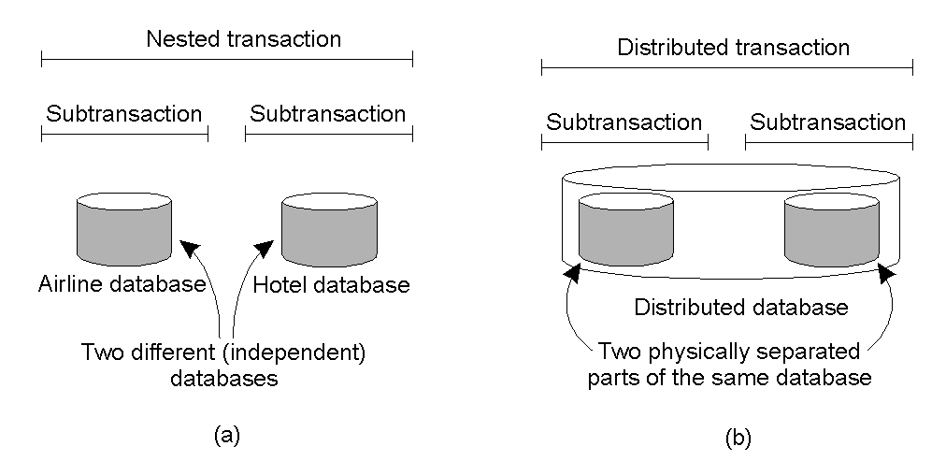
Nested vs Distributed Transactions

Slide 42
Atomic commit protocols
The atomicity of transaction requires that when a distributed transaction comes to end, either all of its operations are carried out or none of them.
In case of distributed transaction, the client has requested the operations at more then one servers.
Atomic commit protocol are designed to achieve this effect even if server crashes during their execution.
The two phase commit protocol allows a server to decide to abort unilaterally. It includes timeout actions to deal with delays due to servers crashing.
The two phase protocol can take an unbounded amount of time to complete but is guaranteed to complete eventually.

Slide 43
Operations for two-phase commit protocol
canCommit?(trans)-> Yes / No
Call from coordinator to participant to ask whether it can commit a transaction. Participant replies with its vote.
doCommit(trans)
Call from coordinator to participant to tell participant to commit its part of a transaction.
doAbort(trans)
Call from coordinator to participant to tell participant to abort its part of a transaction.
haveCommitted(trans, participant)
Call from participant to coordinator to confirm that it has committed the transaction.
getDecision(trans) -> Yes / No
Call from participant to coordinator to ask for the decision on a transaction after it has voted Yes but has still had no reply after some delay. Used to recover from server crash or delayed messages.

Slide 44
The two-phase commit protocol
Phase 1 (voting phase):
1. The coordinator sends a canCommit? request to each of the participants in the transaction.
2. When a participant receives a canCommit? request it replies with its vote (Yes or No) to the coordinator. Before voting Yes, it prepares to commit by saving objects in permanent storage. If the vote is No the participant aborts immediately.
Phase 2 (completion according to outcome of vote):
3. The coordinator collects the votes (including its own).
(a) If there are no failures and all the votes are Yes the coordinator decides to commit the transaction and sends a doCommit request to each of the participants.
(b) Otherwise the coordinator decides to abort the transaction and sends doAbort requests to all participants that voted Yes.
4. Participants that voted Yes are waiting for a doCommit or doAbort request from the coordinator. When a participant receives one of these messages it acts accordingly and in the case of commit, makes a haveCommitted call as confirmation to the coordinator.

Slide 45
Communication in two-phase commit protocol
Coordinator
Participant
step
status
step
status
prepared to commit
canCommit?
1
(waiting for votes)
Yes
2
prepared to commit
3
committed
doCommit
(uncertain)
haveCommitted
4
committed
done
Operations in coordinator for nested transactions
openSubTransaction(trans) -> subTrans
Opens a new subtransaction whose parent is trans and returns a unique subtransaction identifier.
getStatus(trans)-> committed, aborted, provisional
Asks the coordinator to report on the status of the transaction trans. Returns values representing one of the following: committed, aborted, provisional.

Slide 46
Transaction T decides whether to commit
T
abort (at M)
11
T
1
provisional commit (at X)
T
T
provisional commit (at N)
12
T
provisional commit (at N)
21
T
aborted (at Y)
2
T
provisional commit (at P)
22
Information held by coordinators of nested transactions
Coordinator of
Child
Participant
Provisional
Abort list
transaction
transactions
commit list
T
T
1
, T
yes
T
, T
T
, T
2
1
12
11
2
T
1
T
11
, T
12
yes
T
1
, T
12
T
11
T
2
T
21
, T
22
no (aborted)
T
2
T
11
no (aborted)
T
11
T
, T
T
T
12
21
12
but not
21
T
21
, T
12
T
no (parent aborted)
22
T
22

Slide 47
canCommit?for hierarchic two-phase commit protocol
canCommit?(trans, subTrans) -> Yes / No
->call from coordinator to participant
->Call a coordinator to ask coordinator of child subtransaction whether it can commit a subtransaction subTrans. The first argument trans is the transaction identifier of top-level transaction. Participant replies with its vote Yes / No.
canCommit? for flat two-phase commit protoco
canCommit?(trans, abortList) -> Yes / No
Call from coordinator to participant to ask whether it can commit a transaction. Participant replies with its vote Yes / No.

Slide 48
Transaction Recovery
a. Logging:
The recovery file represents a log containing the history of all the transactions performed by a server.
The history consists of values of objects, transaction status entries and intentions lists of transactions. The order of the entries in the log reflects the order in which transactions have Prepared, committed and aborted at that server.
Recovery file contain a recent snapshot of the values of all the objects in the server followed by a History of transactions after the snapshot.

Slide 49
Types of entry in a recovery file
Transaction Recovery
Type of entry
Description of contents of entry
Object
A value of an object.
Transaction status
Transaction identifier, transaction status (
prepared
,
committed
aborted
) and other status values used for the two-phase
commit protocol.
Intentions list
Transaction identifier and a sequence of intentions, each of
which consists of <identifier of object>, <position in recovery
file of value of object>.

Slide 50
Log for banking service
P
0
P
1
P
2
P
3
P
4
P
5
P
6
P
7
Object:
A
Object:
B
Object:
C
Object:
A
Object:
B
Trans:
T
Trans:
T
Object:
C
Object:
B
Trans:
U
100
200
300
80
220
prepared
committed
278
242
prepared
<
A
,
P
1
>
<
C
,
P
5
>
<
B
,
P
2
>
<
B
,
P
6
>
P
0
P
3
P
4
Checkpoint
End
of log
TRANSACTION T | TRANSACTION U
balance = b.getBalance( ); b.setBalance(balance*1.1); a.withdraw(balance/10); | balance = b.getBalance( ); b.setBalance(balance*1.1); c.withdraw(balance/10);
balance = b.getBalance( ); $200 b.setBalance(balance*1.1); $220 a.withdraw(balance/10); $80 | balance = b.getBalance( ); $220 b.setBalance(balance*1.1); $242 c.withdraw(balance/10) ; $278

Slide 51
Description of Log for banking service
The log was recently reorganized, and entries to all the left of schedule the double line represent a snapshot of the values of A,B and C before transactions T and U started.
A ,B and C are unique identifiers for objects.
We show the situation when transaction T has committed and transaction U has prepared but not committed.
When transaction prepares to commit, the values of objects A and B are written at positions p1 and p2 in the log, followed by a prepared transaction status entry for T with its intentions list (<A,P1>, <B,P2>).
When transaction T commits, a committed transaction status entry for T is put at position P4. when transaction U prepares to commit, the values of objects C and B are written as positions P5 and P6 in the log, followed by a prepared transaction status entry for U with its intentions list<C,p5>,<B,P6>)

Slide 52
Shadow Paging
Shadow paging is an alternative to log-based recovery; this scheme is useful if transactions execute serially
Idea: maintain two page tables during the lifetime of a transaction –the current page table, and the shadow page table
Store the shadow page table in nonvolatile storage, such that state of the database prior to transaction execution may be recovered.
Shadow page table is never modified during execution
To start with, both the page tables are identical. Only current page table is used for data item accesses during execution of the transaction.
Whenever any page is about to be written for the first time
A copy of this page is made onto an unused page.
The current page table is then made to point to the copy
The update is performed on the copy

Slide 53
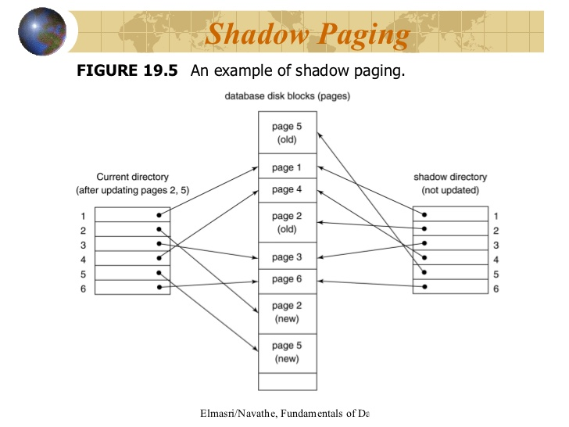
Example Shadow paging
In this example the page2 and page 5 are modified.

Slide 54
Shadow Paging (Cont.)
To commit a transaction :
1. Flush all modified pages in main memory to disk
2. Output current page table to disk
3. Make the current page table the new shadow page table, as follows:
keep a pointer to the shadow page table at a fixed (known) location on disk.
to make the current page table the new shadow page table, simply update the pointer to point to current page table on disk
Once pointer to shadow page table has been written, transaction is committed.
No recovery is needed after a crash — new transactions can start right away, using the shadow page table.
Pages not pointed to from current/shadow page table should be freed (garbage collected).

Slide 55
Shadow Paging (Cont.)
Advantages of shadow-paging over log-based schemes
no overhead of writing log records
recovery is trivial
Disadvantages :
Copying the entire page table is very expensive
Can be reduced by using a page table structured like a B⁺-tree
No need to copy entire tree, only need to copy paths in the tree that lead to updated leaf nodes
Commit overhead is high even with above extension
Need to flush every updated page, and page table
Data gets fragmented (related pages get separated on disk)
After every transaction completion, the database pages containing old versions of modified data need to be garbage collected
Hard to extend algorithm to allow transactions to run concurrently
Easier to extend log based schemes

Slide 56
Deadlock

Slide 57
Overview
Deadlocks – An Introduction.
Deadlocks in Distributed Systems.
Deadlock Handling Techniques.
Algorithms For Deadlock Detection in Distributed Systems.
Summary.
Notes:
First I would start off with a brief introduction to the concept of Deadlocks. I would be covering what deadlocks are and what are the causes of their occurrence.
Then I would discuss the types of deadlocks that occur in distributed systems.
Then in Deadlock Handling Techniques I would discuss the various ways in which we can either prevent or work around the situation of a deadlock occurrence.
Finally the presentation will move on to cover the various Deadlock Detection algorithms in distributed systems.

Slide 58
Reusable/consumable resources
reusable resource
number of units is constant
unit is either free or allocated; no sharing
process requests, acquires, releases units
Examples: memory, devices, files, tables
consumable resources
number of units varies at runtime
process may create new units
process may consume units
Examples: messages, signals

Slide 59
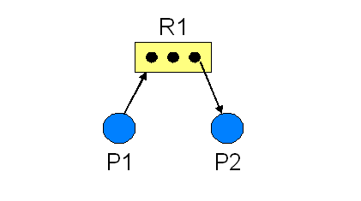
Deadlocks – An Introduction
What Are DEADLOCKS ?
A Blocked Process which can never be resolved unless there is some outside Intervention.
For Example:-
Resource (reusable) R1 is requested by Process P1 but is held by Process P2.
Notes:
So lets begin with an overview of the concept of Deadlocks. I would be keeping the discussion on this introductory slides very brief as these concepts are mostly familiar to everyone of you.
So what are Deadlocks ? ‘ Any blocked process which cannot be resolved unless there is some outside intervention’. So deadlocks can be visualized as occurring where there are processes involved. These processes have some resources held by them and are waiting for some resources to fulfill their completion which are instead being held by some other blocked process. A very simple real-world example is of the two trains halted next to each other and none of them moving unless the other one moves.
The allocation of the various resources to the running processes is depicted by a Resource Allocation Graph(RAG). They are used to represent the current state of a system.

Slide 60
Introduction to Deadlock
Formal definition
“A set of processes is deadlocked if each process in the set is waiting for an event that only another process in the set can cause.”
Because all the processes are waiting, none of them will ever cause any of the events that could wake up any of the other member in the set, and all the processes continue to wait forever.
That is, none of the processes can-
run
release resources
be awakened

Slide 61
Distributed deadlock
Problem definition
Permanent blocking of a set of processes that either compete for system resources or communicate with each other
No node has complete and up-to-date knowledge of the entire distributed system
Message transfers between processes take unpredictable delays
System state representation with wait-for graphs (WFG)
Nodes are processes, P1, P2, etc.
Directed edge from P1 to P2 if P1 blocked and waiting for P2 to release a resource
System is deadlocked if there is a directed cycle

Slide 62
Illustrating A Deadlock
Wait-For-Graph (WFG)
Nodes – Processes in the system
Directed Edges – Wait-For blocking relation
Resource 1
Held By
Waits For
Process 1
Process 2
Resource 2
Waits For
Held By
A Cycle represents a Deadlock
Starvation - A process’ execution is permanently halted.
Notes:
A Wait-for-Graph is the representation of the deadlock situation. In a WFG the nodes represent the processes of the system and the directed edges signifies the wait-for relation between the different nodes. A WFG is a part of the Resource Allocation Graph and is specifically used to identify the presence of deadlocks in the system. The existence of a cycle in the WFG means that there exists a deadlock in the system.
In case a particular process waiting for a resource is not able to obtain it indefinitely then this situation is called starvation.

Slide 63
Deadlocks in Distributed Systems
Resource deadlock
Set of deadlocked processes, where each process waits for a resource held by another process (e.g., data object in a database, I/O resource on a server)
Most Common.
Occurs due to lack of requested Resource
Communication deadlocks:
Set of deadlocked processes, where each process waits to receive messages (communication) from other processes in the set.

Slide 64
Timestamped Deadlock-Prevention Scheme
Each process P_{i} is assigned a unique priority number
Priority numbers are used to decide whether a process P_{i} should wait for a process P_{j}; otherwise P_{i} is rolled back
The scheme prevents deadlocks
For every edge P_{i} → P_{j} in the wait-for graph, P_{i} has a higher priority than P_{j}
Thus a cycle cannot exist
→ There’s possibility of starvation
Can be avoided using timestamps

Slide 65
Wait-Die Scheme
Based on a nonpreemptive technique
If P_{i} requests a resource currently held by P_{j}, P_{i} is allowed to wait only if it has a smaller timestamp than does P_{j} (P_{i} is older than P_{j})
Otherwise, P_{i} is rolled back (dies)
Example: Suppose that processes P₁, P₂, and P₃ have timestamps 5, 10, and 15 respectively
if P₁ requests a resource held by P₂, then P₁ will wait
If P₃ requests a resource held by P₂, then P₃ will be rolled back

Slide 66
Wound-Wait Scheme
Based on a preemptive technique; counterpart to the wait-die system
If P_{i} requests a resource currently held by P_{j}, P_{i} is allowed to wait only if it has a larger timestamp than does P_{j} (P_{i} is younger than P_{j}). Otherwise P_{j} is rolled back (P_{j} is wounded by P_{i})
Example: Suppose that processes P₁, P_{2,} and P₃ have timestamps 5, 10, and 15 respectively
If P₁ requests a resource held by P₂, then the resource will be preempted from P₂ and P₂ will be rolled back
If P₃ requests a resource held by P₂, then P₃ will wait

Slide 67
Handling Deadlocks in resource allocation
Deadlock Prevention
Prioritize processes. Assign resources accordingly.
Provide all required resources from start itself.
Make Prior Rules:
For Ex. – Process P1 cannot request resource R1 unless it releases resource R2.
Drawbacks
Inefficient and effects Concurrency.
Future resource requirement unpredictable.
Starvation possible.
Notes:
So now lets take a look at the various deadlock handling approaches –
- First approach is of deadlock prevention. In this technique all the processes are prioritized and resources are allocated to them accordingly.
- The resources are allocated from the start itself.
- Rules of resource allocation are made such as process P1 can not request a resource R1 unless it releases resource 2. Etc.
- The major drawback of this approach is that it is inefficient because it is not scalable. Also it effects the concurrency of the system.

Slide 68
Handling Deadlocks in resource allocation
Deadlock avoidance
Decision made dynamically, before allocating a resource, the resulting global system state is checked - if safe, allow allocation
Disadvantages
Every site has to maintain global state of system (extensive overhead in storage and communication)
Different sites may determine (concurrently) that state is safe, but global state may be unsafe: verification for safe global state by different sites must be mutually exclusive
Large overhead to check for every allocation (distributed system may have large number of processes and resources)
Requires Prior resource requirement information for all processes.
Conclusion: Deadlock avoidance impractical in distributed systems

Slide 69
Handling Deadlocks
Deadlock Avoidance
Only fulfill those resource requests that won’t cause deadlock in the future.
Simulate resource allocation and determine if resultant state is safe or not.
Drawbacks
Inefficient.
Requires Prior resource requirement information for all processes.
High Cost of scalability.
Notes:
Deadlock Avoidance is achieved when the system has a prior knowledge of all the resource requirements of the running processes. So when a resource is requested from the system, the system simulates the allocation of those resources and determines if the resultant state is safe. And the system fulfills only those resource requests that wont cause any deadlock.

Slide 70
Deadlock in resource allocation
Deadlock Detection
Principle of operation
Detection of a cycle in WFG proceeds concurrently with normal operation
Requirements for the deadlock detection and resolution algorithms
Detection
The algorithm must detect all existing deadlock in finite time
The algorithm should not report non-existent (phantom) deadlock
Resolution (recovery)
All existing wait-for dependencies in WFG must be removed, i.e. roll-back one or more processes that are deadlocked and give their resources to other blocked processes
Observation
Deadlock detection is the most popular strategy for handling deadlocks in distributed systems

Slide 71
Handling Deadlocks
Deadlock Detection
Resource allocation with an optimistic outlook.
Periodically examine process status.
Detect then break the Deadlock.
Resolution – Roll back 1 or More processes and break dependency.
Notes:
Besides the previous 2 mentioned methods is the method of deadlock detection. In Deadlock detection we perform the resource allocation with an optimistic outlook. We periodically examine the process state and detect the presence of deadlocks and if present then break those deadlocks.
The approach is generally to roll back 1 or more processes involved in the deadlock and break the dependency.

Slide 72
Deadlock Detection
Use wait-for graphs
Local wait-for graphs at each local site. The nodes of the graph correspond to all the processes that are currently either holding or requesting any of the resources local to that site
May also use a global wait-for graph. This graph is the union of all local wait-for graphs.

Slide 73
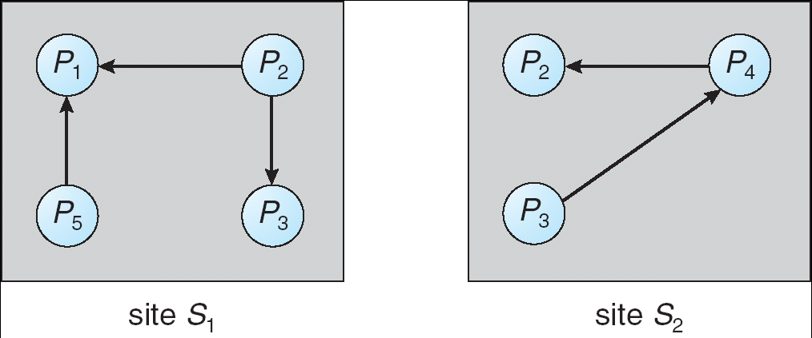
Two Local Wait-For Graphs

Slide 74
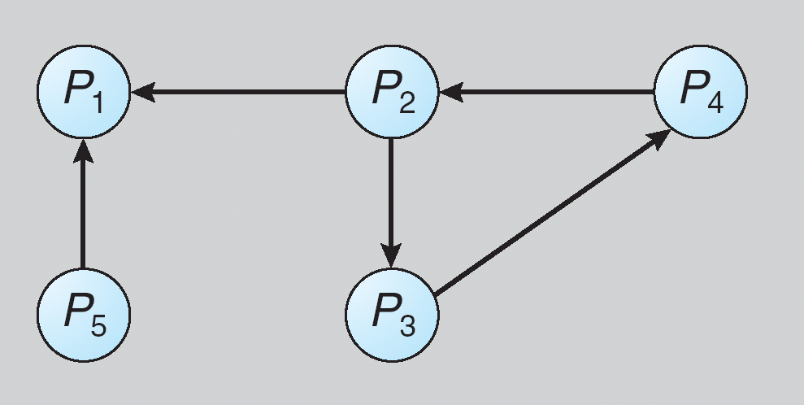
Global Wait-For Graph

Slide 75
Deadlock in resource allocation: Algorithms for distributed deadlock detection
Deadlock Detection (cont.)
Control for distributed deadlock detection can be:
Centralized
Distributed
Hierarchical
1. Centralized deadlock detection algorithms
Each site keeps a local wait-for graph
A global wait-for graph is maintained in a single coordination process
There are three different options (points in time) when the wait-for graph may be constructed:
1. Whenever a new edge is inserted or removed in one of the local wait-for graphs
2. Periodically, when a number of changes have occurred in a wait-for graph
3. Whenever the coordinator needs to invoke the cycle-detection algorithm

Slide 76
Detection Algorithm Based on Option 3
Append unique identifiers (timestamps) to requests form different sites
When process P_{i}, at site A, requests a resource from process P_{j}, at site B, a request message with timestamp TS is sent
The edge P_{i} → P_{j} with the label TS is inserted in the local wait-for of A. The edge is inserted in the local wait-for graph of B only if B has received the request message and cannot immediately grant the requested resource

Slide 77
The Algorithm
1. The controller sends an initiating message to each site in the system
2. On receiving this message, a site sends its local wait-for graph to the coordinator
3. When the controller has received a reply from each site, it constructs a graph as follows:
(a) The constructed graph contains a vertex for every process in the system
(b) The graph has an edge Pi → Pj if and only if
there is an edge Pi → Pj in one of the wait-for graphs,
Or an edge Pi → Pj with some label TS appears in more than one wait-for graph
If the constructed graph contains a cycle ⇒ deadlock

Slide 78
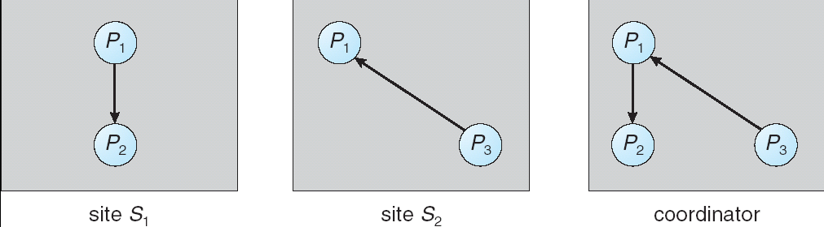
Local and Global Wait-For Graphs

Slide 79
Deadlock in resource allocation: Algorithms for distributed deadlock detection
Deadlock Detection
2. Hierarchical deadlock detection algorithms
Sites organized in a tree structure with one site at the root of the tree
Each node (except for leaf nodes) has information about the dependent nodes
Deadlock is detected by the node that is the common ancestor of all sites which have resource allocations in conflict
Deadlock is detected at the lowest level

Slide 80
3. Distributed deadlock detection algorithms
Principles
All sites responsible for detecting a global deadlock
Global state graph distributed over many sites: several of them participate in detection
Detection initiated when a process suspected to be deadlocked
Advantages: No single point of failure, no congestion
Disadvantages: Difficult to implement
Types of algorithms
Path-pushing algorithms
Each node builds a WFG based on local info & info from other sites
Detect and resolves local deadlocks
Transmits to other sites deadlock info in form of (waiting path)
Edge-chasing algorithms
Special messages (probes) sent along edges of WFG to detect a cycle
When blocked process receives probe, resends it on its outgoing edges of WFG
When a process receives a probe it initiated, declares deadlock

Slide 81
Fully Distributed Approach
All controllers share equally the responsibility for detecting deadlock
Every site constructs a wait-for graph that represents a part of the total graph
We add one additional node P_{ex} to each local wait-for graph
If a local wait-for graph contains a cycle that does not involve node P_{ex}, then the system is in a deadlock state
A cycle involving P_{ex} implies the possibility of a deadlock
To ascertain whether a deadlock does exist, a distributed deadlock-detection algorithm must be invoked

Slide 82
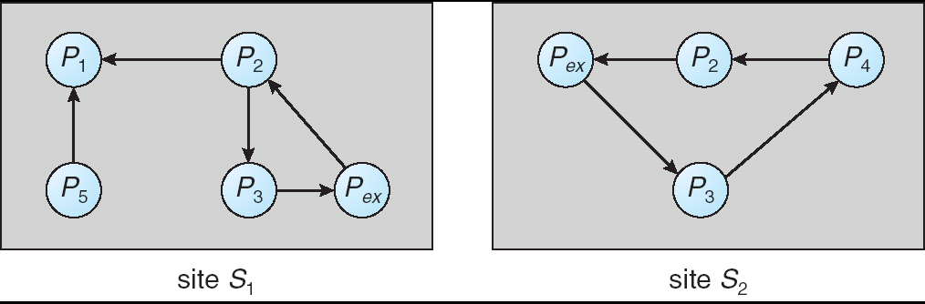
Augmented Local Wait-For Graphs

Slide 83
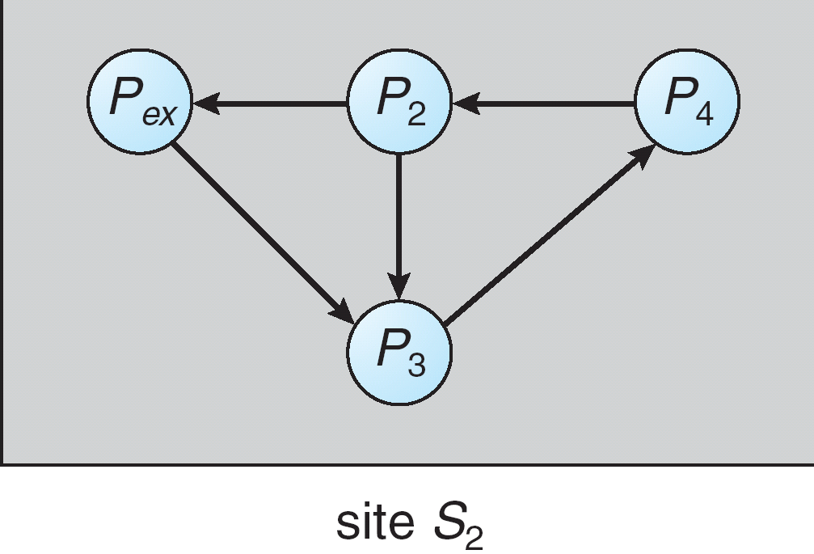
Augmented Local Wait-For Graph in Site S2

Slide 84
Deadlock Detection Algorithms
Centralized Deadlock Detection
Ho-Ramamoorthy’s one and two phase algorithms.
Distributed Deadlock Detection
Obermarck’s Path Pushing Algorithm.
Chandy-Misra-Haas Edge Chasing algorithm.
Hierarchical Deadlock Detection
Menasce-Muntz Algorithm.
Ho-Ramamoorthy’s Algorithm.
Notes:
So now lets see what are the various types of algorithms that come under these deadlock detection control organizations.
- Firstly in a centralized deadlock detection set-up “Ho-Ramamoorthy’s 1 and 2 Phase Algorithms” are used.
- While under Distributed Deadlock detection approach there are 2 algorithms that are used. One is ‘Obermarck’s Path Pushing Algorithm’ and another one is ‘Chandy-Misra-Haas’ Edge Chasing Algorithm’.
- Finally under hierarchical deadlock detection there are “Menasce-Muntz” and “Ho-Ramamoorthy’s” Algorithms that are used.

Slide 85
Centralized Deadlock Detection
Ho-Ramamoorthy’s 1-Phase Algorithm
Each site maintains 2 Status Tables:
Process Table.
Resource Table.
One of the Sites Becomes the Central Control site.
The Central Control site periodically asks for the status tables.
Contd…
Notes:
So lets start off with the centralized deadlock detection algorithms. The first one is Ho-Ramamoorthy’s 1-phase algorithm. As per this algorithm each of the sites of the network maintains 2 status tables. A process table and a resource table. Among these sites one of the site becomes the central control site. These central control site periodically asks for status tables from the other sites.

Slide 86
Centralized Deadlock Detection
Ho-Ramamoorthy’s 1-Phase Algorithm Contd…
Control site builds WFG using the status tables.
Control site analyzes WFG and resolves any present cycles.
Shortcomings
Phantom Deadlocks.(detection of false deadlock, a deadlock that doesn’t really exist but is falsely detected)
High Storage & Communication Costs.
Notes:
After collecting the status tables the central control site builds the WFG for the system. The control site finally analyzes the WFG and resolves the presence of any cycles.
Drawbacks – This algorithm can detect Phantom Deadlocks. A phantom deadlock means the detection of a false deadlock, a deadlock that doesn’t really exist but is falsely detected.
This algorithm also incurs high storage and communication costs.

Slide 87
Phantom Deadlocks
P0
R
P2
System A
System B
S
P1
T
P1 releases resource S and asks-for resource T.
2 Messages sent to Control Site:
1. Releasing S.
2. Waiting-for T.
Message 2 arrives at Control Site first. Control Site makes a WFG with cycle, detecting a phantom deadlock.
Notes:
Here is an illustration of how phantom deadlocks can occur in distributed systems. The diagram represents 2 systems. System A and System B. System A has process P1 holding resource S and waiting for resources T which is in system B. Resource T is presently held by Process 2.
Here process P1 sends 2 messages to the control site stating the release of resource S and need for resource T. So in case the message 2 ie waiting for T reaches the control site first then a cycle would be detected and it would be induced that the system has a deadlock. This false deadlock is called a phantom deadlock.

Slide 88
Centralized Deadlock Detection
Ho-Ramamoorthy’s 2-Phase Algorithm
Each site maintains a status table for processes.
Resources Locked & Resources Awaited.
Phase 1
Control Site periodically asks for these Locked & Waited tables.
It then searches for presence of cycles in these tables.
Contd…
Notes:
The other centralized algorithm proposed by Ho and Ramamoorthy is the 2 phase algorithm. In this algorithm each site maintains a status table for the processes. The status table has the information of the resources that are locked and are awaited by its processes.
Phase 1 – In phase 1 the control site asks for the locked and waited tables from the other sites and searches for the presence of cycles in these tables.

Slide 89
Centralized Deadlock Detection
Ho-Ramamoorthy’s 2-Phase Algorithm Contd…
Phase 2
If cycles are found in phase 1 search, Control site makes 2nd request for the tables.
The details found common in both table requests will be analyzed for cycle confirmation.
Shortcomings
Phantom Deadlocks.
Notes:
Phase 2 – Then in phase 2 the control site looks for the cycles found in phase 1 and makes a 2nd request for the tables. The details that are found common in both the table requests are then analyzed for the cycle confirmation.
In this algorithm too there are chances of detecting phantom deadlocks thus making it not a completely accurate algorithm.

Slide 90
Distributed Deadlock Detection
Obermarck’s Path-Pushing Algorithm
Individual Sites maintain local WFG
A virtual node ‘x’ exists at each site.
Node ‘x’ represents external processes.
Detection Process
Case 1: If Site S_{n} finds a cycle not involving ‘x’ -> Deadlock exists.
Case 2: If Site S_{n} finds a cycle involving ‘x’ -> Deadlock possible.
Contd…
Notes:
Now lets look at deadlock detection in distributed scenario.
Obermarck’s path pushing algorithm is the one that is used for deadlock detection in distributed system architecture. In distributed architectures any of the sites can play the role of the control site.
In this approach each site maintains a local Wait-For Graph. A virtual node exists at each site that represents external processes.
Detection Process –
When the deadlock detection process begins the site Sn collects the WFG from all other sites. In case a cycle is found at Site Sn which doesn’t involve the external node ‘x’ it means the deadlock exists. This deadlock exists within the site Sn itself. While in case there exists a cycle involving ‘x’ it signifies a possibility of a deadlock.

Slide 91
Obermarck’s Path-Pushing Algorithm
If Case 2 ->
Site S_{n} sends a message containing its detected cycles to other sites. All sites receive the message, update their WFG and re-evaluate the graph.
Consider Site S_{j} receives the message:
Site S_{j} checks for local cycles. If cycle found not involving ‘x’ (of S_{j}) -> Deadlock exists.
If site S_{j} finds cycle involving ‘x’ it forwards the message to other sites.
Process continues till deadlock found.
Notes:
Now, this site Sn sends a message to other sites, the message contains the detected cycles.Now each site update their WFG and evaluate the resource graph. For each site if there exists a cycle not involving x it would mean that a deadlock exists. While if the cycle exists involving ‘x’ then it forwards the message to other sites.
This process is continued until a deadlock is found.
Detection of phantom deadlocks is a limitation of this technique too. Phantom deadlocks are detected in this technique because the different sites take asynchronous snapshot of the WFG status.

Slide 92
Distributed Deadlock Detection
Chandy-Misra-Haas Edge Chasing algorithm.
The blocked process sends ‘probe’ message to the resource holding process.
‘Probe’ message contains:
ID of blocked process.
ID of process sending the message.
ID of process to which the message was sent.
When probe is received by blocked process it forwards it to processes holding the requested resources.
If Blocked Process receives its own probe -> Deadlock Exists.
Notes:
This Algorithm uses a probe message to detect the presence of cycles. The blocked process sends the probe message. The message contains three variables. The Id of the blocked process, Id of the process sending the message and the Id of the process to which the message was sent.
When the probe is received by the blocked process it forwards it to the processes holding the requested resources.
If the blocked process receives it own probe it means that a cycle exists and hence the deadlock also exists.

Slide 93
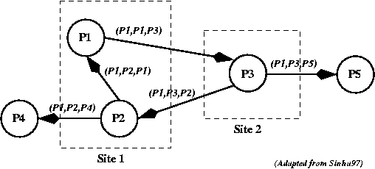
Example…
Message Format: (Initiator, from, to)
In this case P1 initiates the probe message, so that all the messages shown have P1 as the initiator.
When the probe message is received by process P3, it modifies it and sends it to two more processes.
Eventually, the probe message returns to process P1. Deadlock!

Slide 94
Hierarchical Deadlock Detection
Menasce-Muntz Algorithm
Sites (controllers) organized in a tree structure.
Leaf controllers manage local WFG.
Upper controllers handle Deadlock Detection.
Each Parent node maintains a Global WFG, union of WFG’s of its children. Deadlock detected for its children.
Changes propagated upwards in the tree.
Notes:
Now lets move on to the hierarchical Deadlock detection algorithms.
- Menasce-Muntz Algorithm
In this algorithm the sites are organized in a tree like structure. The leaf controllers manage the WFGs. While the parent of the leaves ie the upper controllers manage the deadlock detection. In this each parent node maintains a Global WFG, which is a union of WFG’s of its children.
The Global WFG’s and their outcomes are propagated upwards in the tree.

Slide 95
Hierarchical Deadlock Detection
Ho-Ramamoorthy’s Algorithm
Sites grouped into clusters.
Periodically 1 site chosen as central control site:
Central control site chooses controls site for other clusters.
Control site for each cluster collects the status graph there:
Ho-Ramamoorthy’s 1-phase algorithm centralized DD algorithm used.
All control sites forward status report to Central Control site which combines the WFG and performs cycle search.
Notes:
In this algorithm the various sites are grouped into clusters. Periodically 1 site is chosen as the central control site. Now this central control sites chooses control sites for other clusters.
The control sites of each cluster collect the status graphs for their respective cluster. Within each cluster the Ho-Ramamoorthy’s centralized Deadlock Detection algorithm is applied.
The status reports from each of the clusters are sent to the Central Control Site. The Central Control Site combines the WFG from all control sites and performs the cycle search.

Slide 96
Deadlock in message communication
Mutual Waiting
Deadlock conditions
Each of a group of processes is waiting for a message from another member of the group and here are no messages in transit
Concepts
Dependence set (DS) of process Pi is the set of all processes from which Pi is expecting a message
Pi can proceed when any of the expected messages arrive
Deadlock in a set S of processes
All processes in S are stopped, waiting for messages
S contains the dependence set of all processes in S
No messages are in transit between processes in S

Slide 97
Mutual Waiting (cont.)
Resource deadlock vs. message deadlock
Resource deadlock
A deadlock exists if there is a cycle in the WFG
A process Pi is dependent on process Pj if Pj holds a resource that Pi needs
Message deadlock
All successors Pj of a process Pi in S are also in S
Example
Fig. 14.16a
P1 is waiting for a message from either P2 or P5
P5 is not waiting for any message; sends a message to P1, which is released
Links (P1, P5) and (P1, P2) are removed
No deadlock
Fig. 14.16b
P5 is now waiting for a message from P2
P2 is waiting for a message from P3
P3 is waiting for a message from P1
P1 is waiting for a message from P2
Deadlock
Solution: prevention or detection

Slide 98
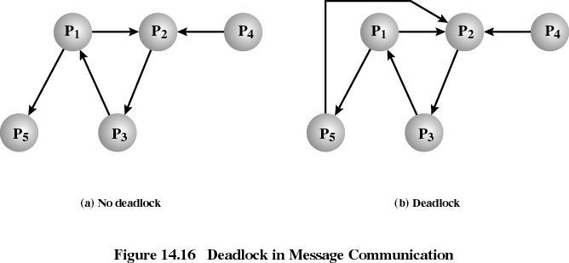
Deadlock in message communication: Mutual waiting (cont.)

Slide 99
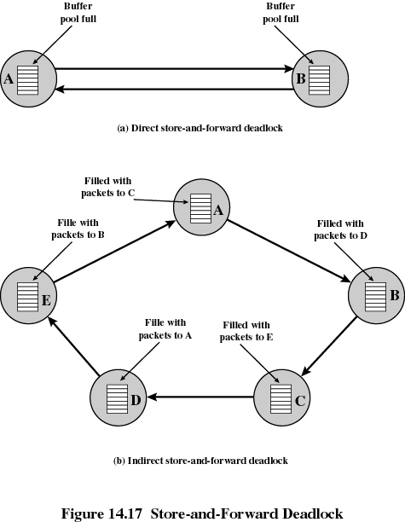
Deadlock in message communication
Unavailability of Message Buffers
Deadlock can occur in the allocation of buffers for the storage of messages in transit (Example: packet-switching data networks)
Direct store-and-forward deadlock
Example:
Two packet switching nodes, each using a common buffer pool from which buffers are assigned to packets on demand
Buffer space for A is filled with packets destined for B
Buffer space for B is filled with packets destined for A
Neither node can transmit or receive packets: deadlock
Solution: Use separate buffers, one for each link

Slide 100
Deadlock in message communication (cont.)
Unavailability of Message Buffers (cont.)
Indirect store-and-forward deadlock
For each node, the queue to the adjacent node in one direction is full with packets destined for the next node beyond

Slide 101
Deadlock in message communication: (cont.)
Unavailability of Message Buffers (cont.)
Deadlock in a distributed OS using message passing for inter-process communication
A non-blocking Send operation requires a buffer to hold outgoing messages
Example 1
Process X has a buffer of size n
After sending n messages, buffer is full
When sending message n+1, process X will block until sufficient buffer is freed
Example 2
Process X has a buffer of size n
Process Y has a buffer of size m
Both buffers, n and m, become full and the two processes are blocked: deadlock
Possible solutions
Prevention: estimate maximum number of messages in transit and allocate corresponding number of buffers
Detection: detect deadlock and roll back one of the processes

Slide 102
Summary
Centralized Deadlock Detection Algorithms
Large communication overhead.
Coordinator is performance bottleneck.
Possibility of single point of failure.
Distributed Deadlock Detection Algorithms
High Complexity.
Detection of phantom deadlocks possible.
Hierarchical Deadlock Detection Algorithms
Most Common.
Efficient.
Notes:
So to summarize I would like to make a brief analysis on the different architecture types of Deadlock Detection algorithms.
The centralized deadlock algorithms are not a very common and effective method as they incur large communication overhead. Also as this type depends on a Central Control Site so it represents over-reliability on a single node. Hence any degradation in performance in the central coordinator would become a performance bottleneck for the whole system. And also there is a possibility of failure of the control site thus jeopardizing the whole system.
The distributed deadlock detection algorithms are better than to centralized ones to an extent as they solve the problem of single point of control. But they are highly complex to implement. Besides they still are not able to solve the issue of phantom deadlocks.
The most common model in use today are the Hierarchical architectures. They are also the most efficient and solve the problems that are faced in other approaches.

