Slide 1
Test design techniques
SOFTWARE TESTING, VERIFICATION, VALIDATION AND QUALITY ASSURANCE
Sujan Tamrakar

Slide 2

Experience based testing technique
In experience-based techniques, people’s knowledge, skills and background are of prime importance to the test conditions and test cases.
The experience of both technical and business people is required, as they bring different perspectives to the test analysis and design process. Because of the previous experience with similar systems, they may have an idea as what could go wrong, which is very useful for testing.
Experience-based techniques go together with specification-based and structure-based techniques, and are also used when there is no specification, or if the specification is inadequate or out of date.
This may be the only type of technique used for low-risk systems, but this approach may be particularly useful under extreme time pressure – in fact this is one of the factors leading to exploratory testing.

Slide 3

Error Guessing
Error guessing is a technique where the experienced and good testers are encouraged to think of situations in which the software may not be able to cope.
Some people seem to be naturally good at testing and others are good testers because they have a lot of experience either as a tester or working with a particular system and so are able to find out its weaknesses. This is why an error guessing approach, used after more formal techniques have been applied to some extent, can be very effective.
It also saves a lot of time because of the assumptions and guessing made by the experienced testers to find out the defects which otherwise won’t be able to find.
The success of error guessing is very much dependent on the skill of the tester, as good testers know where the defects are most likely to be.

Slide 4

How to choose that which testing technique is best?
The internal factors that influence the decisions about which technique to use are:
Models used in developing the system- Since testing techniques are based on models used to develop that system, will to some extent govern which testing techniques can be used. For example, if the specification contains a state transition diagram, state transition testing would be a good technique to use.
Testers knowledge and their experience - How much testers know about the system and about testing techniques will clearly influence their choice of testing techniques. This knowledge will in itself be influenced by their experience of testing and of the system under test.
Similar type of defects - Knowledge of the similar kind of defects will be very helpful in choosing testing techniques (since each technique is good at finding a particular type of defect). This knowledge could be gained through experience of testing a previous version of the system and previous levels of testing on the current version.
Test objective - If the test objective is simply to gain confidence that the software will cope with typical operational tasks then use cases would be a sensible approach. If the objective is for very thorough testing then more rigorous and detailed techniques (including structure-based techniques) should be chosen.
Documentation – Whether or not documentation (e.g. a requirements specification) exists and whether or not it is up to date will affect the choice of testing techniques. The content and style of the documentation will also influence the choice of techniques (for example, if decision tables or state graphs have been used then the associated test techniques should be used).
Life cycle model used - A sequential life cycle model will lend itself to the use of more formal techniques whereas an iterative life cycle model may be better suited to using an exploratory testing approach.

Slide 5
How to choose that which testing technique is best?
The external factors that influence the decisions about which technique to use are:
Risk assessment - The greater the risk (e.g. safety-critical systems), the greater the need for more thorough and more formal testing. Commercial risk may be influenced by quality issues (so more thorough testing would be appropriate) or by time-to-market issues (so exploratory testing would be a more appropriate choice).
Customer and contractual requirements - Sometimes contracts specify particular testing techniques to use (most commonly statement or branch coverage).
Type of system used - The type of system (e.g. embedded, graphical, financial, etc.) will influence the choice of techniques. For example, a financial application involving many calculations would benefit from boundary value analysis.
Regulatory requirements - Some industries have regulatory standards or guidelines that govern the testing techniques used. For example, the aircraft industry requires the use of equivalence partitioning, boundary value analysis and state transition testing for high integrity systems together with statement, decision or modified condition decision coverage depending on the level of software integrity required.
Time and budget of the project - Ultimately how much time there is available will always affect the choice of testing techniques. When more time is available we can afford to select more techniques and when time is severely limited we will be limited to those that we know have a good chance of helping us find just the most important defects.

Slide 6

Project Success
Successful projects should have the following:
a well-defined scope and agreed understanding of intended outcomes
an active management of risks, issues and timely decision-making, supported by clear and short lines of reporting
an ongoing commitment and support from senior management
a senior individual with personal accountability and overall responsibility for the successful outcome of the project
an appropriately trained and experienced project team and, in particular, a project manager whose capabilities match the complexity of the project
well-defined and visibly managed processes, which are appropriate for the scale and complexity of the project.

Slide 7

Project Success
To increase the chances of success, projects should have the following:
clear and well-managed processes
a clearly defined purpose and limits
shared understanding of intended outcomes
realistic objectives
good management of risks and problems
thorough planning
timely decision-making supported by short, clear lines of reporting
strong leadership
commitment and support from senior management
a senior person with overall responsibility for the success of the project
a trained and experienced project manager who is suited to the particular project
a trained and experienced project team
clearly defined jobs and responsibilities
good communications.

Slide 8

Project Success
The most common reasons for project failure are:
following a method without thinking
being too confident of success
not having enough of a contribution from those with an interest
having unrealistic expectations
contributors or partners having too little involvement
poor communication
poor project specification
not enough resources
having the wrong people involved in the project
having too much reliance on one person
not enough planning – unrealistic time and resource estimates – unclear or unmeasurable project objectives – changing project objectives during the project
failure to manage risks and problems.

Slide 9



In-house project v/s Outsourced project
An in-house project is something developed by the company that is going to use it or created for mass/generic organizations.
A project that is executed within a company. The role of a project manager is to oversee a project from beginning to end. He will typically delegate tasks to people and ensure those tasks are completed on time and within budget.
The opposite of an in-house project is an outsourced project where they pay to other developers (companies) for building their product. Project for clients is the project/product that is developed for the specific customer based on their needs and demands and following their orders.

Slide 10
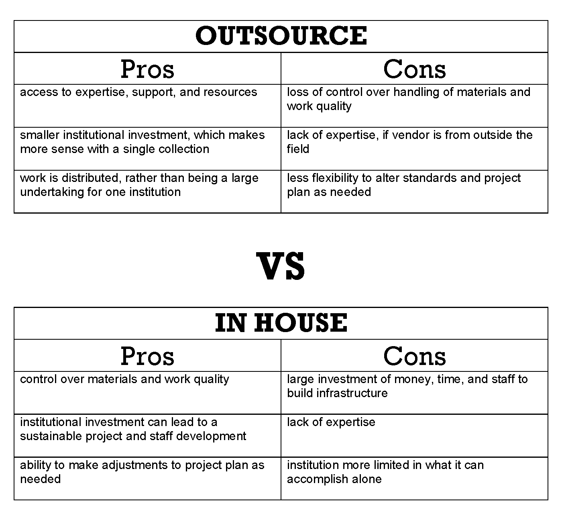

Slide 11
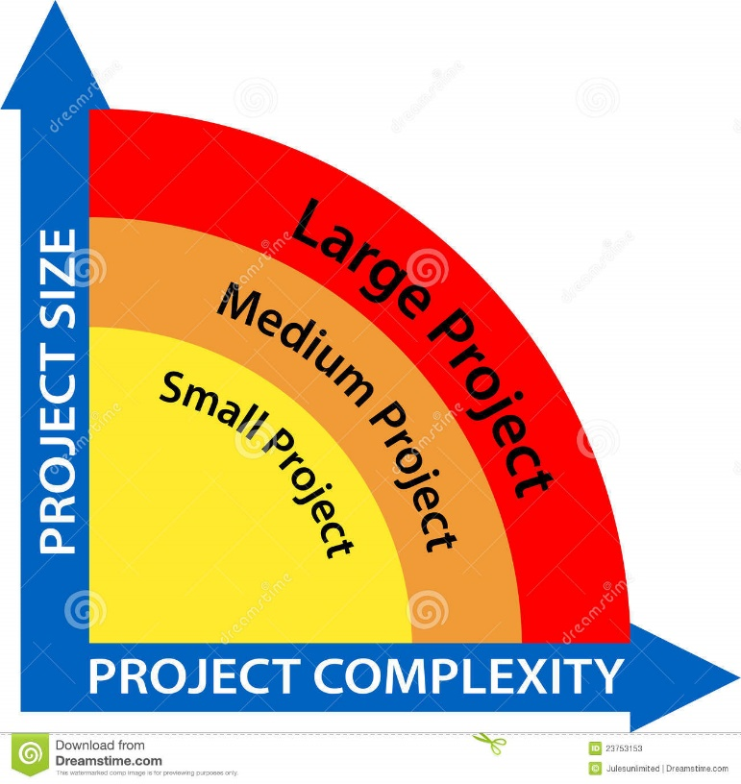
The Nature of Project Complexity
Some of the causes of project complexity:
Details – number of variables and interfaces
Ambiguity – lack of awareness of events and causality
Uncertainty – inability to pre-evaluate actions
Unpredictability – the inability to know what will happen
Dynamics – rapid rate of change
Social structure – numbers and types of interactions
Interrelationships – many interdependencies and interconnections exist
Therefore, FOR PROPER MANAGEMENT, applying complexity thinking to projects involves:
selecting appropriate methods and techniques,
assigning project leadership and project cycles based on the project profile and the complexity dimensions that are present,
and building complex, adaptive business solutions that are easy to change as the business needs evolve.

Slide 12
Purpose and importance of test plans
Test plan is the project plan for the testing work to be done. It is not a test design specification, a collection of test cases or a set of test procedures; in fact, most of our test plans do not address that level of detail.
3 main reasons to write the test plans:
First, by writing a test plan it guides our thinking. Writing a test plan forces us to confront the challenges that await us and focus our thinking on important topics. By using a template for writing test plans helps us remember the important challenges.
Second, the test planning process and the plan itself serve as the means of communication with other members of the project team, testers, peers, managers and other stakeholders. This communication allows the test plan to influence the project team and the project team to influence the test plan, especially in the areas of organization-wide testing policies and motivations; test scope, objectives and critical areas to test; project and product risks, resource considerations and constraints; and the testability of the item under test. We can complete this communication by circulating one or two test plan drafts and through review meetings.
Third, the test plan helps us to manage change. During early phases of the project, as we gather more information, we revise our plans. As the project evolves and situations change, we adapt our plans. By updating the plan at major milestone helps us to keep testing aligned with project needs. As we run the tests, we make final adjustments to our plans based on the results.

Slide 13

Things to keep in mind while planning tests
A good test plan is always kept short and focused. At a high level, you need to consider the purpose served by the testing work. Hence, it is really very important to keep the following things in mind while planning tests:
What is in scope and what is out of scope for this testing effort?
What are the test objectives?
What are the important project and product risks?
What constraints affect testing (e.g., budget limitations, hard deadlines, etc.)?
What is most critical for this product and project?
Which aspects of the product are more (or less) testable?
What should be the overall test execution schedule and how should we decide the order in which to run specific tests?
How to split the testing work into various levels (e.g., component, integration, system and acceptance).

Slide 14
Things to keep in mind while planning tests
Typical factors for ‘entry criteria’ and ‘exit-criteria’ are:
Acquisition and supply: the availability of staff, tools, systems and other materials required.
Test items: the state that the items to be tested must be in to start and to finish testing.
Defects: the number known to be present, the arrival rate, the number predicted to remain, and the number resolved.
Tests: the number run, passed, failed, blocked, skipped, and so forth.
Coverage: the portions of the test basis, the software code or both that have been tested and which have not.
Quality: the status of the important quality characteristics for the system.
Money: the cost of finding the next defect in the current level of testing compared to the cost of finding it in the next level of testing (or in production).
Risk: the undesirable outcomes that could result from shipping too early (such as latent defects or untested areas) – or too late (such as loss of market share).

Slide 15
Estimating what testing will involve and what it will cost
Testing is a process rather than a single activity.
Hence, we need to break down a testing process into phases using the fundamental test process like:
planning and control;
analysis and design;
implementation and execution;
evaluating exit criteria and reporting;
and test closure.
Within each phase we identify activities and within each activity we identify tasks and perhaps subtasks. To identify the activities and tasks, we work both forward and backward.

Slide 16

Estimation techniques in software testing
There are two techniques for estimation:
1. One involves people with expertise on the tasks to be done (involves analysing metrics from past projects and from industry data.)
We ask the individual contributors and experts involves working with experienced staff members to develop a work-breakdown structure for the project.
The idea is to draw on the collective wisdom of the team to create your test estimate. This technique is often called ‘bottom up’ estimation because you start at the lowest level of the hierarchical breakdown in the work-breakdown structure – the task – and let the duration, effort, dependencies and resources for each task add up across all the tasks.
More reliable approach involves classifying the project in terms of size (small, medium or large) and complexity (simple, moderate or complex) and then observing on average how long project of a particular size and complexity combination have taken in the past.

Slide 17
Estimation techniques in software testing
2. Other involves consulting the people who will do the work.
Even the best estimate must be negotiated with management.
Negotiating sessions display amazing variety, depending on the people involved. It’s not unusual for management to look for smart ways to accelerate the schedule or to press for equivalent coverage in less time or with fewer resources.
Our experience has been that successful negotiations about estimates are those where the focus is less on winning and losing and more about figuring out how best to balance competing pressures in the realms of quality, schedule, budget and features.

Slide 18

Factors affecting test effort in software testing
The test strategies you pick will have a major influence on the testing effort. The factors which affect the test effort are:
While good project documentation is a positive factor, it’s also true that having to produce detailed documentation, such as accurately specified test cases, results in delays. During test execution, having to maintain such detailed documentation requires lots of effort, as does working with fragile test data that must be maintained or restored frequently during testing.
Increasing the size of the product leads to increase in the size of the project and the project team. Increases in the project and project team increases the difficulty of predicting and managing them. This leads to the disproportionate rate of collapse of large projects.
The life cycle itself is an influential process factor, as the V-model tends to be more fragile in the face of late change while incremental models tend to have high regression testing costs.
Time pressure is another factor to be considered. Pressure should not be an excuse to take unwarranted risks. However, it is a reason to make careful, considered decisions and to plan and re-plan intelligently throughout the process.
People execute the process, and people factors are as important as or more important than any other. Important people factors include the skills of the individuals and the team as a whole, and the alignment of those skills with the project’s needs. It is true that there are many troubling things about a project but an excellent team can often make good things happen on the project and in testing.

Slide 19
Thank you !

