Slide 1
Test Strategy, Monitoring & Control
Configuration Management
SOFTWARE TESTING, VERIFICATION, VALIDATION AND QUALITY ASSURANCE
Sujan Tamrakar

Slide 2

TEST STRATEGY (Tactic / Approach / Plan)
Test strategy is one of the most powerful factor in the success of the test effort and the accuracy of the test plans and estimates. This factor is under the control of the testers and test leaders.
Major types of test strategies:
Analytical (risk-based strategy involves performing a risk analysis using project documents and stakeholder input, analytical test strategy is the requirements-based strategy, where an analysis of the requirements specification forms the basis for planning)
Model-based (If the behaviour of the system under test conforms to that predicted by the model, the system is deemed to be working.)
Methodical (failure based, experience based, checklist based)
Process – or standard-compliant (following the standard - IEEE 829, Extreme Programming)
Dynamic (concentrating on finding as many defects as possible during test execution and adapting to the realities of the system under test as it is when delivered)
Consultative or directed (reliance on a group of non-testers like developers, users to guide or perform the testing effort)
Regression-averse (set of procedures – usually automated – that allow them to detect regression defects) [ averse = opposed ]

Slide 3
TEST STRATEGY
Some of these strategies are more preventive, others more reactive.
For example, analytical test strategies involve upfront analysis of the test basis, and tend to identify problems in the test basis prior to test execution. This allows the early – and cheap – removal of defects. That is a strength of preventive approaches.
Dynamic test strategies focus on the test execution period. Such strategies allow the location of defects and defect clusters that might have been hard to anticipate until you have the actual system in front of you. That is a strength of reactive approaches.
How do you know which strategies to pick for the best chance of success?
Based on Risks, Skills, Objectives, Regulations, Product and Business.
You must choose testing strategies with an eye towards the factors mentioned earlier, the schedule, budget, and feature constraints of the project and the realities of the organization and its politics.

Slide 4

TEST MONITORING
Purposes:
Give the test team and the test manager feedback on how the testing work is going, allowing opportunities to guide and improve the testing and the project.
Provide the project team with visibility about the test results.
Measure the status of the testing, test coverage and test items against the exit criteria to determine whether the test work is done.
Gather data for use in estimating future test efforts.
For small projects, the test leader can gather test progress monitoring information manually using documents, spreadsheets and simple databases.
For large teams, distributed projects and long-term test efforts, we find that the efficiency and consistency of data collection is done by the use of automated tools.

Slide 5

TEST MONITORING
One way to keep the records of test progress information is by using the Standard test log template like test-by-test information in spreadsheets with multiple rows of features and columns with status, date, bug_Id, duration, comment, etc.
It is also common to monitor test progress during the test execution period by looking at the number of defects found and fixed. Graph that plots the total number of defects opened and closed over the course of the test execution. It can show defect density/failure rates.
They may plot the number of unresolved defects normalized by the size of the product. Once the number of unresolved defects falls below some predefined threshold – for example, three per million lines of code – then the product may be deemed to have met the defect density exit criteria.

Slide 6

TEST CONTROL
Projects do not always open up as planned. If the planned product and the actual product is different then risks become occurrences, there will be changes. Hence it is required and needed to bring the project back under control.
Test control is about guiding and corrective actions to try to achieve the best possible outcome for the project. The specific guiding actions depend on what we are trying to control. Let us take few hypothetical examples:
A portion of the software under test will be delivered late but market conditions dictate that we cannot change the release date. At this point of time test control might involve re-prioritizing the tests so that we start testing against what is available now.
For cost reasons, performance testing is normally run on weekday evenings during off-hours in the production environment. Due to unexpected high demand for your products, the company has temporarily adopted an evening shift that keeps the production environment in use 18 hours a day, five days a week. In this context test control might involve rescheduling the performance tests for the weekend.
Hence, above examples show that how test control affect testing.

Slide 7
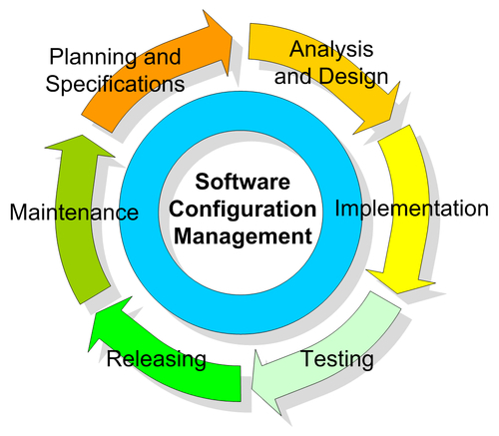
CONFIGURATION MANAGEMENT
The task of tracking and controlling changes in the software
Practices include revision control and the establishment of baselines. If something goes wrong, SCM can determine what was changed and who changed it.
If a configuration is working well, SCM can determine how to replicate it across many hosts.
Configuration management determines clearly about the items that make up the software or system. These items include source code, test scripts, third-party software, hardware, data and both development and test documentation.
Example: SVN (SubVersioN), GIT

Slide 8
CONFIGURATION MANAGEMENT
is also about making sure that these items are managed carefully.
also supports the build process, which is important for delivery of a test release into the test environment
allows us to keep the record of what is being tested to the underlying files and components that make it up. This is very important.
Configuration management is a topic that is very complex. So, advanced planning is very important to make this work.
During the project planning stage – and perhaps as part of your own test plan – make sure that configuration management procedures and tools are selected.
As the project proceeds, the configuration process and mechanisms must be implemented, and the key interfaces to the rest of the development process should be documented.

Slide 9
Thank you !
Assignment:
Write about Test Level and Test Types.
Detailed notes on Equivalence Partitioning, Boundary Value Analysis, Decision Table Testing, State Transition Testing, Use Case Testing.
Due: Sunday 11th Mar. 2018 (Hard deadline)

