Slide 1
TESTING MOBILE APPLICATION
Software Testing, Verification, Validation and Quality Assurance
Sujan Tamrakar

Slide 2

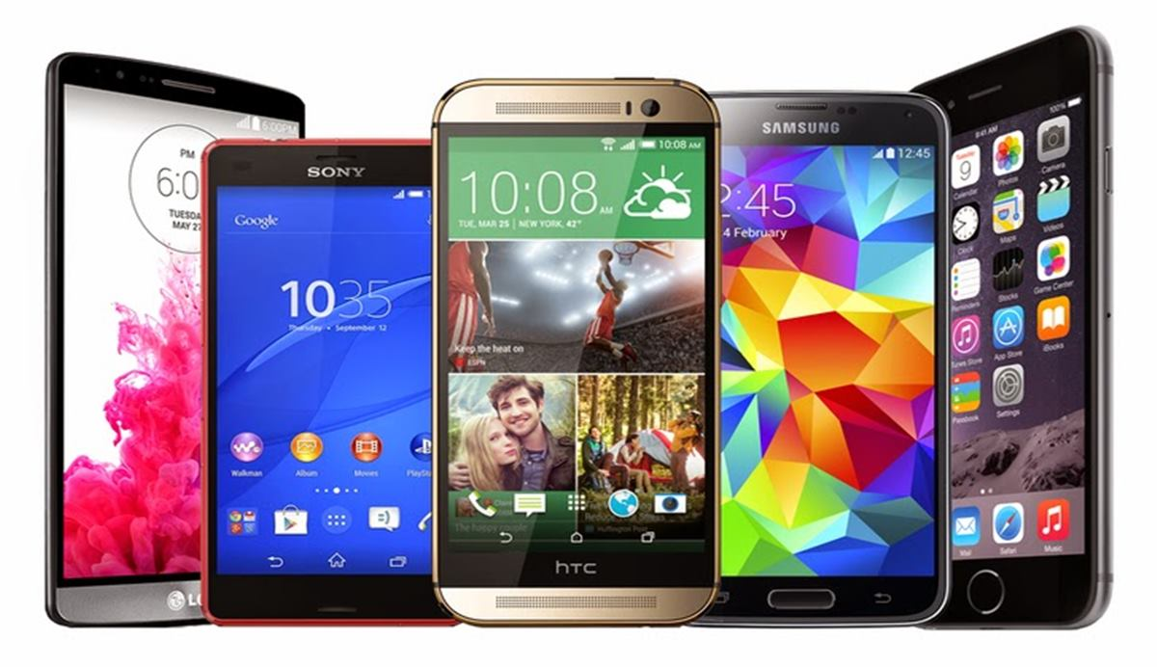

Mobile application testing
Mobile application testing is a process by which application developed for hand held mobile devices is tested for its functionality, usability and consistency.
Mobile application testing can be automated or manual type of testing.
Mobile applications either come pre-installed or can be installed from mobile software distribution platforms.

Slide 3
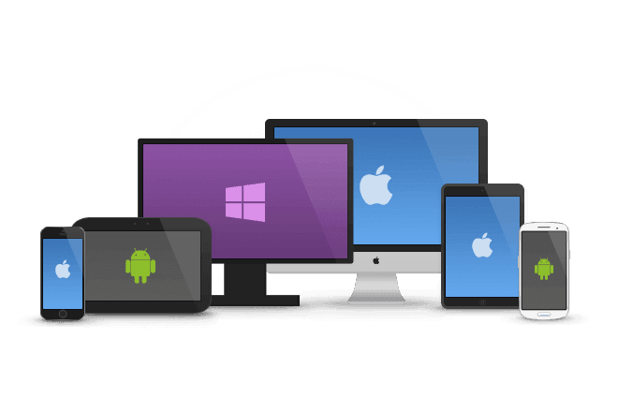
Key Challenges in Mobile Application Testing
Variety of Mobile Devices- Mobile devices differ in screen sizes, input methods (QWERTY, touch, normal) with different hardware capabilities.
Diversity in Mobile Platforms/OS- There are different Mobile Operating Systems in the market. The major ones are Android, iOS, BREW, BREWMP, Symbian, Windows Phone, and BlackBerry. Each operating system has its own limitations. Testing a single application across multiple devices running on the same platform and every platform poses a unique challenge for testers.
Mobile network operators- There are over 400 mobile network operators in the world; out of which some are CDMA, some GSM. Each network operator uses a different kind network infrastructure and this limits the flow of information.
Scripting- The variety of devices makes executing the test script (Scripting) a key challenge. As devices differ in keystrokes, input methods, menu structure and display properties single script does not function on every device. [menu button from hardware or software]

Slide 4
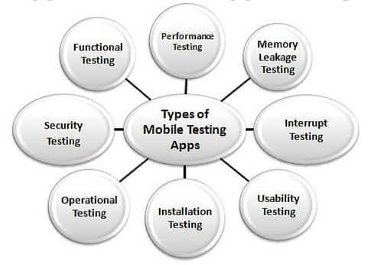
Types of Mobile Application Testing
Functional Testing - Functional testing ensures that the application is working as per the requirements. Most of the test conducted for this is driven by the user interface and call flows.
Laboratory Testing - Laboratory testing, usually carried out by network carriers, is done by simulating the complete wireless network. This test is performed to find out any glitches when a mobile application uses voice and/or data connection to perform some functions.
Performance Testing - This testing process is undertaken to check the performance and behaviour of the application under certain conditions such as low battery, bad network coverage, low available memory, simultaneous access to application’s server by several users and other conditions. Performance of an application can be affected from two sides’ application’s server side and client’s side. Performance testing is carried out to check both.

Slide 5
Types of Mobile Application Testing
Interrupt Testing - An application while functioning may face several interruptions like incoming calls or network coverage outage and recovery. The different types of interruptions are:
Incoming and Outgoing SMS and MMS ~ Incoming and Outgoing calls
Incoming Notifications ~ Battery Removal
Cable Insertion and Removal for data transfer ~ Network outage and recovery
Media Player on/off ~ Device Power cycle
An application should be able to handle these interruptions by going into a suspended state and resuming afterwards.
Usability testing - Usability testing is carried out to verify if the application is achieving its goals and getting a favourable response from users. This is important as the usability of an application is its key to commercial success (it is nothing but user friendliness).

Slide 6
Types of Mobile Application Testing
Installation testing - Certain mobile applications come pre-installed on the device whereas others have to be installed from the store. Installation testing verifies that the installation process goes smoothly without the user having to face any difficulty. This testing process covers installation, updating and uninstalling of an application.
Certification Testing - To get a certificate of compliance, each mobile device/application needs to be tested against the guidelines set by different mobile platforms.
Memory Leakage Testing - Memory leakage happens when a computer program or application is unable to manage the memory it is allocated resulting in poor performance of the application and the overall slowdown of the system. As mobile devices have significant constraints of available memory, memory leakage testing is crucial for the proper functioning of an application.

Slide 7
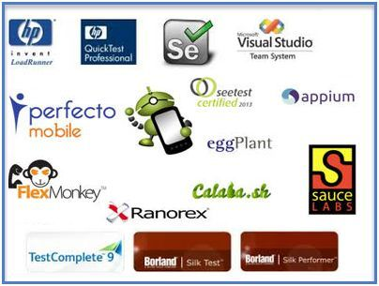
Some Mobile Application Testing Tools
Some tools that are being used to test code quality in general for mobile applications are as follows:
Cross-Platform (Android and iOS)
Testmunk - Automated Mobile App Testing for iOS and Android (http://testmunk.com)
Appium - Mobile device automation for functional testing (http://appium.io)
Calabash - Mobile device automation for functional testing (http://calaba.sh)
Testdroid - Mobile App and Game test automation on real Android and iOS devices
[Web/Google Analytics, Check on legacy devices (old, most used in market), Emulator/Real device ~ different h/w features, screen size, memory, network speed., Cloud test lab by google ]

Slide 8
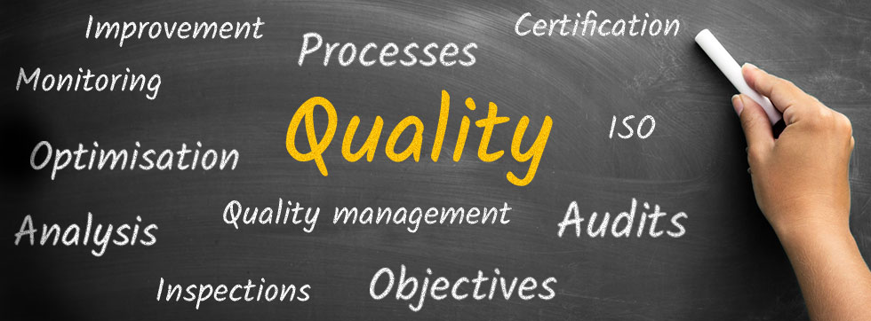
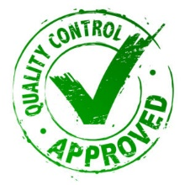
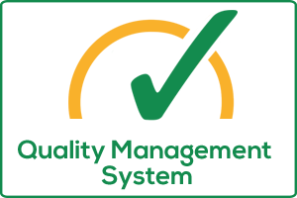
Quality management

Slide 9
Quality: Degree to which a set of inherent characteristics fulfills requirements. – ISO
Can also be defined as FITNESS FOR USE.
Can be judged as poor, good, excellent.
Total Quality Management:
“A management approach for an organization, centered on quality, based on the participation of all its members, and aiming at long-term success through customer satisfaction and benefits to all members of the organization and to society.”
It involves entire organization in the management of quality. It aims to reduce process variation within the organization.

Slide 10

Product Quality: focuses on core functionality (main features) and ancillary functionality (supplementary/extra supporting features) to achieve the product fineness.
Process Quality: Most quality problems could be resolved by improving the process itself. Process should be developed such that it produce defect-free products.
Following are the 3 steps to achieve process quality:
1. Process definition
2. Process improvement
3. Process stabilization

Slide 11
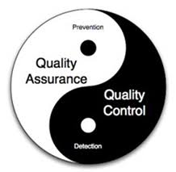
Quality of a software product is measured at the release stage. Measurement is quantifying the quality of an application. Measurement can be based on following parameters:
An organizational environment that fosters product quality
Effectiveness of organizational quality assurance activities (should eliminate or minimize residual defects passed on to customer)
Peer review coverage of software artifacts - Peer review coverage rating ‘PRCR’ is based on following percentage of artifacts covered:
PRCR = (Number of software artifacts covered by peer review / Total number of software artifacts) * 100

Slide 12

Unit testing coverage of code – independent testing by person who did not code the artifact. Unit testing coverage rating ‘UTCR’ is based on following percentage of artifacts covered:
UTCR = (Number of software artifacts covered by unit testing / Total number of software artifacts) * 100
Exhaustiveness of software testing – it includes two aspects: the number of tests that have been conducted and the number of test cases that should have been executed. A rating for exhaustiveness of tests conduct is based on following percentage:
(Number of tests actually conducted / Number of tests that should have been conducted) * 100

Slide 13

Few test metrics:
Schedule variance = (actual time taken – planned time) / planned time * 100
Effort variance = (actual effort – planned effort) / planned effort * 100
Test case coverage = (total test cases – requirements that cannot be mapped to test cases ) / total test cases * 100
Customer satisfaction = number of complaints / period of time
Defect age = fixed date – reported date
Defect density = number of defects in the module
Defect cost = cost to analyze the defect + cost to fix it + cost of failures already incurred due to it
Bug clearance ratio = the ratio between valid and invalid bugs

Slide 14

ISO * International Organization for Standardization * Applicable for all types of organizations (not only software) * Based on PDCA cycle and 8 quality management principles
Software Quality Standards

Slide 15
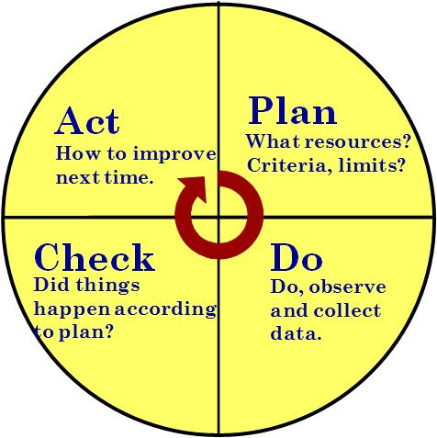
* PDCA – PLAN DO CHECK ACT ] Define a Plan ] Do / Execute the plan ] Check the results ] Take necessary Action
Software Quality Standards
ISO

Slide 16
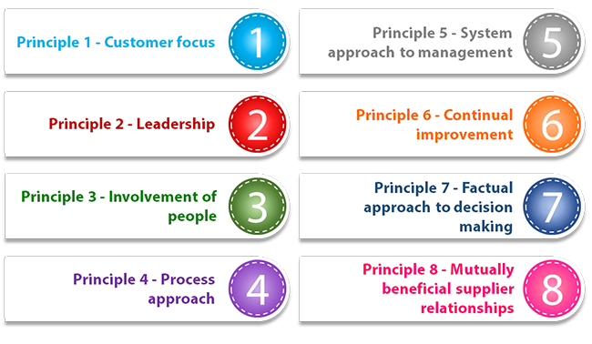
* 8 Quality management principles
Software Quality Standards
ISO

Slide 17
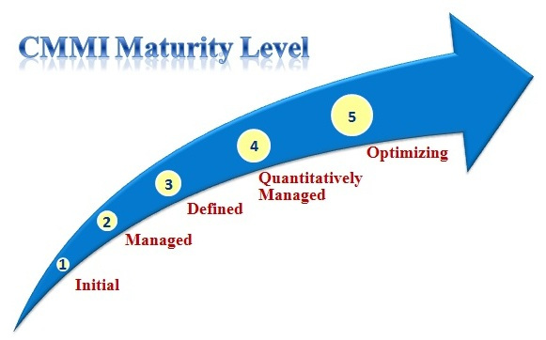

* Capability Maturity Model Integration * Given to only IT based companies * Given based on process followed by company * Certification is given in different levels. * Each level has several KPA’s (key process areas)
Software Quality Standards
CMMI

Slide 18
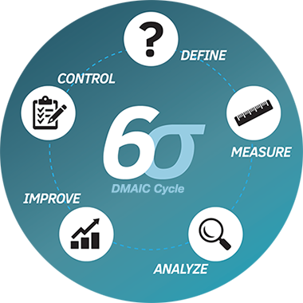

* Given to any type of company * Given based on quality produced by the company * Seeks to improve the quality output of process by identifying and removing the causes of defects (errors) and minimizing variability in manufacturing and business processes. * A six sigma process is one in which 99.99966% of all opportunities to produce some feature of a part are statistically expected to be free of defects (3.4 defective features / million opportunities).
Software Quality Standards
Six Sigma

Slide 19

This slide marks the end of the Syllabus.

