Slide 1
Software Testing, Verification, Validation and Quality Assurance
Sujan Tamrakar
WHAT | WHAT NOT | WHY | HOW | WHO | WHEN

Slide 2
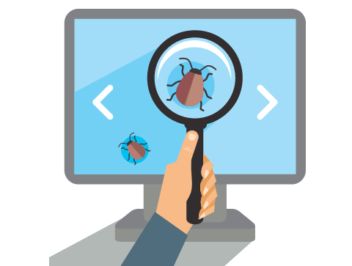
WHAT is testing?
Process of evaluating a system by manual or automated means to verify that it satisfies specified requirements. – IEEE 83a
Process of executing a program/system with the intent of finding errors. – Myers
(basically a task of locating errors)
WHAT | WHAT NOT | WHY | HOW | WHO | WHEN

Slide 3
Testing : a critical element of SQA ultimate process to ensure the correctness of product activity that should be done throughout the whole development process and not only at last phase.
Quality Testing Process
Quality Product
WHAT | WHAT NOT | WHY | HOW | WHO | WHEN
Notes:
One should not test a product to show that it works. Rather one should start with the assumption that the program contains errors & then test the program to find as many errors as possible.

Slide 4
Testing is not
Process of demonstrating that errors are not present.
Process to show that a program performs its intended functions correctly.
Process of establishing confidence that a program does what it is supposed to do.
WHAT | WHAT NOT | WHY | HOW | WHO | WHEN

Slide 5

WHY testing?
To find errors.
To ensure that software delivered does not have defects.
To ensure all the product functionalities work as per the specifications.
Post-release removal of defects is most expensive.
Buggy software can be harmful to data, property and life.
To improve quality thus, having good business & trust.
A successful test is one that causes the program to fail.
(is it doing what it is supposed to do?)
WHAT | WHAT NOT | WHY | HOW | WHO | WHEN

Slide 6
HOW to test?
Demonstration oriented | Positive testing
- to show the software works
- program executed in normal straight-forward flow
- all branches may not be tested
- to satisfy the customer
Destruction oriented | Negative testing
- to show the software doesn’t work
- sadistic approach
- testing mainly focuses on it
Debugging oriented
- To identify the errors during debugging the program
WHAT | WHAT NOT | WHY | HOW | WHO | WHEN

Slide 7
WHO should test?
Every team member and not only testing team.
Dedicated and skilled testing unit personnel.
Tester should have knowledge in:
Software testing techniques - Tester must learn testing techniques including writing test cases.
Application Under Test (AUT) - Tester must invest time in learning about the application.
WHAT | WHAT NOT | WHY | HOW | WHO | WHEN

Slide 8
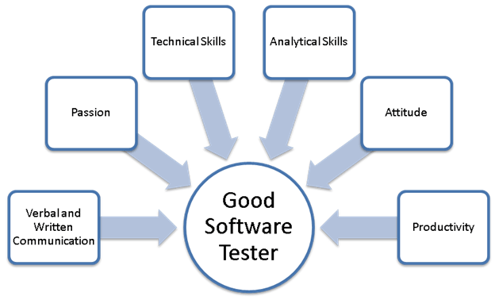
WHO should test?
WHAT | WHAT NOT | WHY | HOW | WHO | WHEN

Slide 9
WHEN to start test?
From the very beginning of project development.
Should start with small measurable unit → Testing integrated components → Finally entire application level.
If not started early, cost (human resource, time, money) of bug will increase dramatically over time.
… but when to stop testing ???
WHAT | WHAT NOT | WHY | HOW | WHO | WHEN

Slide 10
WHEN to stop test? “EXIT CRITERIA”
(TESTING IS POTENTIALLY ENDLESS)
Cannot test till all defects are unearthed & removed.
At some point, have to stop testing & ship the product.
Question is WHEN ???
Answer is trade-off between BUDGET, TIME & QUALITY
Approaches:
Pessimistic: stop testing when any of the allocated resources (budget, time, test cases) are exhausted.
Optimistic: stop when either reliability meets the requirement or the benefit from continuing testing can’t justify the testing cost.
WHAT | WHAT NOT | WHY | HOW | WHO | WHEN

Slide 11
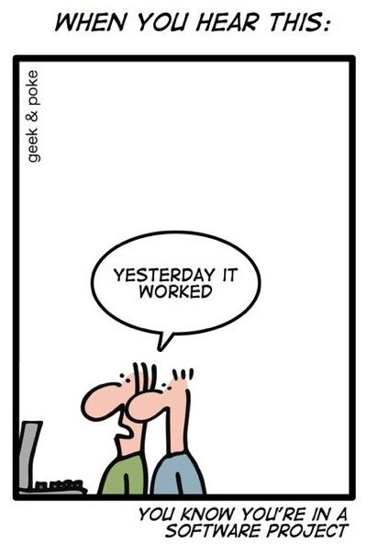
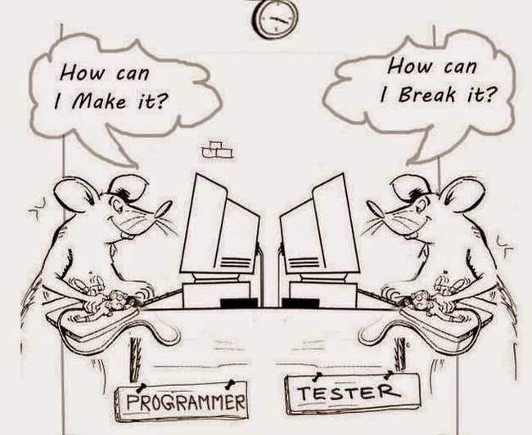
Thank you.

