Slide 1
PSYCHOLOGY OF TESTING
Software Testing, Verification, Validation and Quality Assurance
Sujan Tamrakar

Slide 2
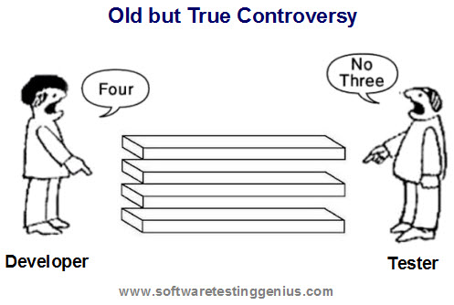
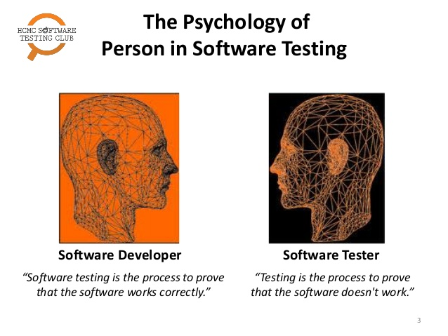

Slide 3
Comparison of the mind-set of the tester and developer:
If we are developing applications we are working positively to solve the problems during the development process and to make the product according to the user specification.
While testing or reviewing a product we are looking for the defects or failures in the product.
Thus building the software requires a different mind-set from testing the software.

Slide 4
The balance between self-testing and independent testing:
We all know that it is difficult to find our own mistakes so, programmers depend on others to help test their work
It does not mean that the tester cannot be the programmer, or that the programmer cannot be the tester, although they often are separate roles
Programmers always test their component which they built : they always test their own code before giving it to anyone
This other person might be other developer from the same team or the testing specialists or professional testers. Giving applications to the testing specialists or professional testers allows an independent test of the system.

Slide 5
Degree of independence avoids author bias & is often more effective at finding defects and failures :
There is several level of independence in software testing which is listed here from the lowest level of independence to the highest:
Tests by the person who wrote the item.
Tests by another person within the same team, like another programmer.
Tests by the person from some different group such as an independent test team.
Tests by a person from a different organization or company, such as outsourced testing or certification by an external body.
When tested by other unacquainted (unaware) testers, there won’t be bias (unfairness) to point out bugs. Hence, more effectiveness in bug hunting and fixing.

Slide 6
Clear & courteous communication & feedback on defects between tester & developer :
We all make mistakes and we sometimes get annoyed or upset or depressed when someone points them out.
While reporting the bug, testers need to be very careful as how they react or report the defects and failures to the programmers.
Testers are pleased because they found a good bug but how will the requirement analyst, the designer, developer, project manager and customer react.
Because testing can be seen as destructive activity, one need to take care while reporting defects and failures as objectively and politely as possible.
The people who build the application may react defensively and take this reported defect as personal criticism.
The project manager may be annoyed with everyone for holding up the project.
The customer may lose confidence in the product because he can see defects.
Notes:
Courteous = polite, well-mannered

Slide 7
CODE OF ETHICS
Principles, Moral Code

Slide 8
A written set of guidelines issued by an organization to its workers & management to help them conduct their actions in accordance with its primary values & ethical standards.
Involvement in software testing enables individuals to learn confidential and privileged information.
A code of ethics is necessary, among other reasons to ensure that the information is not put to inappropriate use.

Slide 9
Exercise honesty, objectivity, and diligence in the performance of their duties and responsibilities.
Exhibit loyalty in all matters pertaining to the affairs of their organization or to whomever they may be rendering a service. However, they shall not knowingly be party to any illegal or improper activity.
Not engage in acts or activities which are discreditable to the profession of information services quality assurance or their organization.
Refrain from entering any activity that may be in conflict with the interest of their organization or would prejudice their ability to carry out objectively their duties and responsibilities.
Not accept anything of value from an employee, client, customer, supplier, or business associate of their organization that would impair or be presumed to impair their professional judgment and integrity.
Undertake only those services that they can reasonably expect to complete with professional competence.

Slide 10
Be prudent/careful in the use of information acquired in the course of their duties. They shall not use confidential information for any personal gain nor in any manner that would be contrary to law or detrimental to the welfare of their organization.
Reveal all material facts known to them that, if not revealed, could either distort reports of operation under review or conceal unlawful practices.
Continually strive for improvement in their proficiency, and in the effectiveness and quality of their service.
Maintain and improve their professional competency through continuing education.
Cooperate in the development and interchange of knowledge for mutual professional benefit.
Maintain high personal standards of moral responsibility, character, and business integrity.

Slide 11
Thank you.

