Slide 1
Testing throughout
the Software Lifecycle
Software Testing, Verification, Validation and Quality Assurance
Sujan Tamrakar

Slide 2
Software life cycle models describe phases of the software cycle and the order in which those phases are executed.
Each phase produces deliverables required by the next phase in the life cycle.
There are following six phases in every Software development life cycle model:
1. Requirement gathering and Analysis
2. Design
3. Implementation or Coding
4. Testing
5. Deployment
6. Maintenance
Artifacts

Slide 3
1) Requirement gathering and analysis:
Business requirements are gathered in this phase.
Main focus area for project managers and stake holders.
Meetings with managers, stake holders and users are held in order to determine the requirements like; who is going to use the system? How will they use the system? What data should be input into the system? What data should be output by the system?
These are general questions that get answered during a requirements gathering phase.
After requirement gathering, these requirements are analysed for their validity
The possibility of incorporating the requirements in the system to be developed is also studied.
Finally, a Requirement Specification document is created which serves the purpose of guideline for the next phase of the model.

Slide 4
2) Design:
The system and software design is prepared from the requirement specifications which were studied in the first phase.
System Design helps in specifying hardware and system requirements and also helps in defining overall system architecture.
The system design specifications serve as input for the next phase of the model.

Slide 5
3) Implementation / Coding:
On receiving system design documents, the work is divided in modules/units and actual coding is started.
Since, in this phase the code is produced so it is the main focus for the developer.
This is the longest phase of the software development life cycle.

Slide 6
4) Testing:
After the code is developed it is tested against the requirements to make sure that the product is actually solving the needs addressed and gathered during the requirements phase.
During this phase unit testing, integration testing, system testing, acceptance testing are done.
5) Deployment:
After successful testing the product is delivered / deployed to the customer for their use.

Slide 7
6) Maintenance:
Once the customers starts using the developed system then the actual problems come up and needs to be solved from time to time.
This process where the care is taken for the developed product is known as maintenance.

Slide 8
Software development models (Methodologies)

Slide 9
Choosing right model for developing the software product/application is very important.
Based on the software application/product, the development model and testing processes are carried out (whichever suits the best).
Types:
1. Waterfall model
2. V model
3. Incremental model
4. RAD model
5. Agile model
6. Iterative model
7. Spiral model

Slide 10
Waterfall model - linear-sequential life cycle model
Very simple to understand and use.
Each phase must be completed fully before the next phase can begin
For small projects (moderately easy and simple)
A review takes place to determine if the project is on the right path and whether to continue or discard the project
Testing starts only after the development is complete.
In waterfall model phases do not overlap

Slide 11
Waterfall model - linear-sequential life cycle model

Slide 12
Waterfall model - linear-sequential life cycle model
Pros: Simple and easy to understand and use. Easy to manage due to the rigidity of the model – each phase has specific deliverables and a review process Phases are processed and completed one at a time. Phases do not overlap. Works well for smaller projects where requirements are very well understood. | Cons: Once an application is in the testing stage, it is very difficult to go back and change something No working software is produced until late during the life cycle. High amounts of risk and uncertainty. Not a good model for complex and object-oriented projects. Poor model for long and ongoing projects. Not suitable for the projects where requirements are at a moderate to high risk of changing.

Slide 13
V-model - Verification and Validation model / sequential development model
VERIFICATION: ARE WE BUILDING THE PRODUCT RIGHT?
VALIDATION: ARE WE BUILDING THE RIGHT PRODUCT?

Slide 14
V-model - Verification and Validation model / sequential development model
Each phase must be completed before the next phase begins.
Testing of the product is planned in parallel with a corresponding phase of development.

Slide 15
V-model - Verification and Validation model / sequential development model
Pros: Testing activities like planning, test designing happens well before coding. This saves a lot of time. Hence higher chance of success over the waterfall model. Proactive defect tracking – that is defects are found at early stage. Avoids the downward flow of the defects. Works well for small projects where requirements are easily understood. | Cons: Least flexible. Software is developed during the implementation phase, so no early prototypes of the software are produced. If any changes happen in midway, then the test documents along with requirement documents has to be updated.

Slide 16
Incremental model
Whole requirement is divided into various builds
Multiple development cycles take place here, making the life cycle a “multi-waterfall” cycle.
Cycles are divided up into smaller, more easily managed modules.
Each module passes through the requirements, design, implementation and testing phases. A working version of software is produced during every cycle.
Each subsequent release of the module adds function to the previous release.
The process continues till the complete system is achieved.

Slide 17
Incremental model

Slide 18
Incremental model
Pros: Generates working software quickly and early during the software life cycle. This model is more flexible – less costly to change scope and requirements. It is easier to test and debug during a smaller iteration. In this model customer can respond to each built. Lowers initial delivery cost. Easier to manage risk because risky pieces are identified and handled during it’s iteration. | Cons: Needs good planning and design. Needs a clear and complete definition of the whole system before it can be broken down and built incrementally. Total cost is higher than waterfall.

Slide 19
Iterative model
Does not attempt to start with a full specification of requirements.
Instead, development begins by specifying and implementing just part of the software, which can then be reviewed in order to identify further requirements.
This process is then repeated, producing a new version of the software for each cycle of the model.

Slide 20
Iterative model

Slide 21
Iterative model
Pros: We can only create a high-level design of the application before we actually begin to build the product and define the design solution for the entire product. Later on we can design and built a skeleton version of that, and then evolve the design based on what had been built. We are building and improving the product step by step. Hence we can track the defects at early stages We can get the reliable user feedback. | Cons: No overlapping of iteration Costly system architecture or design issues may arise because not all requirements are gathered up front for the entire lifecycle

Slide 22
RAD model - Rapid Application Development
The components or functions are developed in parallel as if they were mini projects.
The developments are time boxed, delivered and then assembled into a working prototype.
This can quickly give the customer something to see and use and to provide feedback regarding the delivery and their requirements.

Slide 23
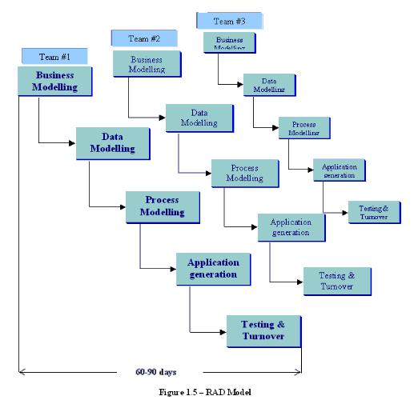
RAD model - Rapid Application Development

Slide 24
RAD model - Rapid Application Development
Pros: Reduced development time. Increases reusability of components Quick initial reviews occur Encourages customer feedback Integration from very beginning solves a lot of integration issues. | Cons: Depends on strong team and individual performances for identifying business requirements. Only system that can be modularized can be built using RAD Requires highly skilled developers/designers. High dependency on modelling skills Inapplicable to cheaper projects as cost of modelling and automated code generation is very high.

Slide 25
Spiral model
More emphasis placed on risk analysis
Four phases: planning, risk analysis, engineering and evaluation
The baseline spiral, starting in the planning phase, requirements are gathered and risk is assessed. Each subsequent spirals builds on the baseline spiral.

Slide 26
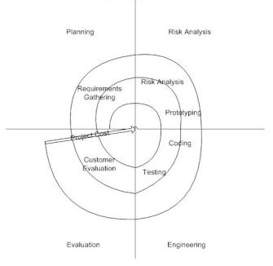
Spiral model

Slide 27
Spiral model
Pros: High amount of risk analysis hence, avoidance of Risk is enhanced. Good for large and mission-critical projects. Strong approval and documentation control. Additional Functionality can be added at a later date. Software is produced early in the software life cycle. | Cons: Can be a costly model to use. Risk analysis requires highly specific expertise. Project’s success is highly dependent on the risk analysis phase. Doesn’t work well for smaller projects.

Slide 28
Agile model
Software is developed in incremental, rapid cycles.
This results in small incremental releases with each release building on previous functionality.
Each release is thoroughly tested to ensure software quality is maintained.
It is used for time critical applications.

Slide 29
Agile model

Slide 30
Agile model
Pros: Customer satisfaction by rapid, continuous delivery of useful software. People and interactions are emphasized rather than process and tools. Customers, developers and testers constantly interact with each other. Working software is delivered frequently (weeks rather than months). Face-to-face conversation is the best form of communication. Close, daily cooperation between business people and developers. Continuous attention to technical excellence and good design. Regular adaptation to changing circumstances. Even late changes in requirements are welcomed. | Cons: In case of some software deliverables, especially the large ones, it is difficult to assess the effort required at the beginning of the software development life cycle. There is lack of emphasis on necessary designing and documentation. The project can easily get taken off track if the customer representative is not clear what final outcome that they want. Only senior programmers are capable of taking the kind of decisions required during the development process. Hence it has no place for newbie programmers, unless combined with experienced resources.

Slide 31
Prototype model
The basic idea here is that instead of freezing the requirements before a design or coding can proceed, a throwaway prototype is built to understand the requirements.
The goal is to provide a system with overall functionality.
By using this prototype, the client can get an “actual feel” of the system, since the interactions with prototype can enable the client to better understand the requirements of the desired system.
Prototyping is an attractive idea for complicated and large systems for which there is no manual process or existing system to help determining the requirements.

Slide 32
Prototype model

Slide 33
Prototype model
When to use: Should be used when the desired system needs to have a lot of interaction with end users. Typically, online systems, web interfaces are best suited for prototype model. Prototyping ensures that the end users constantly work with the system & provide a feedback which is incorporated in the prototype to result in a useable system. They are excellent for designing good human computer interface systems. | Advantages: Users are actively involved in the development Since in this methodology a working model of the system is provided, the users get a better understanding of the system being developed. Errors can be detected much earlier. Quicker user feedback is available leading to better solutions. Missing functionality can be identified easily Confusing or difficult functions can be identified.

Slide 34
Thank you !

