Slide 1

Logo generated by: Ideogram AI
Made by:
Gergely Szabó, Balázs Bogdán

Slide 2

Private Clinic Website
Development of a website for a private clinic where patients can easily book appointments and leave reviews for different doctors. The system allows patients to browse specialists and access detailed information about the available services.

Slide 3

Planned Features
Registration and login interface
Search field for medical consultations
Doctor profiles
Display of available appointment slots
Confirmation emails
Reviews
Treatment duration and pricing information

Slide 4

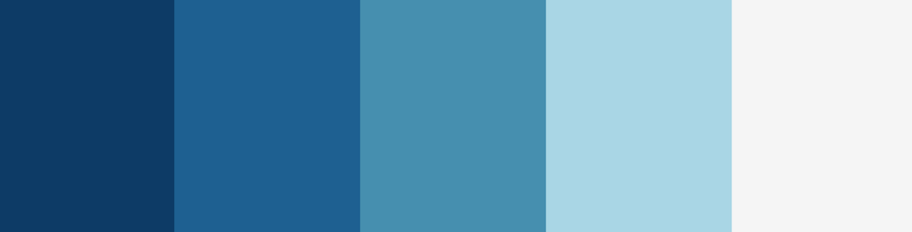
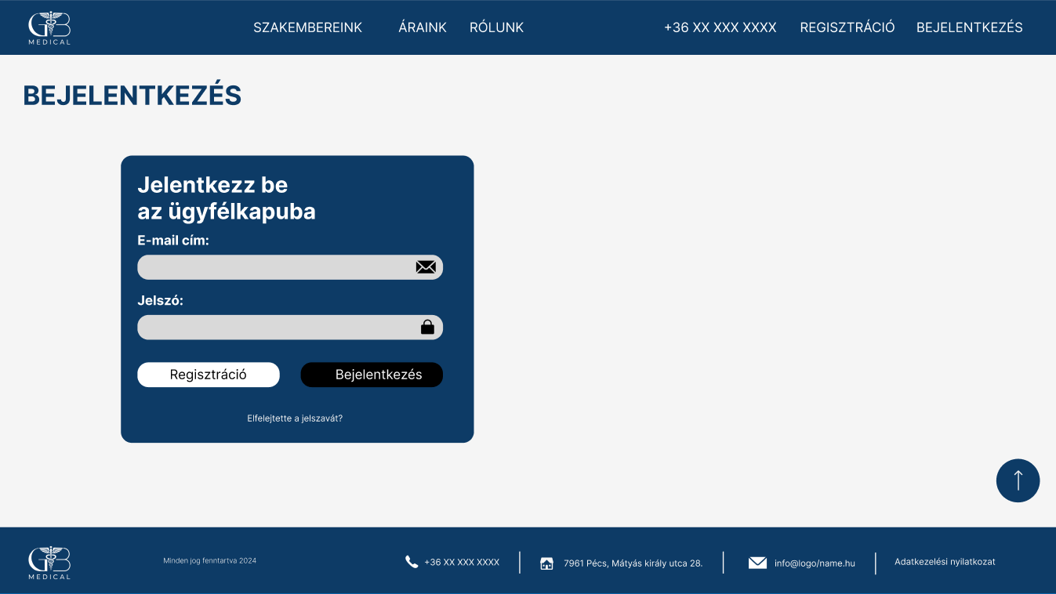
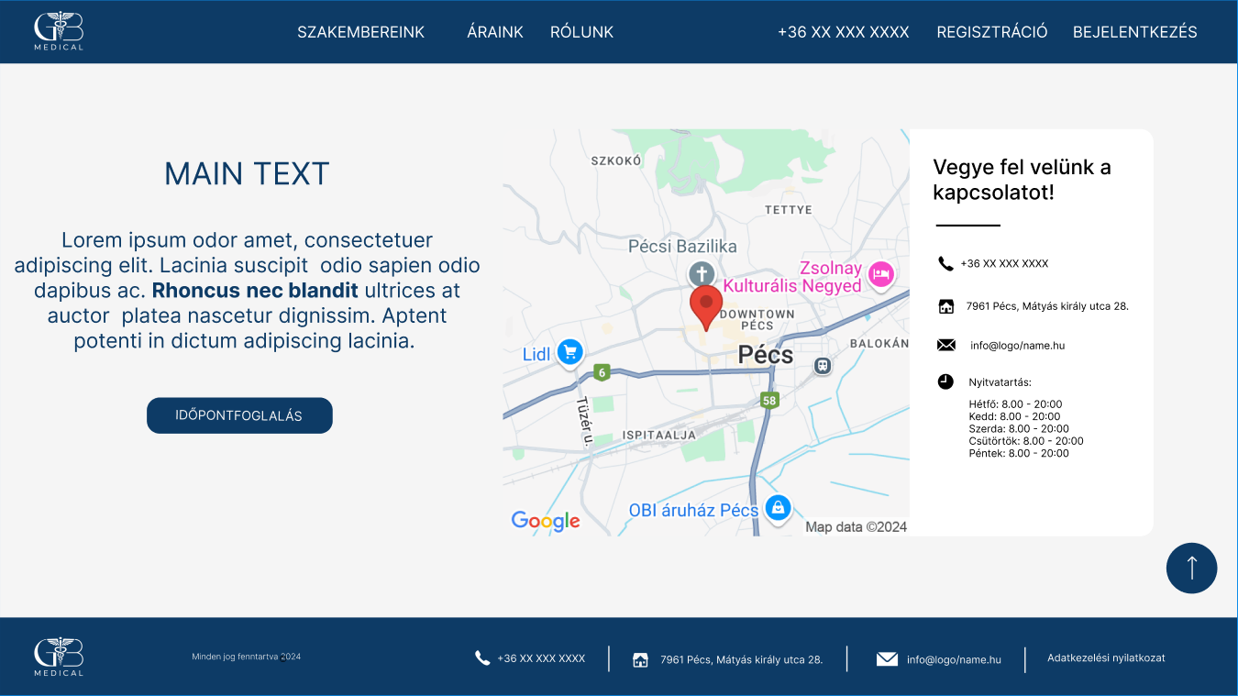
Design plan - Desktop

Slide 5

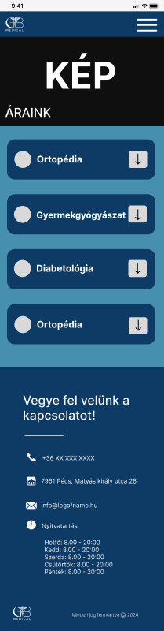
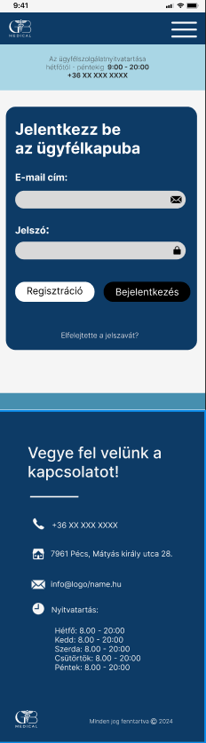
DESIGN Plan - Mobile

Slide 6

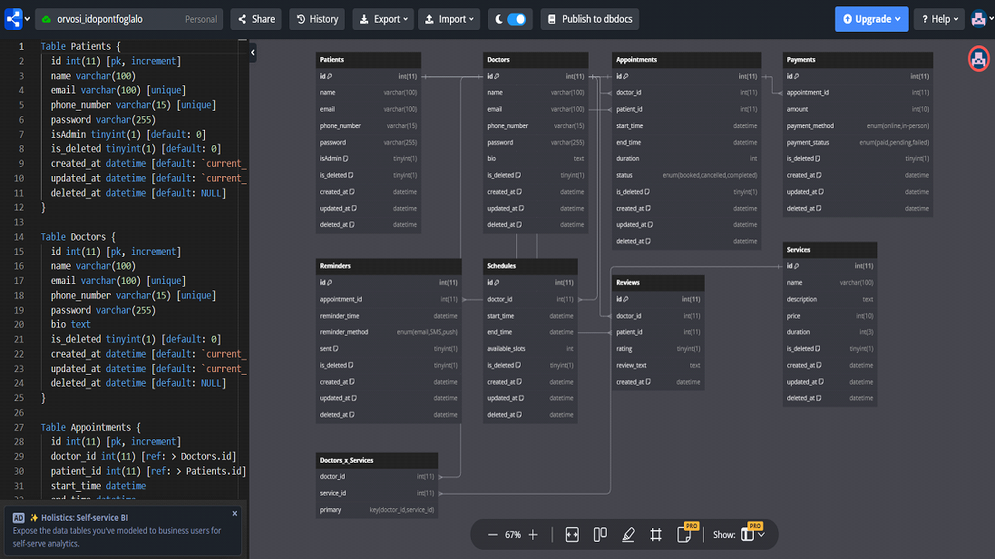
Database Design -

Slide 7

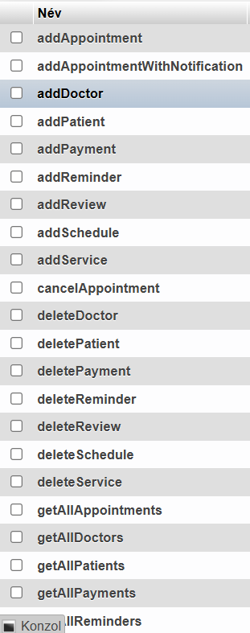
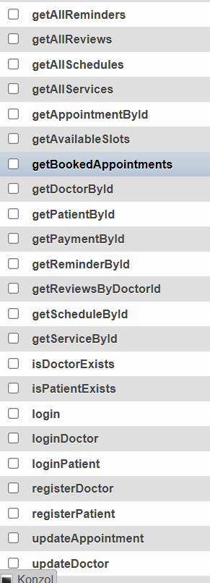
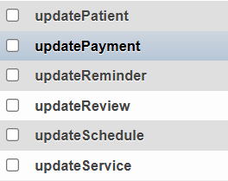
Defined their relationship and logical connections
Created the database tables
Generated demo records with AI for each table to test the system
Developed CRUD procedures for each table

Slide 8

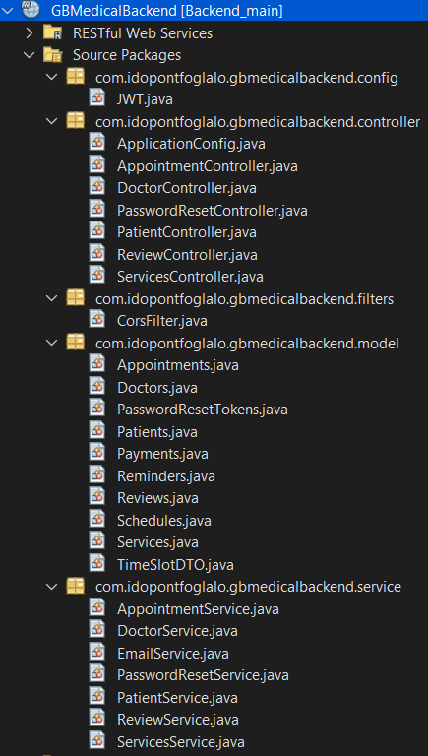

Backend – Netbeans 19
JAVA
🔹 config – Configuration settings, such as JWT-based authentication 🔹 controller – REST API endpoints that handle incoming requests and forward them to the service layer
🔹 service – Business logic, where data management operations (e.g., appointment booking) are processed
🔹 model – Database entities and DTOs (e.g., Appointments.java, Patients.java)
🔹 filters – responsible for handling Cross-Origin Resource Sharing (CORS) settings, allowing the frontend to securely communicate with the backend.

Slide 9

WildFly is a Java EE application server used for deploying the backend and running REST APIs. It ensures that the backend services are accessible to clients (e.g., the Angular frontend).

Slide 10

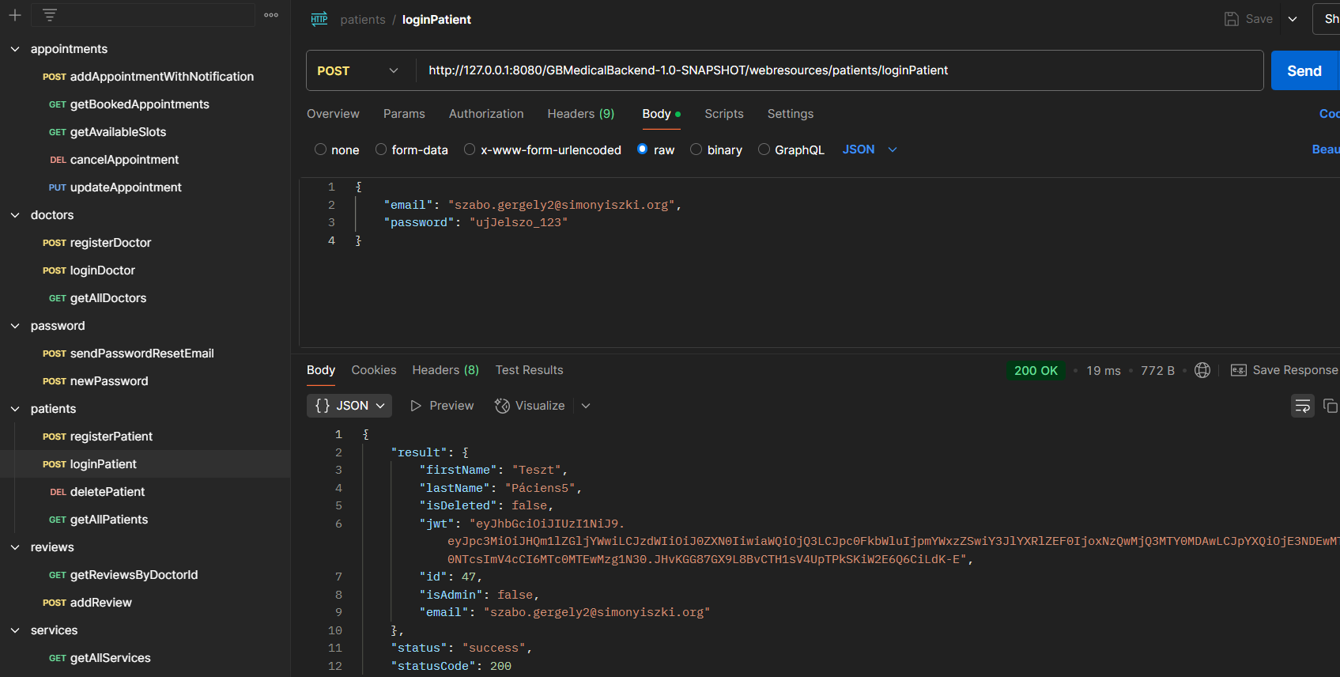

Slide 11

Frontend -
The project is developed using Angular 19, an open-source TypeScript-based framework. Its component-based architecture facilitates long-term maintenance and future development of the application.

Slide 12

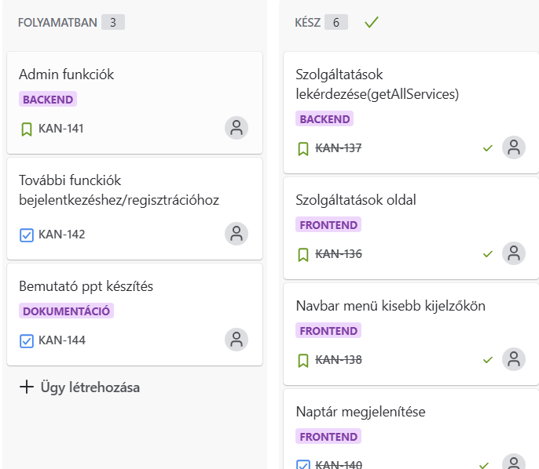

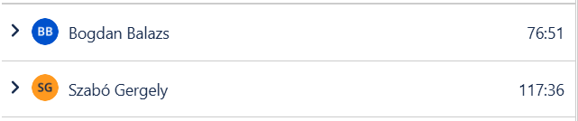

projectmanagement -

Slide 13

We use GitHub for source code version control and team collaboration. It allows us to store the project code, track changes, and work together efficiently throughout the development process.

Slide 14
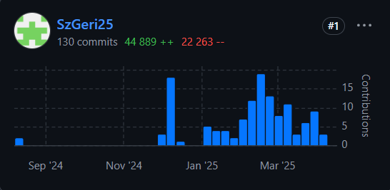
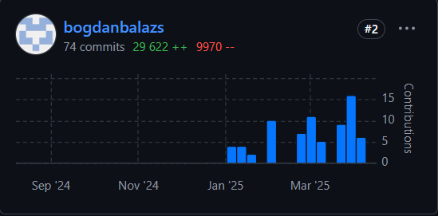

Slide 15



Next steps
New dashboard interface for doctors
Admin panel enhancements
Automatic SMS notifications

Slide 16


Thank You for Your Attention!

