Slide 1

Bookshop project
Made by: Zoltan Szabo, Bence Szabo

Slide 2
Problem
Lack of User-Friendly Bookshop Websites in Hungary
Outdated and Unattractive Design
Limited Search and Filtering Options
Solution
Create a User-Friendly, Intuitive Webshop
Modern, Clean, and Attractive Visual Design
Advanced Search Functionality
Robust Security for User Data
Basic SEO Optimization & Performance Enhancements

Slide 3
Teamwork
Full-stack
Software
Zoltan Szabo:
Bence Szabo:
Frontend
Backend
SEO parts
DataBase
Game
DataBase Data Collection

Slide 4





Technologies & Tools Used
Visual Studio Code
Visual Studio 2022
Xampp
Github
MySQL

Slide 5
Functions of the Bookshop
Registration
Wishlist
Login
Buy
Game

Slide 6
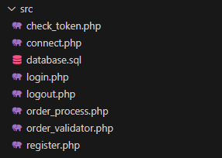
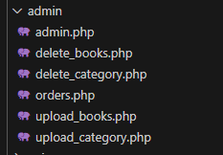
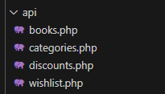
Backend
Php
The skeleton of the project Connections, State, Auth
Restful API
Stateless
Authentication
Hexadecimal secure token Is admin? Is logged in?

Slide 7
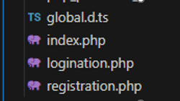
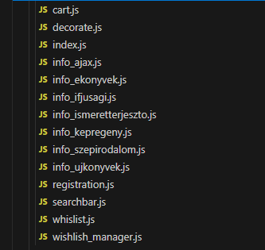
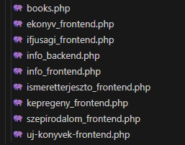
Frontend
User Authentication
Responsive UI & Styling
Login and registration forms
Dynamic content Loading
Layout is responsive and styled with modern CSS
Page content is loaded dynamically using Javascript

Slide 8
Database
Data loading
Database first
Books properties, token, wishlist
It is usually faster, and more time-saving than Model First
Direct SQL
Prepared statements
Full control, better performance, less abstraction, more flexibility
Protection from hackers
Main defense against SQL Injection

Slide 9

Game
Pomelo
DataBase connection
WinForms
The Game has been created using WinForms
Exe starter
The game can be launched from the website

Slide 10
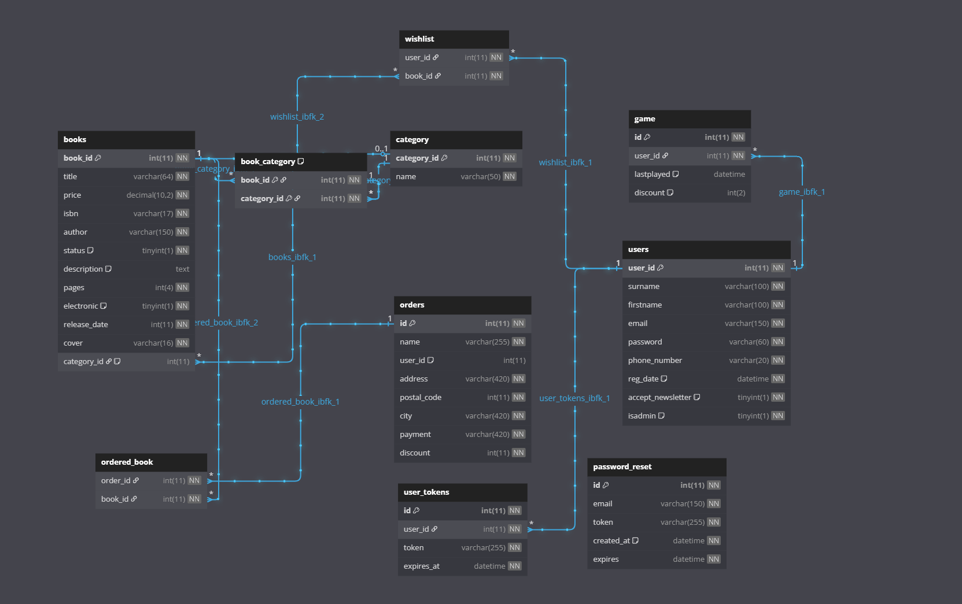
Database

Slide 11
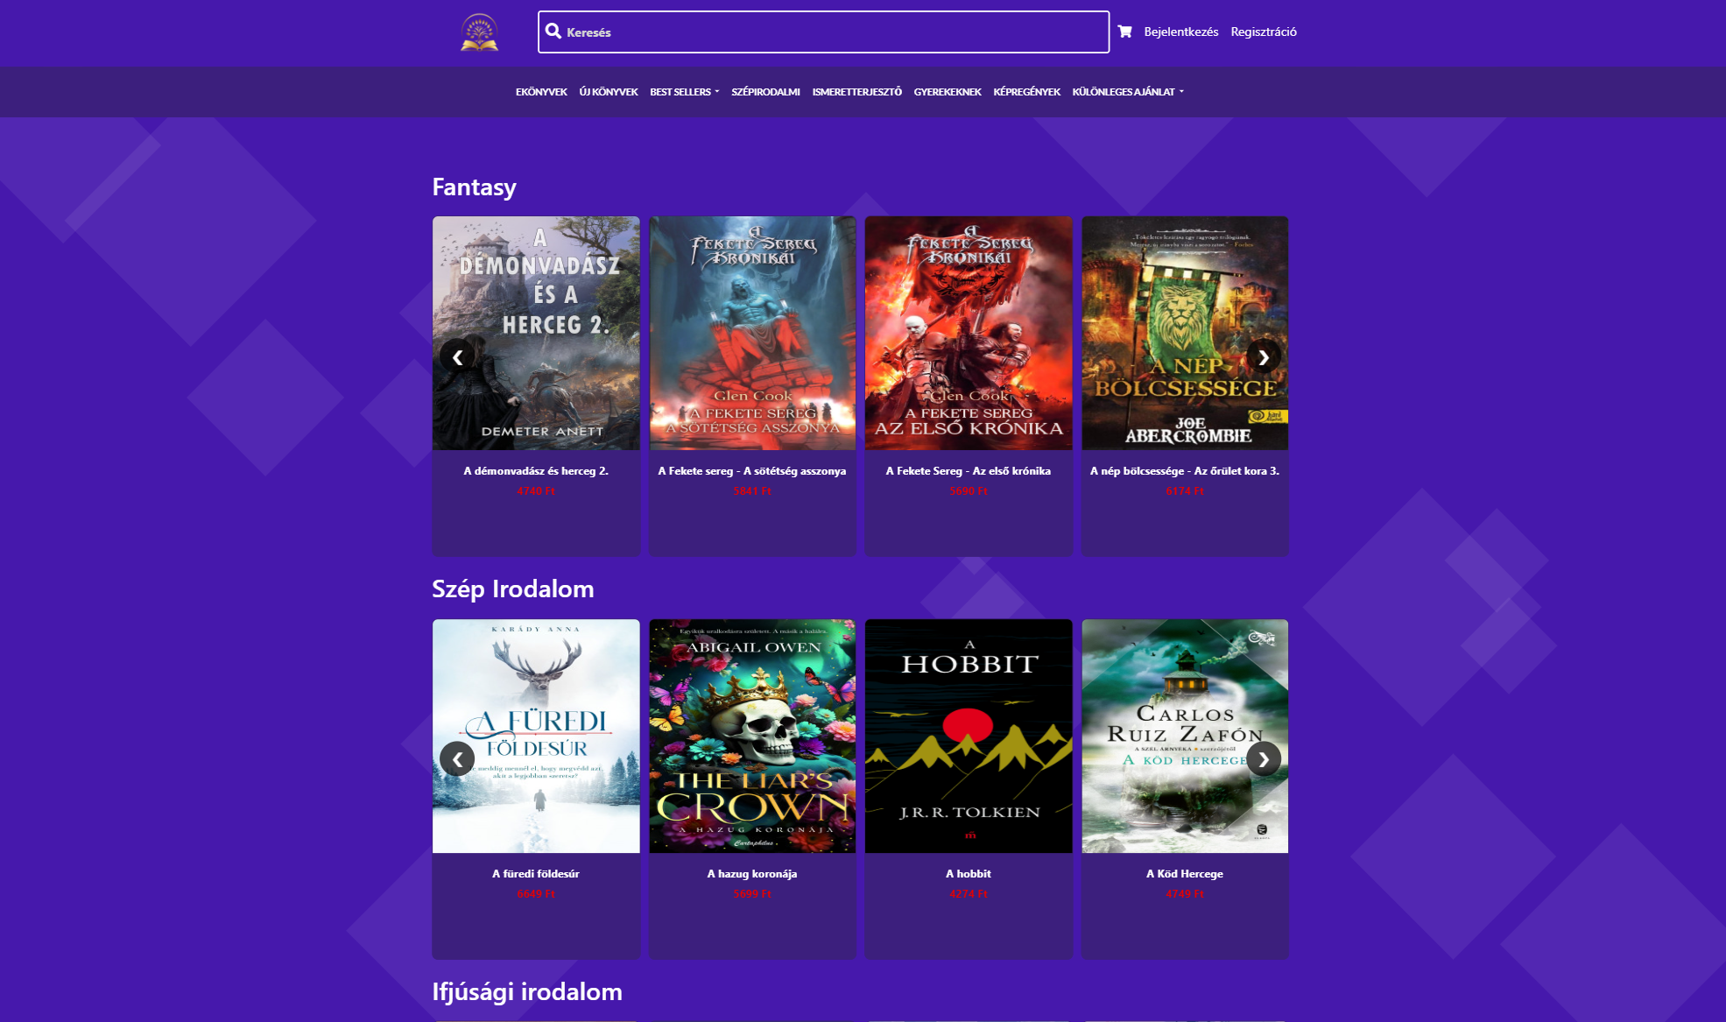
Desktop Frontend

Slide 12
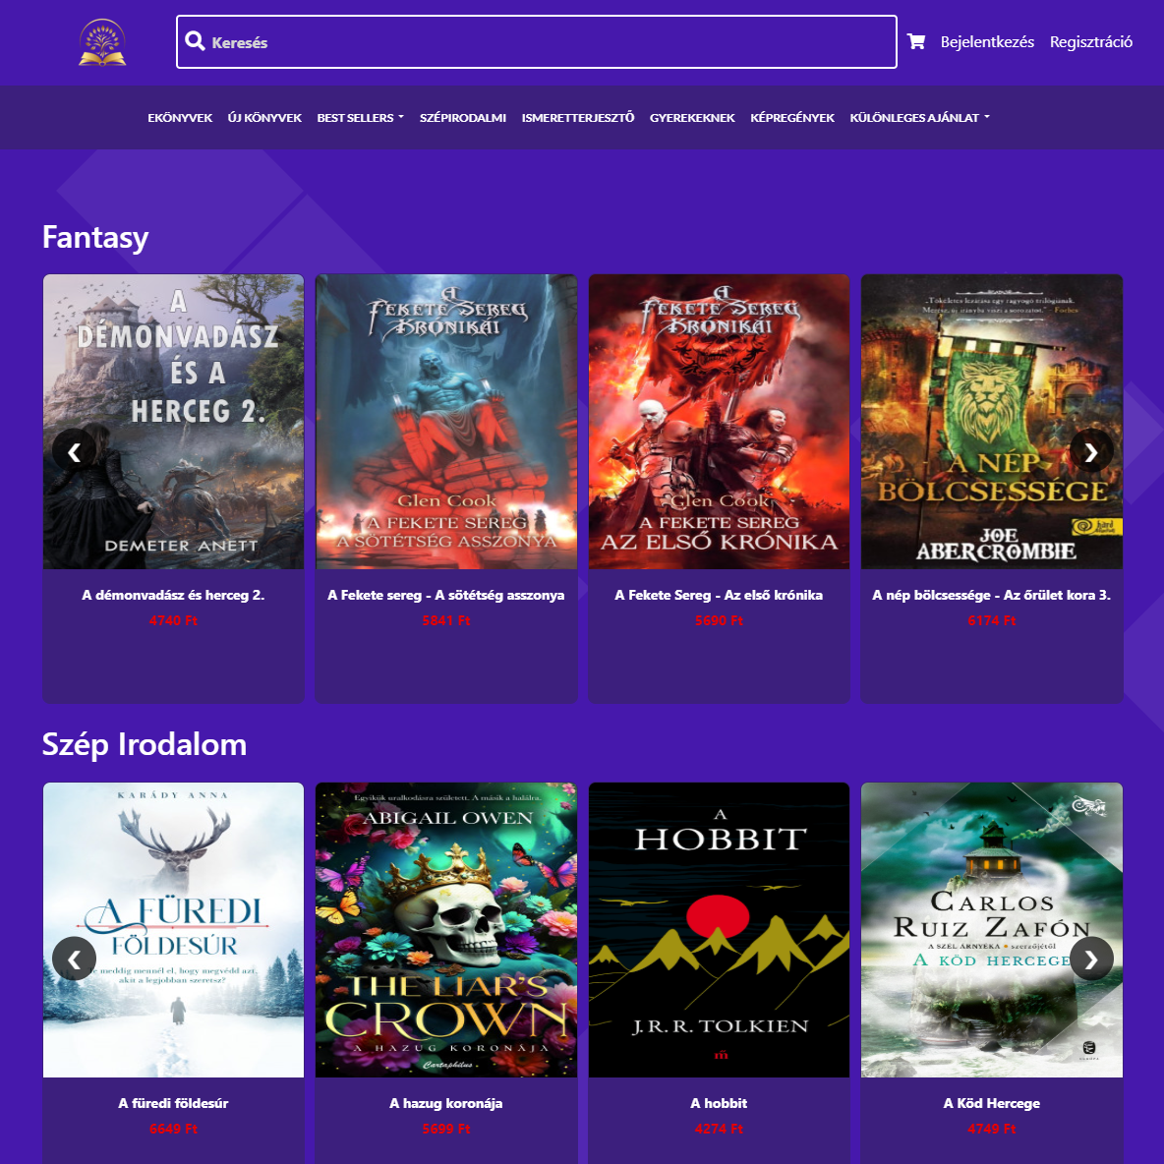
Tablet

Slide 13
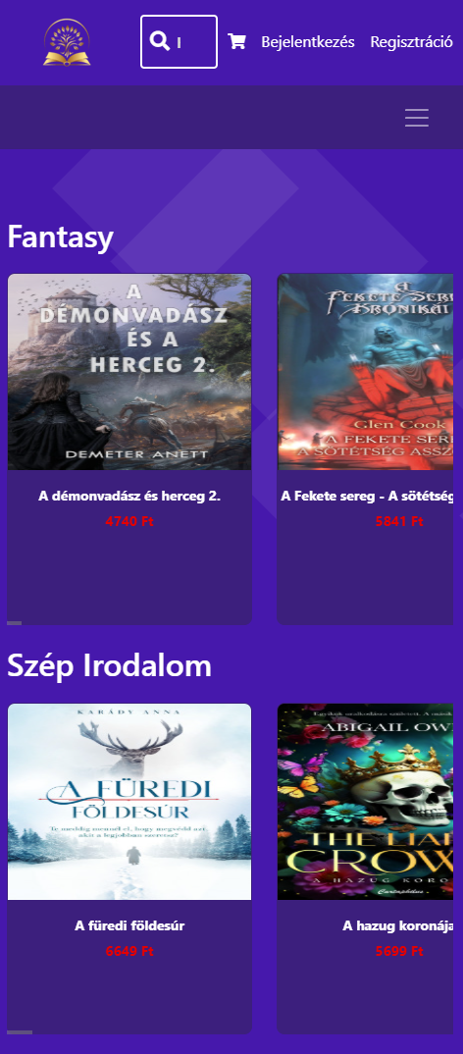
Mobile

Slide 14
Percentage of programming languages used
71.3%
14.1%
10.9%
3.6%
0.2%
Php
Js
Css
C#
Hack

Slide 15
Tests
User testing
Unit and integration test
Reveals the front- or backend main problems
Selenium
Validators
Speed test (Google page webspeed)

Slide 16
Future Plans
Full-seo Optimalization
GEO building
SEM
Build a comprehensive SEO strategy to achive the best ranking
Currently managed by AI technology
Create ads to boost site traffic

Slide 17
Sources
Template
Icons
Diagram

Slide 18
Thanks for watching!
Hope you enjoyed our presentation.

