Slide 1
Oil price pass-through to inflation in Poland, Romania and Hungary
INTERVIEW PRESENTATION
Dávid Szaniszló | 2026.10.05

Slide 2
Agenda
Key Findings
Data and Methodology
Pump Price Structure
Crude Oil to Pump Prices
Pump Prices to HICP
Headline Inflation and Components
Price Caps and Tax Measures
Country Comparison
Conclusion

Slide 3
Key Findings
Effects of a 10% increase in Brent crude prices
Immediate effect: fast, driven by fuels. Headline HICP +0.1-0.2% in month 1 and +0.25-0.5% after 3 months, around 60% of this is the direct effect of petrol and diesel prices.
Delayed effect: mainly via food and core. After 12 months the price level is 0.3–0.45% higher in normal times. The 2021–23 energy crisis lifts this to 0.5–0.9%, reflecting the co-movement of gas, heating and coal prices.
Pump prices: pass-through within a month. 80–100% of the crude price change reaches pre-tax prices within four weeks, petrol and diesel +3-4%, as crude is only approx. 1/3 of the retail price.
Cross-country: strongest in Hungary, weakest in Romania. Hungary reacts fastest and most strongly (+0.5% within 3 months), as fuel has the largest weight in its consumer basket (5.8%). Romania reacts slowest, but the effect keeps building through food prices (+0.45% after 12 months). Poland was hit hardest in the 2021–23 crisis (+0.9% after 12 months, vs 0.3% in normal times).
Normal times: 2008–21 (HICP), 2008–19 (pump prices). Source: Eurostat, ECB, FRED, EC Weekly Oil Bulletin; own estimates

Slide 4
Data and methodology
Brent crude oil prices
Petrol and diesel pump prices
HICP
headline and components
Stage 1
Stage 2
Approach:
Data (downloaded automatically):
Brent crude oil price (FRED)
Exchange rates (ECB)
Petrol and diesel prices, with and without taxes (EC Oil Bulletin)
HICP headline, components and weights (Eurostat)
Fuel price caps (official sources)
Methodology:
Stage 1 – Error-correction model (weekly, 2008–19)
Long-run relationship: pump price on Brent (dynamic OLS)
Short-run: speed of adjustment, lags up to 8 weeks (AIC)
Stage 2 – Local projections (monthly, 2008–26)
One regression per component and horizon (0–12 months)
Controls: exchange rate, demand, taxes, price caps
vs VAR: more robust, no identification needed
weekly,
2008-19
monthly,
2008-26

Slide 5
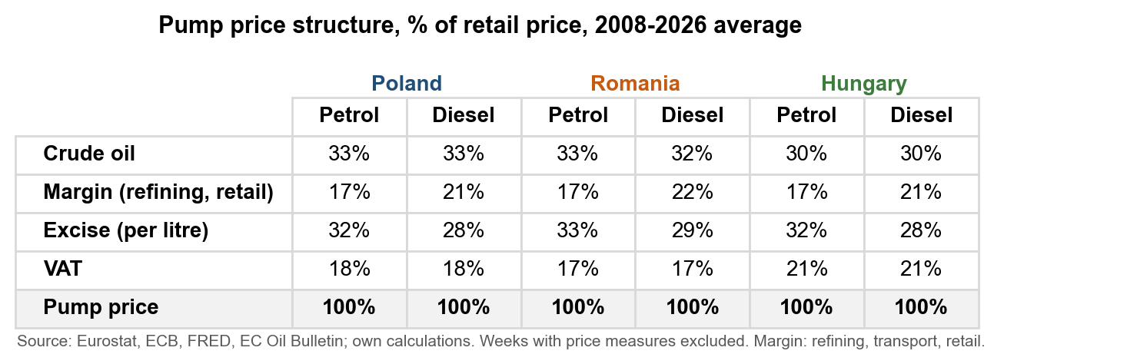
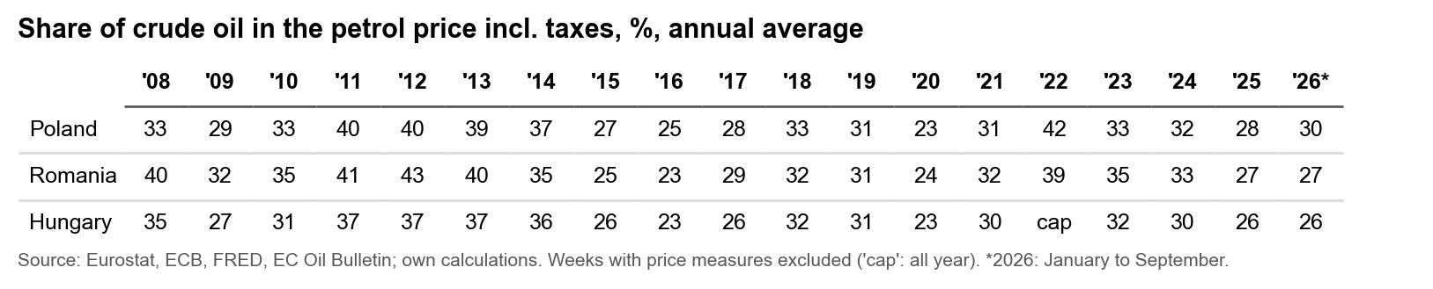
Pump price structure

Slide 6
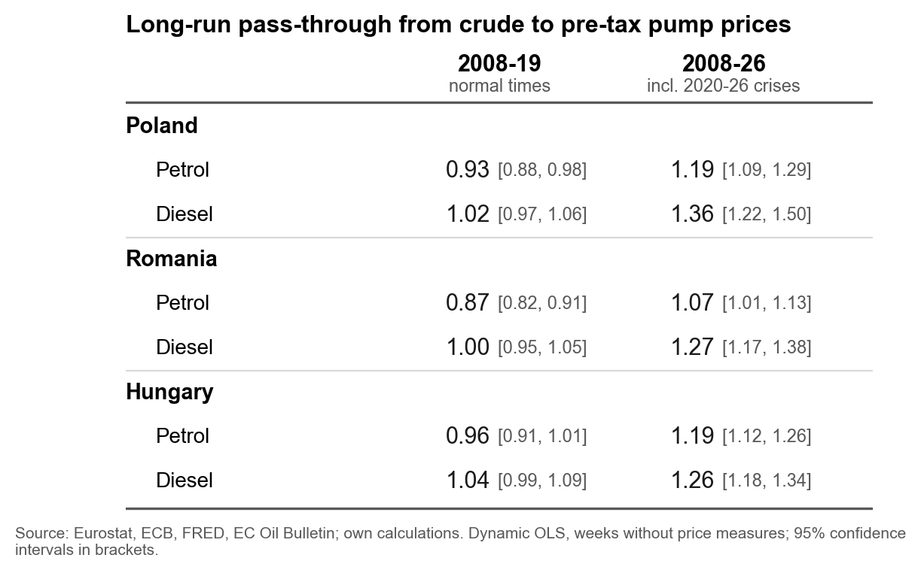
Crude Oil to Pump Prices
Takeaways:
2008-19: pass-through around 1 for both fuels in all three countries.
Refiners and retailers pass crude cost changes on fully: they neither absorb nor add to them.
Since 2020, refining margins widened: That's why it's above 1, especially for diesel

Slide 7
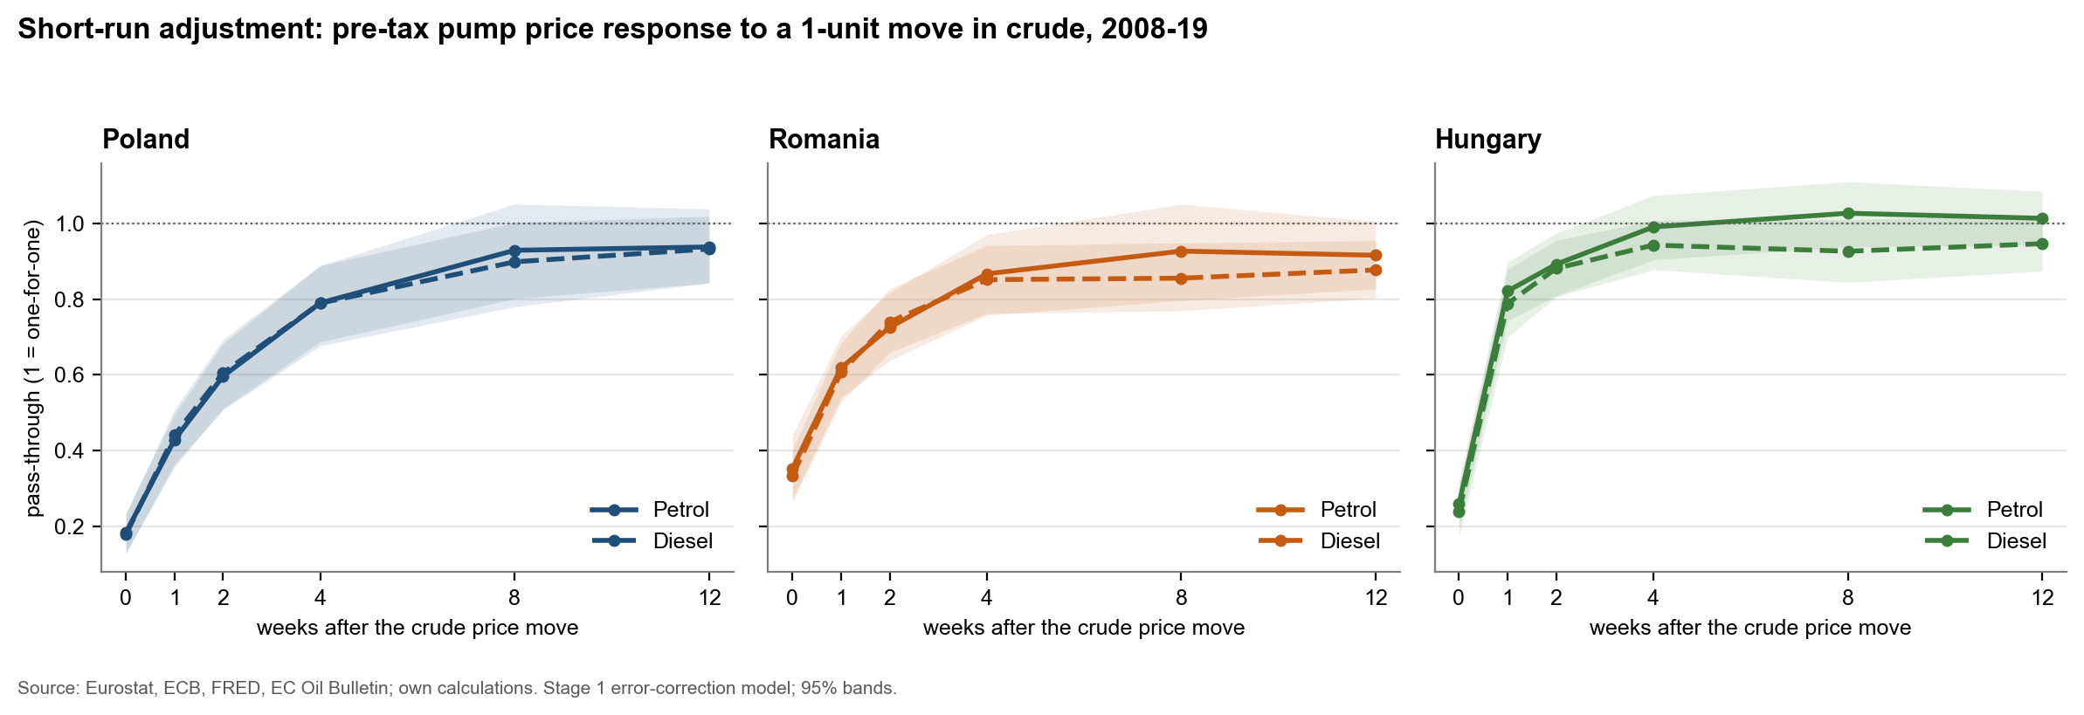
Crude Oil to Pump Prices
Fast: apporx. 25% of a crude price change reaches pre-tax pump prices within the 1 week, and 80–100% within 4 weeks.
Hungary adjusts fastest: around 80% of the change is passed through in 1 week, consistent with formula-based wholesale pricing.
Poland shows the most gradual initial response (0.79 after four weeks), while Romanian diesel has the longest tail (16 weeks to 90%).

Slide 8
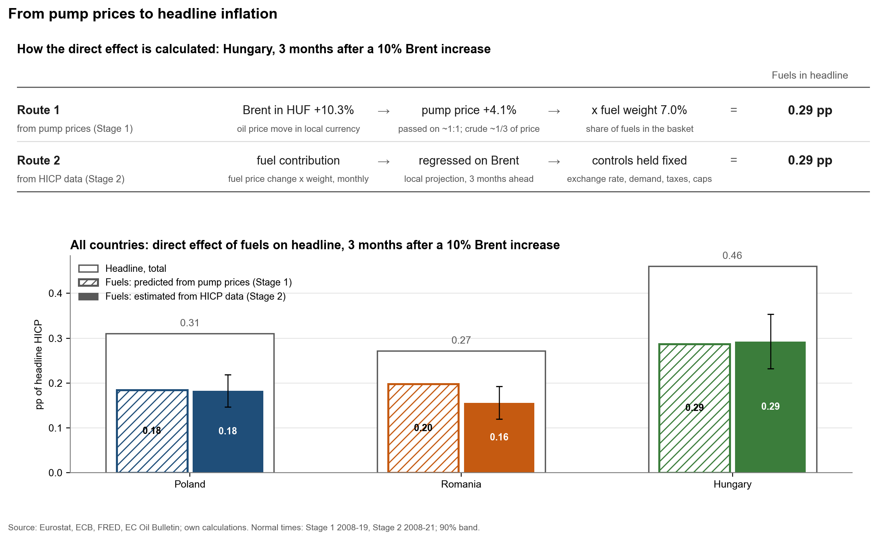
Pump Prices to Headline Inflation
Takeaways:
Direct effect of fuels after 3 months: 0.18 0.29 pp of headline per 10% Brent increase, largest in Hungary (higher fuel weight)
Both approaches give consistent results: effect built up from pump prices (Stage 1) matches direct HICP estimate (Stage 2)
Fuels account for around 60% of the headline response after 3 months, the remainder reflects other energy, food and core prices

Slide 9
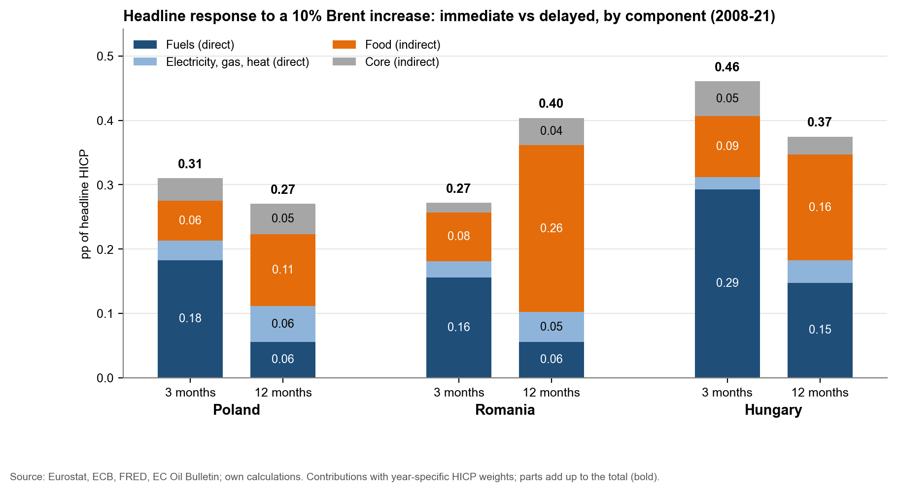
Headline Inflation and Components
Takeaways:
Immediate effect (0–3 months) is driven by fuels
Delayed effect (6–12 months) shifts to food:

Slide 10
Handling Interventions
 |  | Interventions modelled | Interventions ignored
Poland | Petrol | 0.95 | 0.78
 | Diesel | 1.12 | 1.02
Romania | Petrol | 0.93 | 0.76
 | Diesel | 1.05 | 0.92
Hungary | Petrol | 1.04 | 0.50
 | Diesel | 0.98 | 0.65
 | Tax changes | Price caps and margin caps
What | VAT and excise changes: 65–104 weeks with a change per country since 2008 | 10 cases: price caps in Hungary (2021–22, 2026), maximum prices in Poland (2026) and Orlen pricing (2023), margin caps in Romania (2026)
Data | EC Weekly Oil Bulletin tax sheets, checked against pump prices | Own database built from legislation and official announcements
Stage 1 pump prices | Estimated on pre-tax prices, so tax changes do not affect pass-through | Normal-times dynamics estimated only on weeks without a measure, behaviour under caps estimated separately
Stage 2 consumer prices | Controls for the price change caused by tax changes, robustness check with HICP at constant tax rates | Share of each month under a measure and its interaction with oil (Hungary), level control for Poland and Romania

Slide 11
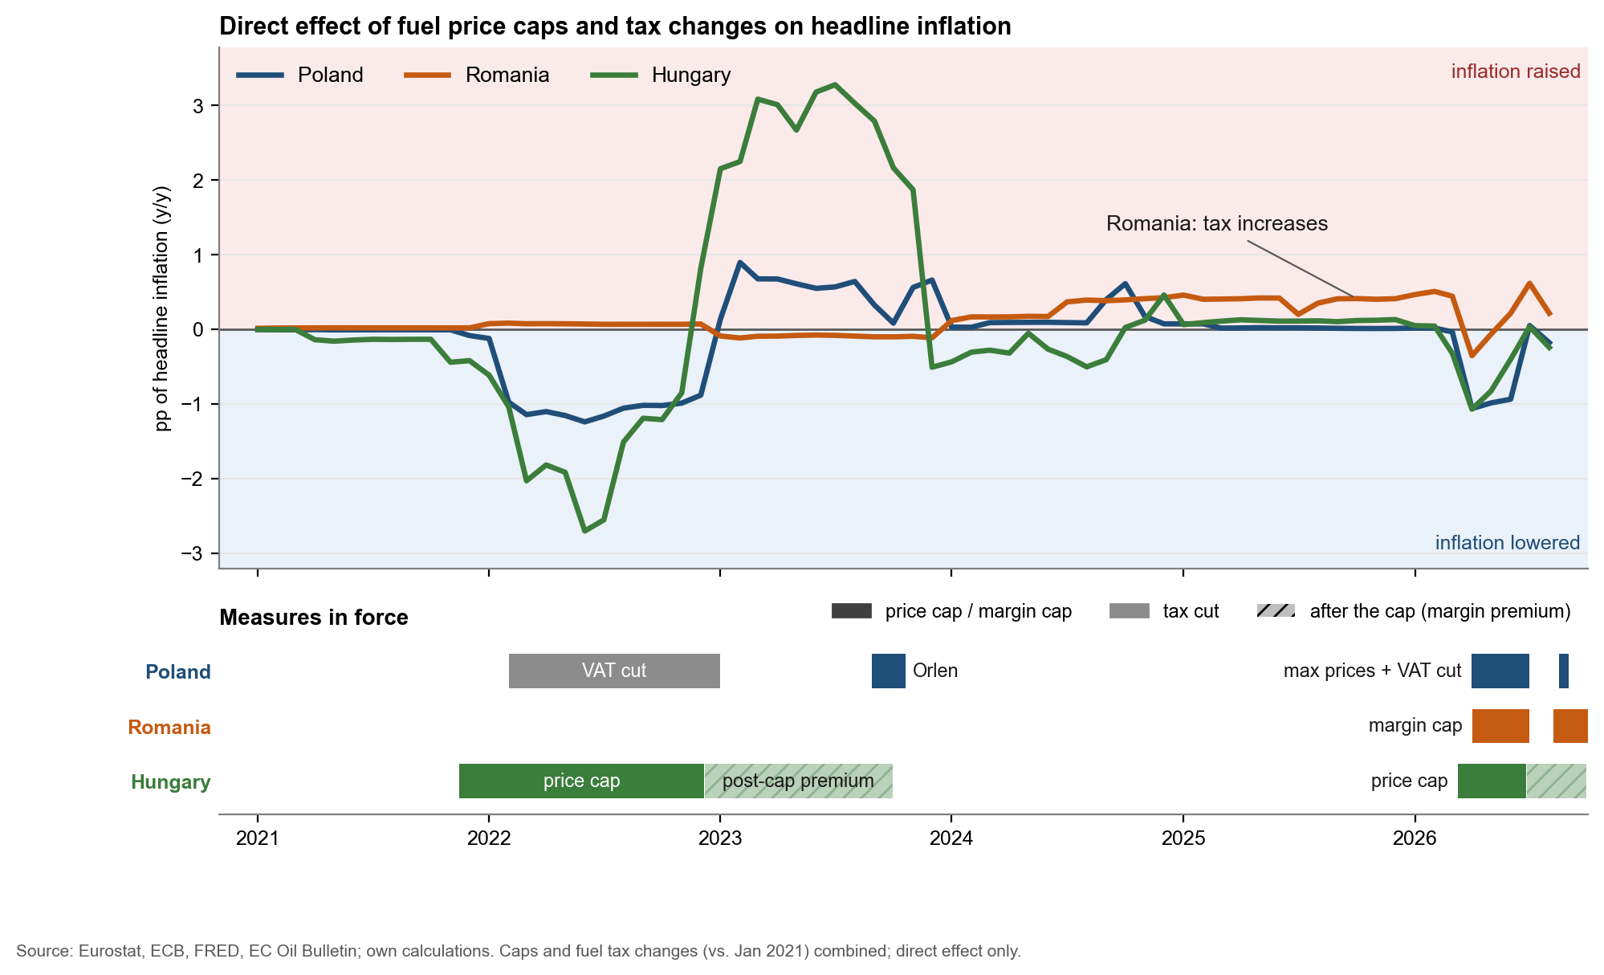
Handling Interventions
Takeaways:
Intervensions have reverse effect one the measure ended: Hungary +2.4 pp on average in 2023.
Change from long measures to short, targeted ones: 11-13 months in 2022 vs about 3 in 2026

Slide 12
Country Comparison
 | Poland | Romania | Hungary
Speed at the pump weeks to 90% pass-through | 8 weeks | 10 weeks | 2.5 weeks
Short-term effect headline, after 3 months | 0.31% | 0.27% | 0.45%
Delayed effect headline, after 12 months | 0.30% | 0.45% mainly via food | 0.38%
12-month effect incl. 2021–23* headline, after 12 months | 0.88% mainly heating and coal | 0.68% | 0.53% mainly gas
Policy approach fuel price measures | Tax cuts 2022 and 2026 | Margin cap tax increases 2024-26 | Hard price caps 29 months since 2021
Main structural driver | Heating and coal 4.6% of the basket | High excise, food excise ~1/3 of price, food 1/3 of basket | Highest fuel weight 5.8% of basket, 89% petrol
Profile | Moderate in normal times, most exposed in energy crises | Slow but persistent | Fast and front-loaded
* Same estimate on data to August 2026 instead of October 2021. It is larger because gas, coal and heating prices rose together with oil in 2021–23; in Hungary the increase disappears when the gas price is held fixed.
Normal times: pump prices 2008–19, HICP 2008–21. Bold: most pronounced of the three countries.

Slide 13
Thank you
Questions and discussion
Dávid Szaniszló | szaniszlod2003@gmail.com | LinkedIn

