Slide 1

Validating the FireEdge Assessment
Robert W. Szarek
March 10, 2021

Slide 2
Background Knowledge
R&D Team developed the FireEdge test for firefighter selection
Test content based on a job analysis study that identified the skills and abilities needed to succeed in the job
Those skills and abilities were then translated into test questions
The result is a cognitive and situation-based reasoning test
A total of 150 questions
Time limit of 2 hours

Slide 3
Presentation Overview
Overall goal was to establish predictive evidence of job performance from test scores
Ideally, a higher FireEdge score would accompany a higher job performance rating
The benefits of a successful research study include:
Marketing FireEdge as a proven screening device to select talent
Provide legal defensibility for using the FireEdge
Helping minimize bias and adverse impact in score results
Notes:
- Because the

Slide 4
Research Study Design
Partnered with agencies to provide study participants
Created a stratified sampling plan from available personnel
Administered FireEdge under standardized conditions
Obtained ratings of job performance from supervisors
Performed exploratory data analysis (EDA)
Ran several statistical analyses (correlation, regression, ANOVA)
Summarized findings and developed technical documentation

Slide 5
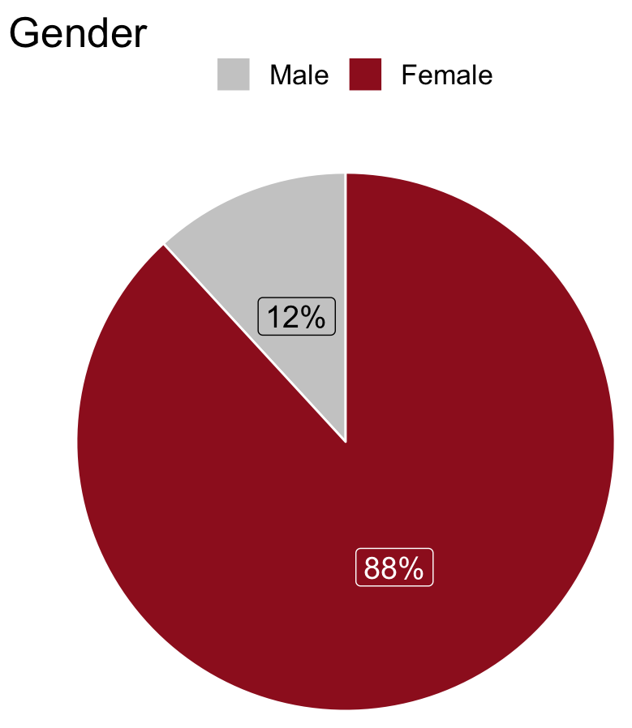
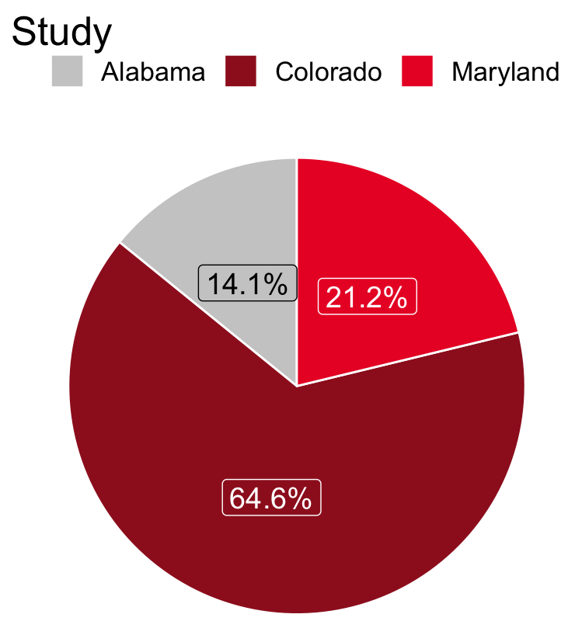
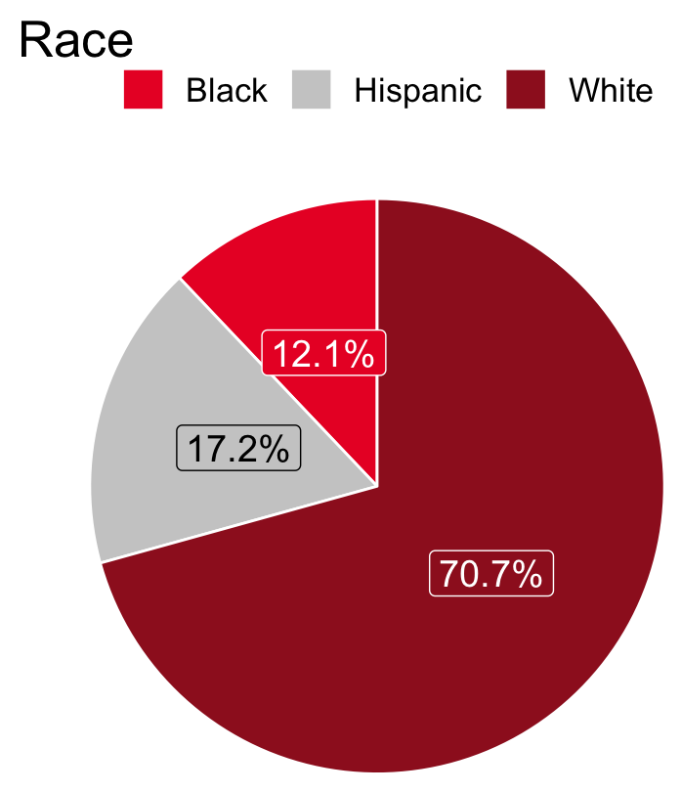
Sample Composition
Break down of study participants:
Notes:
Larger size on the plots?

Slide 6
Pearson Correlation Coefficient
A significant, positive correlation between FireEdge and Job Performance was found:
t(295) = 4.884, p < .001
Pearson Correlation r = .273
The t-test statistic demonstrates that the correlation coefficient is significantly different from zero
As test scores rise, so too does job performance

Slide 7
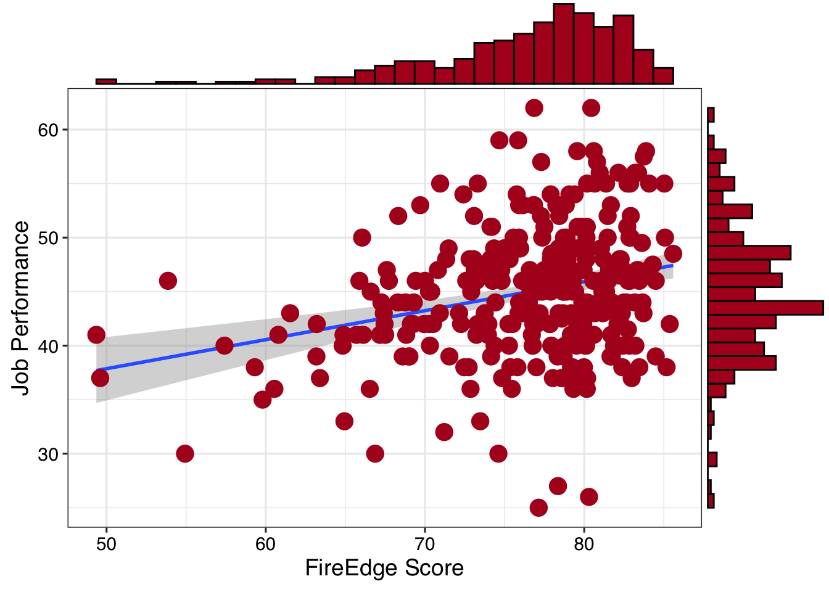
Linear Regression Model
Correlation = .273, p < .001
Test predicts job performance
Line of best fit trends upward
F-test is also significant
F(1, 295) = 23.85, p < .001
Notes:
The omni-bus F test in a linear regression denotes that the independent variables in your study, mainly, the FireEdge score, does contribute a significant effect to the model and should be retained.

Slide 8
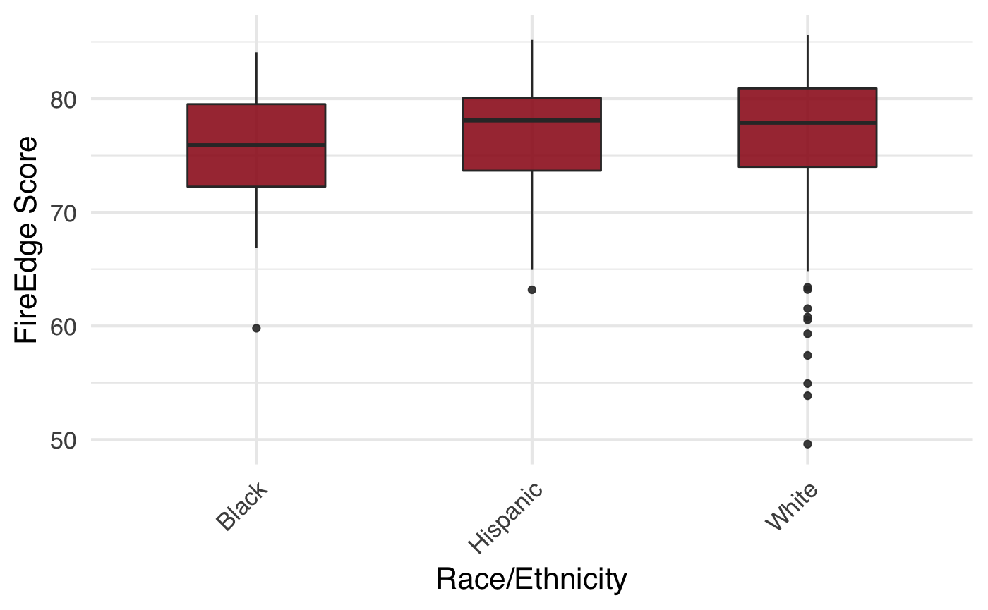
Analysis of Variance on FireEdge Score
Non-significant findings
F(4,274) = .663, p = .618
No evidence of significant differences in FireEdge scores by Race/Ethnicity
Test scores were consistent across Race

Slide 9
Study Limitations
Concurrent study design
More diversity in study participants
Potential bias in job performance ratings
Overpredicting performance due to qualified applicant pool
Correcting correlation coefficients

Slide 10
Conclusion
Empirical evidence that test scores are significantly correlated with subsequent firefighter job performance(r = .273, p < .000)
Analysis of Variance (ANOVA) test concludes no significant differences on FireEdge test score by Race
Ensures no bias/adverse impact in test scores
Rank ordering of top-down scoring appropriate
We conclude that higher scores on the FireEdge will yield more successful firefighters in general on the job, without adverse impact

