Slide 1

Validating the FireEdge Assessment
Robert W. Szarek
March 10, 2021

Slide 2
Background/Context
R&D Team developed the FireEdge test for firefighter selection
Test content based on a job analysis study that identified the skills and abilities needed to succeed in the job
Those skills and abilities were then translated into test questions
The result is a cognitive and situation-based reasoning test
A total of 150 questions
Time limit of 2 hours

Slide 3
Research Study Purpose
Goal: To establish predictive evidence of job performance from test scores
Ideally, a higher FireEdge score would accompany a higher job performance rating
The benefits of a successful research study include:
Marketing FireEdge as a proven screening device to select talent
Provide legal defensibility for using the FireEdge
Helping minimize bias and adverse impact in score results
Notes:
Tying the scores on this newly developed test to some sort of external criteria, something that would help us establish that using the test makes sense to hire for this position.

Slide 4
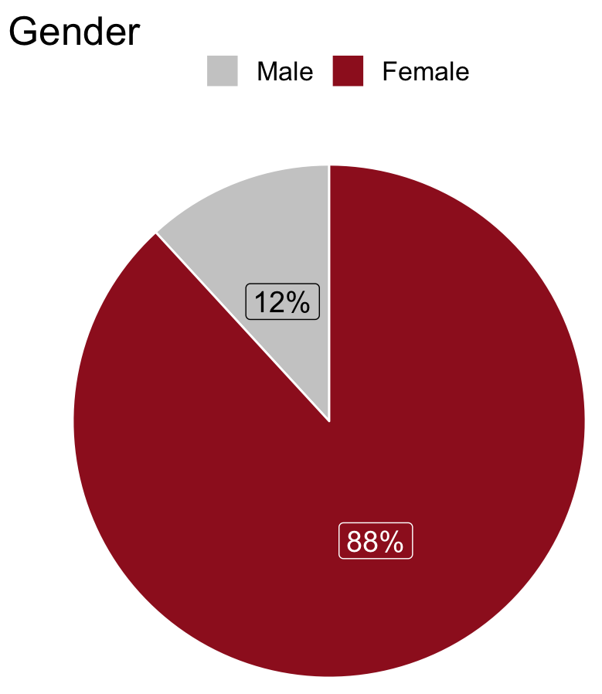
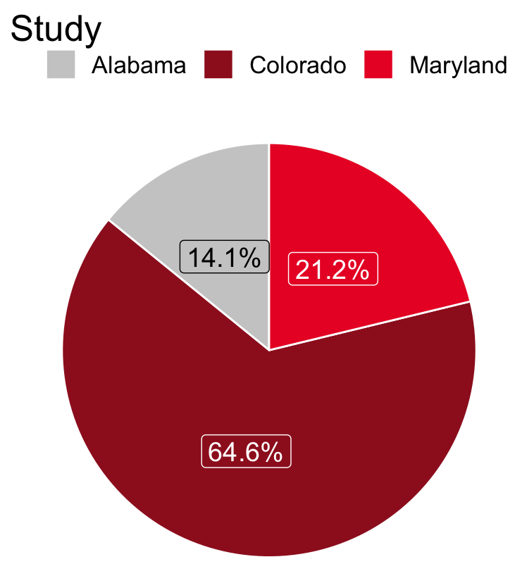
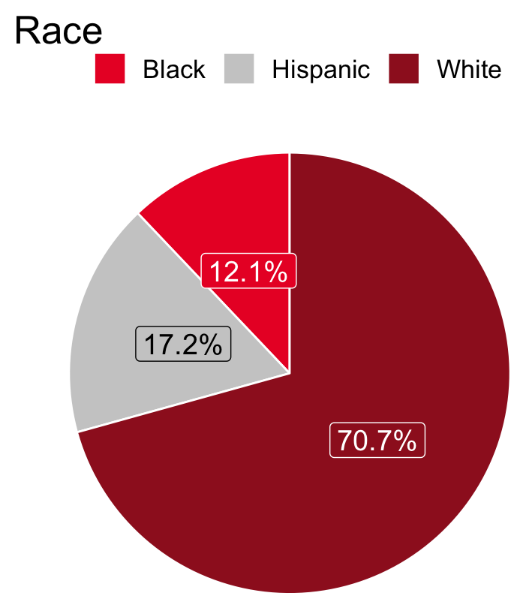
Research Study Demographics
Break down of study participants:
Notes:
Larger size on the plots?

Slide 5
Research Study Procedure
Provided participants context for the study
Administered FireEdge under standardized conditions
Obtained ratings of job performance
- - - - - - - - - - - - - - - - - - - - - - - - - - - - - - - - - - - - - - - - - - - - - - - - - - - - - -
4. Performed exploratory data analysis (EDA)
5. Employed statistical analyses (correlation, regression, ANOVA)
6. Summarized findings and developed technical documentation
Notes:
EDA revolves around imputation of missing data, removing outliers, identifying trends, multi-collinearity, etc.

Slide 6
Study Outcome 1: Correlation Analysis
Hypothesis: As FireEdge scores rise, so too does job performance
Test: A significant, positive correlation between FireEdge and Job Performance was found:
t(295) = 4.884, p < .000
Pearson Correlation r = .273
Conclusion: The t-test statistic demonstrates that the correlation coefficient is significantly different from zero, indicating a relationship between FireEdge scores and job performance

Slide 7
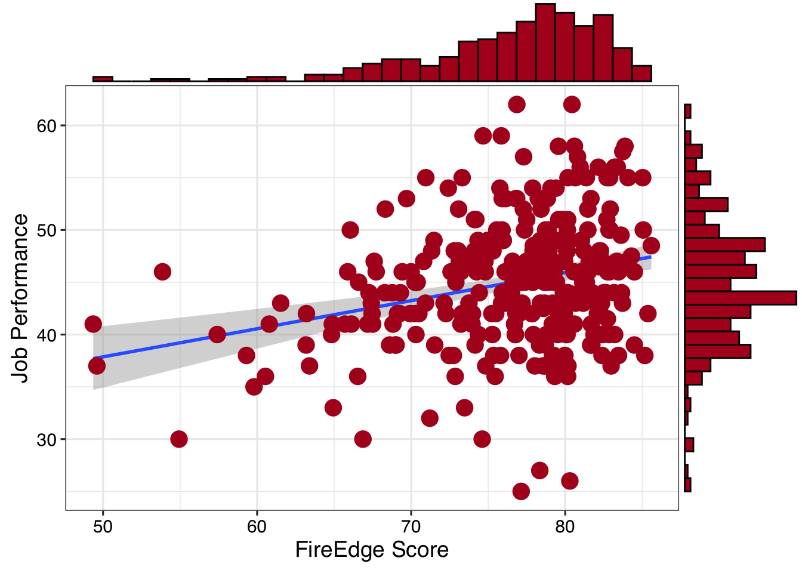
Study Outcome 2: Linear Regression
Hypothesis: A statistically significant slope in line of best fit
Test: Significant F-ratio test
F(1, 295) = 23.85, p < .001
Conclusion: Imputing a FireEdge score should provide a reasonably stable estimate of future job performance
Notes:
Linear regression is simply an extension of the correlational analysis from the slide before.

Slide 8
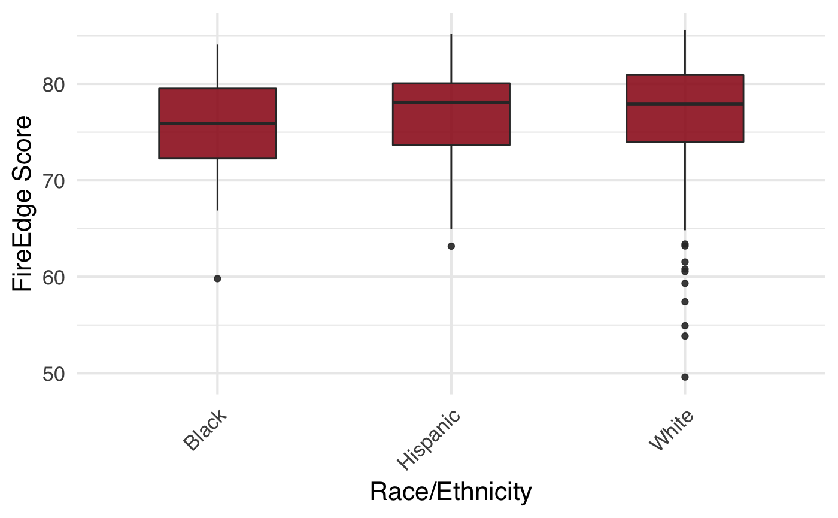
Study Outcome 3: Analysis of Variance
Hypothesis: No differences in FireEdge scores when grouped by race
Test: Non-significant findings
F(4, 274) = .663, p = .618
Conclusion: No evidence of test bias in scores across race
Notes:
Diversity and equity is an important piece

Slide 9
Research Study Conclusions
Empirical evidence that test scores are significantly correlated with subsequent firefighter job performance(r = .273, p < .000)
Analysis of Variance (ANOVA) test concludes no significant differences on FireEdge test score by Race
Ensures no bias/adverse impact in test scores
Rank ordering of top-down scoring appropriate
We conclude that higher scores on the FireEdge will yield more successful firefighters in general on the job, without adverse impact
Notes:
The conclusions revolve around two very important concepts, one, that the test we are employing is tied to significant performance feedback and two, that the test does not cause bias against anybody by race.

Slide 10
Research Study Limitations
Concurrent study design
More diversity in study participants
Potential bias in job performance ratings
Overpredicting performance due to qualified applicant pool
Correcting correlation coefficients

