Slide 1

Employee Engagement Analysis
Atlassian
December 19, 2023

Slide 2
Background/Context
Employee engagement scores have recently been trending in a negative direction
This study was initiated to determine the cause(s) and provide leaders with some actionable next steps for course correction
Data was aggregated consisting of 1,000 active employees across 21 unique fields to provide these preliminary insights
Descriptive statistics, correlations and a regression model were run to help shed light on these questions

Slide 3
Purpose of Analysis
Goal: To establish significant predictors of employee engagement in Atlassian
Ideally, we’d be looking for positive variables where an increase in a specific metric leads to an increase in employee engagement
The benefits of a successful research study include:
Confirming whether engagement scores are indeed trending negative
Understanding ways leadership can reduce this trend
Understanding which parts of the company are faring better than others

Slide 4
Procedure
Feature Engineering: Transform existing variables for more insights
Time Zones (Calculation of hr. difference between employee and manager)
Conversion of Performance Ratings to Numeric
Calculation of Engagement Favorability Index (New metric)
Exploratory Data Analysis: Determine the validity of the provided data
Correlation Matrix to understand variable trends & relationships
4. Linear Regression to explain the drivers of employee engagement
5. Summarized findings and developed technical documentation
Notes:
EDA revolves around imputation of missing data, removing outliers, identifying trends, multi-collinearity, etc.

Slide 5
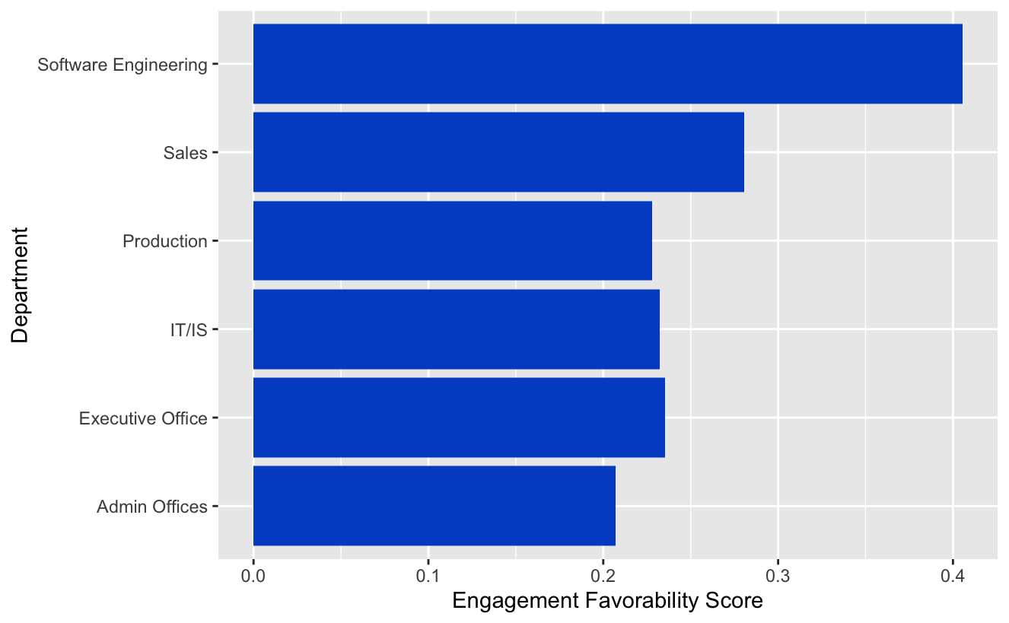
Department by Engagement Index Score
Performing an Analysis of Variance test results in a significant difference in employee engagement between the various departments at Atlassian
The conclusion from this part of the analysis is that certain departments within Atlassian are doing things differently to make their employees more engaged, leadership needs to better understand the inter-departmental differences to capitalize on these advantages and promote them across the entire enterprise
Notes:
Atlassian is a software company, that is the backbone of the company. It could make sense that the culture on this part of the “house” is better than the rest.

Slide 6
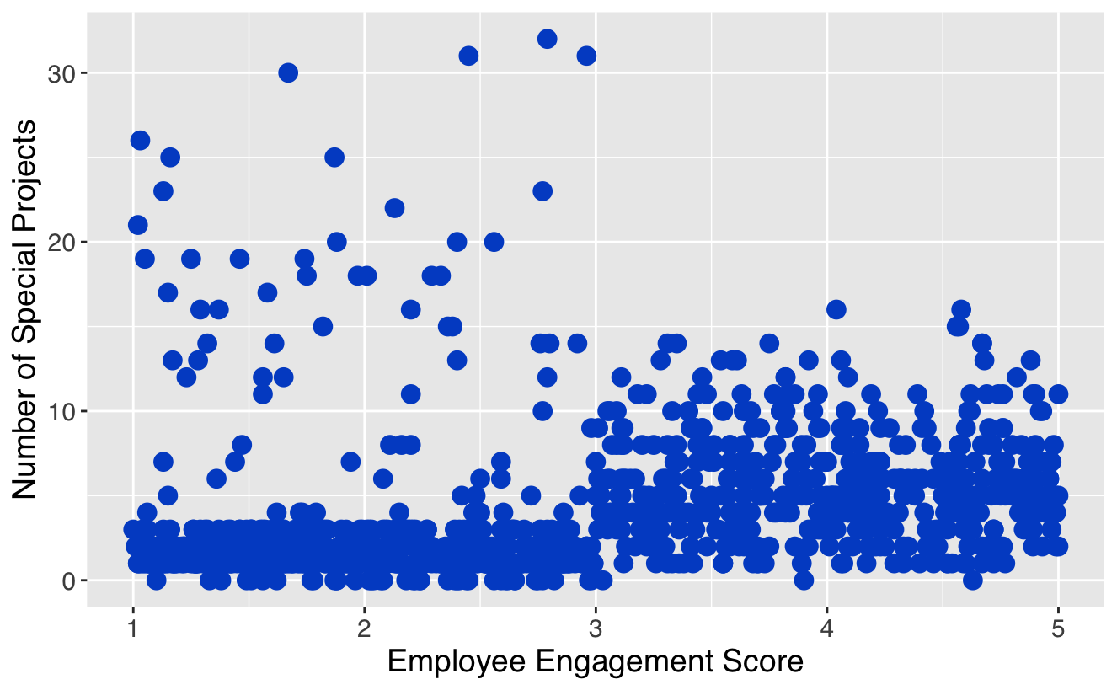
Special Projects and Engagement
Taking a look at the distribution of projects and engagement, we see an entire group of employees who have greater than 15 projects who have a very low employee engagement score
This group of employees is certainly at an increased risk of burnout and should be further addressed immediately

Slide 7
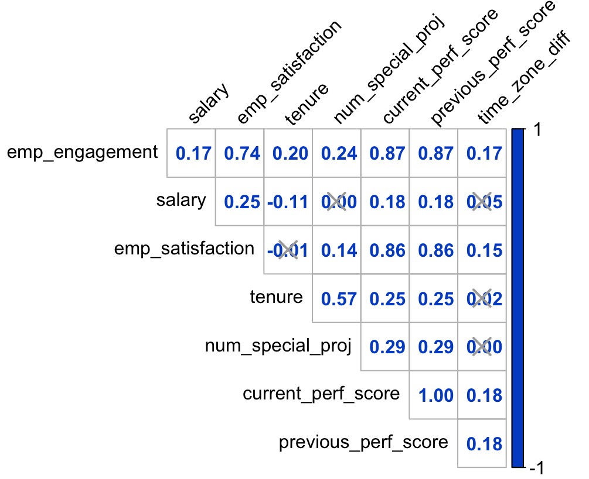
Correlation Analysis
Satisfaction, Engagement and Performance Scores are very positively correlated to one another, with an almost perfect correlation
This finding would make it difficult to understand the directionality of the relationship, does employee engagement increase job performance, or vice versa?
Engagement is significantly correlated with special projects, tenure, salary and time_zone_diff between employee and manager

Slide 8
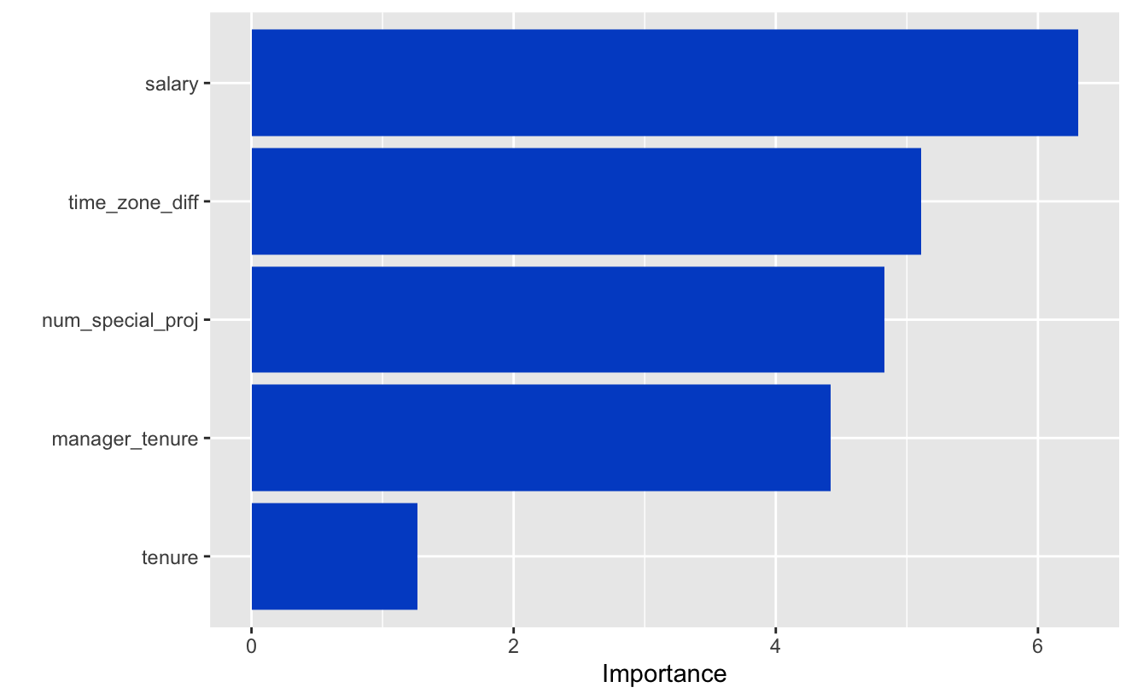
Linear Regression
Linear regression found nearly all the features to be significant, though some have more weight than others in their significance
Salary has the highest weight for explaining employee engagement, followed by the time zone difference between employee and manager and finally the number of special projects an employee has completed
Special projects should however be limited to < 15 per 6 month period

Slide 9
Conclusions
Employee engagement, satisfaction and job performance are all heavily positively correlated with one another, to an almost inseparable degree
A simple linear regression showed us that a one unit increase in our engagement score (scale of 1-5) would lead to a .7 increase in our performance rating scale (scale 1 – 4), which is a very high change meaning that engagement impacts performance significantly
A large time zone difference between employee and manager results in higher levels of employee engagement, one interpretation of this finding is a manager is less able to micro-manage
Managers with higher tenure also seem to increase employee engagement
Employee engagement fluctuates significantly across different departments, more analyses need to be conducted to better understand how the successful departments engage employees
To a certain degree, special projects help boost employee engagement, but anything more than 15 projects will have an adverse effect on an employee’s engagement levels

Slide 10
Next Steps
Meet with leaders in departments that have high employee engagement scores (Software Engineering, Sales), to better understand their approach
Immediately address employees with a significant number of projects (greater than 15) for potential burnout
Create focus groups with high tenured managers to better understand how they interact and engage with their employees, this work could potentially lead to a pilot study based on the information learned from these focus group sessions
Meet with the external vendor to drill deeper into engagement into areas such as: career development, well-being, job security, autonomy, work-life balance to better help understand which parts of employee engagement Atlassian is doing well/not so well

Slide 11
Study Assumptions
The term “employee engagement” could mean a wide range of issues, for the purposes of this study we are assuming this is a composite metric across a wide variety of sub-topics
The engagement scale has a min/max of 1-5. We assume 1 = low engagement and 5 = high engagement
Previous performance rating and current performance rating have identical distributions

