Slide 1

Employee Engagement Analysis
Atlassian
January 11, 2024

Slide 2
Background
Address rumors of employee engagement scores trending negatively
Better understand what drives engagement and its subsequent impact on performance
Provided with a dataset with several key metrics, including survey results, performance ratings and employee information
Goal: Provide leaders with actionable insights for course correcting low engagement scores
But also helping leaders understand the cost of low engagement to the organization
Notes:
- The beautiful aspect of People Analytics is, with the correct data, we’re able to
- Atlassian is fundamentally a software company.

Slide 3
Purpose
Why care about employee engagement?
Companies with highly engaged employees grew revenue 2.5x than those with low engaged employees
When employees connect their work to customer impact, they identify with the company’s purpose which leads to organizational performance
Employees are Atlassian’s greatest asset. By investing in them to do their best work, they will be more likely to exert themselves to be more successful
In a software company, the capability to deliver quality software quickly certainly serves as a strategic advantage
Notes:
We know what the problem is, we know why that problem is very important. How do we go about

Slide 4
Procedure
What did we do to the data in order for it to tell us what we wanted to know?
First, we set up our variables in a way that makes more sense to analyze
Calculated the time difference between time zones to understand whether the gap is meaningful
Translated performance ratings into numeric values – to calculate averages
Developed a novel “Engagement Favorability Index” that collapsed a 5-point scale into Positive/Negative
Exploratory Data Analysis: How do averages look across various groups?
Sometimes simple averages can tell us so much!
Correlation Matrix to understand variable trends & relationships
What goes together, may give us clues to help us answer our research questions
3. Linear Regression to explain the drivers of employee engagement
Notes:
Well, several things, and this is where my knowledge of machine learning really helps in the analysis portion of my data efforts.
Once we set up our data the way we liked it, and checked for any issues such as missingness, or NZV, we were able to move on to EDA
EDA revolves around imputation of missing data, removing outliers, identifying trends, multi-collinearity, etc.

Slide 5
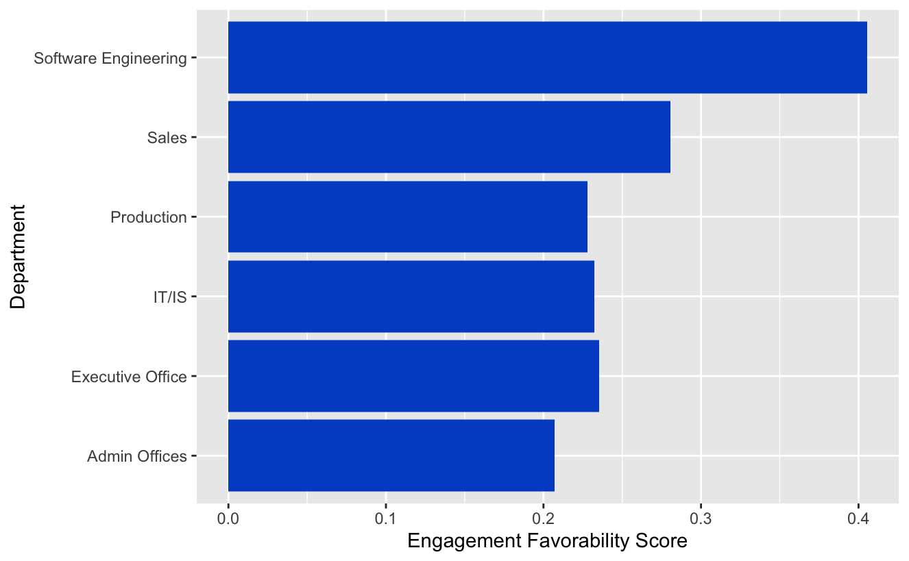
Department by Engagement
A statistical test found significant differences in engagement between departments
Software Engineering has nearly double the favorability as compared to all other departments
What is software engineering doing differently that makes such a dramatic difference?
Opportunity to leverage those findings and re-engineer the solutions to other segments of the company
On the whole, engagement is ~ 25% favorable, which is poor
Employee engagement has been found to drive key organizational outcomes like profitability and market share
Notes:
It’s amazing what a simple bar chart can do to tell you the story about a company’s performance.
Atlassian is a software company, that is the backbone of the company. It could make sense that the culture on this part of the “house” is better than the rest.

Slide 6
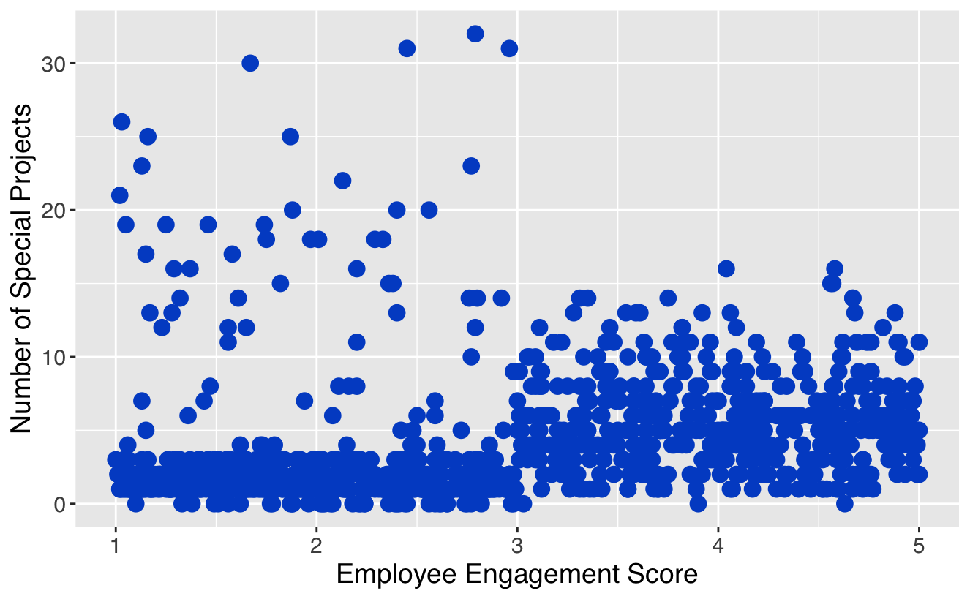
Special Projects and Engagement
We plotted engagement scores across special projects to better understand how special projects affects employee engagement
The red box indicates employees who have a low engagement score and a high number of special projects
These employees seem to be at risk for being overworked and subsequent burnout
It’s not all bad news, though, highly engaged employees with special projects < 10 are quite numerous
Notes:
As the saying goes, “everything in moderation”.
There are almost NO highly engaged employees with projects > 15 !

Slide 7
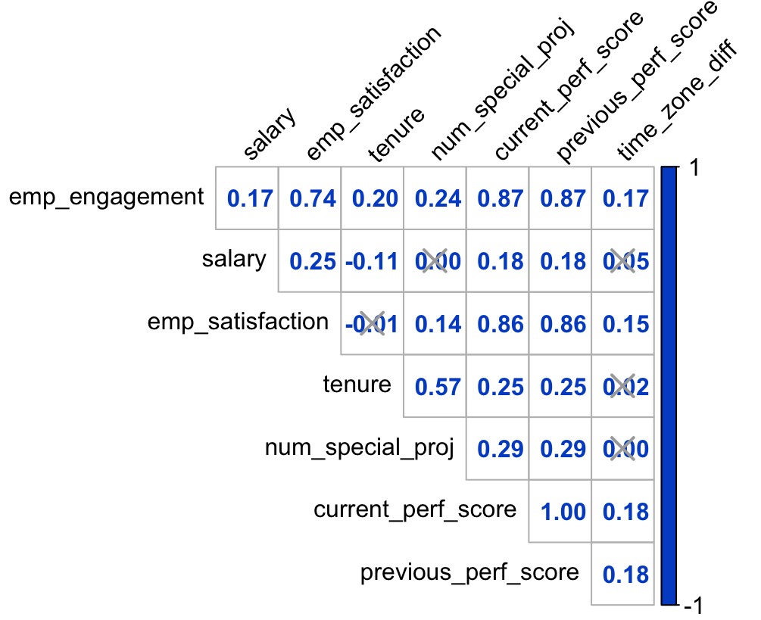
Correlation Analysis
Satisfaction, engagement and performance are nearly perfectly correlated
All these metrics are critical to unlocking organizational performance
Nearly all variables have positive relationships with job performance and employee engagement, except for salary and tenure
Engagement is significantly correlated with special projects, tenure, salary and time zone difference
Correlation does not imply causation, which metrics are the driver?
Research studies reached consensus on determining that job engagement leads to job performance, which makes sense

Slide 8
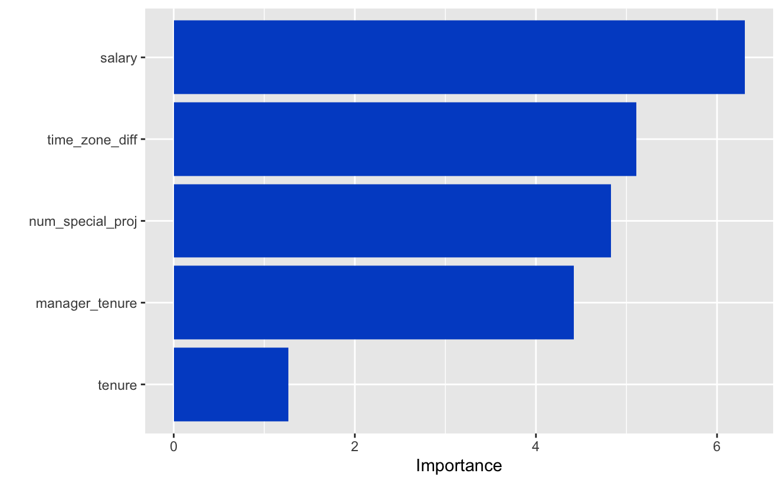
Linear Regression
Regression serves as a useful feature to tease apart which predictors have more leverage on engagement
The analysis found nearly all the features to be significant
Salary has the highest weight for explaining employee engagement by a significant margin, followed by the time zone difference, number of special projects and manager tenure
Special projects should however be limited to < 15 per 6 month period
In essence, according to our very bare-bones model, everything seems to matter and drive impact
The really interesting finding is time zone difference, which could lead to an organizational culture analysis
Managers with higher tenure also seem to know and understand how to engage their workforce
Notes:
Salary often times ranks highly, no surprise there. But time zone difference is the interesting one

Slide 9
Beyond The Data
Organizational culture that promotes communication, teamwork, trust; minimizes blame and information siloes
Leads to employees building better products and working in harmony
Helps them feel more connected to the rest of their organization
Which stimulates higher levels of job performance because they feel so connected to the work
Leading to better overall job engagement and job satisfaction, which results in higher organizational performance
Better understand the culture of Atlassian:
Do teams effectively collaborate and trust one another?
Does information flow freely through the organization?
Are employees mission-oriented?
Deeper dive into how Atlassian hires, retains and manages their workforce
Better understand the “psychometric” properties of the tools used to aggregate this data

Slide 10
Conclusions
Employee engagement, satisfaction and job performance are all heavily positively correlated with one another, to an almost inseparable degree
A simple linear regression showed us that a one unit increase in our engagement score (scale of 1-5) would lead to a .7 increase in our performance rating scale (scale 1 – 4), which is a very high change meaning that engagement impacts performance significantly, at an almost 1 to 1 ratio
A large time zone difference between employee and manager results in higher levels of employee engagement, one interpretation of this finding is a manager is less able to micro-manage, which hints at the broader organizational culture of the organization (see diagram on Slide #9)
Managers with higher tenure also seem to increase employee engagement
Employee engagement fluctuates significantly across different departments, more analyses need to be conducted to better understand how the successful departments engage employees
To a certain degree, special projects help boost employee engagement, but anything more than 15 projects will have an adverse effect on an employee’s engagement levels

Slide 11
Next Steps
Meet with leaders in departments that have high employee engagement scores (Software Engineering, Sales), to better understand their approach (DevOps, Agile, Scrum)
Apply findings to other areas of the organization
Immediately address employees with a significant number of projects (greater than 15) for potential burnout, keep projects at a maximum of 15 to maintain employee engagement
Create focus groups with high tenured managers to better understand how they interact and engage with their employees, this work could potentially lead to a pilot study based on the information learned from these focus group sessions
Meet with the external vendor to drill deeper into engagement into areas such as: career development, well-being, job security, autonomy, work-life balance to better help understand which parts of employee engagement Atlassian is doing well/not so well
Gather more data! Especially dimensions on Performance/Engagement

Slide 12
Study Assumptions
The term “employee engagement” could mean a wide range of issues, for the purposes of this study we are assuming this is a composite metric across a wide variety of sub-topics
The engagement scale has a min/max of 1-5. We assume 1 = low engagement and 5 = high engagement
Previous performance rating and current performance rating have identical distributions
What do we mean by “job performance” or “engagement”?
Are the surveys developed psychometrically valid?

