Slide 1
RunReady: Campus Weather & Air Quality Analyzer
Smart City Infocommunication Technologies project
Szarka Móric (Project Leader), Békési Marcell

Slide 2
Project Goal & Overview
The Problem: Students and faculty often don't know if the local air quality and weather are safe and comfortable for outdoor activities like running or walking.
The Solution: A real-time monitoring dashboard that collects local weather (temperature, humidity, wind) and air pollution (AQI, PM2.5, PM10) data via APIs for the university area.
The Value: The system will calculate a custom "Runability Score" (0-100) combining these factors to provide an immediate recommendation on whether it's a good time to go outside.

Slide 3
Task Breakdown & Commitments
Data Ingestion: Write a Python script to reliably fetch real-time and forecasted data from weather and AQI APIs.
Algorithm Development: Create the logic for the "Runability Score" that penalizes extreme heat/cold, high wind, and poor air quality.
Database Integration: Set up an InfluxDB time-series database to store the historical and real-time data securely.
Dashboard Creation: Design an interactive Grafana dashboard featuring current conditions, the Runabilty score, and a clear "Go / Don't Go" run indicator.

Slide 4
System Architecture
To ensure high availability and easy deployment, the entire stack will be orchestrated using Docker and Docker Compose.
The required 3 Containers:
Data Collector: Custom Python image to fetch API data and push to InfluxDB.
Database: InfluxDB 2.x for time-series data storage.
Visualization: Grafana for the real-time dashboard.
Orchestration: Docker Compose to manage networking and volume persistence between containers.

Slide 5
System Architecture II
Development: Personal laptops for Docker development and testing.
Department Server: Linux VM with Docker & Docker Compose installed (BME Cloud).
Department Resources: Minimum 2GB RAM, and a stable Internet connection.
Network Access: Port 3000 (Grafana) opened for university-wide dashboard access.

Slide 6
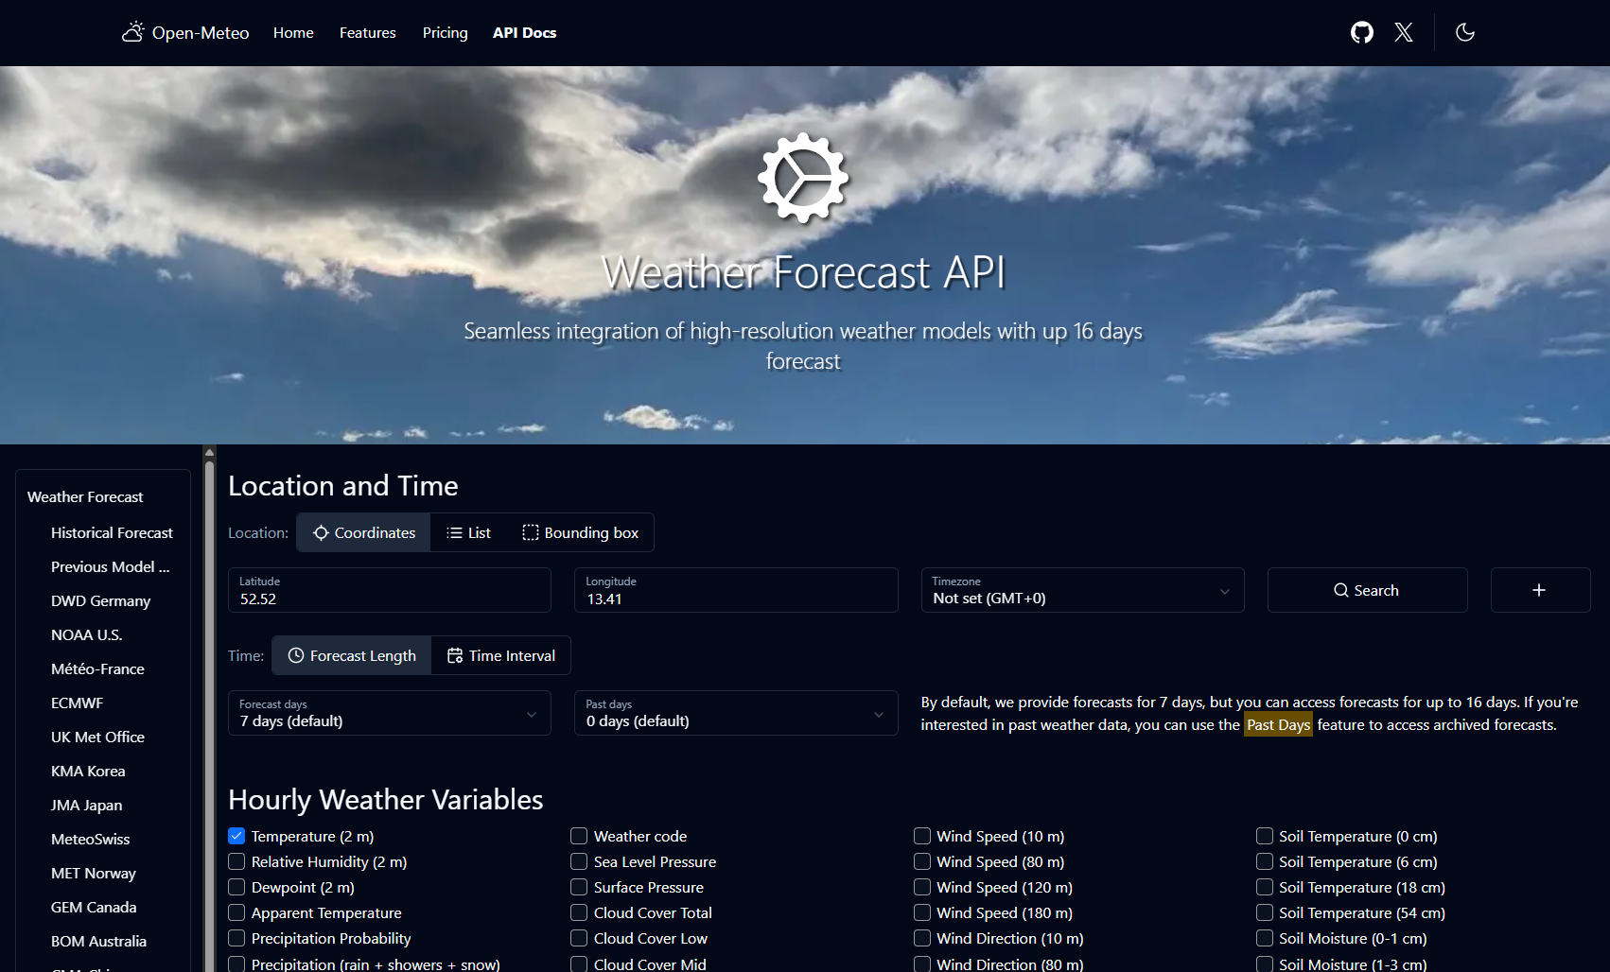
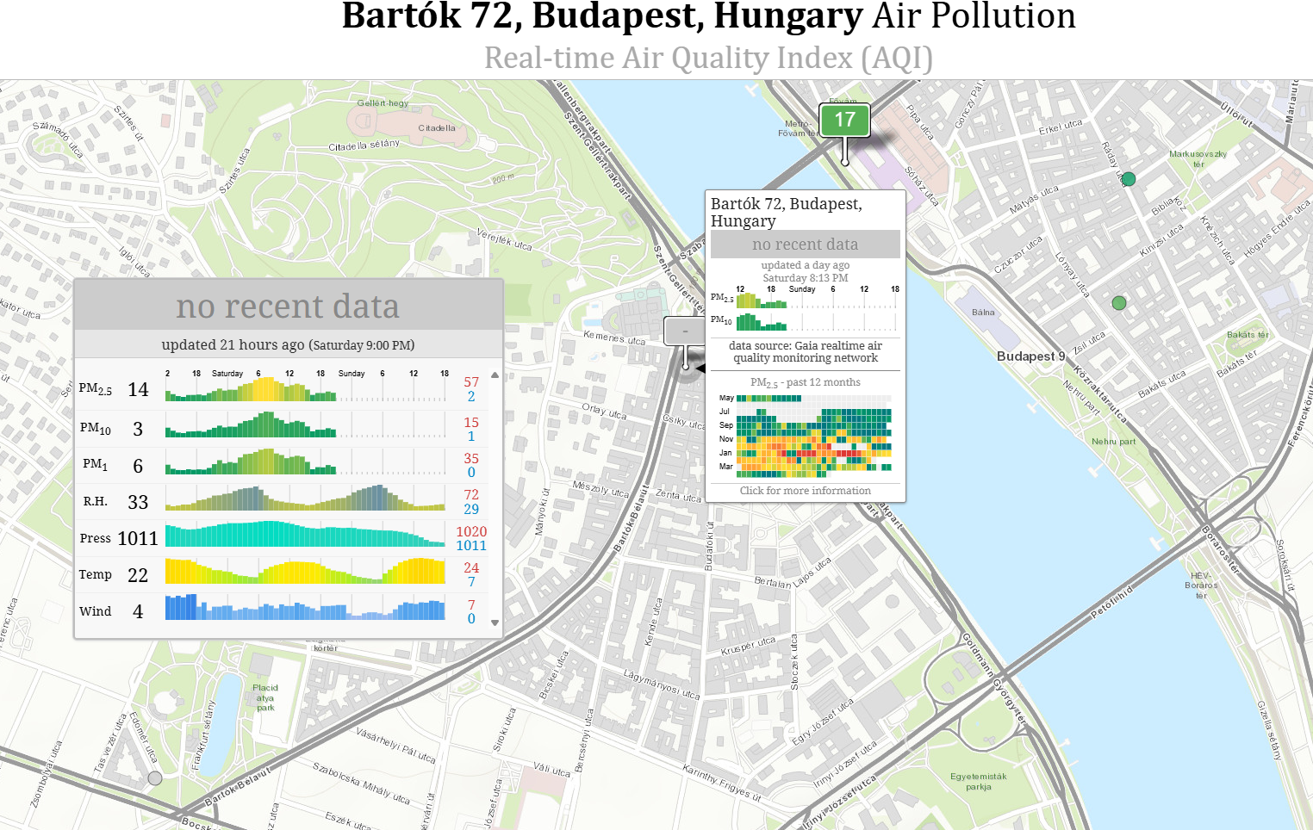
Real-Time Data Sources
Data Sources:
Open-Meteo API
World Air Quality Index (WAQI) API

Slide 7
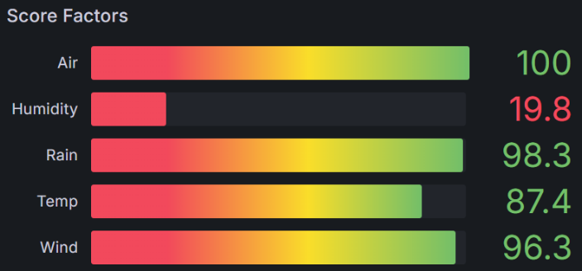
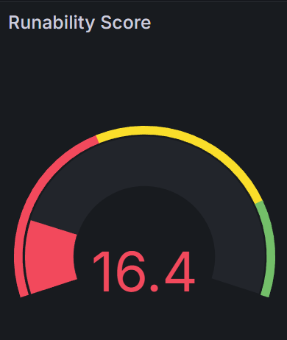
Runability Score
Unlike many existing outdoor activity recommendation tools that rely primarily on Air Quality Index (AQI) alone, our system combines multiple environmental factors, including temperature, humidity, wind, and rain, to provide a more realistic activity suitability score.
Scoring Logic: Each input is converted into a 0-1 comfort factor
Runability Score = 100*temp_score*hum_score*wind_score*rain_score*aqi_score
temp_score = exp(- ((value - ideal)/ tolerance)^2)

Slide 8
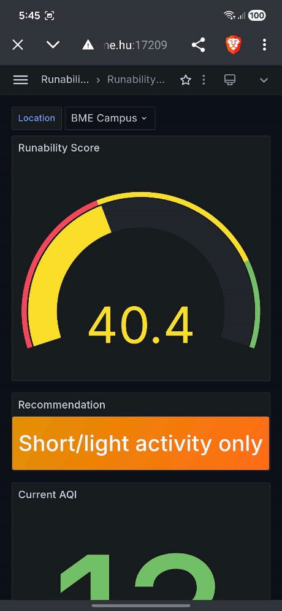
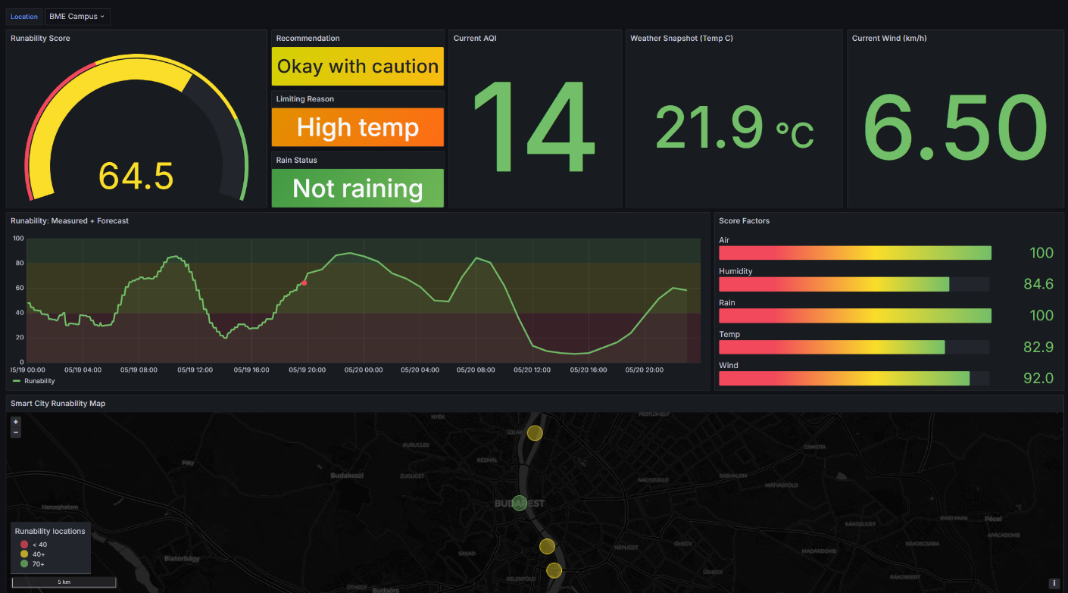
The Dashboard
http://vm.smallville.cloud.bme.hu:17209/d/runability-overview/runability-homework-dashboard?orgId=1

Slide 9
Thank you for your attention!
We’re happy to answer your questions and hear your feedback!

