Slide 1
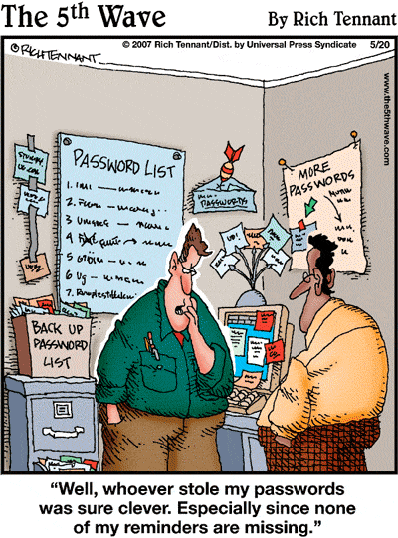
IST346: Namespaces, Identity Management

Slide 2

Agenda
Discussion
Content
Namespaces
Identity Management
Wrap-Up

Slide 3
Discussion Questions
What is a namespace? What are 4 common ways to choosing names? What are the two types of namespaces?
Provide 2 examples of a hierarchical namespace which is global.
What is the name service for computers? For people?
What is AAA? Define each term.
Define self-service. Provide an example of it used on campus.
What is a Distinguished Name, or DN? Is it a global namespace?
Notes:
Give students 1-2 minutes for each question. Its important to provide them with the opportunity to answer the questions based on the reading, labs, and assigned homework.
Thematic, Functional, Descriptive, Formulaic

Slide 4
Namespaces
Types:
Flat
mafudge
Global / Heirarchial
mafudge@gmail.com
mafudge@syr.edu
Conventions:
Formulaic
User001, user001
Thematic
Red, blue, green
Functional
Mail, web, print
Descriptive
Ist-hinds010-pc1

Slide 5

Namespace type and Convention?
What are the namespace type and convention?
An SUID? 101892932
A URL? http://ischool.syr.edu/classes
A Docker image name? Ubuntu Ubuntu:latest
Course numbers? IST346, CAS104
NFL Teams? Dallas Cowboys
A Twitter user name? @mafudge

Slide 6
Authentication, Authorization
Demo: OAUTH2 workflow
Sign in g.syr.edu
Setup 2 step verification
Message sent to my phone
Login in to fa.ischool.syr.edu
Login to stack overflow.com

Slide 7
Group Activity
Perform some group activity

Slide 8
Details of Group Activity
Fsadghsadfasd
Fsadgfsad
fashdfas

Slide 9

Your To-Do List
What to work on for next class
Notes:
ALWAYS CONSULT THE SYLLABUS

Slide 10

Exit Ticket
Share one thing you learned today that you didn’t know before class!

Slide 11

Questions?

