Slide 1
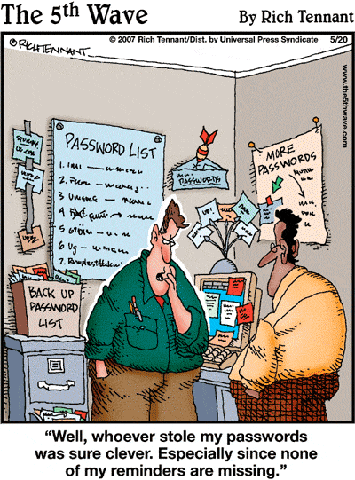

IST346:
Namespaces
Directories
Documentation

Slide 2
Today’s Agenda
Namespaces – what is a namespace? Why is it important?
Examples of namespace policies
Directories and Directory services
LDAP – lightweight directory access protocol
Active Directory
Documentation

Slide 3
Namespaces

Slide 4
So, what is a namespace?
A namespace consists of :
A set of defined and named keys
The attributes associated with each of the keys
For example, the linux and windows user accounts we’ve created in our labs are namespaces
The have defined names (the user accounts themselves) tom, dick, harry, etc…
Each account has attributes associated with it: password, home directory, default shell, etc…

Slide 5
All sorts of namespaces:
Computer Names
Printers
Service Names
IP Addresses
User Accounts
Email addresses

Slide 6
Two type of namespaces
Flat
No duplicates can exist in a flat namespace.
SU NetID is a flat namespace: no two people have the same named key: tajorgen, sjrieks, relstad
User accounts are a flat namespace.
Hierarchical
Namespace is organized in a tree
Duplicates can exist at nodes in the tree, but the overall name is globally unique.
DNS is an example of such a namespace: www.syr.edu www.microsoft.com help@oracle.com help@microsoft.com

Slide 7
Namespace Policy
Consistent namespaces make everyone’s job easier.
Helps your users and admins find resources
A well-governed policy is the key to a consistent and reliable namespace.
The policy should have collision prevention for flat namespaces.
Once you decide on a naming convention, it is difficult to change it.
If there’s one thing you should do by committee, its namespace policy creation!
ITS-Printer-MH250-01

Slide 8
Issues Surrounding Namespaces
Protection
Naming Convention
Longevity
Scope
Does the namespace contain sensitive data?
How long should entries remain? When should they be removed?
Where should they be used?
How does one formulate the named keys?

Slide 9
Naming Conventions
Formulaic
Based on an algorithm, generic look and feel
Student001, student1002, server0001
Themeatic
Planets, Constellations, Cartoon characters
Gamera.syr.edu, rodan.syr.edu
Functional
Name matches function
smtp-host.syr.edu, help.syr.edu, clock.syr.edu
Descriptive
By location, resource, type, device class
How SU names its objects in Active Directory.
No Method
Everyone picks their own, first come first serve.
This is how DNS registrars allocate names on the Internet.
Applied uses are usually a combination of multiple approaches.

Slide 10
Some Examples of namespaces.
And their naming conventions

Slide 11
Example namespace: NetID
What is it?
Represents accounts for all users on campus
Rules and Constraints:
Legacy systems require the account to be no more than 8 characters.
Flat namespace for all users associated with SU.
No two people can have the same NetID
Convention:
Named keys are created via a combination of formulaic and functional approaches
Examples:
Timothy A Jorgensen - tajorgen
Peggy M Brown – pmbro01 (pmbrown already existed)

Slide 12
iSchool Workstation Naming (AD)
What is it?
The method the iSchool uses to identify user workstations
Rules and Constraints
For legacy windows computers, 15 characters maximum
Must begin with IST- to avoid conflicts with other organizations on campus (flat namespace)
Convention:
Named keys are created from the user’s netid and machine type (fac/staff desktop/laptop)
Examples:
IST-SD-MAFUDGE
IST-FL-DJMOLTA

Slide 13
DNS Namespace
What is it?
Used for registering names of computers on the internet or intranet.
www.syr.edu help@google.com
Rules and Constrains
Except for .edu, .gov and.mil there aren’t any
DNS is a hierarchy, duplicates allowed within different contexts, but not globally.
www.syr.edu www.syracuse.com www.google.com
Convention
Top level, org level, hostname
Top level: http://www.iana.org/gtld/gtld.htm

Slide 14
DNS Hierarchy www.syr.edu
www
Syr
Edu
host
domain
gtld
Notes:
Gtld – generic top-level domain

Slide 15
Descriptive Namespaces
Descriptive names are the friendliest namespace.
They are usually “self-explanatory”
The should be governed carefully within the organization, for obvious reasons.
Examples:
president@whitehouse.gov forwards email to user barak.obama
chancellor@syr.edu forwards email to ksyverud
http://printing.google.com gives you information about all the printers in google
The wireless networks AirOrangeHelp, AirOrange, AirOrangeX

Slide 16
Managing Namespaces
Let’s suppose your organization has
10 Linux,10 windows servers, and 100’s of workstations.
100’s of Users
An established a naming convention for user accounts and computers.
How can you:
Avoid collisions of named keys?
E.g. jasmith = Jo Ann Smith on a Linux host, John Andrew Smith on a Windows host.
Manage the user and computer namespaces so that your system admins follow the conventions?
Create user jsmith, instead of jasmith for example.
These are real-world issues… ideas?

Slide 17
Meta-Directory
A Meta-Directory is a unified database of your namespaces.
To create a named key for a namespace, such as a new user:
The information is added to the meta-directory
The account is provisioned from the meta-directory to the resource itself. (Account created on the Windows or Linux Server or both)
Meta-Directories are namespace management.
You can buy identity management software to implement a meta-directory or build your own.
These solutions require a lot of planning, design and testing.

Slide 18
Directories
Directories offer a database for your namespaces.

Slide 19
Directories 101
Directory
A collection of information that is primarily searched and read, but rarely modified.
Named keys from namespaces are ideal storage candidates for directories.
Directory Service
Provides access to directory information.
Directory Server
Application that provides a directory service.
Note:
Directories are not Meta-directories. Directories store named keys, but do not provision them.

Slide 20
Advantages of Directories
Make administration easier.
Change data only once: people, accounts, hosts.
Unify access to network resources.
Single sign on.
Single place for users to search (address book)
Improve data management
Improve consistency (one location vs many)
Secure data through only one server.

Slide 21
LDAP
Lightweight Directory Access Protocol
Lightweight version of the DAP based on X.500 directories. http://www.x500standard.com/
Just an Access protocol, not a directory itself.
The directory must be implemented on the server end.
Directory services which implement LDAP
OpenLDAP
Fedora Directory Server (formerly Sun, Netscape)
Mac Open Directory
Microsoft Active Directory
Novell eDirectory (NDS)

Slide 22
LDAP Structure
Hierarchal structure
Containers are called organizational units
An LDAP directory is made of entries.
Entries may be employee records, hosts, accounts etc.
Each entry consists of attributes.
Attributes can be names, phone numbers, etc.
objectClass attribute identifies entry type, or schema
Schema determines the available attributes for the entry
Each attribute is a type / value pair.
Type is a label for the information stored (name)
Value is value for the attribute in this entry.
Attributes can be multi-valued.

Slide 23
LDAP DN
dc=syr, dc=edu
ou=IST
cn=maufgde
cn=ist-sd-mafudge
ou=WHIT
cn=jadaley
The DN, or distinguished name represents the path from the root of the directory to the entry.
(In this example the rectangle is a user objectClass, and the trapezoid is a computer objectClass)
My account: Dn: cn=tajorgen,ou=Users,ou=ITS,dc=ad,dc=syr,dc=edu My laptop computer:
Dn: cn=its-l-tajorgen,ou=Computers,ou=ITS,dc=ad,dc=syr,dc=edu

Slide 24
LDAP Authentication
Anonymous Authentication
Binds with empty DN and password.
Simple Authentication
Binds with DN and password. Cleartext. Bad.
Simple Authentication over SSL/TLS
Use SSL to encrypt simple authentication.
Simple Authentication and Security Layer
SASL is an extensible security scheme.
SASL mechanisms: Kerberos, GSSAPI, SKEY

Slide 25
Active Directory
Microsoft’s Directory service
Used to manage users and computers in the enterprise.
Hierarchy: Forest, Trees, Domains
The Namespace is flat at the domain level
AD Implemented using LDAP + DNS + Kerberos
LDAP used for user, group, computer, policies and more.
Kerberos used for computers on the domain and user logons
DNS is used for naming computers on the domain

Slide 26
Active Directory
Some details about Microsoft’s Active Directory

Slide 27
What is Active Directory?
Functional definition:
A Directory service developed by Microsoft that uses a hierarchical structure to store information about objects on the network. The differentiating component of this directory implementation vs. others are the types of objects that it tracks.
Also referred in some circles as AD or ADS.

Slide 28
What kinds of objects can AD track?
Shared Resources:
Workstations
Servers
Shared volumes
Printers
Applications
User resources
Users
Groups
Contacts
Mailboxes (Exchange)

Slide 29
Key features of AD
AD as a namespace that is integrated with the Internet's Domain Name System (DNS).
AD is a directory service central to the Windows Server operating system, which runs only on servers called “Domain Controllers”.
Some directory services are integrated with an the operating system, and others with applications such as e-mail (Exchange) directories. Operating system directory services provide user, computer, and shared resource management while application services it provides extend the functionality or management of said application. Ex: AD stores all smtp (email) address for accounts in the user objects, allowing Exchange servers to receive email destined for those addresses.

Slide 30
AD Utilizes a distributed architecture
In addition to providing a place to store data and services to make that data available, Active Directory can also protect network objects from unauthorized access and replicate information about objects across the entire network so that information about objects is not lost if one domain controller fails.
The key here is building in redundancy when designing redundancy of this service (remember our in-class exercise from last week?).

Slide 31
Authentication
Each domain controller has information for the entire forest to support authentication and access control.
This provides the ability for local domain controllers (the “tree”) to provide a quick local lookup of authority.
Not only do users but every object authenticating to Active Directory must reference the global catalog server (a domain controller), including every computer that is joined.

Slide 32
Benefits to using AD - Users
Prior to AD
User accounts were configured in all of the disparate systems that users had to access, each with different passwords and policies governing access. Myslice, Email, file sharing servers, database servers, Peoplesoft, registrar system, etc…
After AD
User accounts are created one central directory system and all other systems access AD for account information. Single account to manage, single system for making password changes, and groups can be created in AD for granting multiple users access to the same resource.

Slide 33
Benefits to using AD - Computers
Prior to AD
PCs were setup as standalone entities, it would take as much as 10-20 hours of effort to manually visit each machine to configure the OS, setup local user accounts, map network drives, install software, etc… Not to mention the ongoing maintenance costs!
After AD
PCs are joined to the domain, group policies can be created that will push new security patches, software, shared printers, and manage settings for all machines with a few mouse clicks.

Slide 34
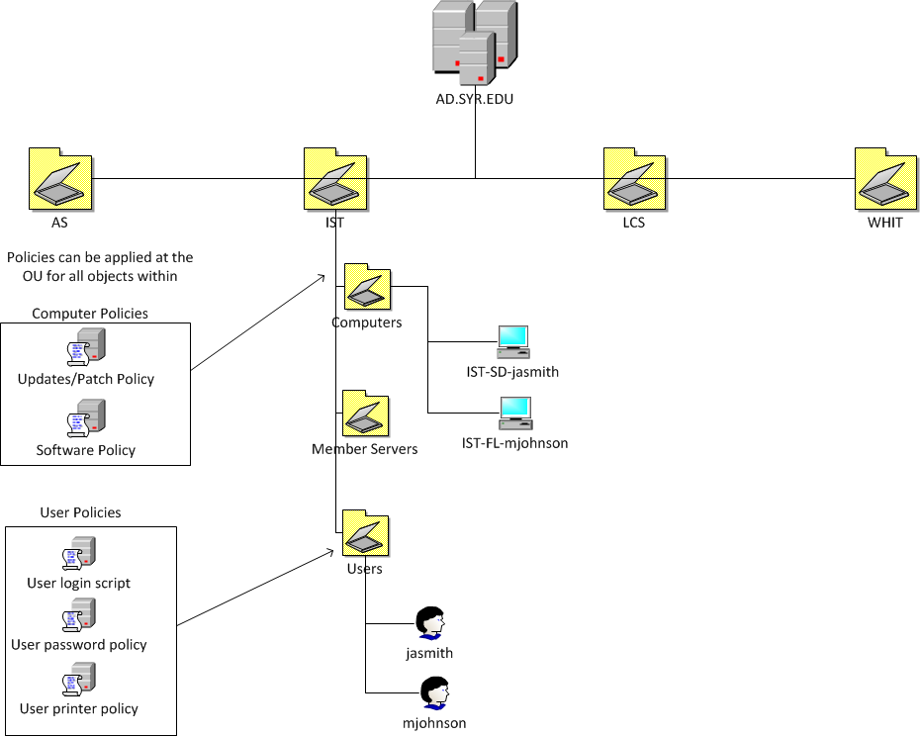

Slide 35
Documentation
Every SA’s favorite thing to do!

Slide 36
What is Documentation?
Documentation: Process of keeping records for the purpose of referencing information at a later time or for use by others.
What should be documented?
What you need later in time.
Don’t’ try to document everything. You can’t.
Don’t over complicate documentation.

Slide 37
Documentation
What?
Complex procedures
Screen captures
Source code
How?
Templates (title, metadata, what, body)
Tools (wiki, document repository, shared drive)
Why?
Train other staff
Eliminate single-person dependencies
Reduce support calls
Justify the need for additional staff
Notes:
What is documentation: Process of keeping records for the purpose of referencing information at a later time or for use by others.
What should be documented?
What you need later in time.
Don’t’ try to document everything. You can’t.
Don’t over complicate documentation.
Screen captures or screen shots
Serial numbers or licensing information
Complex command
Source code, if writing programs
Important contact information, vendors information, emergency contact information.
Checklists needed for common repetitive tasks.
HOW
Template: Create a document template so similar types of documentation
Title: title of document that others understand
Metadata: author’s name, date created / edited, etc.
What: sentence describing the goal of the document
Body: the information your interested in documenting.
Used by many types of users for various purposes
Many systems allow you to create documentation. Some can be automatic.
WHY
To get new staff members up-to-speed on how things are done.
Justify the need for a new employee, “look at all the stuff we’re doing and are responsible for”
To refer back later in time when you need to recreate a system
For others when your responsibilities change (you get promoted).

Slide 38
Documentation templates
Create a document template for similar types of documentation
Title: title of document that others understand
Metadata: author’s name, date created / modified, etc.
What: describing the goal or purpose of the document
Body: the information your interested in documenting.

Slide 39
Examples of Common SA Documents
Screen captures or screen shots
Serial numbers or licensing information
Complex commands or procedures
Source code, if writing programs
Important contact information, vendors information, emergency contact information.
Checklists needed for common repetitive tasks.
System/service design documents

Slide 40
Tools for Documentation
Systems for documentation other than file shares
Helpdeks, SysAdmins, Procedures, FAQ, etc
Wiki, such as wikipedia.com
Confluence: http://answers.syr.edu
Sharepoint: http://sp.syr.edu
Any type of Content Management System (CMS)
Basically what appears to be a website but can be managed, new pages added, documents attached, groups created, etc. via a series of web forms and a WYSIWYG tools.
Can be automatically created: HW and SW inventory
Notes:
Helpdesk staff – ticketing system. Used to track helpdesk calls from customers (users) and provides support staff a method of prioritizing incidents, searching for solutions, and verifying that all problems are tracked and handled.
System Administrators – documenting servers, systems, etc
How-to Docs – users to clients in an effort to solve their own problems before calling the support number. Commonly used at technical websites or large corporations.
Frequently asked Questions (FAQ): common problems with simple answers. Can be dynamically created from the list of most frequently accessed How-to’s.
Procedures: Comply with International Organization of Standards (ISO), OSHA, etc.

Slide 41
Questions?
Do people who spend $2 apiece on bottles of Evian water know that spelling it backwards is Naive?

