Slide 1
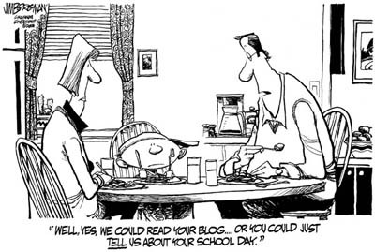

IST346:
Web Services

Slide 2
Today’s Agenda
Learn the basics of how the Web works
Understand various web service architectures
Address scaling, security, and change management issues with web architectures

Slide 3
What is a website?
“A way of presenting information to users using a client/server model.”
Built upon open standards, the successes of websites on the internet are hinged upon this
Data can be accessed by any client that speaks http
Website can consist of static content (html, images, etc..) or dynamic content through interpreted code (asp,php,jsp)
Code and applications can be run on the web server and delivered to the client in the form of html, or can be shipped to the client browser for processing
INTERESTING STAT: Half a billion people accessed the internet via their mobile device in 2009
MORE INTERESTING: 1.2 billion mobile web users in 2011…roughly 17% of the world population! http://mobithinking.com/mobile-marketing-tools/latest-mobile-stats#mobile-internet-access

Slide 4
Terms and Ports
URL: uniform resource locator, http://www.syr.edu
Typically use the http (hyper text transport protocol, port 80) for communications, but doesn’t need to.
Has anyone ever seen an address that looks like the following
http://www.somewebsite.com:8080
The 8080 at the end is the specific port number to open
Can also start with https (hyper text transport protocol secured, typically port 443 but can differ)

Slide 5
Webmaster vs. Web Administrator
Two major roles in the web
Webmaster (a very outdated term)
Person responsible for content, graphics, usability, etc
What is classically thought of when creating websites / webpages.
Web Administrator
Person responsible for administering webserver (machine or VM), create virtual directories, virtual sites, patching, backups, etc.
Basic skills required in administering any server
Generally the same person for small companies
But NOT the same person for midsized or larger companies.

Slide 6
Website basic dependencies
Web server(s)
TCPIP
DNS (internal and root DNS servers)
Client (browsers)
Code interpreter (for applications)
On the web server (server-side apps)
On the client (web plugins or native interpreter)
Content store/database (may not be local to the webserver)
Other web servers?

Slide 7
Web servers
Commonly used examples are LAMP (linux,apache,mysql,php), IIS (internet information server)
Can be architected in different ways:
Single web server, single website
Single web server, multiple websites
Multiple TCP ports (80, 81, 8080, 85, etc..)
Multiple network interfaces/IP addresses
Host header values (multiple IP addresses and DNS records pointing to the same server)
Multiple web servers, single website
Or better known from previous topics as “horizontal scaling”

Slide 8
HTTP
Browser
Web Server
URL / URI
Platform ASP /PHP /JSP
Micro-formats
HTML / XHTML
Web Building Blocks
AJAX

Slide 9



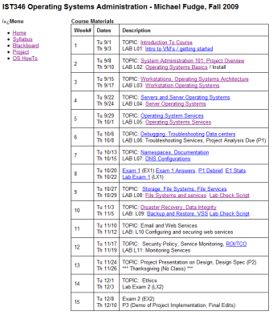

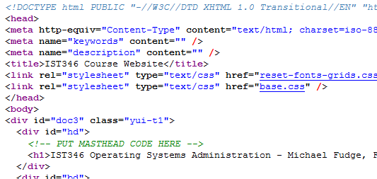
The Web at work
Your computer IP: 192.168.0.55
Web Server IP: 128.230.182.251
URL
Browser: Connect
Send: HTTP GET /ist346/
Server
Recv: HTTP Response Stream
File containing HTML
Rendered HTML

Slide 10


Web Service Architectures
TYPE
Server Interactions
HTTP GET /index.html
Static
HTTP Response Stream
Dynamic CGI / Platform
HTTP GET /index.php
HTTP Response Stream
Dynamic Database- Driven
HTTP GET /index.php
HTTP Response Stream

Slide 11
Web Scalability –Vertical (Scale Up)
Web Server
DB Server
Clients
HTTP Request
DB Calls
HTTP Response
DATA

Slide 12
Web Scalability – Horizontal (Scale Out)
Server 1
Clients
HTTP Request
Load-Balancer *
Data Replication
HTTP Response
Server 2
* Round-Robin DNS, reverse Proxy, hardware load balancer

Slide 13
Web Scalability –Up and Out
Web Server 1
Db Server 1
Clients
Web Server 2
HTTP Response
HTTP Request
Data Replication
Web Server 3
Load-Balancer *
Db Server 2
Web Server 4

Slide 14
Scaling
Don’t underestimate the importance of scalability
Scaling up is easier, but limiting.
You might not need to scale right away…
But you should always consider it when deploying a service.
Factor it into the equation from the beginning.

Slide 15
Web Platforms – Everyone’s got one
Java
Apache / Tomcat / JSP
Microsoft
IIS / ASP.NET
Linux
Apache / PHP
Ruby on Rails
Python
Classic Perl / CGI

Slide 16
Analytics (Website Analysis)
Trending, methods of entry, exit, etc
Allows you to tailor your site for exactly whom your trying to attract and market too.
Determine what browsers users are using so you can again tailor your site properly.
http://www.google.com/analytics/tour.html

Slide 17
Web Content Management Systems WCMS
Web Content Management System is what appears to be a website but in reality is a web based application.
Use WYSIWUG (what you see is what you get editor) for page creation.
Generally can be managed by users with no prior web management experience.
All management is done via a series of forms.

Slide 18
Websites and Security

Slide 19
Web Service Security
Since virtually everyone can access your service, security is important.
Rule #1 ALWAYS assume the worst.
There are many layers of security, use them all:
Secure communication with SSL (Secure Sockets Layer)
Protect the server by service Hardening on the Web server. Only run the services that are required – nothing more.
Protect the web service itself
Secure the application running over the web

Slide 20
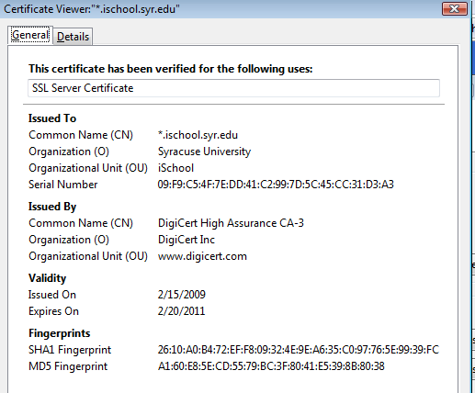
SSL – Secure Sockets Layer
Encrypts traffic over the wire
Protects against “Man in the Middle” attacks (sniffing data in transmission)
Orgs purchase the SSL certificate from an Authority
Browsers “Trust” the Authority and encrypt the traffic
Moral:
Just because a site uses SSL doesn’t mean its “secure” it only means the traffic between you and the server is encrypted!!!!

Slide 21
Encryption - SSL
Offers secure transmission between client and server at the lowest level – socket level, sits atop TCP.
Two types:
Self-signed – certificate created by the host/service you are connecting to.
CA issued – an intermediate Certificate Authority issues a certificate that both the server and client “trust”
Certificate Authorities can be both public and private.
*Internet-based services ultimately require a Public CA to assure a proper trust chain be established.
Intranet-based services can utilize a Private CA as the trust can be established within the organization.
*Clients trust public CAs if they are able to obtain their public key in the browser certificate store.

Slide 22
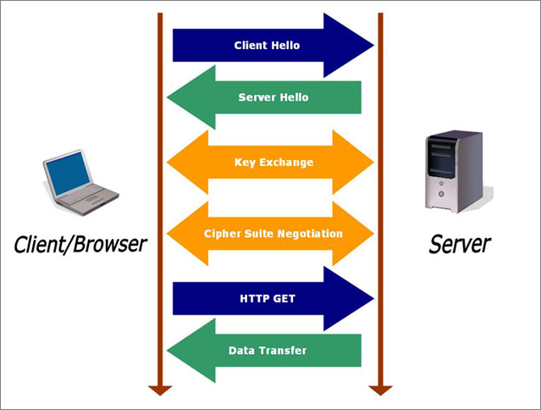
SSL – how it works on the web
Client request
Server response
Key exchange
Cipher negotiate
Client http get
Data transfer

Slide 23
Protecting content
We must take many steps in protecting website
Common methods of attacks
Directory Traversal: using ../../ to go up or down a directory structure. Can obtain data that is otherwise unavailable
Form field corruption: using a websites forms to enter data or purchase items via hidden data fields. If you know what variables are being used to pass data, you can change the values.
SQL injection: inject SQL statements (select * from lastnames) to add, edit, or delete data in a database or even execute applications on the webserver.

Slide 24
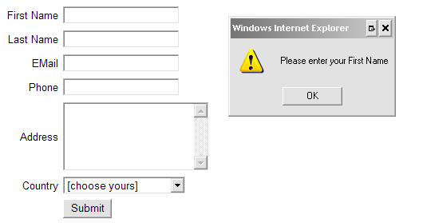
Protecting data
Limited the potential damage.
Connect to databases with read-only permissions if you are not updating or inserting data.
Validate form fields: verify the data the user typed before proceeding
Run web services with only the minimal level of permissions that is needed.
Use logging so if something does happen.
Use change control

Slide 25
Web Content Management
Change control
Update – new material
Change – alter existing material
Fix – correct existing material
Production websites at least should have:
Prod - obvious
Dev/Draft – where new changes are first made
Test/QA – final proofing before the rollout to prod

Slide 26
TODO Web APIs
What is an API
What is a web API
XML
JSON
REST / RESTFul
Back End Services
Microservices and Web

