Slide 2
IST346: Web Services and API’s

Slide 3
Web Services ???
The most important service in any organization.
Beyond a company’s website, other business processes get “webified”
Webmail
Customer Relationship Portals
E-Commerce
To support these same services outside the browser we “webify” the business logic into an API (Application Program Interface)

Slide 4
Web Basics

Slide 5
The World-Wide Web
Information System on the Internet for displaying content resources.
The world wide web is not the Internet; it is part of it!
Built upon open standards
INTERESTING STAT: Half a billion people accessed the internet via their mobile device in 2009!
MORE INTERESTING: 1.2 billion mobile web users in 2011…roughly 17% of the world population! http://mobithinking.com/mobile-marketing-tools/latest-mobile-stats#mobile-internet-access

Slide 6
Web Terminology
URL – Uniform Resource Locator. A global name space which identifies a resource on the web.
HTML – Hypertext Markup Language. A Markup language for rendering web pages.
Web Server – A computer on the web which hosts resources.
Web Browser – A computer on the web which consumes resources
Resource – content at a URL, hosted on a web server and requested by a web browser.

Slide 7

How the web works
Clients make requests to web servers, typically using a browser.
The client provides a request method and a URL
The web server send a response to the client. In the response is the content based on the URL
The client renders (draws) the content in the web browser
Request: GET http://www.syr.edu
Response: Content-Type: HTML

Slide 8
HTTP
HTTP, or the Hypertext Transport Protocol is the data transfer protocol of the web.
It consists of requests, which contain a verb and URL and a response, which contains a status code and content type.
HTTP is a stateless protocol, which means the current request knows nothing of the previous requests.
The well-known port for HTTP is TCP/80

Slide 9
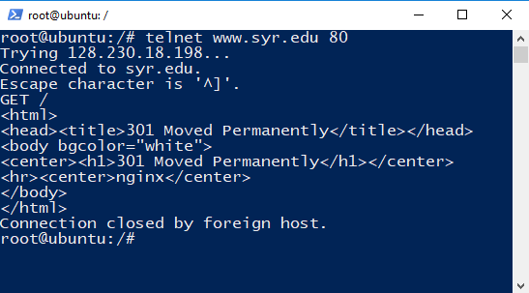
HTTP Protocol in Action
Like SMTP and IMAP, you can use the HTTP protocol directly with telnet:
Host
Port
Request
Response HTML

Slide 10
HTTP Request and Response
HTTP Request
HTTP Response
Verb – Nature of the request
URL – The resource to request
Status Code – What happened?
Content Type – The actual content

Slide 11
HTTP Request Verbs
GET – Request a resource. Most common
POST – Add to a resource. Used when sending data to the website, like submitting a form.
Other Verbs:
PUT – Update a resource
DELETE – Remove a resource
PATCH – Update part of a resource
HEAD – No Response Body
OPTIONS – Reserved.

Slide 12
HTTP Response Status Codes
1xx – Informational
2xx – Success
200 – OK
201 – Created
202 – Accepted
3xx – Redirection
301 – Moved Permanently
304 – Not Modified
307 - Redirect
4xx – Client error
400 – Bad Request
401 – Unauthorized
403 – Forbidden
404 – Not Found
5xx – Server Error
500 – Internal Server Error
501 – Not Implemented
502 – Bad Gateway

Slide 13
HTTP Content Types
These are Media Types. They instruct the client (usually a browser) what to do with the content.
text/plain – plan text
text/html – HTML text
image/gif – gif image format
image/jpeg – jpeg image format
application/json – JSON data format
application/xml – XML data format
application/javascript - JavaScript

Slide 15
Website basic dependencies
Web server(s)
TCPIP Neto
DNS (internal and root DNS servers)
Client (browsers)
Code interpreter (for applications)
On the web server (server-side apps)
On the client (web plugins or native interpreter)
Content store/database (may not be local to the webserver)
Other web servers?

Slide 16
Webmaster vs. Web Administrator
Two major roles in the web
Webmaster (a very outdated term)
Person responsible for content, graphics, usability, etc
What is classically thought of when creating websites / webpages.
Web Administrator
Person responsible for administering webserver (machine or VM), create virtual directories, virtual sites, patching, backups, etc.
Basic skills required in administering any server
Generally the same person for small companies
But NOT the same person for midsized or larger companies.

Slide 17
Web servers
Commonly used examples are LAMP (linux,apache,mysql,php), IIS (internet information server)
Can be architected in different ways:
Single web server, single website
Single web server, multiple websites
Multiple TCP ports (80, 81, 8080, 85, etc..)
Multiple network interfaces/IP addresses
Host header values (multiple IP addresses and DNS records pointing to the same server)
Multiple web servers, single website
Or better known from previous topics as “horizontal scaling”

Slide 18
HTTP
Browser
Web Server
URL / URI
Platform ASP /PHP /JSP
Micro-formats
HTML / XHTML
Web Building Blocks
AJAX

Slide 19



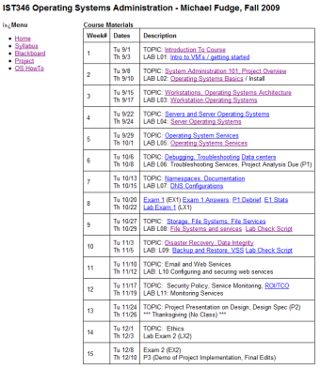

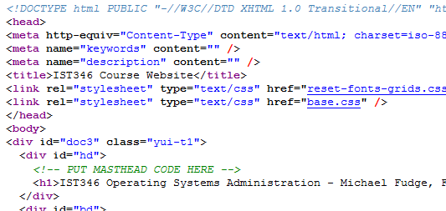
The Web at work
Your computer IP: 192.168.0.55
Web Server IP: 128.230.182.251
URL
Browser: Connect
Send: HTTP GET /ist346/
Server
Recv: HTTP Response Stream
File containing HTML
Rendered HTML

Slide 20


Web Service Architectures
TYPE
Server Interactions
HTTP GET /index.html
Static
HTTP Response Stream
Dynamic CGI / Platform
HTTP GET /index.php
HTTP Response Stream
Dynamic Database- Driven
HTTP GET /index.php
HTTP Response Stream

Slide 21
Web Scalability –Vertical (Scale Up)
Web Server
DB Server
Clients
HTTP Request
DB Calls
HTTP Response
DATA

Slide 22
Web Scalability – Horizontal (Scale Out)
Server 1
Clients
HTTP Request
Load-Balancer *
Data Replication
HTTP Response
Server 2
* Round-Robin DNS, reverse Proxy, hardware load balancer

Slide 23
Web Scalability –Up and Out
Web Server 1
Db Server 1
Clients
Web Server 2
HTTP Response
HTTP Request
Data Replication
Web Server 3
Load-Balancer *
Db Server 2
Web Server 4

Slide 24
Scaling
Don’t underestimate the importance of scalability
Scaling up is easier, but limiting.
You might not need to scale right away…
But you should always consider it when deploying a service.
Factor it into the equation from the beginning.

Slide 25
Web Platforms – Everyone’s got one
Java
Apache / Tomcat / JSP
Microsoft
IIS / ASP.NET
Linux
Apache / PHP
Ruby on Rails
Python
Classic Perl / CGI

Slide 26
Analytics (Website Analysis)
Trending, methods of entry, exit, etc
Allows you to tailor your site for exactly whom your trying to attract and market too.
Determine what browsers users are using so you can again tailor your site properly.
http://www.google.com/analytics/tour.html

Slide 27
Web Content Management Systems WCMS
Web Content Management System is what appears to be a website but in reality is a web based application.
Use WYSIWUG (what you see is what you get editor) for page creation.
Generally can be managed by users with no prior web management experience.
All management is done via a series of forms.

Slide 28
Websites and Security

Slide 29
Web Service Security
Since virtually everyone can access your service, security is important.
Rule #1 ALWAYS assume the worst.
There are many layers of security, use them all:
Secure communication with SSL (Secure Sockets Layer)
Protect the server by service Hardening on the Web server. Only run the services that are required – nothing more.
Protect the web service itself
Secure the application running over the web

Slide 30
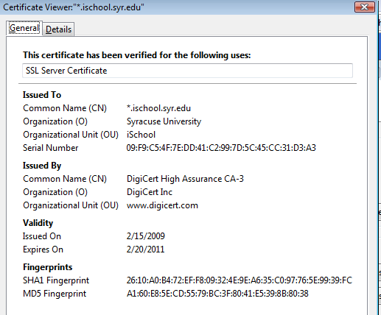
SSL – Secure Sockets Layer
Encrypts traffic over the wire
Protects against “Man in the Middle” attacks (sniffing data in transmission)
Orgs purchase the SSL certificate from an Authority
Browsers “Trust” the Authority and encrypt the traffic
Moral:
Just because a site uses SSL doesn’t mean its “secure” it only means the traffic between you and the server is encrypted!!!!

Slide 31
Encryption - SSL
Offers secure transmission between client and server at the lowest level – socket level, sits atop TCP.
Two types:
Self-signed – certificate created by the host/service you are connecting to.
CA issued – an intermediate Certificate Authority issues a certificate that both the server and client “trust”
Certificate Authorities can be both public and private.
*Internet-based services ultimately require a Public CA to assure a proper trust chain be established.
Intranet-based services can utilize a Private CA as the trust can be established within the organization.
*Clients trust public CAs if they are able to obtain their public key in the browser certificate store.

Slide 32
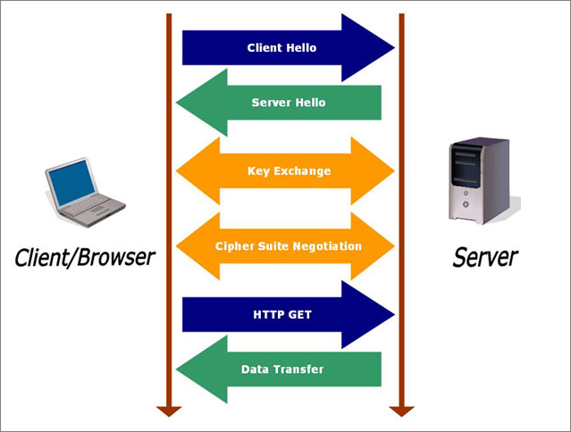
SSL – how it works on the web
Client request
Server response
Key exchange
Cipher negotiate
Client http get
Data transfer

Slide 33
Protecting content
We must take many steps in protecting website
Common methods of attacks
Directory Traversal: using ../../ to go up or down a directory structure. Can obtain data that is otherwise unavailable
Form field corruption: using a websites forms to enter data or purchase items via hidden data fields. If you know what variables are being used to pass data, you can change the values.
SQL injection: inject SQL statements (select * from lastnames) to add, edit, or delete data in a database or even execute applications on the webserver.

Slide 34
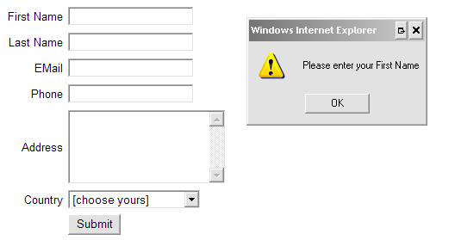
Protecting data
Limited the potential damage.
Connect to databases with read-only permissions if you are not updating or inserting data.
Validate form fields: verify the data the user typed before proceeding
Run web services with only the minimal level of permissions that is needed.
Use logging so if something does happen.
Use change control

Slide 35
Web Content Management
Change control
Update – new material
Change – alter existing material
Fix – correct existing material
Production websites at least should have:
Prod - obvious
Dev/Draft – where new changes are first made
Test/QA – final proofing before the rollout to prod

Slide 36
TODO Web APIs
What is an API
What is a web API
XML
JSON
REST / RESTFul
Back End Services
Microservices and Web

