Slide 1
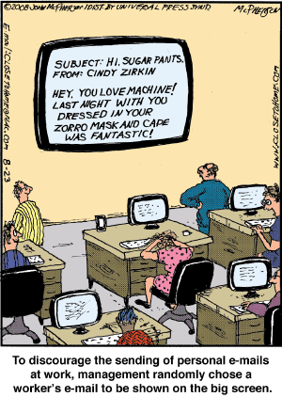
IST346: Email and Messaging

Slide 2

Agenda
Discussion
Content
Email
Other Messaging Services
Wrap-Up

Slide 3
Discussion Questions
List 3 technical challenges of email service?
List 3 logistical / policy issues of email service?
What are the 4 components of email?
How does email scale vertically?
Define a strategy for scaling an MTA like SMTP horizontally?
What about a strategy for scaling an Access Agent like IMAP horizontally?
Notes:
Give students 1-2 minutes for each question. Its important to provide them with the opportunity to answer the questions based on the reading, labs, and assigned homework.
3. Vertically though MTA, MUA, MDA, AA

Slide 4

Lab Debrief
Lab K

Slide 5
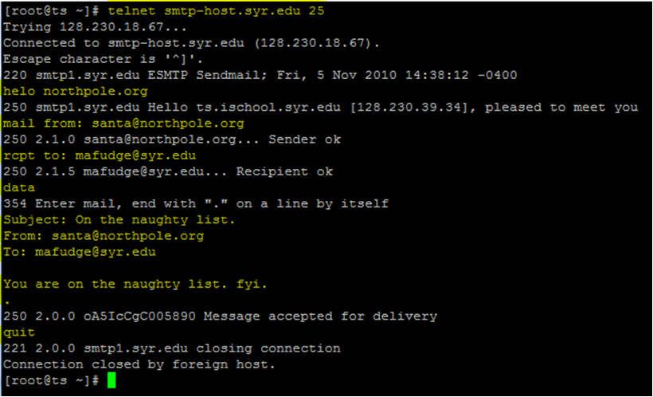
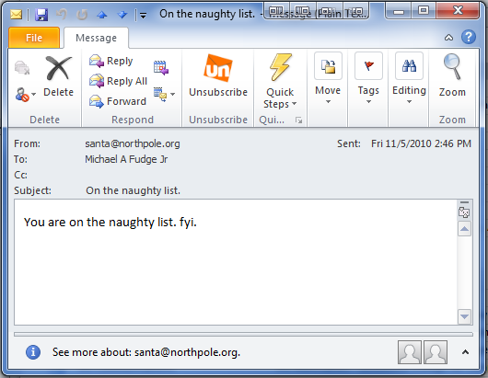
SMTP Protocol in Action
The “S” in SMTP stands for “Simple”. ☺

Slide 6
Components at work –sending email
syr.edu
gmail.com
MUA
Message
Store
Outlook
MTA
sendmail
internet
MUA
MTA
Phone
sendmail
MDA
MUA
MDA
exchange
iMail
procmail
Example of sending an email from tajorgen@syr.edu to tim.jorgensen@gmail.com

Slide 7
Components at work –receiving email
internet
MUA
syr.edu
Outlook
MUA
AA
MDA
MTA
Exchange CAs
Imaps,
Mapi,EWS
Message
Store
Phone
Exchange
hubs
sendmail
MUA
iMail
Example of receiving an email from anywhere to tajorgen@syr.edu

Slide 8
Policy is so important!
Acceptable Use Policy
The company owns / pays for the technology
Do they own the message?
ECPA – Electronic Communications Privacy Act
Employee privacy is protected
Consent must be given – agreeing to the AUP use can be considered consent
SA’s can see all communications (due to how the technology works), so this is why policy is so important.

Slide 9
Group Activity
Syracuse University Acceptable Use Policy

Slide 10
Details of Group Activity
Split into groups of 3-4, Read the SU AUP: https://policies.syr.edu/policies/free-speech/information-technology-resources-acceptable-use-policy/
Questions:
Can you run an internet business out of your dorm?
Can a professor request access to her student’s web browsing history on the campus network?
Can the IT staff who maintain the campus network see your email?
Notes:
Can you run an internet business out of your dorm?
- Are you profiting from the campus network or using campus resources? Then no.
Can a professor request access to her student’s web browsing history on the campus network?
- No.
Can the IT staff who maintain the campus network see your email?
- Yes, as part of the access they require to do their job, but they should not be snooping around in your messages.

Slide 11

Your To-Do List
What to work on for next class
Notes:
ALWAYS CONSULT THE SYLLABUS

Slide 12

Exit Ticket
Share one thing you learned today that you didn’t know before class!

Slide 13

Questions?

