Slide 2
IST346: Email and Messaging Services

Slide 3
What is email?
A means to exchange electronic messages and data on the internet.
First email system was MAILBOX, used at Massachusetts Institute of Technology starting in 1965.

Slide 4
Email – a IT manager’s personal nightmare?
Technology Issues
Policy Issues
Uses a lot of storage.
Complicated service
Requires a lot of servers to operate at scale
Illegitimate email – SPAM
Not very secure
Easy to “spoof”
ECPA compliance- email requires consent, being employed is consent
Archival policy
Subpoenas – pulling emails from backups for a court order
Employees use company property
And despite all of this, everyone must have email!

Slide 5
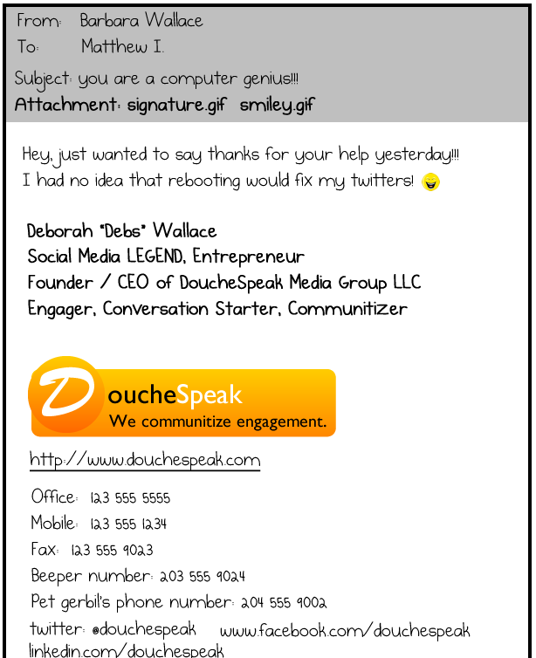
Organizational policies for email
Policies governing personal use of corporate email
Policies governing types of data that can be transmitted.
Message size limitations.
Confidentiality / Ownership / Disclosure
Employee is using the company’s property.
Sometimes the policy is “injected” into the outgoing message.
http://theoatmeal.com/comics/email - funny take :-)

Slide 6
Email Namespaces
How is this different from other namespaces we’ve discussed?
Companies should use consistent email namespaces, so internal and externally bound mail should have the same address.
Try using a namespace that is unique, company-wide.
Ex: tajorgen, mafudge, relstad
JohnSmith is not always going to be unique
Namespaces should be relatively difficult to change
Tokens should not be reused for a period of time, if at all.
The full email addess is a global namespace:
Ex. mafudge@syr.edu or michael.fudge@gmail.com

Slide 7
Reliability of Email
Email is a utility, a constant, and therefore it’s come to be expected to just work at all times.
Unlike many other IT services, inaccessible or missed email will cost a company money.
Outages should be almost non-existent.
If architected properly, mail should never be lost in delivery.
Email services are complex and require many servers/services to operate properly.
Centralization of email services is a must for any modern organization.

Slide 8
Spam/Virus Blocking
Spam and Viruses are normal occurrences in email, so a filtering service for both should exist in ALL email systems.
Filtering of Spam and Viruses should be done on a server, not at the email client.
Servers can be upgraded to handle increased load, clients are unpredictable.
If messages are filtered for spam or viruses, logging should also be implemented.
Sometimes false-positives can occur, which is why logging becomes important.

Slide 9
Email automation
Automate as much as possible in an email system.
Account creation
Account changes (smtp address, display name, etc..)
Moving accounts between email servers
Access removal for employees who leave the company (depending on the company policy on this)
What should we not automate:
Setting up away messages for users that are out of the office for extended periods (should always be setup by the user)
Setting up mail forwarding rules (should always be configured by the user or someone with rights to their account)

Slide 10
Email service monitoring
An email service is important, so why would you implement it without proper monitoring?
Are the servers/services alive? (ping, telnet, nmap)
Disk space (size of disks, volumes, and mailbox databases)
Disk activity (read/write times)
Usage (user mailbox sizes and message counts)
Network traffic (response times for various methods or protocols used to access email by clients)
CPU utilization (both for the server as a whole and the individual services running within)
Delivery failures (both internal and external)

Slide 11
Scaling: considerations
Email services need to be built to scale as demands inevitable WILL change.
Take these things into consideration when planning to scale up or out your email service:
Number of users
Amount of mail sent by users
Size of messages sent
Large bursts of traffic (promotions, bulk emails, etc..)
Number of clients connecting (web, outlook, iMail, mobile)
Mobile clients can equal 2 traditional mail clients in terms of there demands on email servers.

Slide 12
Getting technical regarding email
Service dependencies, components, and how it works.

Slide 13
Anatomy of Email - components
Protocols IMAP4, POP3,SMTP, IMAPS
Components MUA, MTA, Delivery Agent (MDA), Access agent (AA), Message Store.
APIs SMTP, MIME, Various RFC’s http://www.ietf.org

Slide 14
Email Service Dependencies
IMAP4, POP3, SMTP
DNS, DHCP, LDAP
Email
Application
Network / Transport
Core Infrastructure

Slide 15
Components
MUA – Mail user agent. This is usually a client like Outlook, Thunderbird, or a web browser (in the case of gmail, for instance)
MTA – Message transfer agent. Sends mail around the internet, from domain to domain. (Eg. Sendmail, exim, exchange, postfix,)
MDA - Mail Delivery agent. Writes mail to the mail message from the MDA to the message store. (Eg. procmail, exchange)
AA - Access agent. Exposes a protocol so users can read mail from the message store. Access protocols are POP3 and IMAP4 (Eg. ews, imaps, mapi)

Slide 16
Components at work –sending email
syr.edu
gmail.com
MUA
Message
Store
Outlook
MTA
sendmail
internet
MUA
MTA
Phone
sendmail
MDA
MUA
MDA
exchange
iMail
procmail
Example of sending an email from tajorgen@syr.edu to tim.jorgensen@gmail.com

Slide 17
Components at work –receiving email
internet
MUA
syr.edu
Outlook
MUA
AA
MDA
MTA
Exchange CAs
Imaps,
Mapi,EWS
Message
Store
Phone
Exchange
hubs
sendmail
MUA
iMail
Example of receiving an email from anywhere to tajorgen@syr.edu

Slide 18
Email addresses, Namespaces, and You!
Format: mailbox@domain
Domains use MX records in DNS not A records. This is how mail from northpole.org knows where which server to send to syr.edu
dig syr.edu MX
MTA’s will accept mail even if the mailbox does not exist. MDA will reject it if the mailbox is not found.
“Undeliverable”

Slide 19
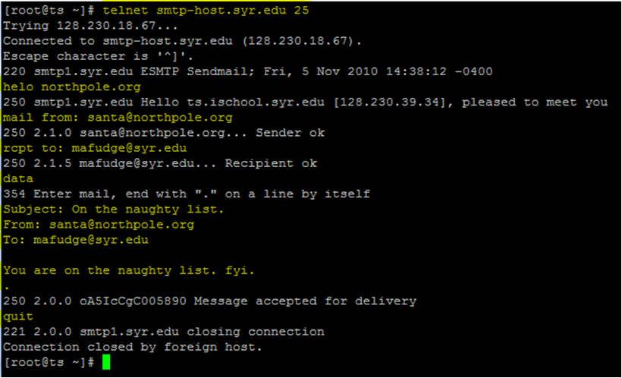
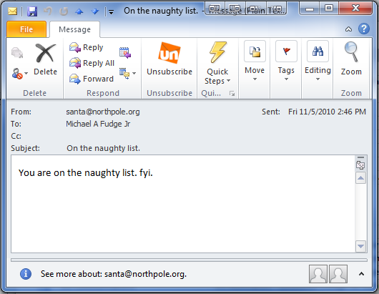
SMTP Protocol in Action
The “S” in SMTP stands for “Simple”. ☺

Slide 20
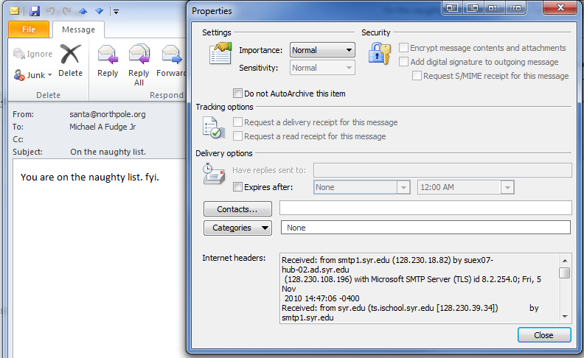
What’s in an email message?
Envelope
Body
Headers

Slide 21
Other Types of Enterprise Messaging

Slide 22
Chat / Instant Messaging
Chat / Instant Messaging
Send messages to people in real-time
Share information and files
Not a global namespace for all users like email!
Proprietary protocols. Applications do not integrate
Examples: Yammer, Chatter, Slack, Facebook Messenger

Slide 23
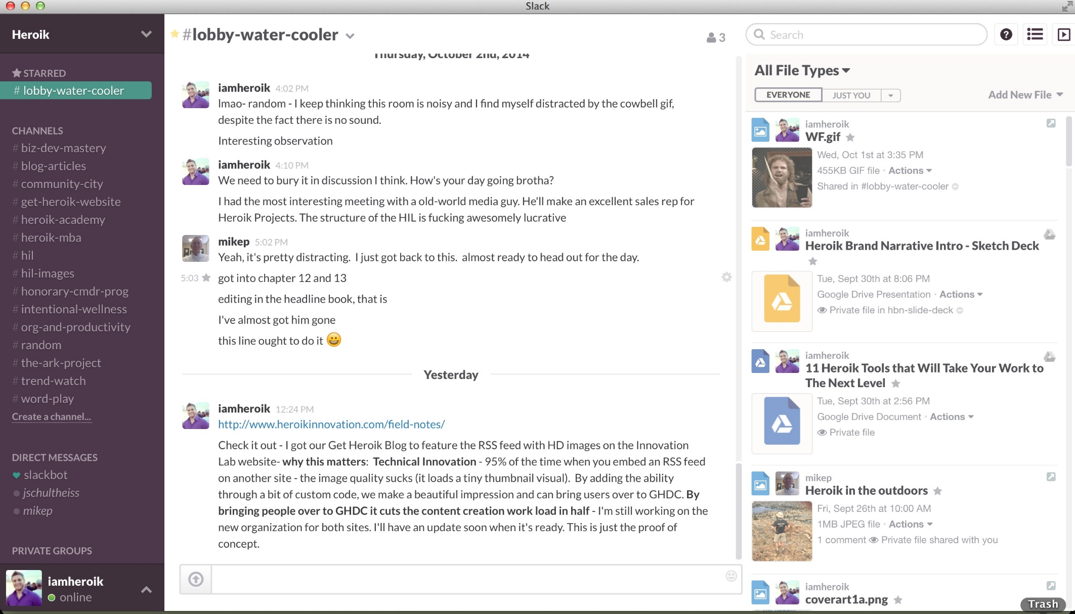
Slack – Workspace for teams

Slide 24
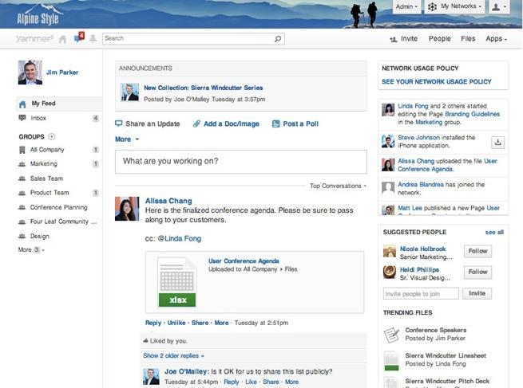
Yammer – Enterprise social networking

Slide 25
Audio / Video Conferencing
Real-time audio / video communications.
Can also share screen and files
Again! Not a global namespace.
Proprietary protocols. Applications do not integrate!
Skype, Google Hangouts, Zoom, Facebook workplace, WebEx, Gotomeeting

Slide 26
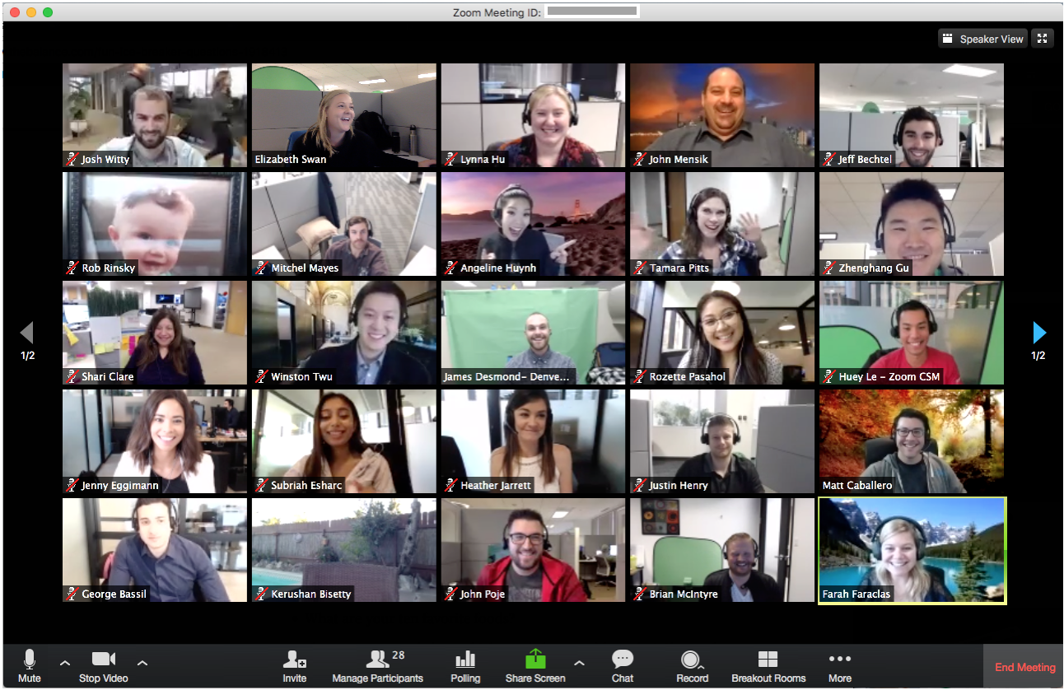
Zoom – Team meetings

Slide 27
Challenges of Enterprise Messaging
Similar to email!
Governing Policies
Organization owns the platform – terms of use
Additional Challenges
Services are often hosted in the cloud as SaaS
Good SLA’s are necessary!

