Slide 1
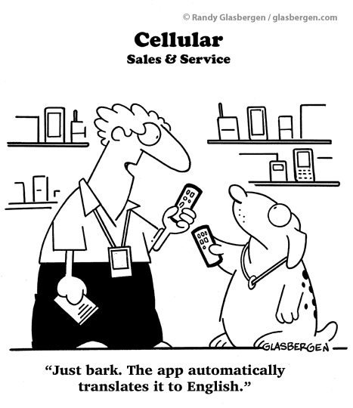
IST346: Mobile Services

Slide 2

Agenda
Discussion
Content
Mobile Services
Wrap-Up

Slide 3
Discussion Questions
To build a mobile app, you will need to write code for which two components?
Which programming languages would one need to know to write mobile apps on Android and iOS?
What are the three methods of developing mobile apps?
Which method performs the best? Which is easiest to maintain and why?
What is MDM and why is it important in an organization?
What are some advantages of MBaaS?
Notes:
Give students 1-2 minutes for each question. Its important to provide them with the opportunity to answer the questions based on the reading, labs, and assigned homework.

Slide 4

Lab Debrief
Lab ?

Slide 5
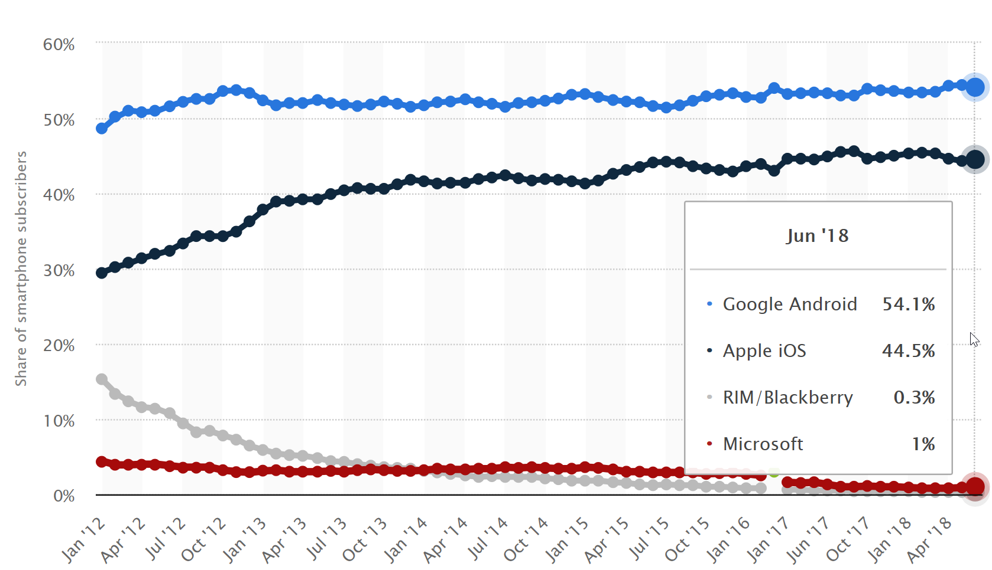
Mobile Market Share - US
https://www.statista.com/statistics/266572/market-share-held-by-smartphone-platforms-in-the-united-states/

Slide 6
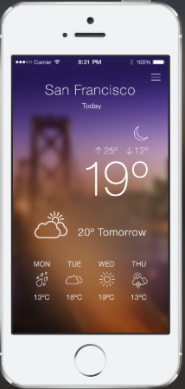
Mobile Application Architecture
GET http://fudweather.com/San+Francicso,CA/current
fudweather
Web API (Mobile Back End)
Response: Content-Type: application/json
{
“temperature” : 19,
“conditions” : “partly-cloudy”,
“tomorrow” : 20
}
Weather App On Phone
Need to write the mobile app and the back-end API’s which support the app

Slide 7
Group Activity
MBaaS

Slide 8
Details of Group Activity
Team up in Groups of 3 Students.
Your company has designed a mobile app which your developers estimate needs following back end requirements:
For each device they estimate 5 push notifications 10MB of database storage per month.
Assuming an initial install base of 10,000 devices at rollout
Decide on a MBaaS to use and estimate your monthly costs.
Be sure to justify your decision!

Slide 9

Your To-Do List
What to work on for next class
Notes:
ALWAYS CONSULT THE SYLLABUS

Slide 10

Exit Ticket
Share one thing you learned today that you didn’t know before class!

Slide 11

Questions?

