Slide 1
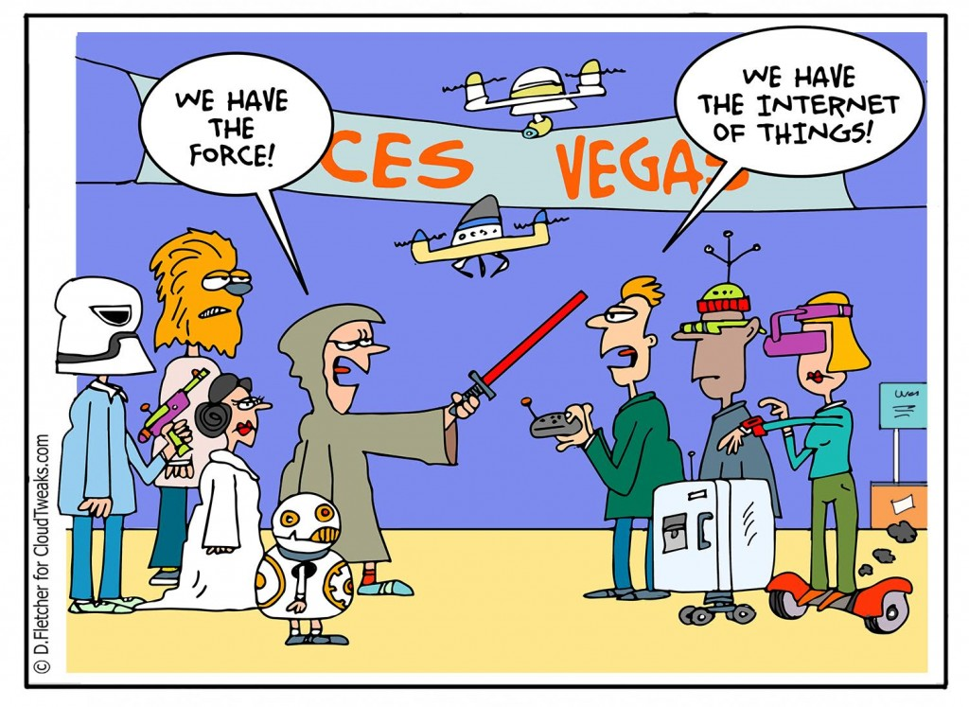
IST346: Internet of Things

Slide 2

Agenda
Discussion
Content
Internet of Things
Wrap-Up

Slide 3
Discussion Questions
List 4 Types of IoT.
What is the difference between smart / connected devices and the IoT?
What is a software defined product? What are the two components of it?
Give an example of a sensor and an Actuator.
What is an MQTT Topic?
What are the 5 types of analytics?
Notes:
Give students 1-2 minutes for each question. Its important to provide them with the opportunity to answer the questions based on the reading, labs, and assigned homework.

Slide 4

Lab Debrief
Lab M

Slide 5
Group Activity
IoT Identification

Slide 6
Details of Group Activity
Research the following Products and identify with your best guess if it is Really “IoT”:
Software Defined Product
Software application?
Cybermodel?
Hardware
Sensors used?
Analytics?
fashdfas
Products to Research
Google Nest Learning Thermostat
TP-Link Smart Plug
Sense home energy monitor
Worx Landroid Pre-Programmed Robotic Lawn Mower
Notes:
Yes
No – no cyber model or analytics – just a device
Yes
No ? Can the cybermodel be updated? It is connected?

Slide 7

Your To-Do List
What to work on for next class
Notes:
ALWAYS CONSULT THE SYLLABUS

Slide 8

Exit Ticket
Share one thing you learned today that you didn’t know before class!

Slide 9

Questions?

