Slide 1
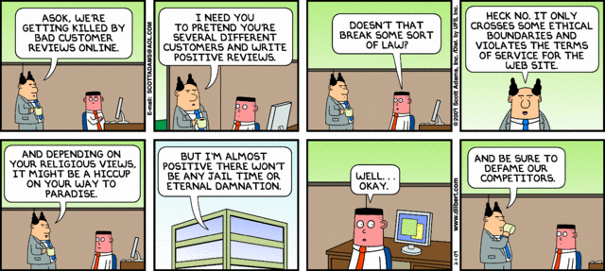
IST346: Ethics

Slide 2

Agenda
Discussion
Content
Ethics
Wrap-Up

Slide 3
Discussion Questions
What are ethics? How they different from Morals?
Can you have ethics without them being defined?
What is the point of defining a code of ethics?
Is it wise to assume a code of ethics? Why or why not?
Notes:
Give students 1-2 minutes for each question. Its important to provide them with the opportunity to answer the questions based on the reading, labs, and assigned homework.

Slide 4
Ethics Exercises

Slide 5
Example 1 “You’ve been hacked!”
Dave the SA plays a prank on his co-worker Steve. He sends a direct computer message (something SA’s can do) to Steve computer with the text “you’ve been hacked!” Believing the message is legitimate, Steve reacts accordingly, changing his passwords and notifying the rest of the SA team of the incident. Shortly after Dave let’s everyone know is was a joke and they all share a laugh over the “incident”.
What is the ethical problem?
If you supervised these individuals, how would you handle this situation?

Slide 6
Example 2 “I wish I didn’t know that.”
While trying to diagnose a server problem, you discover Gigabytes of pirated Movies and Music on your server’s hard drive. Thinking it might be a hack you investigate further, only to find the files belong to a co-worker.
What is the ethical problem?
How would you handle this situation?
Can policy help in this situation?

Slide 7
Example 3 “A sales opportunity”
You’re the lead SA for your company. You’ve been approached by the manager of the sales department (Mary). She is requesting access to one of her staff’s email accounts (Tom) so she can assist in closing a big sales deal while Tom’s on vacation.
What is the ethical problem?
What would you do in this situation?
Does a supervisor have the right to access her employee’s email?
Can policy help in this situation?

Slide 8
Example 4 “The moral dilemma”
You are the director of Information Technology for your company. One of your staff from the helpdesk (John) has come to you with a problem. A VP (Tim) brought his notebook in for maintenance, complaining his computer was “sluggish.” When John inspected the computer he stumbled upon sexually explicit material. Though the material is not illegal, it is a violation of the company’s terms of use for IT
What is the ethical problem?
What would you do in this situation?
Do you believe John acted ethically?

Slide 9
Group Activity
Ethical Dilemmas

Slide 10
Details of Group Activity
Divide into large groups of 5-6
Each group brainstorms within itself what are the most tricky or common ethical dilemmas.
They select one dilemma to explore.
On a piece of poster paper, have each group write down their best ethical dilemma and what would be the best decisions to make related to it.
Share out to the entire class.

Slide 11

Your To-Do List
What to work on for next class
Notes:
ALWAYS CONSULT THE SYLLABUS

Slide 12

Exit Ticket
Share one thing you learned today that you didn’t know before class!

Slide 13

Questions?

