Slide 1
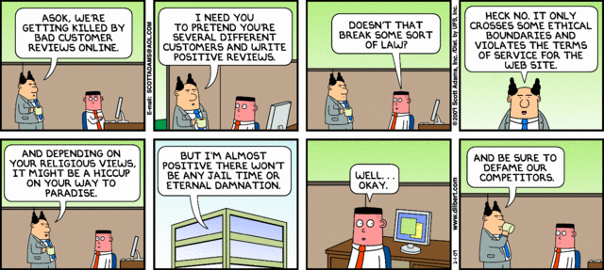

IST346: Information Ethics

Slide 2
Ethics
Ethics are the principles of conduct that govern a group of people.
Ethics are not morals.
Morals are the proclamation of what is right and good.
The boundary between what is and is not ethical is usually blurry….
Not because people lack a moral compass
But because the organization does not have clear policies

Slide 3
Why discuss Ethics?
SA’s have privileged access to information
User’s Email and Files
Customer financial data
Employee confidential data
“With great power comes great responsibility.”
You need to be able to trust yourself with that responsibility
You need to be able to question others who ask you to use your privileged access

Slide 4
A cue from the Medical Community: “Informed Consent”
Informed
Knowing your options
Knowing the benefits and drawbacks of those options
Consent
Getting permission from the user or granting body
Bottom line:
Inform the users affected then ask for consent, if required.
Example: Doctor asks a patient whom they can share their medical records with, inform them that they are granting consent to pass along ANY information to these individuals.

Slide 5
SA Professional Code of Conduct
SAGE – System Admins guild
LoPSA – League of Prof. SA’s
Code of ethics, covers:
Professionalism
Personal Integrity
Privacy
Laws and Policies
Communication
System Integrity
Education
Responsibility to Computing Community
Social and Ethical Responsibility

Slide 6
Network/Computer User Code of Conduct
Policies help to define the ethical boundaries of the organization.
Acceptable Use Policy
Is personal use of company equipment permitted? When?
Are there certain types of personal use that are forbidden?
Is the AUP location dependent? Time dependent?
Personal email from a company email address?
Network Monitoring Policy
Explain services are monitored and logged as part of their administration
Information in the logs might be a privacy concern.

Slide 7
SA Privileged Access Code of Conduct
People with privileged access (can see other people’s otherwise private information) need a special code of conduct.
People with privileged access should be
trained in ethics
well versed in User code of conduct, policy and procedure
required to accept the CoC before obtaining access

Slide 8
Three Rules of Privileged Access
Be careful. Think before you type.
Be mindful of and respect the privacy of others.
If you mess up, let your supervisor know right away.
It is better to be honest and up front about any situation.
“Honesty is the best policy.”

Slide 9
Getting caught in the middle
What if you catch someone doing something unethical?
Eg. You know someone is pirating software at your company.
What if you’re asked to perform an unethical activity?
Eg. A Co-worker asks for someone else’s files.
In all cases
Verify the request. Get clarification
Keep written records of all your activity
When in doubt, get clarification. From HR, your supervisor, a lawyer.
Change names to protect the innocent when discussing the situation with others.
Try to convince people doing unethical activity to confess.

Slide 10
Information Ethics Examples

Slide 11
Example 1 “You’ve been hacked!”
Dave the SA plays a prank on his co-worker Steve. He sends a direct computer message (something SA’s can do) to Steve computer with the text “you’ve been hacked!” Believing the message is legitimate, Steve reacts accordingly, changing his passwords and notifying the rest of the SA team of the incident. Shortly after Dave let’s everyone know is was a joke and they all share a laugh over the “incident”.
What is the ethical problem?
If you supervised these individuals, how would you handle this situation?

Slide 12
Example 2 “I wish I didn’t know that.”
While trying to diagnose a server problem, you discover Gigabytes of pirated Movies and Music on your server’s hard drive. Thinking it might be a hack you investigate further, only to find the files belong to a co-worker.
What is the ethical problem?
How would you handle this situation?
Can policy help in this situation?

Slide 13
Example 3 “A sales opportunity”
You’re the lead SA for your company. You’ve been approached by the manager of the sales department (Mary). She is requesting access to one of her staff’s email accounts (Tom) so she can assist in closing a big sales deal while Tom’s on vacation.
What is the ethical problem?
What would you do in this situation?
Does a supervisor have the right to access her employee’s email?
Can policy help in this situation?

Slide 14
Example 4 “The moral dilemma”
You are the director of Information Technology for your company. One of your staff from the helpdesk (John) has come to you with a problem. A VP (Tim) brought his notebook in for maintenance, complaining his computer was “sluggish.” When John inspected the computer he stumbled upon sexually explicit material. Though the material is not illegal, it is a violation of the company’s terms of use for IT
What is the ethical problem?
What would you do in this situation?
Do you believe John acted ethically?

Slide 15
Questions?
If a man with multiple personalities threatens to kill himself, is it considered a hostage situation?

