Slide 1
DevOps for Data Science
Why containerization, cloud, scripting and source code management are essential for data science teams.
Michael A. Fudge, Jr
Assistant Professor of Practice
The School of Information Studies
Syracuse University
Notes:
This webinar will provide an overview of dev ops technologies like containerization, scripting an source code management and explain how they can be used to help data science teams collaborate, address setup / dependency issues, and trivialize deployment of data science products to public or private clouds.

Slide 2
Goals of This Webinar
Understand the Data Science Process and Its Challenges
Provide a very high level overview of DevOps
Discuss the tools used in DevOps
Explain how DevOps can be used in Data Science
Dive deeper into specific DevOps tools appropriate to Data Science

Slide 3
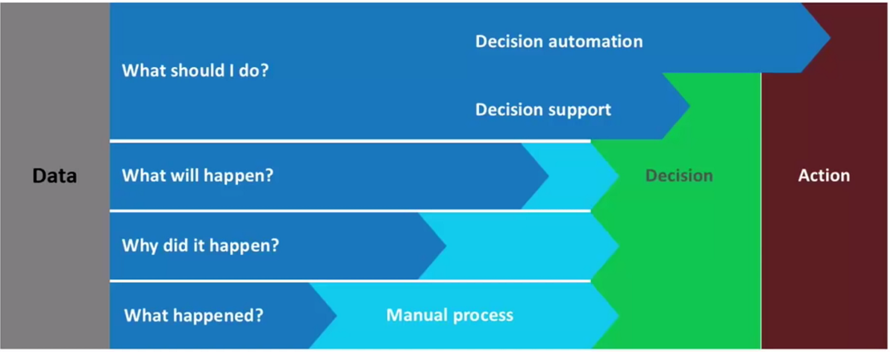
Data Science From the Analytics Perspective
Data
Science
Difficulty
Notes:
I like to think about data science from an analytics perspective. I find most people unfamiliar with data science can understand it when I approach it this way.
Analytics is about obtaining insights from data, while data science is more targeted, its about supporting the decision making process with data.
With Retrospective analytics, we know what happened, then there is a great deal of manual effort to turn that into decisions and actions.
With Diagnostic Analytics, we know why something happened, but we still need manual effort to turn that into decisions and actions.
With Predictive analytics we know what’s going to happen so very little manual intervention is required to make a decision or take an action.
With Prescriptive analytics the process through to decision or action is automated. Automated decision making is called “decision support” while automated actions are called “decision automation”
[ADVANCE]
Data Science sits firmly in the realm of decision automation, decision support and predictive analytics. We use data to drive our decision making.

Slide 4
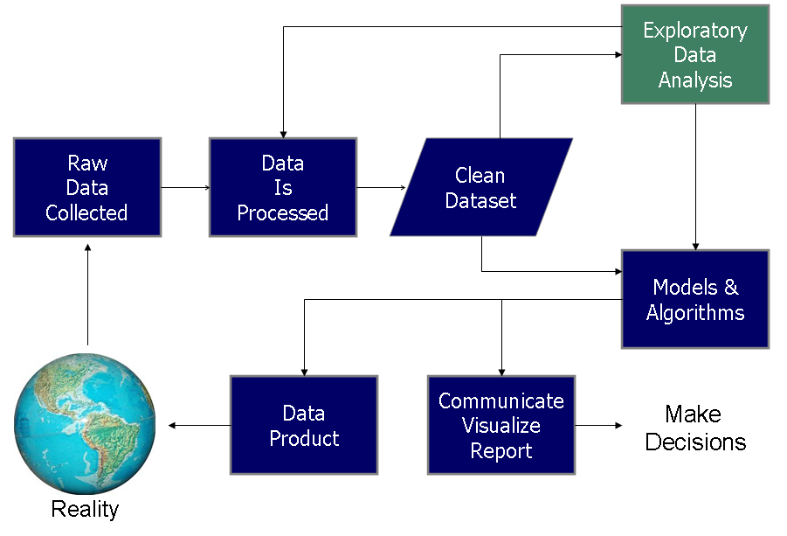
The Data Science Process
DS Pipeline:
Feature Extraction / Engineering /
Model building, algorithm selection and validation
Parameter tuning
Evaluation and Optimization: Remove ineffective features, test / train splits, cross validation
https://upload.wikimedia.org/wikipedia/commons/b/ba/Data_visualization_process_v1.png
Notes:
There are many models of the data science process. I grabbed this one from Wikipedia because its so simple, direct, and fits well within the context of my talk. Let me walk you through the data science process.
We might spend some time in Exploratory data analysis, eventually finding insights, and then building a machine learning model to help make decisions.

Slide 5
Example: Not Hotdog App
https://itunes.apple.com/app/not-hotdog/id1212457521
Notes:
Let suppose you want to create an app so that when you take a picture of an object it will instantly tell you whether that object is a hot dog or not. Let’s see how the data science process applies to this example.
Supervised learning to train a model based on photos classified as either a hot dog or not
Need a classifier – naïve bayes, decision tree, etc.
Data Science tells us that this type of problem is better solved with more data so we collect a vast mount of data, prepare it and use it to train our model.
We then evaluate our model’s accuracy and try different things to improve it.
Once we get the model the way we like we can roll it into production. For a mobile app, this could mean our model is a web API – a simple “function” on the web where the photo is the input and whether it’s a hot dog is output. This is an example of a data product. The model is placed in production and used by millions of users who download the app.
We might consider a version of the app which allows the user to provide feedback when a photo is incorrectly classified. This feedback would then be used to train a new version of the model which would eventually roll into an update version.
Rinse Lather Repeat

Slide 6
Challenges to the Data Science Process
The data science process is Collaborative, yet the tools are non-trivial to Collaborate with.
Challenges:
Dealing with data sets
Reproducing Experiments
Working together
Deploying data products
Notes:
Dealing with data sets – How do you share them across your data science team?
Reproducing Experiments – How easy is it to take the R code you’ve written along with its dependencies and share it with your team mates do they can execute your code?
Working Together – How do you work concurrently with a co-worker on a statistical model in Python ? You could divide the work
Deploying data products – How do we move our findings into production and guarantee what we have done is reproduceable?

Slide 7
Data Science Challenges
How is this done concurrently and collaboratively?
Where is this stores so my team has access?
DevOps
Can
Help
How is this done concurrently and collaboratively?
How do I deploy this?
https://upload.wikimedia.org/wikipedia/commons/b/ba/Data_visualization_process_v1.png
Notes:
So in context with the data science process, here are the challenges.
[ADVANCE]
As we will see, Dev Ops can help!

Slide 8
Essential Components of any System
Code – The functionality
Data - The inputs and outputs to that system
Infrastructure – The Software required to run the code and store the data
Code
System
Data
Infra- structure
Notes:
Before we define devops, let’s cover a few more things. Every system regardless of whether it includes data science or not consists of there components Code, Data and Infrastructure.
[READ BULLETS]
Consider our hotdog app.
The code is our algorithm to determine whether it’s a hot dog, as well as the mobile app and web api.
The data are the photos we use to train the hot dog detection model and the feedback our users give us when the model is right or wrong.
The infrastructure are the servers needed to run the back end of the web app, store the images, feedback from the users, including the function which predicts if the photo is a hot dog.
Managing the code and data are relatively trivial, but the infrastructure can be a challenge, as we’ll see next.

Slide 9
Infrastructure x3: Dev, Test, & Production
Bug Fix or Feature
Complete
Dev:
Isolated to the developers only
Used for fixing bugs and new features
Test:
Open to some end users
As close to the prod environment as possible
We measure performance here
Prod:
The actual system
Never make changes here
Must be stable and performant.
Test
Prod
Dev
New Bug or Feature
QA Signoff / Approval
Notes:
The reason infrastructure is such a challenge in systems is because to manage our system properly we need three different infrastructures
Dev, Test, and Prod.
[READ BULLETS]
What if we find a problem in our hot dog app or would like to release a new more accurate predictive model? It would be irresponsible to just correct it on the live production servers. In the case of the mobile app running on the phone, you CANT! First we fix the problem and test it on our own system as the developer. Next, we deploy it to a test environment where others can test the changes. This also allows us to make sure our change plays niice with the other components in our system. Finally when everything looks good we move it into production.
This seems really simple, conceptually but actually its’ not. Systems are complex and their configurations can be difficult to reproduce. In addition, we must maintain and secure the infrastructure which runs our app.
Consider our hot dog detector runs Tensor flow and flask on python 3. Those applications must be installed in the dev, test, and prod environments. Furthermore, its more than likely you’re not doing this by yourself, so it would be several dev environments. Yikes!

Slide 10
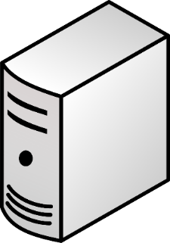
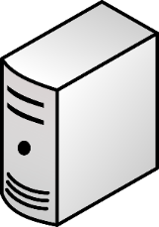
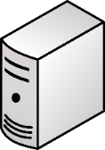
Scaling Services: How do you address growth?
Vertical “Scale Up”
Horizontal “Scale Out”
Add more resources to an existing system running the service.
Easier, but limited scale.
Single point of failure
Run the service over multiple systems, and orchestrate communication between them.
Harder, but massive scale.
Overhead to manage nodes.
Notes:
The last thing to discuss before we get into devops is how services are scaled.
[CLICK, READ]
To be compatible with the devOps universe we need to build apps that scale out. More on this as we cover devOps next.

Slide 11
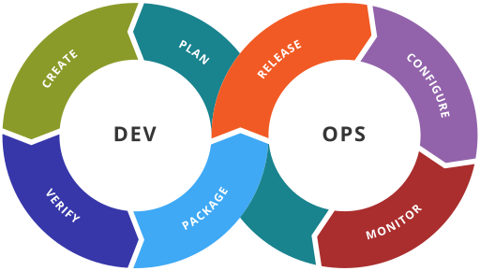
What is DevOps?
A set of practices to reduce the time between making a change to a system and realizing that change in production, without sacrificing quality of system stability.
https://en.wikipedia.org/wiki/DevOps#/media/File:Devops-toolchain.svg
Notes:
So finally now that we understand how systems come together, how data science products are deployed, and the complexities with managing the process we can now define DevOps because we can see the need for it.

Slide 12
Core Values of DevOps - CAMS
Culture – breaking down barriers between teams, shortening feedback loops
Automation – productivity gains in deployment, systems thinking
Measurement – basing decisions on data instead of guessing
Sharing – tooling, discoveries and lessons
Notes:
CAMS was first coined by Damon Edwards and John Willis at DevOpsDays Mountainview 2010 It is an acronym describing the core values of the DevOps Movement: Culture, Automation, Measurement, and Sharing.
[READ BULLETS]

Slide 13
DevOps Goals
Systems thinking - imagine your systems as a whole not as parts
Culture of ownership – over the entire system and process
Shortening feedback loops - take less time to fix problems and achieve goals.
Culture of experimentation and learning
Notes:
Systems thinking - imagine your systems as a whole not as parts
Culture of ownership – over the entire system and process. Everyone on the team has the same vested interest whether you’re a DBA, Developer, Data Scientist, Systems Administrator
Shortening feedback loops - take less time to fix problems and achieve goals. Try not to bog yourself down in bureaucracy and process.
Culture of experimentation and learning - focus on learning from your mistakes, and setup a technology environment which encourages and supports this.

Slide 14
Infrastructure as Code Methodology for DevOps
Treat your infrastructure as if it were code!
Store configurations, dependencies and scripts to bootstrap your systems in a source code management (SCM) system like Git.
This allows you set-up and tear down environments quickly and easily and deploy your systems in Dev, Test or Production.
Servers are commodity / utility resources, and not at all strategic.
Notes:
In the Infrastructure as Code methodology we our systems infrastructure as if it were code!
We Store configurations, dependencies and scripts to bootstrap your systems in a source code management (SCM) system like Git.
This allows you set-up and tear down environments and dependencies quickly and easily and deploy your systems in Dev, Test or Production.
In the grand scheme of things the servers (hardware and networks) are simply a commodity or utility and have no strategic value at all.

Slide 15

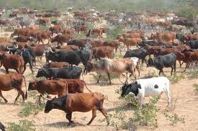
Treat Servers like Cattle, Not Pets
Pet servers
Few of them
Are given names like mail.mycompany.com
Are built to solve the task at hand (email)
When they are “sick” we “nurse them back to health”
Cattle servers:
Lots of them
Are given numbers like s0045.mycompany.com
Are built to do the same thing: compute and storage
When they are “sick” we “take them out of commission” and replace with another.
Notes:
A big mantra of DevOps is “Treat Servers like Cattle, Not Pets” It’s important to recognize we’re talking about HARDWARE here not the applications running on the hardware. We want the underlying infrastructure to be a commodity of storage network and compute . So the when we can design our application so that it is free to scale. The big internet companies like Google, Facebook, and Yahoo learned this early on.

Slide 16
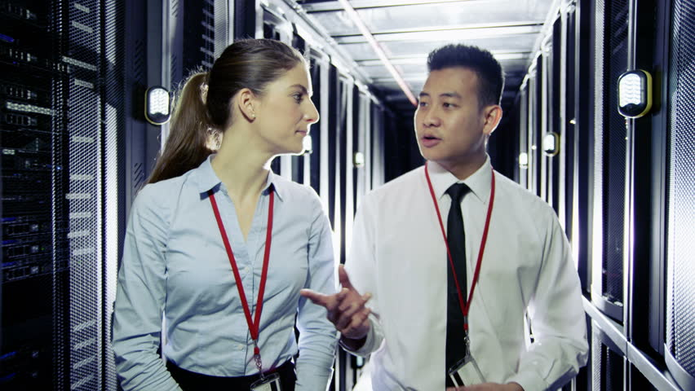
Which one of these runs our email?
Any of them!
Notes:
When you have this mindset, you’re ready for DevOps.

Slide 17
Essential DevOps Toolbox for IaC
Source Code Management (git, subversion, mercurial)
Virtualization / Containerization (VMWare, Vagrant, Docker, CoreOS)
Configuration Management (Ansible, Chef, Puppet, Docker-Compose)
Orchestration (Kubernetes, Mesos, Rancher, Docker Swarm)
Continuous Integration / Continuous Delivery (Jenkins, TeamCity)
Monitoring / Logging (Monit, Nagios, ELK Stack)
Notes:
There are tools which help us execute the philosophy behind DevOps.
Source Code Management tools like Git allow us to work collaboratively, store multiple versions of our code and configurations, manage releases, and track changes to not only our applications but our infrastructure dependencies too.
Virtualization and Containerization tools are a key component which allows us to treat our servers like cattle, abstracting away an application’s dependencies so that they can be deployed easily to different hardware.
Configuration Management tools allow us to manage complete environment tools allow us to control and manage an application’s dependencies as a whole. In addition these tools allow us to push changes to existing systems.
Orchestration tools are best thought of as the combination of containerization + configuration management. These platforms abstract away the compute, network and storage of your hardware resources into a virtual pool of resources which can be allocated to your application as needed. Orchestration tools represent the next logical progression of containerization and configuration management and many of them incorporate such technologies into their platform.
Continuous Integration / Continuous Delivery tools pick up code commits from source code management tools and execute a task. They can test committed code to ensure no new bugs were introduced, or work with orchestration tools to automatically deploy an application to a test environment for use by beta testers. Likewise, they can even deploy changes into production!
Monitoring / Logging – one of the core values of devops is measurement, and these tools assist with that. They help us determine if services crash and why, and can perform auto-restarts. They can collect useage data (telemetry) so we can measure how our users interact with our applications – valuable information which can be used to create new features and enhancements.
ELK Elasticsearch Logstash Kibana

Slide 18
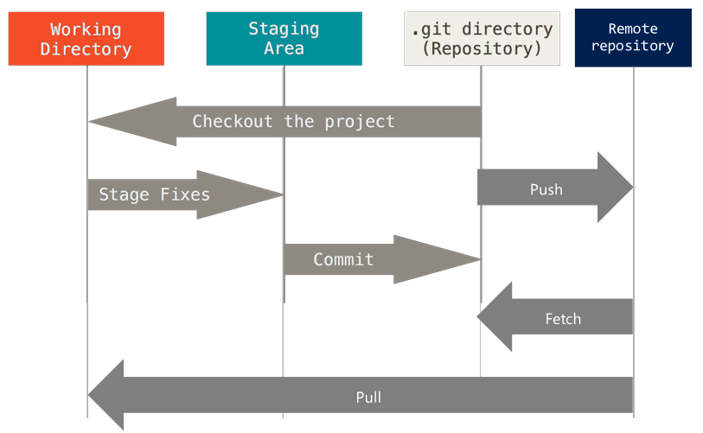
Git – Distributed Source Code Management
http://navtechno.blogspot.com/2016/02/git-basics.html
Notes:
Next we will deep dive into two important aspects of DevOps for data science. Source code management and containerization.
Git is different from other SCM’s in that the code check-in/check-out process is independent of the code sharing process.
With git you can commit code changes locally and then when you need to share with another person (or system in the case of DevOps) you can push the code changes to a remote repository.
The diagram explains a basic Git work flow. The working directory, staging area and Repository are local to the developer. The .git repository is a special folder which tracks changes to the working directory.
[Explain the rest]

Slide 19
Resources Git in Data Science
“Development Workflows for Data Scientists”
https://resources.github.com/downloads/development-workflows-data-scientists.pdf
“Course: Introduction to Git for Data Science”
https://www.datacamp.com/courses/introduction-to-git-for-data-science
Notes:
Here are two great resources for those Data Scientists looking to learn git.
The first “Development Workflows for Data Scientists” is an O’Reilly media book by the authors of GitHub. It a great overview of how Git and Github can help data scientists with their workflows.
The second “Introduction to Git for Data Science” is a DataCamp course. It’s more hands on and in-depth than the book.

Slide 20
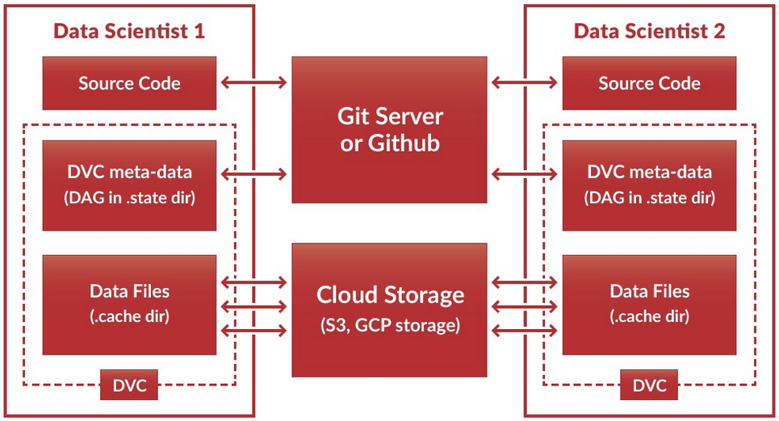
Data Version Control
https://github.com/dataversioncontrol/dvc
Notes:
Data version control is a git workflow for data science teams. It is a command line interface which integrates Git or GitHub for your code and Cloud Storage such as Amazon S3 or Google Cloud Platform for your data.
DVC encapsulates best practices of data science teams in the exploratory data science pipeline where the data scientists are constantly writing code to engineer features, split data sets, train models, and evaluate them.
It does this by storing the code in Git (where it belongs) and the data in shared storage outside of git (data is not code and does not belong in git). This simplifies the best practices of using git in data science, and is ideal for code sharing among teams.

Slide 21
What is Containerization?
Containerization is the next step in virtualization.
Instead of virtualizing the entire operating system we virtualize the app itself.
Containerization Trivializes
Moving applications from dev to test to prod
Software Dependencies, making it easy to reproduce experiments and analysis

Slide 22
Understanding Containerization by Example
WordPress blog application
WordPress Consists of
A database storage layer (usually in MySQL)
Web application in PHP
Page Cache Layer (optional)
HTTP proxy (optional)
Notes:
Wordpress is a popular blog website application. It’s typically used as an example of how containerization works making it the – The Hello Word of Containerization

Slide 23
Monolithic Deployment
Production
Application
WordPress
Everything is on one server
Inefficient use of hardware
The only way to scale is to upgrade the hardware.
Easy to administer and secure
Need to duplicate the same environment in dev, test and prod which is wasteful.
App Dependencies / Libraries
PHP, MySQL, Nginx, Etc.
Operating System
Ubuntu Linux
Server (Hardware)
Dell PowerEdge
Test
Development
Application
WordPress
Application
WordPress
App Dependencies / Libraries
PHP, MySQL, Nginx, Etc.
App Dependencies / Libraries
PHP, MySQL, Nginx, Etc.
Operating System
Ubuntu Linux
Operating System
Ubuntu Linux
Server (Hardware)
Dell PowerEdge
Server (Hardware)
Dell PowerEdge
Notes:
Everything is on one server
Inefficient use of hardware –Dedicated hardware for test and development usually sits idle.
The only way to scale is to upgrade the hardware. – Buy more memory or upgrade the server.
Easy to administer and secure – There’s only 3 operating systems to administer and harden
Need to duplicate the same environment in dev, test and prod which is wasteful – high hardware costs.

Slide 24
Horizontal Scaling
Production - Web
Production - Database
Application
WordPress Website
Application
WordPress Database
Break up components / services into their own server
This separates concerns and makes the system easier to secure and manage.
Costs of multiple hardware and operating systems to maintain.
Maintain extra versions for test and development
App Deps / Libraries
PHP, Nginx
App Deps / Libraries
MySQL
OS
Ubuntu Linux
OW
Ubuntu Linux
Server (HW)
Dell Server
Server (HW)
IBM Server
Test - Web
Test - Database
Dev - Web
Dev - Database
Notes:
Break up components / services into their own server –we know scaling this way is good, but its also costly
This separates concerns and makes the system easier to secure and manage – we can use the web server and the database server independently. We don’t need to install extra libraries on the server – only those needed to accomplish the job.
Costs of multiple hardware and operating systems to maintain. – This example has 2X the hardware!
Maintain extra versions for test and development – more hardware and operating systems.

Slide 25
Virtualization
Production
Development
Test
Web
Db
Web
Db
Web
Db
WP Web
WP Db
App Deps
App Deps
App Deps
App Deps
App Deps
App Deps
PHP,
Nginx
My SQL
Optimize your investment in hardware
Each host runs as a virtual machine
Hardware not required for test and development environments
Must maintain multiple operating systems and configurations
Guest OS
Guest OS
Guest OS
Guest OS
Guest OS
Guest OS
Ubuntu Linux
Ubuntu Linux
Hypervisor Host OS
VMWare ESX
Server (HW)
Dell PowerEdge
Notes:
Virtualization maximizes our hardware investment as we can run multiple operating systems with separate environments over the same hardware.
This allows us to scale horizontally and break up our application into multiple services which support an isolation of responsibilities across the application’s components.
Virtualization does not reduce the management complexity. We still have to manage 6 operating systems in this example, and with each operating system in isolation, configurations can get out of sync.

Slide 26
Containerization
Production
Development
Test
Web
Db
Web
Db
Web
Db
WP Web
WP Db
Application components run in a container on an operating system
Operating system and dependencies of each service are no longer an issue.
Can easily re-create the environment multiple times for development and testing
App Deps
App Deps
App Deps
App Deps
App Deps
App Deps
PHP,
Nginx
My SQL
Container Runtime
Docker
Host OS
Linux / Windows
Server (HW)
Dell PowerEdge

Slide 27
Advantages of Containerization
Consistent Environment
Portable
Cloud-Friendly / Ready
Isolated
Notes:
The advantages of containerization are:
Consistent Environment- it’s the same environment everywhere it runs.
Portable – They run anywhere you can install the container runtime.
Cloud-Friendly / Ready – The containers can be easily run in the cloud with zero additional configuration.
Isolated – containers run on the same host but are isolated from one another

Slide 28
Example: Containerization in Data Science
To contribute to our data science team you need:
Python 3.5
Packages: pandas, matplotlib, scikit-learn, tensorflow, Jupyter etc.
Git, dvc
A bunch of other stuff…
Yikes!
Notes:
Let’s imagine all the things required to be installed on a new employee’s computer before she can get started on the data science team.
[ADVANCE]
That’s a lot of stuff. Now let’s see how it works with containerization:
Explain what is going on here.

Slide 29
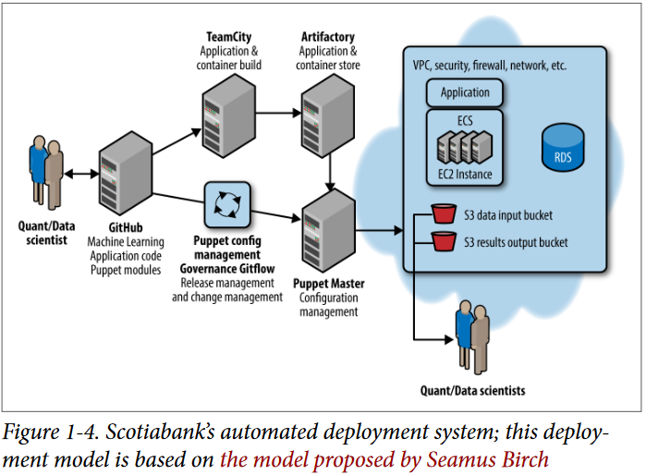
DevOps and Data Science
Notes:
Let’s put it all together with an example, specifically one which demonstrates how devops address the challenge of deploying a data product.
Specifically the diagram, taken from the book “Development Workflows for Data Scientists” depicts how Scotiabank deploys its risk management models to production.
The data scientist commits the model to GitHub, which initiates a TeamCity Build of the infrastructure required containers which then get stored in artifactory. Concurrently, the Puppet server (adorabily named the puppet master) grabs configuration data from the github repository and along with the packaged container, deploys to Amazon EC2.
Meanwhile other data scientists use the model to manage risk scenarios.
DevOps automates the process of taking the work of one data science team and placing it into the hands of another!
The data persists in the RDS = Amazon Relational Data Service

Slide 30
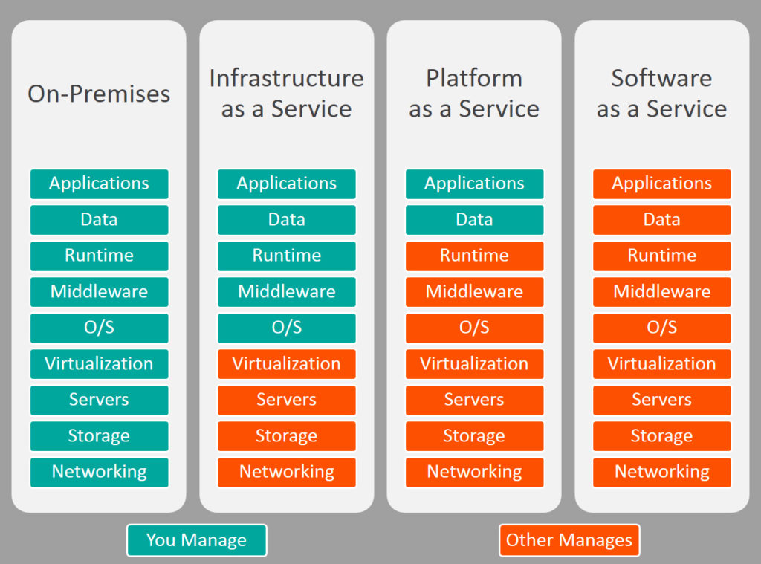
Cloud Offerings And Data Science
IaaS – AWS, Google Cloud Engine
PaaS – Azure HD Insight, MesosSphere, Cloudera Altus
Saas – Datascience.com, Databricks, Azure Notebooks/ML
http://www.bmc.com/blogs/saas-vs-paas-vs-iaas-whats-the-difference-and-how-to-choose/
Notes:
Let’s conclude with some Data Science cloud offerings.

Slide 31
Thank you! Questions?

Slide 32
DevOps for Data Science
Why containerization, cloud, scripting and source code management are essential for data science teams.
Michael A. Fudge, Jr
Assistant Professor of Practice
The School of Information Studies
Syracuse University
Notes:
This webinar will provide an overview of dev ops technologies like containerization, scripting an source code management and explain how they can be used to help data science teams collaborate, address setup / dependency issues, and trivialize deployment of data science products to public or private clouds.

