Slide 1
IST346: Mobile Services

Slide 2
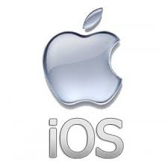

Mobile Operating Systems
Apple iOS
Google Android
iPhone and iPad
AppStore
Code written in Objective-C or Swift
Google Phones, Samsung Phones/Tablets and Many More
Google Play
Code written in Java

Slide 3
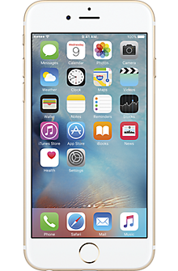
How is mobile different from web?
Phones have a browser, but most of our experiences use native apps downloaded from application stores.
Native offers advantages:
Push Notifications
Offline data
Access to hardware features, camera, microphone, GPS, accelerometer
Better performance!!!
That is true today, but the gap is closing.

Slide 4
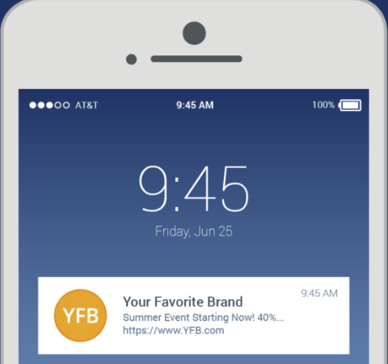
Push Notifications
Messages that pop up on a mobile device.
Each mobile operating system, including iOS, Android, Fire OS, Windows, and BlackBerry, has its own OS push notification service (OSPNS).
App publisher. The app publisher enables their app with an OSPNS.
Client app. In installed on your device and receives incoming notifications.
Not the same as SMS/TXT

Slide 5
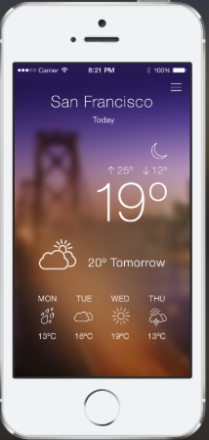
Mobile Apps and Web API’s
GET http://fudweather.com/San+Francicso,CA/current
fudweather
Web API
Response: Content-Type: application/json
{
“temperature” : 19,
“conditions” : “partly-cloudy”,
“tomorrow” : 20
}
Weather App On Phone
The Phone App is responsible for calling the API (requesting content) and drawing the API output on the screen

Slide 6
Mobile Development

Slide 7
Developing Mobile Apps
There are a variety of methods one can choose to make a mobile app.
Native – Write the app in the native language of the mobile operating system
Hybrid – Write the app in an intermediate language which then either compiles to native or
Progressive Web App – Write the app in HTML and JavasScript as you would a website.

Slide 8
Pros and Cons
Approach | Pros | Cons
Native | Best performance Access to all hardware features | Different code for each platform iOS/Android Challenging to maintain Different deployment to each app store
Hybrid | One programming language for all platforms Access to most hardware features Simplifies deployment to app stores | Not suitable performance for some applications Access to “most” hardware features
Progressive Web App | Leverage Web development skillsets HTML/ JavaScript No need to deploy to app stores | Not suitable performance for some applications Not supported by all platforms Least access to hardware

Slide 9
Native App Development
Written in Java on Android and Objective-C / Swift on iOS
You need a Mac to develop for iOS
Developer tools like Xcode and Android Studio are used to design the layouts for the application.

Slide 10
Hybrid-Native App Development
Hybrid Native allow you to use a single programming language which is transpiled (cross-compiled) into Java on Android and Objective-C on iOS.
Examples:
Xamarian,
Unity Gaming Engine
Titanium Mobile

Slide 11
Hybrid App Development
Hybrid App development uses a single language to target both iOS and Android. The application runs in its original language (typically JavaScript) but is wrapped in a native code shell for deployment in the app stores.
Layouts are designed in HTML and CSS
Examples:
Cordova / Phonegap
Ionic
Google Flutter
React Native
Nativescript

Slide 12
Progressive Web Apps
Progressive web apps are written in HTML, CSS, and JavaScript.
The look like native apps but run in a web browser.
They have access to most native features like the camera, GPS, and accelerometer.
They are not deployed to app stores (yet)
Demos: https://pwa.rocks/

Slide 13
Mobile Device Management

Slide 14
Mobile App Deployment
Getting apps into the app stores
Then search the app store for what you want
And install it
You know this and it works for consumers.
How is this done in the enterprise?

Slide 15
MDM Systems
Mobile Device Management Systems
Remotely install apps on devices
Run separate internal “App Stores”
Control which apps can be launched / accessed.
Locate lost devices / Remote Wipe (Erase)
Examples:
IBM Maas 360
MDM for Office 365 (Intune)
VMWare AirWatch

Slide 16
Mobile Back-End as a Service (MBaaS)

Slide 17
Mobile Back Ends
GET http://fudweather.com/San+Francicso,CA/current
fudweather
Web API (Mobile Back End)
Response: Content-Type: application/json
{
“temperature” : 19,
“conditions” : “partly-cloudy”,
“tomorrow” : 20
}
Weather App On Phone
The Mobile Back End contains the Web APIs required by the application and other services like push notifications.

Slide 18
MBaaS Features
MBaaS can save you significant development and administrative resources in your mobile app initiatives.
Data storage with Web API’s
Push Notifications
Auto-Scalability – grows with demand
Client device analytics and usage statistics
Handles Identity Management and Social Authentication

Slide 19
MBaaS Providers
Microsoft Azure Mobile Services
Google Firebase
AWS Mobile
Apple Cloudkit
Kinvey

